Slide 1

BiTE-Sized Breakthroughs: Bispecific Antibodies in Hematologic and Solid Tumors
Traylor Moses, PharmD, MBA, MPH, MS, MB(ASCP)^{CM}
ASLMC PGY2 Oncology Pharmacy Resident

Slide 2
Disclosures
The planner(s) and speaker(s) have indicated that there are no relevant financial relationships with any ineligible companies to disclose.

Slide 3
Learning objectives
Upon completion of this presentation, participants will be able to:​
Describe the mechanisms of action of bispecific T cell engagers​
Review the pathophysiology and treatment of CRS and ICANS
Outline the efficacy of bispecific T cell engagers in the treatment of lymphoma​
Explain the efficacy of bispecific T cell engagers in the treatment of small cell lung cancer​

Slide 4

Table of contents
01
02
01
01
02
03
Bispecific Antibodies
CRs and ICANS
Epcoritamab in lymphoma
01
01
01
04
05
06
Glofitamab in lymphoma
Tarlatamab in Small Cell Lung Cancer
Future of Bispecific Antibodies

Slide 5
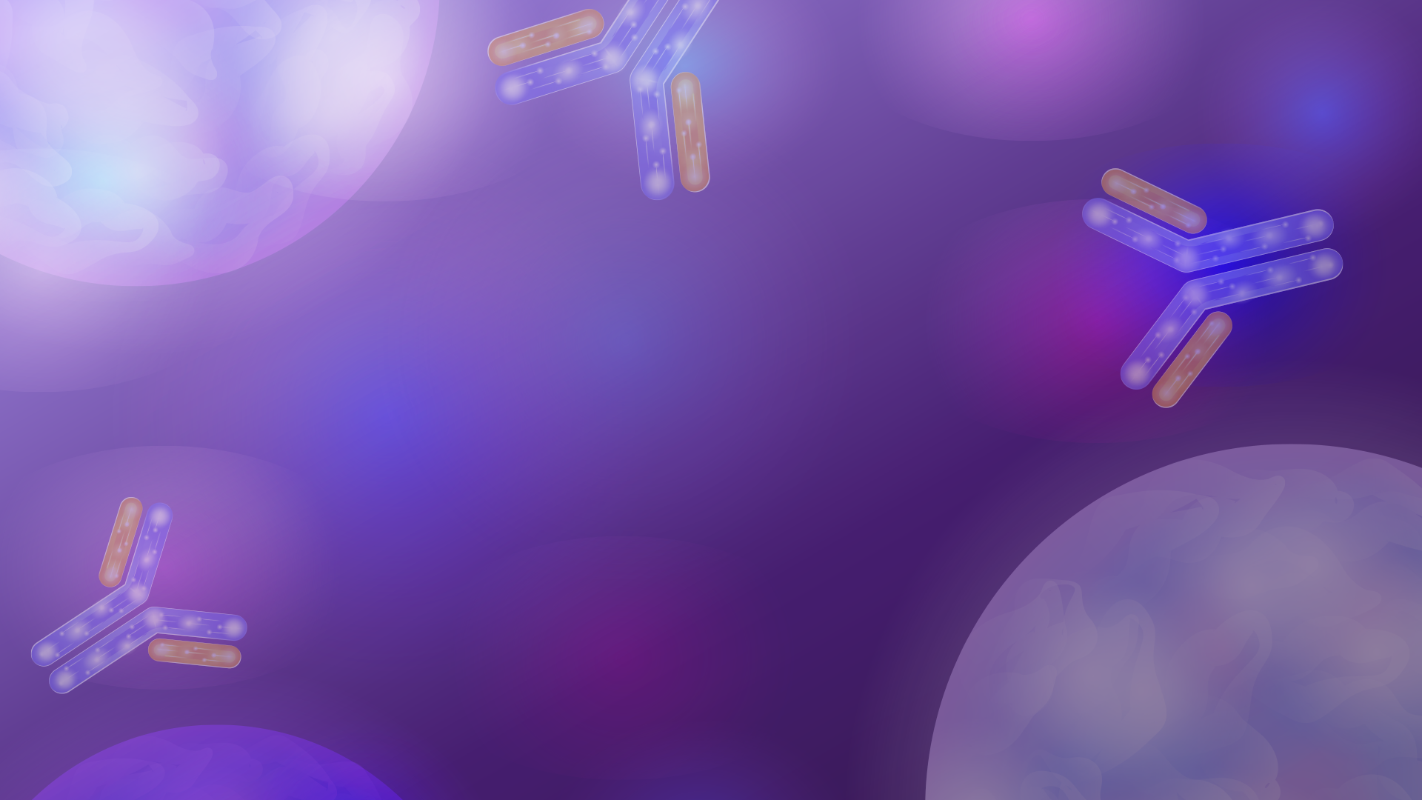
bispecific
Antibodies
01

Slide 6

Bispecific Antibodies
Bispecific antibodies (BsAbs) have two distinct binding domains that are directed at two different antigens or epitopes of an antigen simultaneously
BsAbs are divided into three categories
Antibodies targeting two different tumor antigens
Antibodies targeting one tumor antigen and one immune-related molecule
Antibodies targeting two immune-related molecules
Structures of BsAbs are divided into two categories
Immunoglobulin G (IgG)-based antibodies
Two single chain variable fragments (scFv)-based antibodies
Ma J, et al. Front Immunol. 2021;12:626616.
Tian Z, et al. J Hematol Oncol. 2021;14(1):75.
Notes:
IgG-based antibodies have longer half-lives in vivo because they are larger in size and are hard to be cleared by the kidney.
However, the permeability of IgG-based BsAbs to tumor tissues is lower than Fv-based BsAbs because of the increased molecular weight

Slide 7
Bispecific T Cell engagers
Bispecific T cell engagers belong to the second type of BsAbs and enhance patients’ immune response to tumors by focusing T cells to tumor cells
T cell engagers consist of two scFv connected by a flexible linker
One scFv binds to a T cell-specific molecule, usually CD3
Second scFv binds to a tumor-associated antigen
This structure allows T cell engagers to physically link a T cell to a tumor cell
The immunological synapse between the T cell and tumor cell is essential to assemble and amplify the T cell engager-mediated tumor lysis
The CD3 molecule associates with the T cell receptor (TCR) and participates in antigen-specific signals transduction to activate T cells
T cells are activated without costimulatory signals like CD28 and IL-2
In the presence of T cell engagers, both CD8+ and CD4+ T cells are activated
Ma J, et al. Front Immunol. 2021;12:626616.
Tian Z, et al. J Hematol Oncol. 2021;14(1):75.
Notes:
scFv = single chain variable fragments

Slide 8
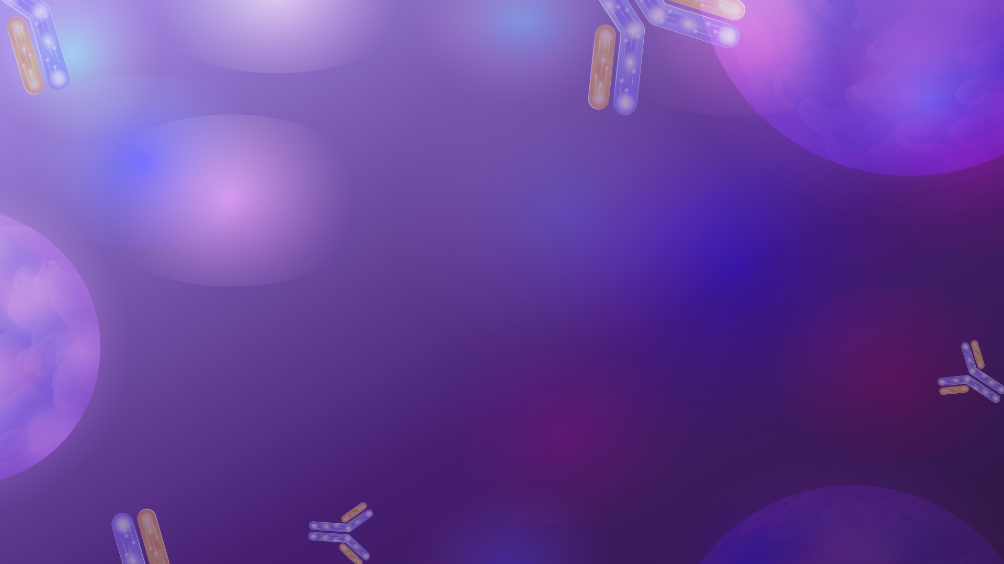
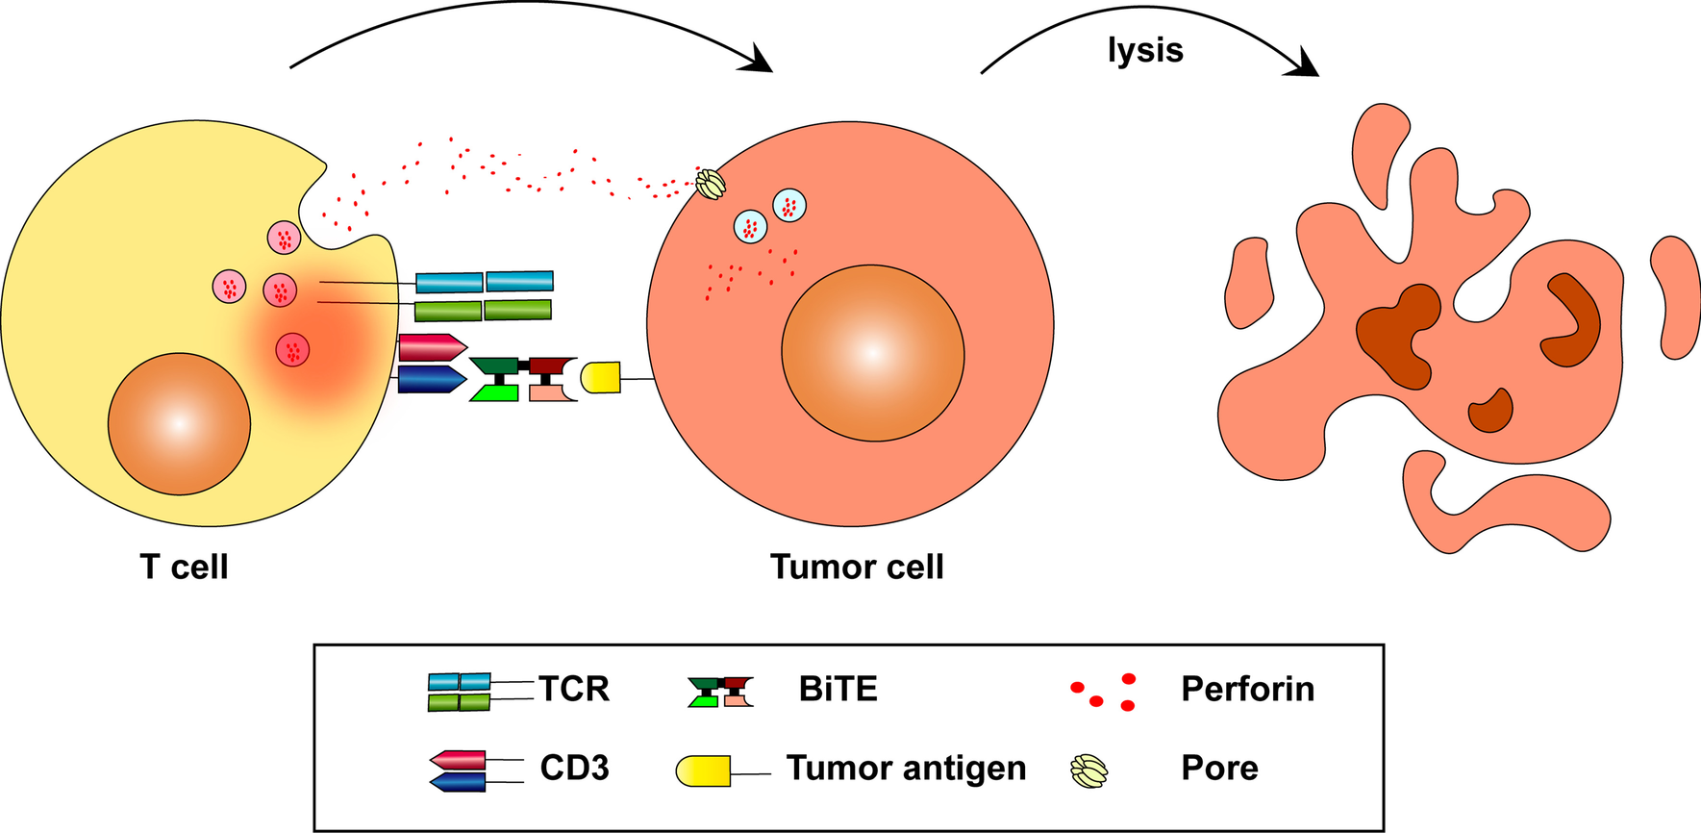
T Cell engager Mechanism
Tian Z, et al. J Hematol Oncol. 2021;14(1):75.
Notes:
BiTEs can redirect T cells to tumor cells and active T cells.
Activated T cells release perforin and other granzymes through immunological synapses.
These cytolytic proteins can form endosomes in tumor cells and lyse tumor

Slide 9
Bispecific T Cell engagers
Generic | Brand | Targets | Indications
Catumaxomab (withdrawn in 2017) | Removab | CD20/EpCAM | Malignant ascites
Blinatumomab | Blincyto | CD3/CD19 | R/R precursor B-cell ALL
Amivantamab-vmjw | Rybrevant | EGFR/cMet | NSCLC
Tebentafusp-tebn | Kimmtrak | CD3/GP100 | Unresectable or metastatic uveal melanoma
Mosunetuzumab | Lunsumio | CD3/CD20 | R/R follicular lymphoma
Cadonilimab | Kaitanni | PD1/CTLA4 | Hepatocellular carcinoma
Teclistamab | Tecvayli | CD3/BCMA | R/R multiple myeloma
Glofitamab | COLUMVI | CD3/CD20 | DLBCL
Epcoritamab | Epkinly | CD3/CD20 | DLBCL
Elranatamab | Elrexfio | CD3/BCMA | R/R multiple myeloma
Talquetamab | Talvey | CD3/GPRC5D | R/R multiple myeloma
Tarlatamab-dlle | Imdelltra | CD3/DLL3 | ES-SCLC
Klein C, Brinkmann, et al.. Nat Rev Drug Discov. 2024;23(4):301-319.
Notes:
BiTES approved for cancer therapy

Slide 10
Bispecific T Cell engagers
BsAb | Target | Indication
Epcoritamab | CD3/CD20 | DLBCL
Glofitamab | CD3/CD20 | DLBCL
Tarlatamab | CD3/DLL3 | ES-SCLC
Notes:
CD3 is a protein complex and T cell co-receptor involved in activating both cytotoxic T cells (CD8+ naive T cells) and T helper cells (CD4+ naive T cells). The CD3-T cell receptor (TCR) provides the “first signal” that initiates T cell activation and determines the specificity of the immune response
CD20
delta-like ligand 3 (DLL3) is aberrantly expressed on the surface of up to 85% of SCLC cells and minimally expressed in normal tissues, making it a compelling therapeutic target. In vitro SCLC models have indicated a role for DLL3 in promoting tumor growth, migration, and invasion

Slide 11
Crs and ICANS
02

Slide 12
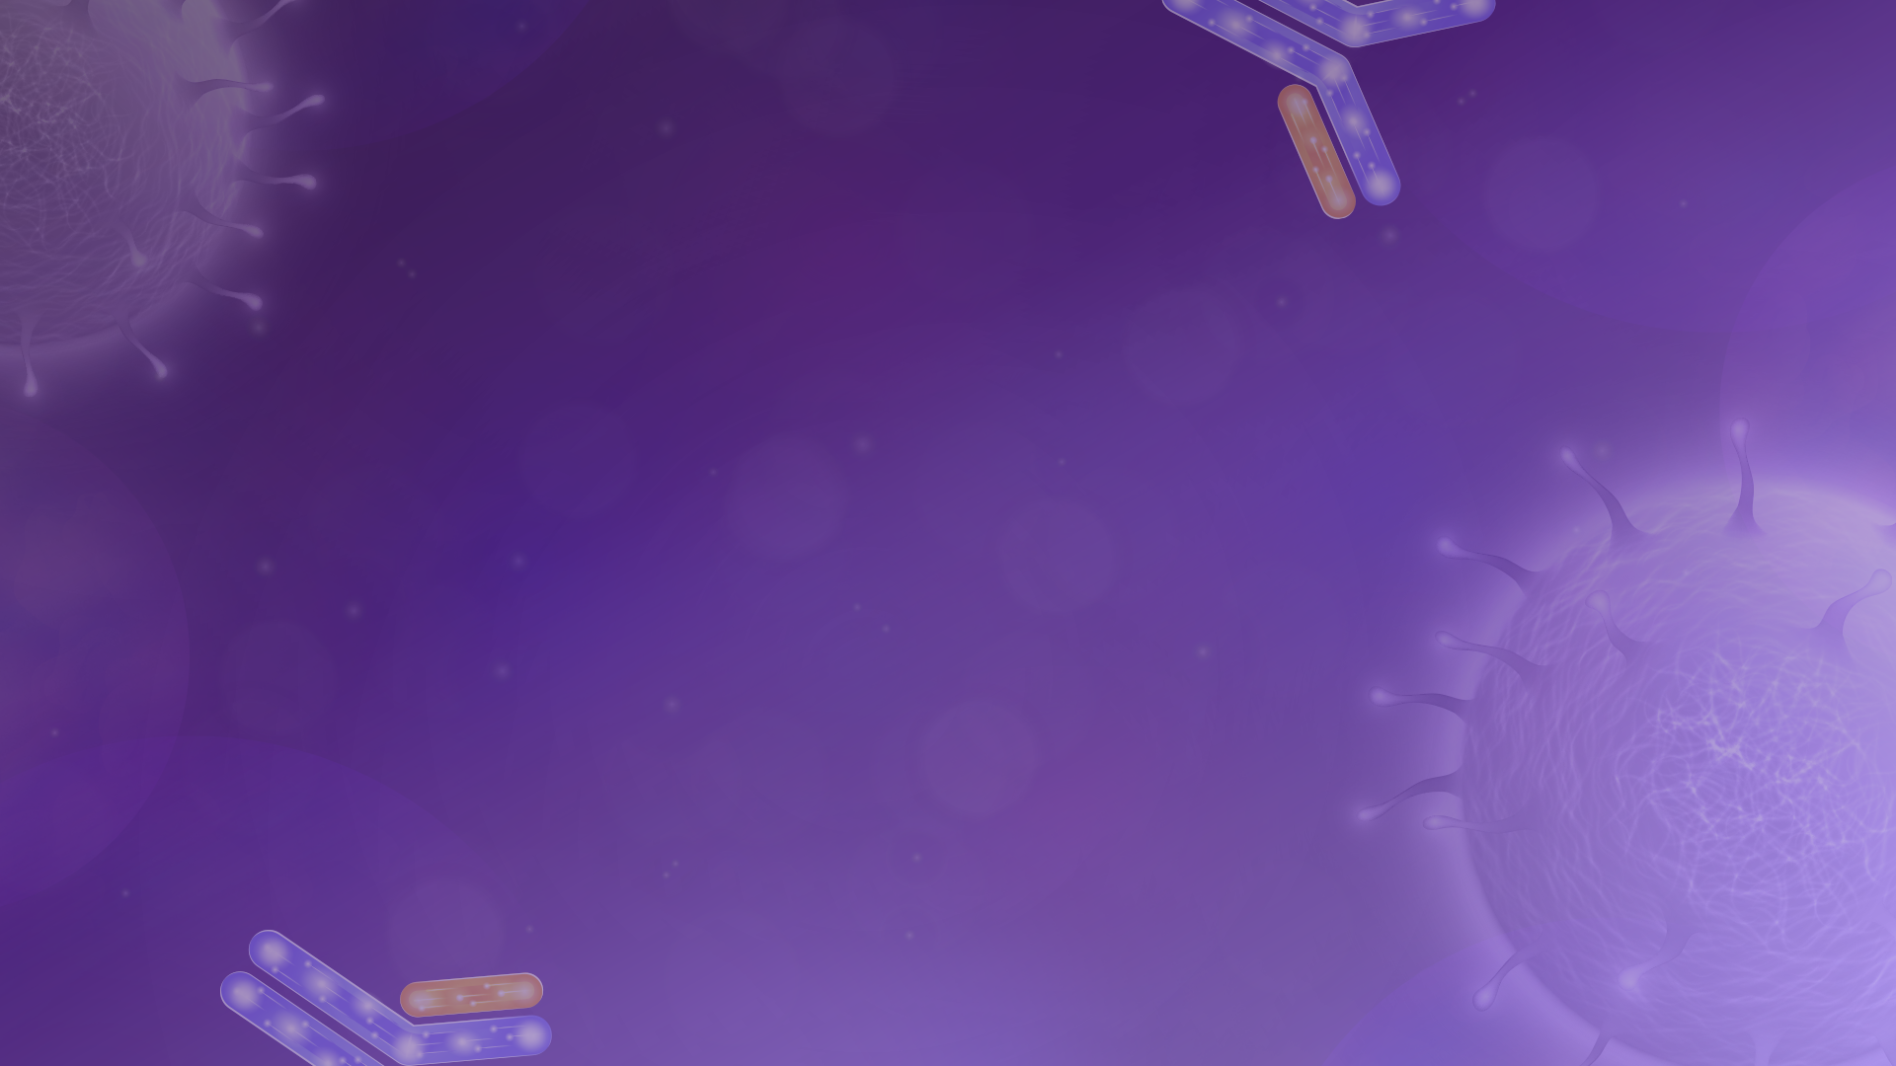
Cytokine Release Syndrome (CRS)
Pathophysiology
CRS is a systemic inflammatory response that results from the rapid release of large amounts of cytokines into the blood from immune cells
Excessive cytokine release can lead to widespread inflammation and multi-organ dysfunction
Key cytokines involved include IL-6, IL-1, IFN-γ, and TNF-α
Signs and Symptoms:
Fever Fatigue Headache Myalgia Nausea | Hypotension Tachycardia Dyspnea Elevated LFTs Organ dysfunction
Shimabukuro-Vornhagen A, et al. J Immunother Cancer. 2018;6(1):56.
Cytokine release syndrome (CRS). In: UpToDate [database online].
Lee DW, et al. Biol Blood Marrow Transplant. 2019;25(4):625-638.
Notes:
CRS mostly occurs after treatments activate the immune system like CAR T-cell therapy, monoclonal antibodies, and some forms of immunotherapy
CRS typically occurs within hours to a few days after treatment. The severity and timing can vary based on the therapy used and the individual's response
fever, fatigue, headache, myalgia, nausea, hypotension, tachycardia, dyspnea, elevated LFTs. In severe cases, organ dysfunction develops

Slide 13
CRS Classification
American Society for Transplantation and Cellular Therapy Grading System of CRS
Grade | Toxicity
Grade 1 | Fever (Temperature ≥38°C/100.4°F )
Grade 2 | Fever (Temperature ≥38°C/100.4°F ) with either: Hypotension not requiring vasopressors Hypoxia requiring low-flow nasal cannula (NC) or blow-by
Grade 3 | Fever (Temperature ≥38°C/100.4°F ) with either: Hypotension requiring a vasopressor with or without vasopressin Hypoxia requiring high-flow NC, facemask, nonrebreather mask, or Venturi mask
Grade 4 | Fever (Temperature ≥38°C/100.4°F ) with either: Hypotension requiring multiple vasopressors (excluding vasopressin) Hypoxia requiring positive pressure (CPAP, BiPAP, intubation, mechanical ventilation)
Grade 5 | Death
Shimabukuro-Vornhagen A, et al. J Immunother Cancer. 2018;6(1):56.
Cytokine release syndrome (CRS). In: UpToDate [database online].
Lee DW, et al. Biol Blood Marrow Transplant. 2019;25(4):625-638.
Notes:
SBP < 90, O2 < 90
Grade 1 – Fever and no hypotension and no hypoxia.
Grade 2 – Fever plus hypotension that does not require vasopressors and/or hypoxia that requires low-flow nasal cannula (≤6 L/minute or blow-by oxygenation)
Grade 3 – Fever plus hypotension that requires one vasopressor (with or without vasopressin) and/or hypoxia requiring high-flow nasal cannula (≥6 L/minute), facemask, non-rebreather mask, or Venturi mask that is not attributable to any other cause.
Grade 4 – Fever plus hypotension that requires multiple vasopressors (excluding vasopressin) and/or hypoxia requiring positive pressure

Slide 14
CRS Treatment
ASTCT Recommendations for CRS Treatment by Grade
Grade 1: Analgesics and antipyretics. Consider tocilizumab if > 3 days
Grade 2:
500-1000 mL IV fluid bolus and tocilizumab
Add dexamethasone 10 mg IV Q6H if hypotension persists
Grade 3: Admission to ICU
Administer tocilizumab and dexamethasone 10 mg IV Q6H
If refractory, increase dexamethasone to 20 mg IV Q6H
If unresponsive, add anakinra 2 mg/kg daily for 3–5 days
Grade 4: Admission to ICU
Administer tocilizumab and high-dose methylprednisolone 1 g/day IV
If unresponsive, add anakinra 2 mg/kg daily for 3–5 days
If unresponsive, consider anti-TNF-α agents
Shimabukuro-Vornhagen A, et al. J Immunother Cancer. 2018;6(1):56.
Cytokine release syndrome (CRS). In: UpToDate [database online].
Lee DW, et al. Biol Blood Marrow Transplant. 2019;25(4):625-638.
Notes:
Treatment includes supportive care and targeted therapies based on CRS grading
Consult REMS program for the specific agent for specific aspects of management
Supportive care: antipyretics, IV fluids, oxygen, vasopressors, ventilation
Targeted therapies: tocilizumab, corticosteroids, anakinra
Tocilizumab (IL-6 receptor antagonist): 8 mg/kg (max: 800 mg) in 100 mL NS
Given over 1 hour, up to 4 doses, 8 hours between
Glucocorticoid doses are hydrocortisone 100 mg every eight hours, dexamethasone 10 mg up to four times daily, or methylprednisolone 1 mg/kg/day
Anakinra (IL-1 receptor antagonist)

Slide 15

Immune effector cell-associated neurotoxicity syndrome (ICANS)
Pathophysiology
ICANS is believed to be caused by an inflammatory response that affects the blood-brain barrier (BBB), leading to the leakage of cytokines and immune cells into the CNS resulting in neurotoxicity.
Signs and Symptoms:
Encephalopathy with confusion and behavioral changes Visual and auditory hallucinations Language dysfunction, speech alterations, and apraxia Headache, fatigue, and tremors | Dysgraphia and other fine motor impairment Clinical or subclinical seizures, including status epilepticus Cerebral edema with coma Death secondary to cerebral edema
Shimabukuro-Vornhagen A, et al. J Immunother Cancer. 2018;6(1):56.
Suarez Montero JC, et al. Med Intensiva (Engl Ed). 2022;46(4):201-212.
Immune effector cell-associated neurotoxicity syndrome (ICANS). In: UpToDate [database online].
Notes:
Clinical presentation of ICANS ranges from mild alterations in the level of consciousness to varying degrees of neurologic dysfunction

Slide 16
ICANS Classification
ASTCT ICANS Consensus Grading for Adults
Grade | ICE score | Depressed level of consciousness | Seizure | Motor findings | Elevated ICP/cerebral edema
Grade 1 | 7-9 | Awakens spontaneously | N/A | N/A | N/A
Grade 2 | 3-6 | Awakens to voice | N/A | N/A | N/A
Grade 3 | 0-2 | Awakens only to tactile stimulus | Any clinical seizure | N/A | Focal/local edema on neuroimaging
Grade 4 | 0: unarousable to perform | Unarousable or requires vigorous | Life-threatening prolonged seizure | Deep focal motor weakness | Diffuse cerebral edema on neuroimaging; decerebrate or decorticate posturing; or cranial nerve VI palsy; or papilledema; or Cushing's triad
Shimabukuro-Vornhagen A, et al. J Immunother Cancer. 2018;6(1):56.
Suarez Montero JC, et al. Med Intensiva (Engl Ed). 2022;46(4):201-212.
Immune effector cell-associated neurotoxicity syndrome (ICANS). In: UpToDate [database online].
Notes:
ICANS grade is determined by the most severe event (ICE score, level of consciousness, seizure, motor findings, raised ICP/cerebral edema)
ICE adds a command-following assessment
Cushing triad: bradycardia, irregular respirations, and a widened pulse pressure due to increased ICP

Slide 17
ICANS Treatment
ASTCT Recommendations for ICANS Treatment by Grade
Grade 1: Haloperidol or lorazepam if agitated. Dexamethasone in high-risk patients. Non-sedating anti-epileptics
Grade 2: Dexamethasone 10 mg IV Q12H. If no change in 48 hrs, increase to 20 mg IV Q6H
Tocilizumab or anakinra if concomitant CRS
Non-sedating anti-epileptics
Grade 3: Dexamethasone 10 mg IV Q6H. If no change in 48 hrs, increase to 20 mg IV Q6H or methylprednisolone 1-2 g/day
Tocilizumab or anakinra if concomitant CRS
Non-sedating anti-epileptics
Grade 4: Dexamethasone 20 mg IV Q6H. If dex refractory, methylprednisolone 2 g Q12H
If steroid refractory, consider alternative therapies including lymphodepletion with cyclophosphamide and other drugs
Shimabukuro-Vornhagen A, et al. J Immunother Cancer. 2018;6(1):56.
Suarez Montero JC, et al. Med Intensiva (Engl Ed). 2022;46(4):201-212.
Immune effector cell-associated neurotoxicity syndrome (ICANS). In: UpToDate [database online].
Notes:
Treatment are based on ICANS grading and center around steroid therapy. Majority of these patients will be admitted to the ICU
Corticosteroids to reduce inflammation and stabilize the BBB
Tocilizumab to manage CRS that can precede or occur with ICANS
Anti-seizure medications: prophylactically or therapeutically to manage/prevent seizures
Consult REMS program for the specific agent for specific aspects of management

Slide 18
Epcoritamab in lymphoma
03

Slide 19
Epcoritamab: a Novel, Subcutaneous CD3xCD20 Bispecific T-Cell-Engaging Antibody, in Relapsed or Refractory Large B-Cell Lymphoma: Dose Expansion in a Phase I/II Trial
Published in the Journal of Clinical Oncology
April 20, 2023

Slide 20
Epcoritamab for R/R LBCL
Study Design: Phase I/II, single-arm, multicenter, open-label, dose-escalation/dose-expansion study
Study Objective: Evaluated the efficacy and safety of subcutaneous epcoritamab in patients with relapsed or refractory LBCL
Patient Population
Between June 19, 2020 - January 31, 2022, 157 patients were enrolled and treated with epcoritamab
Primary Endpoint
The primary end point was overall response rate (ORR) by the independent review committee
Results
Overall response rate was 63.1% (95% CI, 55.0 to 70.6)
Complete response rate was 38.9% (95% CI, 31.2 to 46.9).
Median duration of response was 12.0 months (not reached in complete responders)
Most common tr adverse events were CRS (49.7%) pyrexia (23.6%), and fatigue (22.9%)
Thieblemont C, et al. J Clin Oncol. 2023;41(12):2238-2247.

Slide 21
EPCORE NHL-1: Epcoritamab monotherapy in patients with relapsed or refractory follicular lymphoma
Published in The Lancet Hematology
August 11, 2024
Notes:
Follicular lymphoma is a common indolent non-Hodgkin lymphoma with no standard of care for patients with multiple relapses or refractory disease. Epcoritamab is a novel bispecific antibody targeting CD3 (T cells) and CD20 (B cells) designed to redirect T cells to kill malignant B cells. This study aimed to evaluate the efficacy and safety of epcoritamab as a third-line or later therapy in FL.

Slide 22
EPCORE NHL-1: Epcoritamab in R/R FL
Study Design: Phase 2 part of a single-arm, multicohort, international trial
Pivotal dose optimization cohort
Cycle 1 optimization cohort
Study Objective: Investigate the safety and activity of subcutaneous epcoritamab in the relapsed or refractory follicular lymphoma setting
Patient Population
From June 19, 2020 – April 21,2023, 214 patients were enrolled
Pivotal: 128 patients; Optimization: 86 patients
Before study entry
Primary refractory disease: 54%; 44%
Refractory to previous anti-CD20 therapy: 79%; 78%
Double refractory disease: 70%; 63%
Linton KM, et al. Lancet Haematol. 2024;11(8):e593-e605.
Notes:
88 sites across 15 countries
Primary refractory: disease progressed during therapy or within 6 months
Double refractory: refractory to both an anti-CD20 and an alkylating agent

Slide 23
EPCORE NHL-1: Epcoritamab in R/R FL
Key Inclusion/Exclusion Criteria
Intervention
Epcoritamab subcutaneous injection 48 mg per 28-day cycle:
Weekly cycles 1–3; biweekly cycles 4–9; every 4 weeks until progression or toxicity
CRS Mitigation
Pivotal: Step-up doses in cycle 1 (0.16 mg day 1, 0.80 mg day 8, then full dose day 15+) plus 100 mg prednisolone
Optimization: Additional 3 mg dose day 15, aggressive hydration, and 15 mg dexamethasone
Inclusion Criteria | Exclusion Criteria
≥ 18 years of age Histologically confirmed CD20+ follicular lymphoma R/R to ≥2 prior therapies, including anti-CD20 mAb and alkylator or lenalidomide ECOG status ≤ 2 | Primary CNS lymphoma HIV infection, significant cardio­vascular disease Current autoimmune disease Previous therapy with an investigational bispecific targeting CD3 and CD20 CAR T-cell therapy within 30 days before treatment
Linton KM, et al. Lancet Haematol. 2024;11(8):e593-e605.
Notes:
grade 1–3A
Previous Therapy: ncluding an anti-CD20 monoclonal antibody and an alkylating agent or lenalidomide)

Slide 24
EPCORE NHL-1: Epcoritamab in R/R FL
Primary Endpoints
Pivotal: The primary efficacy endpoint was the overall response rate (ORR), independently reviewed
Optimization: The primary safety endpoint was the incidence of CRS of grade 2 or worse and the rate of any-grade CRS within 7 days on administration
Secondary Endpoints
Pivotal: Complete response rate, time to response, time to complete response, duration of response, duration of complete response, progression-free survival, overall survival
Optimization: Incidence of CRS of grade 2 or worse and the rate of any-grade CRS after the first 48 mg dose and overall adverse events
Linton KM, et al. Lancet Haematol. 2024;11(8):e593-e605.
Notes:
Overall response rate was defined as the proportion of patients who reached a best overall response of partial response or complete response at any time

Slide 25
EPCORE NHL-1: Epcoritamab in R/R FL
Statistical Analysis
128 patients in the pivotal cohort gave about 90% power to detect an ORR > 50% (two-sided significance level 0.05).
80 patients in the optimization cohort gave >80% power to detect a true event rate of grade 2+ CRS of at least 2%.
Time-to-event endpoints (e.g., PFS, OS) were analyzed in the full analysis set using Kaplan–Meier estimates for median time and 95% CI
All enrolled patients who received at least one dose of study treatment were included in the efficacy analysis
Safety endpoints were summarized using frequency and percentages based on all patients who received at least one dose of epcoritamab.
Linton KM, et al. Lancet Haematol. 2024;11(8):e593-e605.
Notes:
Modified intention-to-treat population
Kaplan-Meier involves calculating probabilities of occurrence of the event at a certain point in time and multiplying these successive probabilities to get the final estimate
The Kaplan-Meier curve is a nonparametric method used to estimate the probability of survival past given time points. It is commonly used to analyze time-to-event data, such as the time until death or the time until a specific event occurs. The curve shows the probability that a subject will survive up to time t and is constructed by plotting the survival function against time.

Slide 26
EPCORE NHL-1: Epcoritamab in R/R FL
Efficacy
ORR pivotal cohort: 82.0% (105/128, 95% CI 74.3–88.3)
Complete response rate: 62.5% (80/128, 95% CI 53.5–70.9)
Safety
Most common Grade 3–4 AE: Neutropenia (25%)
CRS:
Pivotal: Any grade 65%, grade 3 in 2%
Optimization: Any grade 49%, grade 2 in 9%, no grade 3 or higher
ICANS (neurotoxicity):
Pivotal: 6% (5% grade 1, 2% grade 2)
Optimization: 0% reported
Linton KM, et al. Lancet Haematol. 2024;11(8):e593-e605.
Notes:
Median follow-up: 17.4 months (IQR 9.1–20.9)
CRS was reduced with the revised dosing/hydration/corticosteroid regimen in the cycle 1 optimization cohort—major advance in managing this side effect.

Slide 27
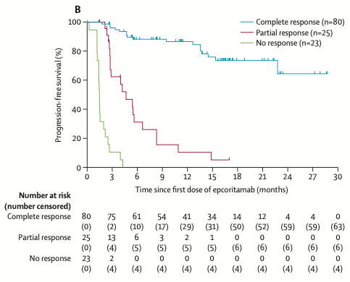
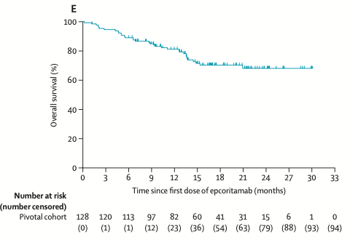
EPCORE NHL-1: Epcoritamab in R/R FL
Efficacy
Linton KM, et al. Lancet Haematol. 2024;11(8):e593-e605.

Slide 28
EPCORE NHL-1: Epcoritamab in R/R FL
Author’s Conclusion
“Results from EPCORE NHL-1 showed robust, clinically meaningful efficacy, including deep and durable responses and high rates of MRD negativity in the largest known analysis of T-cell-engaging therapies in patients with relapsed or refractory follicular lymphoma. Cycle 1 optimization further improved the safety profile, in addition to removing mandatory hospitalization. These results indicate that epcoritamab has the potential to be an important therapy for the treatment of relapsed or refractory follicular lymphoma.”
Linton KM, et al. Lancet Haematol. 2024;11(8):e593-e605.

Slide 29
EPCORE NHL-1: Epcoritamab in R/R FL
Strengths and Weaknesses
Strengths | Weaknesses
Large, multinational population Robust independent efficacy review Detailed safety monitoring Robust response | Single-arm study design Lack of long-term follow-up Excluding previous BsAb Results may not generalize to patients with less refractory disease or to front-line settings
Linton KM, et al. Lancet Haematol. 2024;11(8):e593-e605.
Notes:
Strengths
Large, multinational sample representing a real-world patient mix.
Robust independent efficacy review and detailed safety monitoring
Clear demonstration of efficacy with high ORR and CRR in a heavily pretreated population
Shows feasible management of immune-related toxicities with protocol adaptation
Weaknesses
Single-arm (no comparator), making direct efficacy comparisons to standard therapy impossible
Median follow-up is under 2 years; durability of response and long-term safety need further study
As a sponsored study (Genmab, AbbVie), risk of funding bias—external validation needed

Slide 30
EPCORE NHL-1: Epcoritamab in R/R FL
Presenter’s Conclusion
Epcoritamab monotherapy demonstrated clinically meaningful activity in heavily pretreated FL patients and deliveried a high rate of complete and overall responses. The safety profile was manageable, with CRS being the most common immune-related event, which was further lowered with cycle 1 dosing optimization. These results suggest a clinically meaningful role for epcoritamab in later-line FL therapy, especially for patients who have exhausted traditional options and addressing an unmet need.
Linton KM, et al. Lancet Haematol. 2024;11(8):e593-e605.

Slide 31
Long-term follow-up from EPCORE DLBCL
Updated Results Published November 5, 2024
Median follow-up at 37.1 months:
41% of patients achieved complete response
At 36 months, an estimated 63% of complete responders remained alive
59% of of patients achieved objective response
Median duration of response was 20.8 months (95% CI, 13–32)
Median duration of CR 36.1 months (95% CI, 20.2–NE)
Median overall survival was 18.5 mo (95% CI, 11.7-27.7)
Epcoritamab continued to show deep and durable responses, with more than half of complete responders remaining in remission at 3 years
Vose JM, etal. Blood 2024; 144 (Supplement 1): 4480.

Slide 32
Epcoritamab (Epkinly)
FDA approval: May 19, 2023
Dosing:
Premedications: 30-120 min prior to treatment with glofitamab
Cycle 1: Dexamethasone 15 mg; diphenhydramine 50 mg; acetaminophen 650-1,000 mg
Cycle 2+ if CRS grade 2 or 3 with previous dose: Dexamethasone 15 mg
Cycle | Day | Epcoritamab Dose
Cycle 1 | Day 1 | 0.16 mg SC
 | Day 8 | 0.8 mg SC
 | Day 15 | 3 mg SC
 | Day 22 | 48 mg SC
Cycle 2 and 3 | Day 1, 8, 15, 22 | 48 mg SC
Cycles 4 to 9 | Day 1 and 15 | 48 mg SC
Cycle 10+ | Day 1 | 48 mg SC
UpToDate Lexidrug

Slide 33
Glofitamab in lymphoma
04

Slide 34
Glofitamab for Relapsed or Refractory Diffuse Large B-Cell Lymphoma
Published in New England Journal of Medicine December 11, 2022

Slide 35
Glofitamab for R/R DLBCL
Study Design: Phase 2 part of an open-label phase 1–2 clinical trial
Study Objective: Assess the efficacy and safety of glofitamab monotherapy in patients with relapsed or refractory DLBCL who had received at least two lines of therapy previously
Patient Population
154 patients received at least one dose of any study treatment
Primary Endpoint
Primary efficacy end point was complete response as assessed by independent review committee
Results
39% of patients had a complete response
Median time to a complete response was 42 days
78% of complete responses were ongoing at 12 months
Most common adverse event was CRS (63% of the patients)
Dickinson MJ, et al. N Engl J Med. 2022;387(24):2220-2231.
Notes:
Study treatment = obinituzumab or glofit
Median number of prior therapies was 3 (range: 2-7); 33% had received prior chimeric antigen receptor T-cells and 84% were refractory to their most recent regimen.
Pretreatment with obinutuzumab (1000 mg) was administered intravenously 7 days before the first dose of glofitamab. Glofitamab was then administered intravenously as step-up doses on day 8 (2.5 mg) and day 15 (10 mg) of cycle 1, followed by a dose of 30 mg on day 1 of cycles 2 through 12 (cycles lasted 21 days); this constituted the previously established phase 2 dose. Patients were hospitalized for receipt of the first dose of glofitamab
Tumor assessment on computed tomography (CT) and positron-emission tomography (PET)–CT was performed at screening; after cycles 2, 5, and 8; at the end of treatment; and every 6 months until disease progression occurred. Responses were assessed on PET-CT scans by the investigator and by an independent review committee using the Lugano response criteria
Glofitamab therapy was effective for DLBCL

Slide 36
STARGLO: Glofitamab plus gemcitabine and oxaliplatin versus rituximab-GemOx for relapsed or refractory diffuse large B-cell lymphoma
Published in The Lancet
November 16, 2024
Notes:
DLBCL is the most common aggressive B-cell lymphoma.
Transplant-ineligible patients have historically poor outcomes, with median OS often <12 months.
The trial evaluates whether bispecific antibody therapy offers a practice-changing benefit for this difficult population.

Slide 37
STARGLO: Glofitamab + GEMOX in R/R DLBCL
Study Design: Global phase 3, open-label, randomized trial
Study Objective: Investigate the efficacy and safety of Glofit-GemOx compared with R-GemOx in patients with relapsed or refractory diffuse large B-cell lymphoma after one or more previous therapies
Patient Population
From Feb 23, 2021, to March 14, 2023 , 274 were enrolled and randomized 2:1 to receive either Glofit-GemOx or R-GemOx
183 patients were assigned to the Glofit-GemOx group
91 patients were assigned to the R-GemOx group
Before the study
63% patients had received a median of 1 previous line of therapy
67% relapsed/refractory to any previous therapy
21 patients had previously received CAR-T cell therapy
11 patients had previously received ASCT
Abramson JS, et al. Lancet. 2024;404(10466):1940-1954.
Notes:
Patients were recruited at 62 sites (academic and non-academic centers) in 13 countries in Asia and Australia, Europe, and North America
Patients were stratified by the number of previous lines of therapy (1 vs ≥ 2) and relapsed vs refractory
Baseline characteristics were well balanced between treatment groups: 58% were male and median age was 68 year
Nearly all (271 [99%]) enrolled patients had at least one reason cited for transplant ineligibility. Age ≥ 70 and patient refusal being top reasons

Slide 38
STARGLO: Glofitamab + GEMOX in R/R DLBCL
Key Inclusion/Exclusion Criteria
Intervention
Inclusion Criteria | Exclusion Criteria
≥18 years of age Histologically confirmed DLBCL who received 1 or more previous systemic therapies with relapsed or refractory disease ECOG status of 0-2 Patients with only one previous line of therapy had to be considered ASCT-ineligible | Patients with DLBCL transformed from indolent lymphoma, double or triple hit lymphomas, or high-grade B-cell lymphoma
Glofit-GemOx | R-GemOx
Glofitamab was administered for up to 12 cycles. Obinutuzumab 1,000 mg IV on day 1 of cycle 1 Glofitamab IV by step-up dosing during cycle 1 Day 8: 2·5 mg; day 15: 10 mg Glofitamab 30 mg on day 1 of cycles 2-12 | Rituximab 375 mg/m² IV on day 1 of each cycle up to 8 cycles
GemOx: IV gemcitabine 1000 mg/m² and oxaliplatin 100 mg/m² given on day 2 of cycle 1, then day 1 of subsequent cycles Prophylactic GCSF required during cycles 1-2 in both groups and was optional thereafter
Abramson JS, et al. Lancet. 2024;404(10466):1940-1954.
Notes:
Relapsed disease: recurrence following a response that lasted ≥6 months after completing the last line of therapy
Refractory disease: disease that did not respond to or that progressed within 6 months after completing the last line of therapy
Patients enrolling after only one previous line of therapy had to be considered ASCT-ineligible based on age (≥70 years), end-organ dysfunction, ECOG performance status of 2 or higher, patient refusal for ASCT, or other comorbidities that precluded the use of transplant
Obinutuzumab: 7 days before the first glofitamab dose to mitigate the risk of cytokine release syndrome (CRS)
Patients were hospitalized overnight following the first infusion of glofitamab and received dexamethasone premedication (20 mg) 1 h before glofitamab therapy until they had received two 30 mg target doses without CRS
GemOX was administered identically between the groups for up to eight cycles on a 21-day cycle → Dosing frequency was selected to align with the established schedule of glofitamab monotherapy
No dose modifications of glofitamab, obinutuzumab, rituximab, or gemcitabine were permitted.
Oxaliplatin dose modifications were allowed for peripheral neuropathy
patients considered by the investigator to have a high tumor burden or to be at risk of tumor lysis syndrome were required to have prophylaxis before the initiation of treatment, and before each subsequent cycle if deemed appropriate by the investigator

Slide 39
STARGLO: Glofitamab + GEMOX in R/R DLBCL
Primary Endpoint
The primary end point was overall survival assessed by site investigators
Secondary Endpoints
Key secondary end points included progression-free survival, complete response rate, and duration of complete response assessed by the IRC in a masked manner
Statistical Analysis
A sample size of 270 patients (138 events) provided 80% power to detect a difference in median overall survival of 7.3 months
Efficacy analyses conducted in the intention-to-treat population
OS, PFS, DCR, and DOR were compared between groups with a two-sided log-rank test
Kaplan–Meier method was used to estimate survival, including median survival, 24-month overall survival rate, and 12-month progression-free survival
Safety was assessed in all patients that received any study treatment
Abramson JS, et al. Lancet. 2024;404(10466):1940-1954.
Notes:
Response was ascertained by IRC and investigator assessment of PET-CT and CT scans according to the 2014 Lugano response criteria
OS = time from randomization to death from any cause
PFS = time from randomisation to the first occurrence of disease progression or death from any cause, whichever occurred first)
Complete response rate = proportion of patients whose best overall response was a complete response on PET-CT),
Duration of complete response = time from the first occurrence of complete response to disease progression or death from any cause, whichever occurred first.
These key secondary endpoints were assessed by the IRC in a masked manner
Efficacy analyses included all patients who were randomly assigned (intention-to-treat [ITT] population)
Safety: at least one dose of rituximab in the R-GemOx group or obinutuzumab pretreatment in the Glofit-GemOx group
Subgroup analyses for overall survival were done in prespecified subgroups in the updated analysis → treatment effect in the subgroups were expressed as HRs and corresponding Wald 95% CIs, and were derived by unstratified Cox proportional hazards analysis

Slide 40
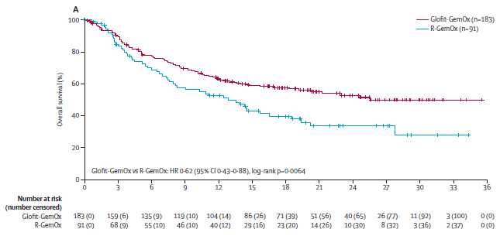
STARGLO: Glofitamab + GEMOX in R/R DLBCL
Efficacy
172 (94%) of 183 patients were exposed to glofitamab
88 (97%) of 91 patients were exposed to rituximab
Primary Endpoint: Investigator-assessed overall survival
Glofit-GemOx: 25.5 months (95% CI 18.3–NE)
R-GemOx: 12.9 months (95% CI 7.9–18.5)
HR: 0.62 (95% CI 0.43–0.88)
p = 0.0064
Abramson JS, et al. Lancet. 2024;404(10466):1940-1954.
Notes:
Median number of glofitamab cycles received was 11·0 (IQR 4–12). In the R-GemOx group, 88 (97%) of 91 patients were exposed to rituximab, and the median number of rituximab cycles received was 4·0
Median follow up of 20.7 months
Kaplan–Meier estimates of investigator-assessed overall survival
Median investigator-assessed OS was significantly longer in the Glofit-GemOx group (25.5 months, 95% CI 18.3–NE) vs the R-GemOx group (12.9 months, 95% CI 7.9–18.5); p=0.0064
HR indicating a 38% reduction in the risk of death for the experimental arm

Slide 41
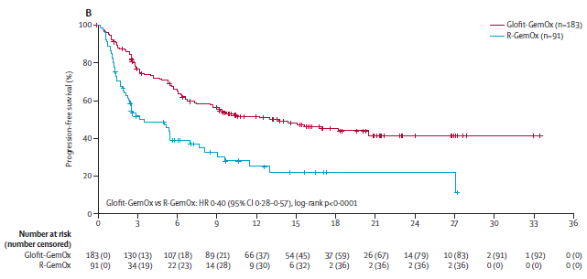
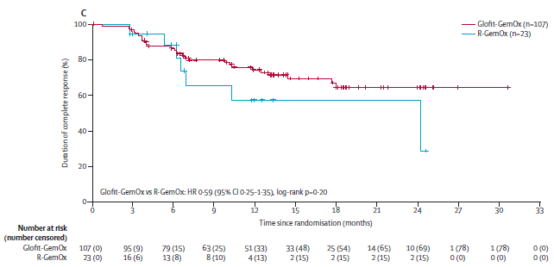
STARGLO: Glofitamab + GEMOX in R/R DLBCL
Secondary Endpoints
IRC-assessed complete response: Glofit-GemOx 58.5% vs R-GemOx 25.3%; p < 0.0001
IRC-assessed progression-free survival
Glofit-GemOx: 13.8 months (95% CI 8.7–20.5)
R-GemOx: 3.6 months (95% CI 2.5–7.1)
p < 0.0001
IRC-assessed duration of complete response
Glofit-GemOx: NE (95% CI NE–NE)
R-GemOx: 24.2 months (95% CI 9.9–NE)
p = 0.205
Abramson JS, et al. Lancet. 2024;404(10466):1940-1954.
Notes:
The IRC-assessed complete response rates for Glofit-GemOx versus R-GemOx were 58·5% (95% CI 51·0–65·7; n=107 of 183) and 25·3% (16·8–35·5; n=23 of 91 )
A higher rate of IRC-assessed disease progression was observed with R-GemOx compared with Glofit-GemOx

Slide 42
STARGLO: Glofitamab + GEMOX in R/R DLBCL
Safety
180 (100%) of Glofit-GemOx patients and 84 of 88 (96%) R-GemOx patients had at least one adverse event
Thrombocytopenia occurred in 48% of Glofit-GemOx patients and 48% of R-GemOx patients
Neutropenia occurred in 42% of Glofit-GemOx patients and 31% of R-GemOx patients
CRS occurred in 76 of 172 glofitamab-exposed patients (44%) and predominantly occurred after the initial 2.5 mg glofitamab dose
ICANS was reported in 4 (2%) Glofit-GemOx recipients
Abramson JS, et al. Lancet. 2024;404(10466):1940-1954.
Notes:
GCSF, mandatory for all in cycles 1 and 2, was administered in 96 (64%) of 149 patients in the Glofit-GemOx group vs 31 (56%) of 55 in the R-GemOx group who received treatment in cycles 3–4, and 76 (60%) of 126 in the Glofit-GemOx group versus 17 (50%) of 34 in the R-GemOx group who received treatment in cycles 5–8.
CRS
Grade 1: 54 patients (31%)
Grade 2: 18 patients (10%)
Grade 3: 4 patients (2%)
CRS management:
Toci only 28
Corticosteroids only 39
Both 18
ICANs
Grade 1–2: 3 patients (2%)
Grade 3 (delirium): 1 patient (1%)

Slide 43
STARGLO: Glofitamab + GEMOX in R/R DLBCL
Author’s Conclusion
“STARGLO met its primary endpoint, with a statistically significant and clinically meaningful overall survival benefit with Glofit-GemOx compared with R-GemOx in relapsed or refractory diffuse large B-cell lymphoma…The results showed a significant benefit with Glofit-GemOx versus R-GemOx for overall survival, progression-free survival, and complete response rate in ASCT-ineligible patients with relapsed or refractory diffuse large B-cell lymphoma, with a safety profile consistent with the known risks of the individual agents.”
Abramson JS, et al. Lancet. 2024;404(10466):1940-1954.

Slide 44
STARGLO: Glofitamab + GEMOX in R/R DLBCL
Strengths and Weaknesses
Strengths | Weaknesses
Global, multi-center design Masked independent endpoint assessment Comprehensive efficacy endpoints, including OS and PFS | Open-label design Under-representation of Black patients and possible regional heterogeneity Exclusion of double/triple-hit lymphomas Duration of follow-up is relatively limited (~21 months)
Abramson JS, et al. Lancet. 2024;404(10466):1940-1954.
Notes:
Strengths
Global, multi-center design = generalizability.
Masked independent endpoint assessment reduces bias.
Comprehensive efficacy endpoints, including OS and PFS, which matter to patients.
Robust sensitivity analyses for pandemic-related confounding and stratification discrepancies
Weaknesses
Open-label design, albeit mitigated by masked review, introduces some bias potential.
Under-representation of Black patients and possible regional heterogeneity (some subgroup variabilities with wide CIs), limiting extrapolation to certain populations.
Exclusion of double/triple-hit lymphomas and strict eligibility narrow applicability somewhat.
Duration of follow-up is relatively limited (~21 months), precluding long-term survival/late toxicity assessment

Slide 45
STARGLO: Glofitamab + GEMOX in R/R DLBCL
Presenter’s Conclusion
The findings of STARGLO demonstrate a substantial, statistically significant benefit in OS, PFS, and response rates for Glofit-GemOx. The OS benefit exceeds that previously achieved by the current standard of R-GemOx in a comparable real-world population. Glofitamab’s relative ease of administration compared to CAR T-cell therapy could expand access to cellular therapies which is important for patients that are ineligible for transplant/CAR T or lack access. The evidence strongly supports Glofit-GemOx as a new standard in transplant-ineligible, relapsed/refractory DLBCL.
Abramson JS, et al. Lancet. 2024;404(10466):1940-1954.

Slide 46
FDA Statement on StarGlo
The FDA issued a complete response letter (CRL) rejecting Glofit-GemOx for the treatment of R/R DLBCL in the U.S. due to insufficient evidence from the STARGLO trial for the U.S. patient population.
Key Points of the FDA's Decision
Low U.S. Participation in STARGLO:
Only a small percentage (9%) of patients in the STARGLO trial were from the U.S., raising concerns about how well the trial's findings apply to the American patient population.
Lack of Survival Benefit in North America:
The survival benefit seen in Asian patients within the STARGLO trial did not translate to non-Asian regions, including North America and Europe.
Ryan C. OncLive. May 20, 2025
Notes:
9% of patients (n = 25) were from North America, 32% of patients (n = 88) were from Europe, 11% of patients (n = 30) were from Australia, and 48% of patients (n = 131) were from Asia
When assessing outcomes for patients from non-Asian regions, patients treated with glofitamab plus GemOx (n = 99) experienced a median OS of 21.2 months compared with 27.8 months for those given rituximab plus GemOx (n = 44; HR, 1.06; 95% CI, 0.61-1.84)

Slide 47
Long-term follow-up For Glofitamab
Updated Results Published November 5, 2024
Median follow-up at 37.7 months:
Median time on study was 41.0 months, with all patients with ongoing remission being treatment-free for ≥ 2 years following end of treatment (EOT)
Patients with a CR
Median duration of CR: 29.8 months (95% CI: 22.0-NE]).
PFS rate 2 years after EOT was 57%
OS rate 2 years after EOT was 77%
Extended follow-up of over 3 years shows durable and continued response with glofitamab in patients with R/R DLBCL
Dickinson MJ, et al. Blood 2024; 144 (Supplement 1): 865.
Notes:
Median time on study was 41.0 months, with all patients with ongoing remission being treatment-free for ≥ 2 years following EOT

Slide 48
Glofitamab (COLUMVI)
FDA approval: June 15, 2023
Dosing:
Pretreat with a single dose of obinutuzumab on cycle 1, day 1
Premedications: 1 hr prior to treatment with glofitamab
Acetaminophen 500-1,000 mg orally
Diphenhydramine 50 mg orally or IV
Dexamethasone 20 mg IV
Required for cycles 1-3 but only in those who experienced CRS in cycles 4+
Cycle | Day | Glofitamab Dose
Cycle 1 | Day 8 | 2.5 mg over 4 hours
 | Day 15 | 10 mg over 4 hours
Cycle 2 | Day 1 | 30 mg over 4 hours
Cycles 3 to 12 | Day 1 | 30 mg over 2 hours
UpToDate Lexidrug
Notes:
Obinutuzumab dose on cycle 1, day 1 (7 days prior to the first glofitamab dose) to deplete B cells (circulating and lymphoid tissue)
Dose modifications: No current modifications for renal or hepatic impairment

Slide 49
Tarlatamab
in Small Cell
Lung Cancer
05

Slide 50
DeLLphi-300: a First-in-Class DLL3-Targeted Bispecific T-Cell Engager, in Recurrent Small-Cell Lung Cancer: An Open-Label, Phase I Study
Published in Journal of Clinical Oncology
January 23, 2023

Slide 51
DeLLphi-300: Tarlatamab For sclc
Study Design: Phase I, international, open-label, dose-escalation study
Study Objective: Evaluate the safety, PK, and preliminary efficacy of tarlatamab in SCLC patients
Patient Population
107 patients received tarlatamab in dose escalation (0.003-100 mg) and expansion (100 mg)
Primary/Secondary Endpoints
The primary endpoint was safety including dose-limiting toxicities, AEs during the treatment period, TEAEs possibly related to tarlatamab
The secondary endpoints were: objective response , duration of response, PFS, and OS
Results
Objective response was 23.4% (2 CR, 23 PR)
Responses were seen starting with the 0.3 mg. Higher rates at doses ≥ 3 mg
78% of complete responses were ongoing at 12 months
Most common ADEs were CRS (56 patients) pyrexia (43) and constipation (33)
Paz-Ares L, et al. J Clin Oncol. 2023;41(16):2893-2903.
Notes:
CRS mostly occurred during cycle 1
Grade 2 CRS occurred in 15 patients (14.0%) and grade 3 in one patient (0.9%)
Median time to onset of CRS after the last dose was 17.5 hours
Median duration of CRS was 3 days and resolved in all cases
8 patients received tocilizumab for CRS (7.5%)

Slide 52
DeLLphi-301: Tarlatamab for Patients with Previously Treated Small-Cell Lung Cancer
Published in the New England Journal of Medicine November 30, 2023
Notes:
SCLC is characterized by high aggressiveness, rapid relapse, and poor long-term outcomes.
DLL3 is expressed in ~85–94% of SCLC tumors but is minimally present in normal tissues, making it an appealing immunotherapy target.
Tarlatamab works by bringing T cells into close proximity with DLL3-expressing tumor cells, inducing cytotoxicity independently of MHC class I presentation.

Slide 53
DeLLphi-301: Tarlatamab For sclc
Study Design: Phase 2, open-label, international trial
Study Objective: Evaluate the antitumor activity, safety, side effect profile, and pharmacokinetics (PK) of tarlatamab in patients with advanced SCLC previously treated with 2 or more lines of therapy
Trial Design: Consisted of 3 parts
Part 1: Dose-comparison of 10 mg or 100 mg of tarlatamab IV infusion
Part 2: Enrolled 100 patients (parts 1 and 2 combined) at selected dose
Part 3: Evaluated the safety when inpatient monitoring during cycle 1 was reduced from 48 to 24 hours after the infusion
Ahn MJ, et al. N Engl J Med. 2023;389(22):2063-2075.
Notes:
Tarlatamab, a novel bispecific T-cell engager targeting delta-like ligand 3 (DLL3) and CD3, was evaluated in a phase 2 trial (DeLLphi-301) for patients with previously treated small-cell lung cancer (SCLC). This population faces limited options beyond first-line regimens, and survival outcomes in this setting are poor
Part 1: Dose-comparison assessment in approximately 180 patients who had been randomly assigned, in a 1:1 ratio, to receive 10 mg of tarlatamab or 100 mg of tarlatamab intravenously during a 60-minute infusion
Interim analysis when 30 patients per group. Dose-selection committee independent of the trial team analyzed the totality of the data and recommended the target dose for parts 2 and 3 of the trial

Slide 54
DeLLphi-301: Tarlatamab For sclc
Key Inclusion/Exclusion Criteria
Patient Population
From December 2021- May 2023, 222 patients were enrolled and randomized 1:1 to 10 mg (N=100, parts 1+2) or 100 mg (N=88) tarlatamab.
Median age: ~64 years; majority male (70–72%)
Median prior therapies: 2 (range 1–8). Most had extensive-stage, platinum-R/R disease
70% had prior PD-1/PD-L1 inhibitor
Inclusion Criteria | Exclusion Criteria
≥18 years of age Histologically/cytological confirmed SCLC R/R to one platinum-based regimen and at least 1 other line ECOG 0-1 Measurable lesions within 21 days prior to first dose | Interstitial lung disease or active, non-infectious pneumonitis Prior anti-cancer therapy within 28 days of first dose History of other malignancy within the past 2 years
Ahn MJ, et al. N Engl J Med. 2023;389(22):2063-2075.
Notes:
Part 1L 88/88; 10 mg dose was selected for part 2 and 12 patients enrolled; part 3 had 34 enroll
Positivity for DLL3 expression on tumor cells was not required for trial entry.
DLL3 was positive in ~96% of tested tumor
Patients with asymptomatic, treated stable brain metastases were eligible
Brain metastases: More common in 100 mg arm (36%) than 10 mg (23%).
Exceptions to prior therapy” conventional chem in 14 days if related toxicity resolved, palliative radiation at least 7 days

Slide 55
DeLLphi-301: Tarlatamab For sclc
Intervention
Step-up dosing was used in all 3 parts of the study
1 mg IV on day 1
Followed by target dose on day 8, day 15,
Every 2 weeks in 28-day cycles
Pre-medications
8 mg dexamethasone before tarlatamab on day 1 and 8 of cycle 1
IV hydration after infusion after each dose in cycle 1
Dose-selection committee independent of the trial team analyzed the data and recommended the 10 mg target dose for parts 2 and 3
Tarlatamab administration was continued until disease progression, unacceptable side effects, or consent withdrawal
Ahn MJ, et al. N Engl J Med. 2023;389(22):2063-2075.
Notes:
Imaging assessments were scheduled to occur every 6 weeks for the first year and then every 12 weeks thereafter. Treatment was allowed to continue after radiographic progression if the investigator judged that tarlatamab was clinically beneficial to the patient, provided that the criteria specified in the protocol

Slide 56
DeLLphi-301: Tarlatamab For sclc
Primary Endpoint
The primary end point was confirmed objective response
Secondary Endpoints
Duration of objective response
Disease control
Duration of disease control
Progression-free survival
Overall survival
Adverse events during the treatment period
Ahn MJ, et al. N Engl J Med. 2023;389(22):2063-2075.
Notes:
Primary: complete or partial - assessed by blinded independent central review according to the Response Evaluation Criteria in Solid Tumor (RECIST v1.1)

Slide 57
DeLLphi-301: Tarlatamab For sclc
Statistical Analysis
To detect an expected ORR of 30% vs the 15% historical control, 100 patients at the selected dose were needed to give a 92% probability that the lower bound of the 97.5% CI would exceed 15%
All patients enrolled in parts 1 and 2 included in intention-to-treat analysis
Patients in part 3 were excluded due to immature data
All patients who received at least one dose of tarlatamab (from parts 1-3) were included in the safety analysis
ORR and other response rates were estimated using the Clopper–Pearson method
Median duration of response, progression-free survival (PFS), and overall survival (OS) were estimated using the Kaplan–Meier method
Ahn MJ, et al. N Engl J Med. 2023;389(22):2063-2075.
Notes:
97.5% CI was used for the primary endpoint to adjust for interim dose selection and minimize false positive risk

Slide 58
DeLLphi-301: Tarlatamab For sclc
Efficacy
Outcome | Tarlatamab 10 mg | Tarlatamab 100 mg
Objective Response Rate (ORR) | 40% (29–52%) [N=100] | 32% (21–44%) [N=88]
Complete Responses | 1% | 8%
Partial Responses | 39% | 24%
Disease Control Rate | 70% (60–79%) | 63% (52–73%)
Median DOR | Not Estimable (≥6 mo in 58%) | Not Estimable (≥ 6 mo in 61%)
Median PFS | 4.9 mo (2.9–6.7) | 3.9 mo (2.6–4.4)
Median OS | 14.3 mo (10.8–NE) | Not Estimable (NE [≥12.4])
Ongoing responses at cutoff | 55% | 57%
Ahn MJ, et al. N Engl J Med. 2023;389(22):2063-2075.
Notes:
Median duration of treatment was 5.1 months in 10 mg vs 3.7 in 100 mg
Median follow up in 10 mg group 10.6 mo; 10.3 mo in 100 mg
Responses were durable and apparent by the first scheduled imaging in 90% of responders.
ORR notably exceeded the historical control rate of 15% for third-line+ SCLC

Slide 59
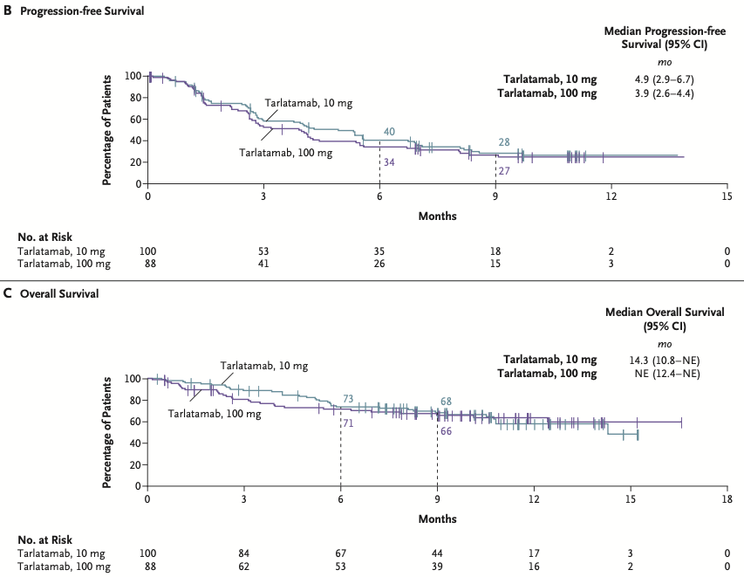
DeLLphi-301: Tarlatamab For sclc
Ahn MJ, et al. N Engl J Med. 2023;389(22):2063-2075.
Notes:
Panel B shows the Kaplan–Meier curve of progression-free survival in the analysis population for antitumor activity
Panel C shows the Kaplan–Meier curve of overall survival in the analysis population for antitumor activity

Slide 60
DeLLphi-301: Tarlatamab For sclc
Safety
Any adverse event: 97% (10 mg arm), 100% (100 mg arm)
Grade ≥3 events: 59% (10 mg), 64% (100 mg)
CRS:
Any grade: 51% (10 mg), 61% (100 mg)
Grade ≥3: 1% (10 mg), 6% (100 mg)
Most CRS cases were grade 1–2, occurred in cycle 1, and were managed supportively
ICANS/neurologic events: 8% (10 mg), 28% (100 mg)
Mostly low grade; no grade ≥ 3 in the 10 mg group
Other common AEs: Decreased appetite, pyrexia, constipation, anemia
Ahn MJ, et al. N Engl J Med. 2023;389(22):2063-2075.
Notes:
Discontinuation due to AE: 4% (10 mg), 3% (100 mg).
Most CRS happened at first 2 doses (day 1 and 8)
CRS Grade 1: 30, 32%
CRS Grade 2: 20, 23%
Median time to onset of CRS: 13.1 hrs
Median duration of CRS: 4 days
Supportive care: APAP, IV fluids, glucocorticoids, alone or in combination
Toci given to 5%, 10%
ICANS most occurred in cycle
Median time to onset 5 days

Slide 61
DeLLphi-301: Tarlatamab For sclc
Author’s Conclusion
“In this phase 2 DeLLphi-301 trial, tarlatamab had durable antitumor activity in patients with heavily pretreated small-cell lung cancer…The 10-mg dose was selected for subsequent tarlatamab trials because it had a more favorable benefit-to-risk profile than the 100-mg dose, with an objective response in 40% of the patients and a median overall survival of 14.3 months.”
Ahn MJ, et al. N Engl J Med. 2023;389(22):2063-2075.

Slide 62
DeLLphi-301: Tarlatamab For sclc
Strengths and Weaknesses
Strengths | Weaknesses
Rigorous and blinded efficacy assessment Adequate size and international Novel mechanism/unmet need Robust antitumor activity | Open-label design Lack of Control Arm Sponsor Involvement Long-term benefit/risks remain uncertain
Ahn MJ, et al. N Engl J Med. 2023;389(22):2063-2075.
Notes:
Strengths
Rigorous and Blinded Efficacy Assessment: Responses were determined by blinded independent central review, minimizing assessment bias.
Adequate Sample Size and International Scope: The trial enrolled over 220 patients across 56 sites in 17 countries, increasing the generalizability of the findings
Novel Mechanism and Unmet Need: Tarlatamab targets DLL3, which is highly expressed in SCLC but not in normal tissues, and acts via a bispecific T-cell engager mechanism, which is especially relevant for a patient population with limited treatment options and dismal prognosis beyond second-line therapy
Robust Antitumor Activity: The study demonstrated a confirmed objective response rate of 40% (10 mg dose) — far exceeding historical controls (≈15% for third-line SCLC)
Weaknesses
Open-Label Design: While response review was blinded, treatment assignment was not, introducing potential for operational or reporting bias
Lack of Control Arm: The trial did not include a randomized comparator (e.g., standard chemotherapy), limiting the ability to directly attribute efficacy/safety differences to tarlatamab versus existing options
The sponsor designed the trial, performed statistical analyses, and provided writing support, introducing potential for conflicts of interest
Median duration of response and some survival endpoints were not reached

Slide 63
DeLLphi-301: Tarlatamab For sclc
Presenter’s Conclusion
Tarlatamab 10 mg IV every two weeks demonstrated significant antitumor activity in heavily pretreated SCLC patients. The safety profile was manageable with most CRS and neurotoxicity events being low grade. Given the lack of approved third-line therapies and historically poor outcomes in this setting, tarlatamab represents a promising and innovative immunotherapeutic option for R/R SCLC.
Ahn MJ, et al. N Engl J Med. 2023;389(22):2063-2075.

Slide 64
Long-term follow-up from DeLLphi-300
Updated Results Published August 2024
No new safety signals on longer follow-up
Overall follow-up at 12.1 months (N=152):
ORR: 25.0% (4 CR, 34 PR)
Median DOR: 11.2 months (95% CI 6.6–22.3).
Median PFS: 3.5 months (95% CI 2.7–3.8).
Median OS: 17.5 months (95% CI 11.4–NE).
10 mg Q2W Cohort (Phase 2 dose, N =17)
ORR: 35.3%
Median DOR: 14.9 months (95% CI 3.0–NE)
Median OS: 20.3 months (95% CI 5.1–NE)
Demonstrated durable responses and clinically meaningful survival outcomes in relapsed SCLC with longer median OS than other second-line agents
Dowlati A, et al. J Clin Oncol. 2024;42(29):3392-3399.
Notes:
10 mg: 29.4% had sustained disease control ≥ 52 weeks
Of 16 evaluable patients with CNS lesions ≥10 mm:
62.5% had ≥30% shrinkage.
Intracranial disease control: 87.5% (median 7.4 months)

Slide 65
Tarlatamab (Imdelltra)
FDA approval: May 16, 2024
Dosing:
Premedications:
Cycle | Day | Tarlatamab Dose
Cycle 1 | Day 1 | 1 mg
 | Day 8 | 10 mg
 | Day 15 | 10 mg
Cycles 2+ | Day 1 and 15 | 10 mg
Cycle | Day | Dose
Cycle 1: Days 1 and 8 | Dexamethasone 8 mg IV 1 hour prior to administration
Cycle 1: Days 1, 8, 15 | NS 1 L IV over 4 to 5 hours immediately after completion
UpToDate Lexidrug

Slide 66
Future of
Bispecific Antibodies
06

Slide 67
Future Studies in Bispecifics
Epcoritamab (Epkinly)
Safety and Efficacy Study of Epcoritamab in Subjects With R/R Chronic Lymphocytic Leukemia and Richter's Syndrome
Epcoritamab and Rituximab for First-line Follicular Lymphoma
Epcoritamab With Dose Adjusted EPOCH-R for the Treatment of Aggressive B-Cell Non-Hodgkin Lymphoma
Glofitamab (Columvi)
A Study Evaluating the Safety and Efficacy of Glofitamab + Gemcitabine + Oxaliplatin in U.S. Patients With R/R DLBCL
A Study of Glofitamab and Lenalidomide in People With Mantle Cell Lymphoma
A Study of Axicabtagene Ciloleucel and Glofitamab as Second-Line Therapy for R/R Patients With LBCL
Clinicaltrials.gov

Slide 68
Future Studies in Bispecifics
Tarlatamab (Imdelltra)
First-Line Tarlatamab in Combination With Carboplatin, Etoposide, and PD-L1 Inhibitor in Subjects With Extensive Stage Small Cell Lung Cancer (ES-SCLC)
A Study of Tarlatamab for People With Prostate Cancer
Tarlatamab in Advanced Delta-like 3 (DLL3)-Expressing Tumors Including Neuroendocrine Neoplasms
Clinicaltrials.gov

Slide 69
Future Concepts in Bispecifics
More than 200 BsAbs in > 300 clinical trials:
~75% for solid tumors, 25% for hematologic cancers
New Modalities
Dual receptor/ligand inhibition: Blocking multiple tumor growth or angiogenesis pathways (Ex: VEGF + PD1/PDL1 BsAbs)
Targeted payload delivery: BsAb–drug conjugates to deliver payloads such as cytotoxic agents or radioactivity
Checkpoint modulation: Dual checkpoint inhibitors (Ex: PD1/CTLA4) and costimulatory BsAbs enhance antitumor immunity with potentially fewer autoimmune toxicities
Conditional/prodrug BsAbs: Activated only in the tumor microenvironment to reduce toxicity
Klein C, Brinkmann, et al.. Nat Rev Drug Discov. 2024;23(4):301-319.

Slide 70
Future Concepts in Bispecifics
New Modalities
BsAb-based proteolysis targeting chimeras (PROTACs): Promote internalization and degradation of tumor-driving surface proteins
Cytokine mimetic BsAbs: Deliver immune-boosting signals like IL-2 or IL-15 selectively to tumor-reactive cells.
Novel delivery: mRNA, viral vectors, and CAR-T cells engineered to secrete BsAbs
Trispecific antibodies: Combine a tumor cell antigen, checkpoint modulation, and co-stimulatory molecule. The simultaneous engagement of multiple immune cell receptors can lead to a stronger and more robust immune response.
Klein C, Brinkmann, et al.. Nat Rev Drug Discov. 2024;23(4):301-319.

Slide 71
Self-Assessment Questions
?

Slide 72
Self-Assessment Questions
1. Which of the following best describes the mechanism of bispecific T-cell engagers (BiTEs)? A. They activate T cells by binding CD28 and IL-2 directly B. They connect T cells to tumor cells via CD3 and a tumor-associated antigen C. They block PD-1 and CTLA-4 simultaneously to enhance immune response D. They deliver cytotoxic payloads to tumor cells through antibody–drug conjugates
Ahn MJ, et al. N Engl J Med. 2023;389(22):2063-2075.
Notes:
B

Slide 73
Self-Assessment Questions
2. What is the most common treatment-emergent adverse event associated with epcoritamab in lymphoma trials? A. Neutropenia B. Fatigue C. Cytokine release syndrome (CRS) D. Peripheral neuropathy
Ahn MJ, et al. N Engl J Med. 2023;389(22):2063-2075.
Notes:
C

Slide 74
Self-Assessment Questions
3. According to the STARGLO trial, what was the primary endpoint when evaluating glofitamab plus GemOx in relapsed/refractory DLBCL? A. Overall survival B. Progression-free survival C. Complete response rate D. Duration of response
Dowlati A, et al. J Clin Oncol. 2024;42(29):3392-3399.
Notes:
A

Slide 75
Self-Assessment Questions
4. In the DeLLphi-301 trial of tarlatamab for small cell lung cancer, why was the 10 mg dose selected for further studies instead of 100 mg? A. The FDA mandated use of the 10 mg dose for all bispecific antibody studies B. The 10 mg dose demonstrated significantly higher complete response rates C. The 100 mg dose caused excessive hematologic toxicity D. The 10 mg dose had a more favorable safety profile with similar efficacy
UpToDate Lexidrug
Notes:
D

Slide 76
References
Ref

Slide 77
References
Ma J, Mo Y, Tang M, et al. Bispecific Antibodies: From Research to Clinical Application. Front Immunol. 2021;12:626616. Published 2021 May 5. doi:10.3389/fimmu.2021.626616
Tian Z, Liu M, Zhang Y, Wang X. Bispecific T cell engagers: an emerging therapy for management of hematologic malignancies. J Hematol Oncol. 2021;14(1):75. Published 2021 May 3. doi:10.1186/s13045-021-01084-4
Klein C, Brinkmann U, Reichert JM, Kontermann RE. The present and future of bispecific antibodies for cancer therapy. Nat Rev Drug Discov. 2024;23(4):301-319. doi:10.1038/s41573-024-00896-6
Shimabukuro-Vornhagen A, Gödel P, Subklewe M, et al. Cytokine release syndrome. J Immunother Cancer. 2018;6(1):56. Published 2018 Jun 15. doi:10.1186/s40425-018-0343-9
Cytokine release syndrome (CRS). In: UpToDate [database online]. Hudson, Ohio: Wolters Kluwer Health. Updated periodically. Accessed August 24, 2025.
Lee DW, Santomasso BD, Locke FL, et al. ASTCT Consensus Grading for Cytokine Release Syndrome and Neurologic Toxicity Associated with Immune Effector Cells. Biol Blood Marrow Transplant. 2019;25(4):625-638. doi:10.1016/j.bbmt.2018.12.758
Suarez Montero JC, Caballero Gonzalez AC, Martín Aguilar L, Mancebo Cortés J. Immune effector cell-associated neurotoxicity syndrome: A therapeutic approach in the critically ill. Med Intensiva (Engl Ed). 2022;46(4):201-212. doi:10.1016/j.medine.2022.02.005
Immune effector cell-associated neurotoxicity syndrome (ICANS). In: UpToDate [database online]. Hudson, Ohio: Wolters Kluwer Health. Updated periodically. Accessed August 24, 2025.
Thieblemont C, Phillips T, Ghesquieres H, et al. Epcoritamab, a Novel, Subcutaneous CD3xCD20 Bispecific T-Cell-Engaging Antibody, in Relapsed or Refractory Large B-Cell Lymphoma: Dose Expansion in a Phase I/II Trial. J Clin Oncol. 2023;41(12):2238-2247. doi:10.1200/JCO.22.01725
Linton KM, Vitolo U, Jurczak W, et al. Epcoritamab monotherapy in patients with relapsed or refractory follicular lymphoma (EPCORE NHL-1): a phase 2 cohort of a single-arm, multicentre study. Lancet Haematol. 2024;11(8):e593-e605. doi:10.1016/S2352-3026(24)00166-2
Vose JM, Cheah CY, Clausen MR, et al. 3-Year Update from the Epcore NHL-1 Trial: Epcoritamab Leads to Deep and Durable Responses in Relapsed or Refractory Large B-Cell Lymphoma. Blood 2024; 144 (Supplement 1): 4480. doi: https://doi.org/10.1182/blood-2024-198714
Epcoritamab. In: UpToDate Lexi-Drugs [database online]. Hudson, Ohio: Wolters Kluwer Health. Updated periodically. Accessed August 24, 2025.
Dickinson MJ, Carlo-Stella C, Morschhauser F, et al. Glofitamab for Relapsed or Refractory Diffuse Large B-Cell Lymphoma. N Engl J Med. 2022;387(24):2220-2231.

Slide 78
References
Dickinson MJ, Carlo-Stella C, Morschhauser F, et al. Glofitamab for Relapsed or Refractory Diffuse Large B-Cell Lymphoma. N Engl J Med. 2022;387(24):2220-2231. doi:10.1056/NEJMoa2206913
Abramson JS, Ku M, Hertzberg M, et al. Glofitamab plus gemcitabine and oxaliplatin (GemOx) versus rituximab-GemOx for relapsed or refractory diffuse large B-cell lymphoma (STARGLO): a global phase 3, randomised, open-label trial. Lancet. 2024;404(10466):1940-1954. doi:10.1016/S0140-6736(24)01774-4
Dickinson MJ, Carlo-Stellan C, Morschhauser F, et al. Fixed-Duration Glofitamab Monotherapy Continues to Demonstrate Durable Responses in Patients with Relapsed or Refractory Large B-Cell Lymphoma: 3-Year Follow-up from a Pivotal Phase II Study. Blood 2024; 144 (Supplement 1): 865. doi: https://doi.org/10.1182/blood-2024-194333
Ryan C. FDA ODAC votes against the applicability of Starglo data for Glofitamab plus Chemo for U.S. patients with R/R DLBCL. OncLive. May 20, 2025. Accessed August 24, 2025. https://www.onclive.com/view/fda-odac-votes-against-the-applicability-of-starglo-data-for-glofitamab-plus-chemo-for-u-s-patients-with-r-r-dlbcl.
Glofitamab. In: UpToDate Lexi-Drugs [database online]. Hudson, Ohio: Wolters Kluwer Health. Updated periodically. Accessed August 24, 2025.
Paz-Ares L, Champiat S, Lai WV, et al. Tarlatamab, a First-in-Class DLL3-Targeted Bispecific T-Cell Engager, in Recurrent Small-Cell Lung Cancer: An Open-Label, Phase I Study. J Clin Oncol. 2023;41(16):2893-2903. doi:10.1200/JCO.22.02823
Ahn MJ, Cho BC, Felip E, et al. Tarlatamab for Patients with Previously Treated Small-Cell Lung Cancer. N Engl J Med. 2023;389(22):2063-2075. doi:10.1056/NEJMoa2307980
Dowlati A, Hummel HD, Champiat S, et al. Sustained Clinical Benefit and Intracranial Activity of Tarlatamab in Previously Treated Small Cell Lung Cancer: DeLLphi-300 Trial Update. J Clin Oncol. 2024;42(29):3392-3399. doi:10.1200/JCO.24.00553
Tarlatamab. In: UpToDate Lexi-Drugs [database online]. Hudson, Ohio: Wolters Kluwer Health. Updated periodically. Accessed August 24, 2025.
Clinicaltrials.gov

Slide 79
Thank You
Do you have any questions?
Traylor Moses, PharmD, MBA, MPH, MS, MB(ASCP)^{CM}
ASLMC PGY2 Oncology Pharmacy Resident
traylor.moses@aah.org

