Slide 1
Breaking Barriers
Navigating the Path to Publication, Presentation, and Podcasts in NPD
Stephanie Zidek, PhD, RN, AGCNS-BC, NEA-BC, NPD-BC | May 2024

Slide 2
IPCE Designation and Accreditation
Accreditation Statement
In support of improving patient care, this activity has been planned and implemented by Advocate Health and Chicago Association for Nursing Professional Development (CANPD). Advocate Health is jointly accredited by the Accreditation Council for Continuing Medical Education (ACCME), the Accreditation Council for Pharmacy Education (ACPE), and the American Nurses Credentialing Center (ANCC), to provide continuing education for the healthcare team.
Credit Statement(s)
American Nurses Credentialing Center (ANCC)
Advocate Health designates this live activity for a maximum of 1.0 ANCC contact hours. Nurses should claim only the credit commensurate with the extent of their participation in the activity.

Slide 3




Learning Objectives
 | Gain an in-depth understanding of available dissemination paths within nursing professional development, including publications, presentations, podcasts, and other digital platforms.
 | Explore the benefits, challenges, and strategies associated with each dissemination route.
 | Design a personalized dissemination journey based on self-reflection and areas of interest
 | Develop practical skills and insights to navigate the landscape of modern-day dissemination for NPDs

Slide 4
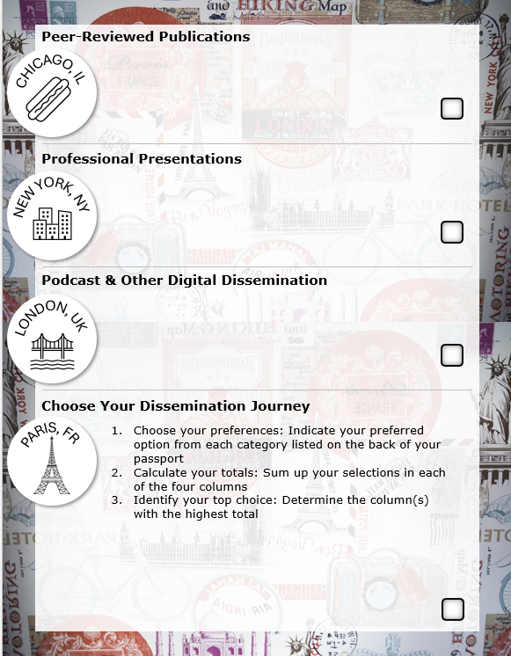
Dissemination Destination Passport

Slide 5

Dissemination Destination Passport Resources
Share key professional development resources that complement each dissemination destination.

Slide 6
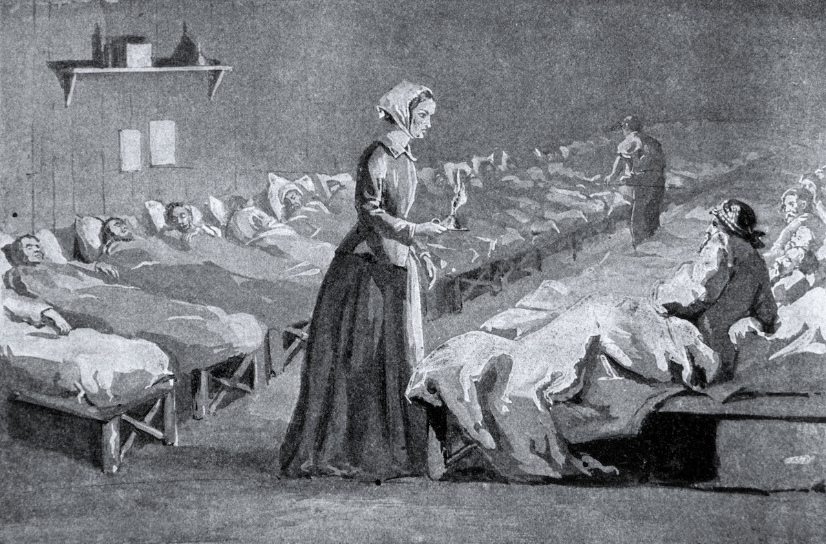

Before we chart our course forward, let's appreciate the path we've traveled...
1st university nursing program established at University of Minnesota
ANCC Magnet Recognition Program formed in 1990
Florence Nightingale studied nursing care
The American Nurse Association was founded
Nursing Research
Published
1850
1896
1909
1952
1990
1886
1900
1924
1985
2010
The Nightingale
Published
American Journal of Nursing Published
1st doctoral program established at Columbia university
National Center for Nursing Research create at the National Institute of Health
Institute of Medicine released The Future of Nursing Report

Slide 7


PEER-REVIEWED PUBLICATION
Publication advances the nursing profession by helping provide evidence for practice and growing our professional body of work.
5 Reasons
Share ideas and expertise
Disseminate findings
Promotion, tenure, and professional development
Development of new knowledge and skills
Personal gains
CHICAGO, IL

Slide 8
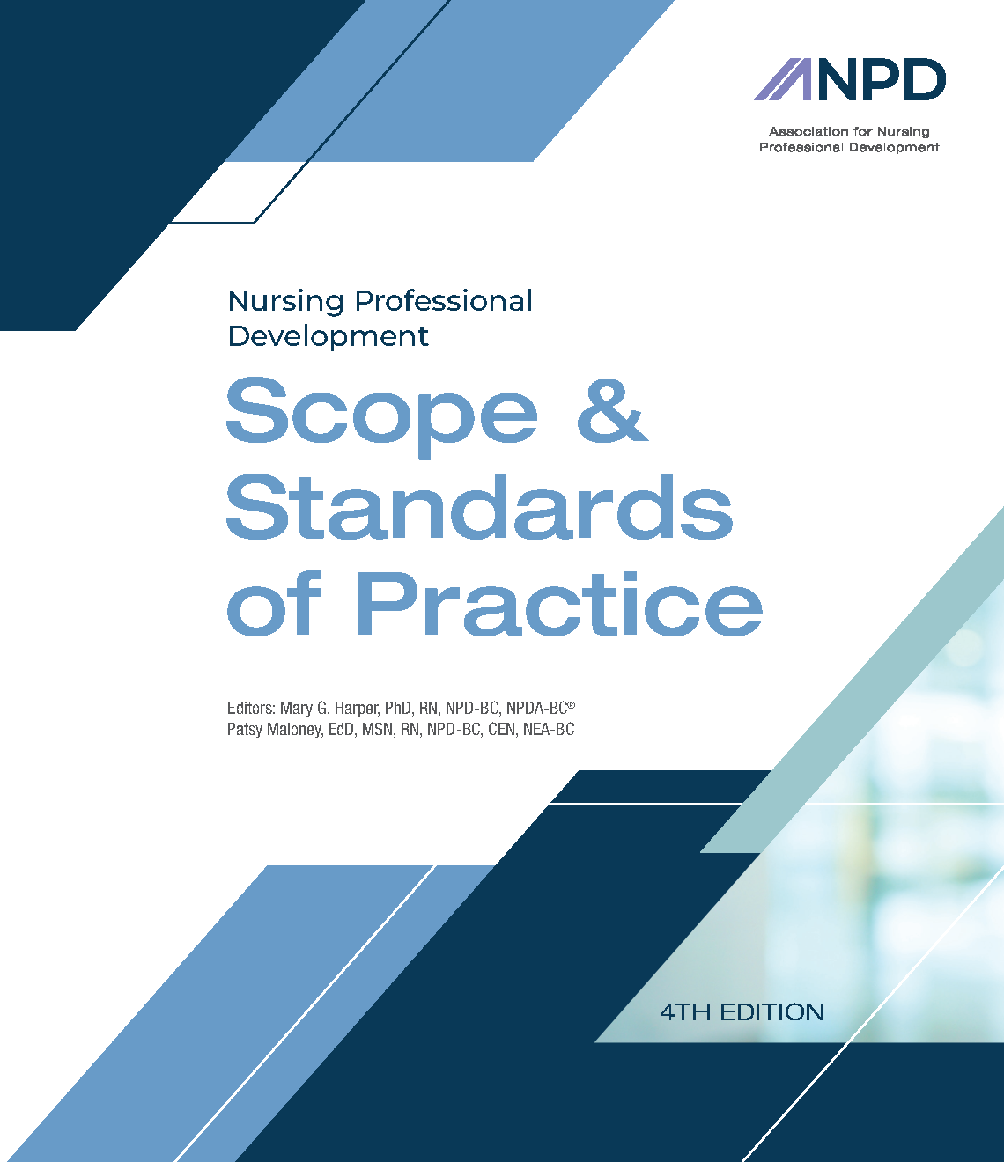
NPD Scope and Standards
Advocacy (Standard 8)
Advances the NPD specialty and nursing profession through publications, presentations, and other inquiry related to NPD practice
Scholarly Inquiry (Standard 14)
Disseminates research, EBP, and QI findings through activities such as presentations, publications, and consultation

Slide 9
Types of Publications
Types | Examples
Original Research | Quantitative, Qualitative, Mixed methods (quantitative and qualitative data are both collected to answer separate, related questions), Secondary analysis (reanalysis of data collected in another study to answer a new question)
Practice Based | Case Studies, Evidenced-based practice, Quality Improvement
Professional Issues | Patient care, Standards of care/guidelines, Ethics, Political Issues, Nursing Professionalism
Other | Literature reviews, Health policy analysis, Education, Economic analysis of health interventions or patient care, Technology
Books & Chapters | Members on this call have written books & chapters!
Notes:
Understanding Publication in Nursing/NPD
Poll the audience about best route for publication
Which type of nursing publication/topic would you be interested in writing for

Slide 10

Where to start
Determine your topic
Select a journal
Create a working title
Make a brief outline
Build out your main points
Craft your axis of logic

Slide 11
AXIS OF LOGIC
INTERPROFESSIONAL EDUCATION PROGRAM EXAMPLE
Problem (Share the problem)
Health professional students lack opportunities to develop clinical expertise in managing older adults with a team care environment.
Purpose (What are you trying to fix)
The purpose of this interprofessional fellowship program was to provide a learning experience for nurse practitioners, clinical nurse specialists, and master’s in social work students to develop clinical expertise for managing older adults within a care team environment.
Aims (What things did you do)
Increase knowledge of age-related changes and health problems experienced by older adults
Appy principles of collaborative interprofessional team practice to providing patient-centered care for older adults
Significance (Why should this problem be fixed)
Students completing this fellowship program will help address the gap in care providers with expertise in caring for older adults with complex health problems.

Slide 12

Writing Tips
Avoid first person
Beware of predators
Capture the correct tense
Embrace grey literature
Find your format – and stick to it
Limit direct quotes
Minimize abbreviations
Omit jargon and slang
Opt for active voice
Remove “that’” and “who”

Slide 13
Nursing Journal Directory
Journal Author Name Estimator
Nursing Research Dept
Health System Library
Citation Manager
Take a Break
Word Editor or Grammarly
Query Letter
Academic Writing Center
Peer Reviewers
Resources
Notes:
Nursing Journal Directory: https://airtable.com/shrjqveaKHtS9xku8/tblNXTxmTr18CC1If
JANE: Audience demo, https://jane.biosemantics.org/suggestions.php
AAH Library: Literature Search Requests, Book Requests, Citation Assistance, Institutional Repository
Citation Manager: EndNote, Zotero
Take a Break: Cheap clarity
Gram or Word: Editor scores, readiability score, clarity, conciseness, formality, inclusiveness, perspectives, punc, sensitive geopolitical references, vocab, similarity read
Query:
Academic Writing Center: Review for scholarly pursuits
Peer review: Powerful two-way act. Your submission will be peer reviewed, so this is a great exercise for you and your colleagues

Slide 14
Dissemination Destination Passport Resources
ANPD
From Pen to Print: Pearls for Publishing Success Webinar
Core Curriculum for Nursing Professional Development, 6th Edition (2023)
Scope & Standards of Practice, 4th Edition (2022)

Slide 15
Check Point
CHICAGO, IL

Slide 16

PROFESSIONAL PRESENTATION
Dissemination venue that allows NPDs to share knowledge, expertise, and innovations.
Presentation Types
Poster
Podium
Panel and/or Group
Session/Symposium
Rapid Session
NEW YORK, NY

Slide 17

Call for Abstracts
Submission Timeframe
Conference Focus
Presenter Eligibility
Guidelines
  Topics or tracks
  Format
  Word or character count
  Presentation selection
Review Process

Slide 18

The Art of the Abstract
Adhere to the word limit
Avoid topics that have been extensively covered or lack originality
Craft a clear (and catchy) title
Commit to keywords and standard language
Emphasize the outcomes
Honor your audience
Keep it current, including references
Refer to the requirements

Slide 19
Dissemination Destination Passport Resources
ANPD
2025 Aspire Convention is now abstracting abstracts for: Onboarding & Education, Competency Management, Education, Role Development, Collaborative Partnerships, Inquiry
ANPD 2025 Abstract Submission Guide

Slide 20
Check Point
NEW YORK, NY

Slide 21

PODCASTS & OTHER DIGITAL DISSEMINATION
Nursing podcasts play a crucial role in the dissemination of nursing knowledge, research, and best practices, serving as accessible, engaging, and valuable resources.
Digital Dissemination
Podcasts
Content Hubs & Blogs
Discussion Forums
Social Media
LONDON, UK

Slide 22
PODCASTS
Approximately 40% of Americans listen to at least one podcast every week. Among these weekly listeners, the average is 8.3 podcast episodes per week.
Podcast Benefits
Accessible education
Diverse topics
Expert insights
Current trends and research
Global reach
Inexpensive for creators and listeners

Slide 23

Podcasting Tips
Planning
Find your format
Select your host(s)
Equipment
Microphone and headphones preferred
Recording platform (Audacity, Zencastr, GarageBand, Zoom/MS Teams, Audio)
Decide on your RSS feed directories (Apple, Spotify, Google)
Promotion
Consider internal and external communication
Be consistent with a regular schedule
Track your analytics

Slide 24
OTHER
DIGITAL DISSEMINATION
Digital dissemination can be a resource for staying current on research, connecting with colleagues, and engaging in professional discussions.
Content Hubs & Blogs
Professional forums often sponsored by specialty organizations
Online Community
Discussion forums, listservs, group discussions
Social Media
Academic Twitter (also known as “X”)
YouTube

Slide 25

Navigating the Digital Highway
Commit and continue to show up
Enhance your engagement through likes, commenting, and re-posts
Embrace feedback from your audience and peers
Follow forum guidelines
Incorporate visual content and multi-media
Select a hashtag strategy when appropriate
Spend some time lurking and learning
Strike a balance of content creation, contribution and self-promotion

Slide 26
Dissemination Destination Passport Resources
ANPD
Podcast: NPD Forecast
Content Hub: NPD in Motion
Online Community: The Neighborhood (Coming Soon!)
Other Resources
Podcast: ANA See You Now
Content Hub: ANA Nursing Resource Hub, NLN Nursing EDge, refer to specialty organization

Slide 27
Check Point
LONDON, UK

Slide 28

CHOOSE YOUR DISSEMINATION JOURNEY
Refer to the Dissemination Destination Passport Resource to map your dissemination journey!
Directions
Choose your preferences: Indicate your preferred option from each category listed
Calculate your totals: Sum up your selections in each of the four columns
Identify your top choice: Determine the column with the highest total
PARIS, FR

Slide 29
Dissemination Itinerary
Publication | Presentation | Podcast | Other
Values credibility, in-depth exploration, and long-term impact, and has the bandwidth for a significant time investment with access to publication resources | Prefers direct engagement, networking opportunities, and real-time feedback, and has the availability for a moderate time investment and conference/event attendance | Prioritizes accessibility, flexibility, and interested in reaching a diverse audience, without any time or resource constraints | Seeks high engagement, community building, and ongoing interaction, without time or resource constraints

Slide 30

Questions

Slide 31

Attendance Code to Claim Credit:
CANPD Educational Series 2024: Breaking Barriers: Navigating the Path to Publication, Presentation, and Podcasts in Nursing Professional Development
Claim your credit instantly by scanning the QR code or clicking the link
CANPD Educational Series 2024: Breaking Barriers: Navigating the Path to Publication, Presentation, and Podcasts in Nursing Professional Development | Advocate Health
**Note: You must be logged into the site. If you are not, you will be prompted to login.
Click Take Course
Enter the Attendance code: LOGWUP
Follow the prompts on screen to complete the evaluation and claim credit.
*Remember your profile and mobile number will need to be updated on the CE Learning Platform in order to claim credit. Credits will be stored in your account on https://ce.advocatehealth.org
Code is valid for 30 days after the day of the activity.

