Slide 1
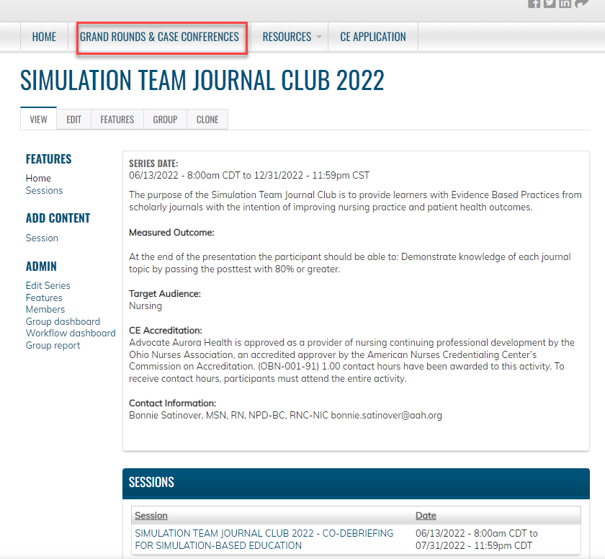
Simulation Team Journal Club 2022 –
Co-debriefing for Simulation-based Education
Independent Study Program Date/Time:
​June 14, 2022, 2022 – July 31, 2022
​
Program Location:
​Article and quiz found on CE Learning Platform
Article: Co-debriefing for Simulation-based Education Cheng, A., Palaganas, J., Eppich, W., Rudolph, J., Robinson, T. & Grant, V.; Society for Simulation in Healthcare, April 2015, Vol 20., No. 2, p 69-75 doi: 10.1097/SIH.0000000000000077
​Contact Person: Bonnie Satinover, MSN, RN, NPD-BC, RNC-NIC- bonnie.satinover@aah.org
Desired Learner Outcome(s): At the end of the presentation the participant should be able to: Demonstrate knowledge of co-debriefing by passing the posttest with 80% or greater.
​​
Continuing Nursing Education Hours:​
1.0 contact hours will be awarded upon successful completion of this program. ​
Criteria for Successful Completion: ​
Credit awarded commensurate with participation.
Read Entire Article.
Complete and pass post test with 80% or greater.
Evaluations will be completed after the event.
Participants will have 28 days to complete the evaluation.
Upon submission of the evaluation, the participant will receive their certificate.
Accreditation Statement: ​
Advocate Aurora Health is approved as a provider of nursing continuing professional development by the Ohio Nurses Association, an accredited approver by the American Nurses Credentialing Center's Commission on Accreditation. (OBN-001-91)​
Created by Bonnie Satinover/ Simulation Created 5.17.2022 Revised NA Post until DATE 7.31.2022

