Slide 1
From Congestion to Control: Vasodilator-Based Approaches in Acute Heart Failure
Dylan Sarocco, PharmD
PGY2 Cardiology Resident
Aurora Health Care Metro, Inc.
Thursday, December 18th, 2025

Slide 2
Disclosure
The planners and speaker have indicated that there are no relevant financial relationships with any ineligible companies to disclose.
Notes:
Title: 32 font
Text: 18 font

Slide 3
Abbreviation Key
NIPPV: Noninvasive positive pressure ventilation
NO: Nitric oxide
NTG: Nitroglycerin
PCWP: Pulmonary capillary wedge pressure
PDE-5: Phosphodiesterase 5
POCUS: Point of care ultrasound
RAAS: Renin-angiotensin-aldosterone-system
RR: Respiratory rate
RV: Right ventricle
SBP: Systolic blood pressure
SCAPE: Sympathetic crashing acute pulmonary edema
SL: Sublingual
SOB: Shortness of breath
SpO2: Saturation of peripheral oxygen
SVR: Systemic vascular resistance
YO: years old
ACS: Acute coronary syndrome
ADHF: Acute decompensated heart failure
AHA: American heart association
AHF: Acute heart failure
AKI: Acute kidney injury
BiPAP: Bilevel positive airway pressure
BP: Blood pressure
cGMP: Cyclic guanosine monophosphate
CO: Cardiac output
DBP: Diastolic blood pressure
ECG: Electrocardiogram
ED: Emergency department
ESC: European society of cardiology
GDMT: Guideline directed medical therapy
GTP: Guanosine triphosphate
LVEDP: Left ventricle end-diastolic pressure
LVEF: Left ventricle ejection fraction
MAD: Mitochondrial aldehyde dehydrogenase
MOA: Mechanism of action
HF: Heart failure
HFpEF: Heart failure with preserve ejection fraction
HFSA: Heart failure society of America
HR: Heart rate
HTN: Hypertension
ICU: Intensive care unit
IV: Intravenous
LOS: Length of stay
LV: Left ventricle
N: Number

Slide 4
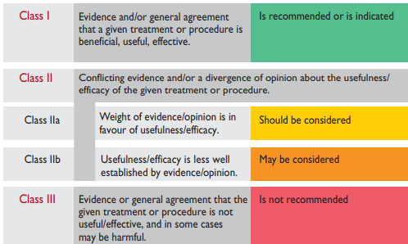
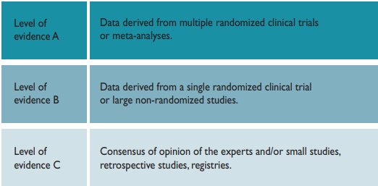
Heidenreich PA et al. Circulation. 2022 May 3;145(18):e895-e1032.
McDonagh TA, et al. Eur Heart J. 2021 Sep 21;42(36):3599-3726.

Slide 5
Learning Objectives
At the end of this session, learners should be able to:
Identify the clinical presentation, pathophysiology, and hemodynamics of ADHF including flash pulmonary edema and SCAPE
Evaluate pharmacological treatment options for ADHF and SCAPE including vasodilators and loop diuretics
Compare the role of high-dose nitroglycerin versus other vasodilators and standard therapy
Analyze treatment strategies for ADHF using guideline-based recommendations and literature

Slide 6
Outline
Background of sympathetic crashing acute pulmonary edema (SCAPE)
Pharmacological treatment options
Literature review
Summary

Slide 7
Background

Slide 8
SCAPE
Definition
Rapid-onset form of cardiogenic pulmonary edema driven by sympathetic activation
Cause
Outcome
Severe hypertension and fluid redistribution into the lungs
Uncontrolled and intense sympathetic activation resulting in increased afterload
Long B, et al. Am J Emerg Med. 2025 Apr;90:35-40.

Slide 9
Who Is at Risk for SCAPE
Underlying subset of acute heart failure syndromes
Chronic conditions
Uncontrolled hypertension
Chronic heart failure
LV or RV diastolic dysfunction
Chronic kidney disease and renal artery stenosis
Diabetes
Triggers
Myocardial ischemia
Acute pain/ illness/ anxiety
Non-compliance to HTN medications
Tachyarrhythmias
Sympathomimetic intoxication
Long B, et al. Am J Emerg Med. 2025 Apr;90:35-40.
Agrawal N, et al. J Crit Care Med. 2016 Dec;20(12):719-723

Slide 10
Prevalence
No official estimate of those presenting with SCAPE
Accounts for the minority presenting with acute heart failure syndromes
SCAPE
Uncommon, severe subset of acute heart failure
Long B, et al. Am J Emerg Med. 2025 Apr;90:35-40.

Slide 11
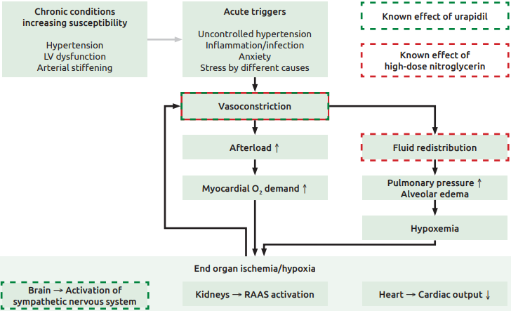
Pathophysiology
Purkarthofer, D, et al. Case report: Sympathetic crashing acute pulmonary edema

Slide 12
Pathophysiology - Trigger
Mechanism
Massive release of catecholamines
Alpha-1 mediated vasoconstriction
Beta-1 stimulation
Agrawal N, et al. J Crit Care Med. 2016 Dec;20(12):719-723.

Slide 13
Pathophysiology - Response
Afterload mismatch
Abrupt increase in SVR
Ventricles unable to compensate
Decrease in stoke volume
Backward flow of blood in pulmonary veins
Agrawal N, et al. J Crit Care Med. 2016 Dec;20(12):719-723.

Slide 14
LV end diastolic pressure increase
PCWP increase
Hydrostatic pressure > oncotic pressure
Fluid shifts from capillaries into alveolar space
Fluid Redistribution
Agrawal N, et al. J Crit Care Med. 2016 Dec;20(12):719-723.

Slide 15
Pathophysiology - Outcome
Agrawal N, et al. J Crit Care Med. 2016 Dec;20(12):719-723.

Slide 16
Characteristics of SCAPE
Rapid onset respiratory distress (< 4-6 hours)
Flash pulmonary edema
Vitals
Hypoxemia, tachypnea, tachycardia
Examination
SBP > 160 mmHg
DBP > 120 mmHg
Tripoding
Diaphoretic
Pinkish, frothy sputum
Bilateral crepitus
Long B, et al. Am J Emerg Med. 2025 Apr;90:35-40.
Agrawal N, et al. J Crit Care Med. 2016 Dec;20(12):719-723

Slide 17
Diagnosis of SCAPE
SCAPE diagnosis is purely clinical
Onset: minutes to hours
Abrupt SOB with progression
Bedside echocardiogram
Preserved ejection fraction, LV filling pressures, and cardiac contraction abnormalities
Labs
Assess end-organ injury
Complete blood cell count, electrolytes, renal/liver function, troponin, lactic acid, natriuretic peptides
ECG
Evaluate for cardiac ischemic and arrhythmia
POCUS
B-lines suggestive for pulmonary edema, interstitial pneumonia, or fibrosis
Long B, et al. Am J Emerg Med. 2025 Apr;90:35-40.
Agrawal N, et al. J Crit Care Med. 2016 Dec;20(12):719-723

Slide 18
SCAPE vs. ADHF
 | SCAPE | ADHF
Main Mechanism | Increased sympathetic activation Afterload mismatch | LV dysfunction Renal retention of sodium and water
Cause of Symptoms | Pressure redistribution from venoconstriction and increased afterload | Fluid accumulation
Onset | Rapid (minutes to hours) | Gradual (days)
Hemodynamic abnormalities | Hypertension (≥160 mmHg), Tachycardiac Increased SVR, LVEDP, PCWP and low CO | Increased LVEDP Low to normal CO Low to normal SBP
Clinical presentation | Cold and wet | Warm and wet OR Cold and dry
McDonagh TA, et al. Eur Heart J. 2021 Sep 21;42(36):3599-3726.

Slide 19
Assessment Question 1

Slide 20
Assessment Question 1
DS is a 70yo male, who presents with sudden severe shortness of breath and anxiety which started about 2 hours ago. His past medical history includes HFpEF and hypertension. His examination shows:
BP 210/115 mmHg, HR 125, SpO2 = 88%, POCUS shows B-lines consistent with pulmonary edema, is seen as euvolemic (at baseline weight 105 kg).
1. Which combination of features is most consistent with the pathophysiology of SCAPE?
Gradual onset, fluid overload, vitals are normal
Quick onset, hypertension and tachycardia, and positive B-lines on POCUS
Normal hemodynamics and patient is having a panic attack

Slide 21
Pharmacological Management Options in SCAPE

Slide 22
Treatment targets
Noninvasive ventilation
BiPAP
IV vasodilators
Nitroglycerin
Nitroprusside
Role of loop diuretics
Medications to avoid in acute setting
Long B, et al. Am J Emerg Med. 2025 Apr;90:35-40.
Agrawal N, et al. J Crit Care Med. 2016 Dec;20(12):719-723
Purkarthofer, D, et al. Case report: Sympathetic crashing acute pulmonary edema

Slide 23
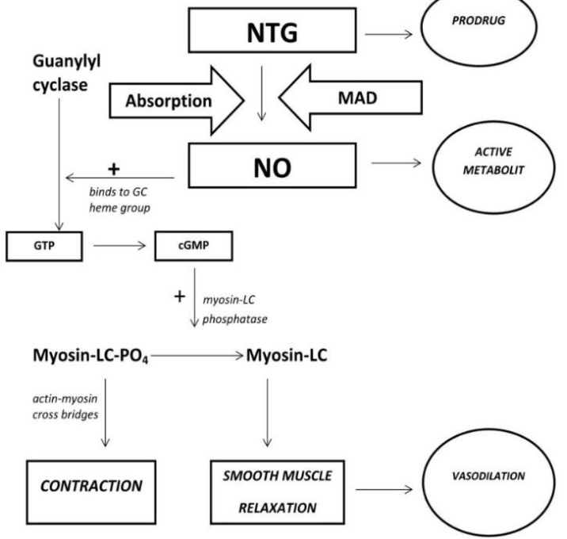
Nitroglycerin
Long B, et al. Am J Emerg Med. 2025 Apr;90:35-40.
Abdelhameed ME, et al. Cureus. 2025 Sep 14;17(9):e92262.

Slide 24
Nitroglycerin
IV Nitroglycerin use in SCAPE
Clinical effect | Low doses: vasodilator effect on peripheral veins > arteries High doses = arterial dilation
Dosing | Bolus dose: 400 mcg – 1000 mcg over 2 minutes Additional bolus doses may be necessary Maintenance infusion: ≥ 100 mcg/ minute
Duration of therapy | Rapid titration by 50 – 100 mcg/minute every 3-5 minutes Clinical improvement ± target SBP 140 – 160 mmHg Average duration of therapy: < 4-24 hours
Adverse outcomes | Hypotension, headache, flushing, angina, syncope Tachyphylaxis
Clinical pearls | Place in therapy: 1st line Half-life elimination: < 4 minutes Contraindications: recent PDE-5 inhibitor, aortic stenosis
Long B, et al. Am J Emerg Med. 2025 Apr;90:35-40.
Abdelhameed ME, et al. Cureus. 2025 Sep 14;17(9):e92262.

Slide 25
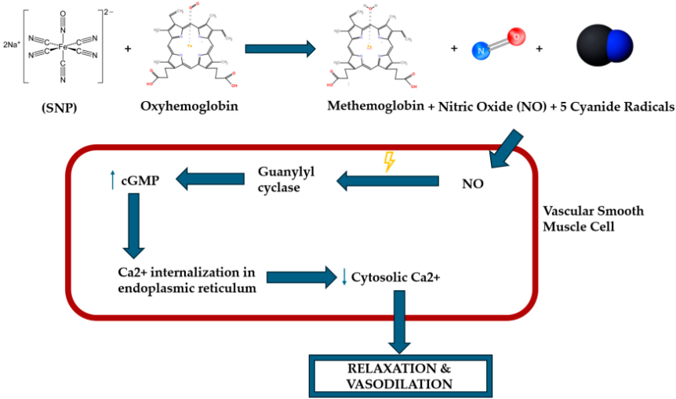
Nitroprusside
D’Elia S, et al. Future Pharmacology. 2025; 5(1):1.

Slide 26
Nitroprusside
IV Nitroprusside use in SCAPE
Clinical effect | Rapid arterial and venous dilation Decreased preload and afterload
Dosing | Continuous infusion: 0.25 – 0.5 mcg/kg/minute Max dose: 10 mcg/kg/minute Titrate by 0.5 mcg/minute every 5 minutes
Duration of therapy | Goal: limit dose ≤ 2 mcg/kg/min (if possible) Limit 8-10 mcg/kg/min for max of 10 minutes | Target SBP 140 – 160 mmHg Average duration: < 4-24 hours
Adverse outcomes | Hypotension, headache, flushing, tachycardia Toxicity: cyanide, thiocyanate
Clinical pearls | Place in therapy: 2nd line Half-life elimination: < 2 minutes (thiocyanate: 3 days) Contraindications: recent PDE5-inhibitor, coronary ischemia, MI, renal/ hepatic dysfunction, aortic stenosis
D’Elia S, et al. Future Pharmacology. 2025; 5(1):1.

Slide 27
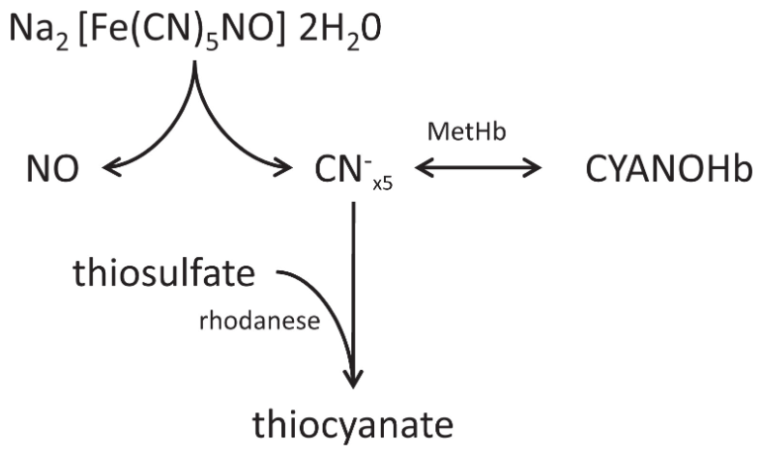
Nitroprusside Toxicity Monitoring
D’Elia S, et al. Future Pharmacology. 2025; 5(1):1.
Holme MR, et al. Sodium Nitroprusside. StatPearls Publishing; 2025 Jan.

Slide 28
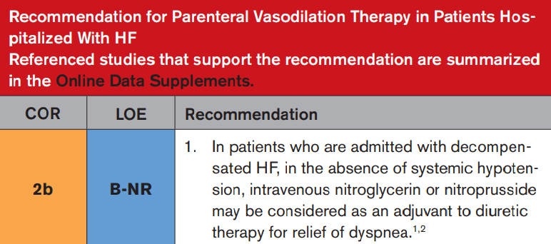
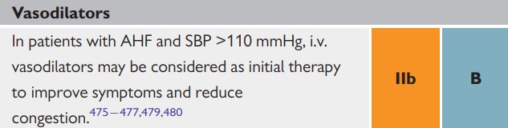
AHA and ESC Guidelines
AHA 2022
ESC 2021
Heidenreich PA et al. Circulation. 2022 May 3;145(18):e895-e1032.
McDonagh TA, et al. Eur Heart J. 2021 Sep 21;42(36):3599-3726.

Slide 29
AHA and ESC Guidelines
 | AHA 2022 | ESC 2021
Class recommendation | Class IIb Elevated BP to improve dyspnea and reduce congestion | Class IIb SBP > 110 mmHg for symptom relief in hypertensive acute HF
Patient population | Acute HF with pulmonary edema and elevated BP Improve dyspnea, reduce preload/afterload | Hypertensive acute HF Acute pulmonary edema with SBP > 110 mmHg
Guideline Emphasis | Supports nitroglycerin/ nitroprusside for rapid symptom improvement | Acknowledges strong physiologic benefit in hypertensive pulmonary edema
Limitations | Avoid in SBP < 90 mmHg, severe aortic stenosis, RV infarction Cautious use to prevent hypotension | Avoid in SBP < 90 mmHg, severe aortic stenosis, RV infarction Emphasis on invasive hemodynamic monitoring
Heidenreich PA et al. Circulation. 2022 May 3;145(18):e895-e1032.
McDonagh TA, et al. Eur Heart J. 2021 Sep 21;42(36):3599-3726.

Slide 30
Role of Loop Diuretics
Sympathetic activation
Increased afterload and redistribution of fluid rather than volume overload
Treatment focus
Respiratory support and blood pressure reduction
Majority of SCAPE patients are hypovolemic or euvolemic
Role of vasodilators
Diuretic role in therapy
Small subset of SCAPE patients
Evidence of systemic fluid overload
IV diuretics may be given
Long B, et al. Am J Emerg Med. 2025 Apr;90:35-40.

Slide 31
Role of Loop Diuretics
Background | Compare furosemide vs. placebo on subjective dyspnea in patients with acute pulmonary edema due to hypertensive crisis Randomized, double-blinded, placebo-controlled trial
Treatment | Urapidil All patients 12.5 mg q20 minutes until SBP < 160 mmHg | Furosemide Randomized Furosemide IV 80 mg bolus vs. placebo
Primary outcome | Subjective perception of dyspnea Monitored at hour 1, 2, 3, and 6
Secondary and safety outcome | Volume status, lactic acid Hypotension, intubation, catecholamine support, non-fatal cardiac arrest
Holzer-Richling N, et al. Eur J Clin Invest. 2011 Jun;41(6):627-34.

Slide 32
Role of Loop Diuretics
Results (N = 53) |  | Urapidil + furosemide (N = 25) | Urapidil + placebo (N = 28) | P value
Primary outcome | Subjective dyspnea (0 = no dyspnea, 4 = max dyspnea) | Hour 1 = 3 Hour 2 = 2 Hour 3 = 1 Hour 6 = 1 | Hour 1 = 3 Hour 2 = 2 Hour 3 = 2 Hour 6 = 1 | 0.4 0.98 0.33 0.76
Secondary outcome - 6 hours after intervention | Volume status | - 600 mL | Net even | 0.001
 | Lactic Acid | 1.3 | 1.0 | 0.08
Safety | Hypotension (SBP < 100 or DBP < 50 ) | 40% | 42.9% | 0.98
 | Intubation | 0% | 0% | 1
 | Catecholamine support | 8% | 14.3% | 0.52
 | Non-fatal cardiac arrest | 4% | 0% | 0.27
Holzer-Richling N, et al. Eur J Clin Invest. 2011 Jun;41(6):627-34.

Slide 33
Medication to Avoid
Beta Blockers
Negative inotropic effect
Further reduce ventricular contractility
Worsen pulmonary edema
Morphine
Increased risk of respiratory depression
Case reports of use increases rates of mechanical ventilation and ICU admission
Long B, et al. Am J Emerg Med. 2025 Apr;90:35-40.

Slide 34
Assessment Question 2

Slide 35
Assessment Question 2
DS is a 70yo male, who presents with sudden severe shortness of breath and anxiety which started about 2 hours ago. His past medical history includes HFpEF and HTN. His examination shows:
BP 210/115 mmHg, HR 125, SpO2 = 88%, POCUS shows B-lines consistent with pulmonary edema, is seen as euvolemic (at baseline weight, 105 kg).
2. Provider gives a diagnosis of SCAPE and is asking for your assistance on recommended treatment options. How can you respond?
Patient requires rapid afterload reduction, recommend IV nitroglycerin
Nitroprusside would not be preferred due to the risk of cyanide toxicity
Tachycardia is driving his symptoms and requires a beta-blocker for rate control
While the patient is euvolemic, IV diuretics are the preferred agents to remove fluid from the pulmonary vasculature

Slide 36
Literature review

Slide 37
Literature Review
High Dose Nitroglycerin Pilot Study (2021)
Hi-DOSE SCAPE Study (2023)
High vs Low Dose IV Nitroglycerin (2024)

Slide 38
High Dose Nitroglycerin: a Pilot Study
Objective | To study the feasibility, efficacy, and safety of high-dose NTG combined with non-invasive ventilation in SCAPE
Design | Prospective, observational study ED within a tertiary-care academic medical center in India
Inclusion criteria | Hypertensive acute heart failure Respiratory distress < 6 hours Respiratory rate ≥ 30/minute | Bilateral coarse crepitations SpO2 < 90% (room air) or < 95% (supplemental) SBP > 160/100 mmHg Sympathetic surge (diaphoresis, tachycardia, agitation)
Exclusion criteria | Immediate endotracheal intubation Immediate cardiopulmonary resuscitation | Sildenafil (within 24 hrs) or tadalafil (within 48 hrs) Moderate/ severe aortic stenosis Hypertrophic cardiomyopathy ACS
Mathew R, et al. J Emerg Med. 2021 Sep;61(3):271-277.

Slide 39
High Dose Nitroglycerin: a Pilot Study
NTG dosing protocol | Bolus dose (600 – 1000 mcg) SBP 160 – 179 mmHg = 600 mcg SBP 180 – 199 mmHg = 800 mcg SBP ≥ 200 mmHg = 1000 mcg |  | High-dose infusion Initial: 100 mcg/min Titrate: 20 mcg/min every 10 min
Non-invasive ventilation | All patients on NTG were simultaneously started on non-invasive ventilation
Primary endpoint | Feasibility, safety, and efficacy of high dose NTG | Efficacy (at 6 hours) Decrease respiratory rate by 25% or ≤ 24/ minute SpO2 ≥ 90% (room air) or ≥ 95% (supplemental) Dyspnea improvement SBP < 160 mmHg Disappearance of course crepitations | Efficacy Decrease respiratory rate by 25% or ≤ 24/ minute SpO2 ≥ 90% (room air) or ≥ 95% (supplemental O2) Improvement of dyspnea SBP < 160 mmHg
Secondary endpoint | Mean bolus of NTG given Infusion/ hour of NTG Correlation of dose with SBP
Mathew R, et al. J Emerg Med. 2021 Sep;61(3):271-277.

Slide 40
High Dose Nitroglycerin: a Pilot Study
Results – Vitals at different times (N = 25) |  |  |  |  |  | P-value
Efficacy endpoint | AT arrival | 1 hour | 3 hours | 6 hours | Discharge | < 0.001
Respiratory rates | 40 | 28 | 30 | 24 | 20
SpO2 | 80% | 99% | 98% | 99% | 99%
Heart rate | 128 | 120 | 106 | 90 | 80
SBP | 200 | 180 | 170 | 140 | 130
DBP | 111 | 110 | 100 | 84 | 80
Mathew R, et al. J Emerg Med. 2021 Sep;61(3):271-277.

Slide 41
High Dose Nitroglycerin: a Pilot Study
Results (N = 25)
Safety outcome | Hypotension (post-bolus) | 0%
 | Hypotension (infusion) | 8%
 | Adverse events | 0%
 | Required endotracheal intubation | 4%
Results (N = 25)
Mean bolus dose (micrograms) | 872 mcg
Mean cumulative dose (milligrams) | 35 mg
Discharge from ED Resolution of symptoms at hour 3 Resolution of symptoms at hour 6 | 24/25
 | 11/24
 | 24/24
Mathew R, et al. J Emerg Med. 2021 Sep;61(3):271-277.

Slide 42
High Dose Nitroglycerin: a Pilot Study
Strengths
Limitations
Feasibility, safety, and efficacy of high dose NTG dosing
Single-center pilot study with small sample size
Long term outcomes of recurrent symptoms not studied
Established dosing protocol followed by providers
Defined patient criteria matching prior case series for SCAPE treatment
No comparative analysis versus other standard therapy
Set up criteria for additional high dose vs. low dose study
Mathew R, et al. J Emerg Med. 2021 Sep;61(3):271-277.

Slide 43
Trial Review
High Dose Nitroglycerin Pilot Study (2021)
Hi-DOSE SCAPE Study (2023)
High vs Low Dose IV Nitroglycerin (2024)

Slide 44
The HI-DOSE SCAPE Study
Objective | Describe the safety and efficacy of high-dose NTG infusion for the management of SCAPE Safety of adjunctive medication use
Design | Retrospective, single-center, chart review study Adult ED within a large, tertiary care academic medical center
Inclusion criteria | NTG infusion ≥ 100 mcg/min Clinical diagnosis of SCAPE SBP ≥ 160 mmHg | Respiratory distress (pulmonary edema, SaO2 ≤ 90%, NIPPV, or RR ≥ 30 breaths/min)
Exclusion criteria | No exclusion criteria applied
Houseman BS, et al. Am J Emerg Med. 2023 Jan;63:74-78.

Slide 45
The HI-DOSE SCAPE Study
NTG dosing strategy | Suggested guidance: 200 mcg IV bolus followed by infusion Initial dosing varied by practitioner Infusion titrated to achieve symptom resolution Institutional max infusion rate: 300 mcg/min
Primary endpoint | Predictor of unfavorable outcomes to high dose NTG infusion and adjunctive therapies Hypotension (SBP < 90 mmHg) Intubation Acute kidney injury within 48 hours
Houseman BS, et al. Am J Emerg Med. 2023 Jan;63:74-78.

Slide 46
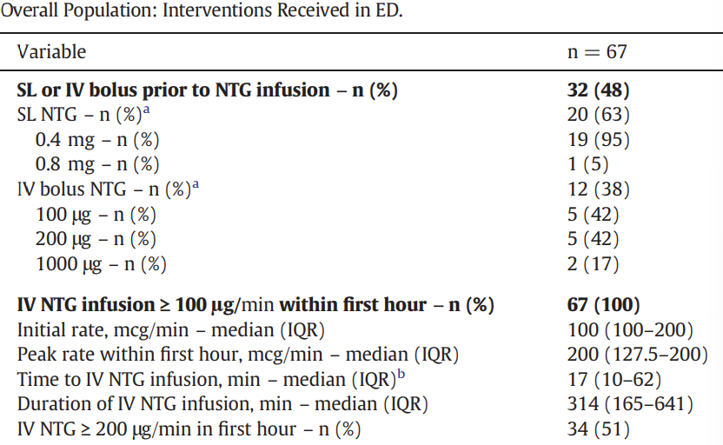
The HI-DOSE SCAPE Study
Houseman BS, et al. Am J Emerg Med. 2023 Jan;63:74-78.

Slide 47
The HI-DOSE SCAPE Study
Patients with unfavorable outcome vs. without Intubation, hypotension (SBP < 90 mmHg), AKI within 48 hours
Interventions | Unfavorable outcomes (N = 21) | No adverse outcome (N = 46) | P-value
NTG SL or IV bolus | 38% | 52% | 0.29
IV NTG rate ≥ 200 mcg/min in 1st hour | 71% | 41% | 0.02
Loop Diuretic (Furosemide 120 mg) | 71% | 52% | 0.14
ACE-I (IV enalaprilat 1.25 mg) | 24% | 39% | 0.22
Non-invasive positive pressure ventilation | 81% | 70% | 0.33
Houseman BS, et al. Am J Emerg Med. 2023 Jan;63:74-78.

Slide 48
The HI-DOSE SCAPE Study
Strengths
Limitations
Provides insight into how high dose NTG infusions are being used in practice
Retrospective, chart review design
Reports on dosing details, rates and use of adjunct therapy options
Provided information on rates of unfavorable outcomes
No control group
NTG titration practices not standardized, variable dosing strategies
Only monitored short term outcomes
Houseman BS, et al. Am J Emerg Med. 2023 Jan;63:74-78.

Slide 49
Trial Review
High Dose Nitroglycerin Pilot Study (2021)
Hi-DOSE SCAPE Study (2023)
High vs Low Dose IV Nitroglycerin (2024)

Slide 50
High vs Low Dose IV Nitroglycerin
Objective | Compare the efficacy of low dose NTG vs high dose NTG in SCAPE Highlight adverse effects in the high dose strategy
Design | Prospective, open-label, randomized controlled trial ED within a tertiary-care academic medical center in India
Inclusion criteria | Hypertensive acute heart failure Respiratory distress < 6 hours Respiratory rate ≥ 30/minute | Bilateral coarse crepitations SpO2 < 90% (room air) or < 95% (supplemental) SBP > 160/100 mmHg Sympathetic surge (diaphoresis, tachycardia, agitation)
Exclusion criteria | Immediate endotracheal intubation Immediate cardiopulmonary resuscitation | Sildenafil (within 24 hrs) or tadalafil (within 48 hrs) Moderate/ severe aortic stenosis Hypertrophic cardiomyopathy ACS
Siddiqua N, et al. Emerg Med J. 2024 Jan 22;41(2):96-102.

Slide 51
High vs Low Dose IV Nitroglycerin
NTG dosing strategy | High dose: 600-1000 mcg bolus → 100 mcg/min infusion (titrate based on response) Low dose: No bolus → Start 20-40 mcg/min infusion (titrate based on response, max 250 mcg/min)
Primary endpoint | Symptoms resolution at 6 hours and 12 hours | Criteria – at least 2 Respiratory rate decreased by 25% or ≤ 24/minute SBP ≤ 160 mmHg and DBP ≤ 100 mmHg or MAP ≤ 120 mmHg SpO2 ≥ 90% on room air OR ≥ 95% on supplemental O2 Subjective improvement in symptoms
Secondary endpoint | Invasive mechanical ventilation rates Admission and discharge rates Length of ED or hospital stay Adverse effects or major adverse cardiac events at 30 days Safety: complications with high dose NTG
Siddiqua N, et al. Emerg Med J. 2024 Jan 22;41(2):96-102.

Slide 52
High vs Low Dose IV Nitroglycerin
Results (N = 52) |  |  |  | P-value
 | Time | High Dose NTG (N=26) | Low Dose NTG (N=26)
Primary outcome | 6 hours | 65.4% | 11.5% | < 0.001
 | 12 hours | 88.5% | 19.2% | < 0.001
Cumulative Dose (in milligrams) | 3 hours | 17.9 | 10.9 | 0.001
 | 12 hours | 26.1 | 89.7 | 0.004
Siddiqua N, et al. Emerg Med J. 2024 Jan 22;41(2):96-102.

Slide 53
High vs Low Dose IV Nitroglycerin
Results (N = 52) |  |  |  | P-value
 | Event | High Dose NTG (N=26) | Low Dose NTG (N=26)
Secondary outcome | Intubation | 3.8% | 19.2% | 0.08
 | ED admission | 11.5% | 57.7% | 0.002
 | ED discharge | 88.5% | 42.3%
 | LOS in ED (hours) | 11 | 24 | < 0.001
 | MACE at 30 day | 3.8% | 26.9% | 0.02
Safety | Short-term adverse event | 11.5% | 42.3% | -
 | Hypotension | 0 | 0 | -
Siddiqua N, et al. Emerg Med J. 2024 Jan 22;41(2):96-102.

Slide 54
High vs Low Dose IV Nitroglycerin
Strengths
Limitations
Open-label study
Controlled and standardized dosing strategy at institution
Small sample size (56)
Study not powered to assess safety outcomes
Randomized patients to treatment groups
Siddiqua N, et al. Emerg Med J. 2024 Jan 22;41(2):96-102.

Slide 55
Assessment Question 3

Slide 56
Assessment Question #3
DS is a 70yo male, who presents with sudden severe shortness of breath and anxiety which started about 2 hours ago.
3. Provider agrees with IV nitroglycerin initiation and asks for your recommendation on dosing. How can you respond?
Start infusion at 10 mcg/ minute (no bolus dose), and increase by 5 mcg/minute every 3 minutes to a max of 50 mcg/minute
IV bolus 50 mcg every 2 minutes up to 200 mcg, without an infusion
Bolus 600-1000 mcg over 1-2 minutes, followed by infusion starting at 100 mcg/minute titrated up to clinical effect
Bolus with 80 mg IV furosemide, then start nitroglycerin infusion at a fixed rate of 200 mcg/minute

Slide 57
Summary

Slide 58
SCAPE Review
Subset of acute heart failure involving a redistribution of fluid into the pulmonary vasculature
Current therapy includes non-invasive ventilation and IV vasodilators
Limited primary literature on the use of IV nitroglycerin or nitroprusside
Early diagnosis and rapid titration of IV vasodilators can improve symptoms rapidly
Characteristics
Rapid onset
Flash pulmonary edema
Hypertension
Hypoxia, tachypnea, tachycardia
Notes:
While there are no trial comparing nitroprusside and nitroglycerin use in SCAPE, there are similarities and differences to point out about their use

Slide 59
Nitroglycerin vs. Nitroprusside
 | Nitroglycerin | Nitroprusside
Mechanism | Metabolized by MAD into nitric oxide | Prodrug, release 1 nitric oxide and 5 cyanide molecules
Clinical effect | Low dose = vasodilation (↓ preload) High dose = arterial dilation (↓ afterload) | Rapid arterial and venous dilation ↓ preload and afterload
Duration of therapy (in SCAPE) | Symptom improvement < 6-24 hours after initiation Rapid titration off once symptoms improve
Evidence | Single center, small, randomized controlled and prospective analysis | Lack of primary literature or case reports Referenced in AHA heart failure guidelines
Adverse outcomes | Hypotension, headache, flushing Tachyphylaxis | Hypotension, headache, flushing Toxicity: cyanide, thiocyanate
Long B, et al. Am J Emerg Med. 2025 Apr;90:35-40.
Abdelhameed ME, et al. Cureus. 2025 Sep 14;17(9):e92262.
D’Elia S, et al. Future Pharmacology. 2025; 5(1):1.

Slide 60
Study Review
High Dose Nitroglycerin: a Pilot Study (2021)
Feasibility, efficacy, and safety of high dose NTG in SCAPE
The HI-DOSE SCAPE Study (2023)
Retrospective look at outcomes and characteristics of high dose NTG
High vs Low Dose IV Nitroglycerin (2024)
Efficacy and safety of high and low dose nitroglycerin in SCAPE
Outcome: High dose NTG is both safe and effective
Outcome: Use of adjunctive therapy with high dose NTG did not improve outcomes in SCAPE
Outcome: Statistically significant benefit for high dose NTG
Mathew R, et al. J Emerg Med. 2021 Sep;61(3):271-277.
Houseman BS, et al. Am J Emerg Med. 2023 Jan;63:74-78.
Siddiqua N, et al. Emerg Med J. 2024 Jan 22;41(2):96-102.

Slide 61
AHA and ESC Guidelines
AHA 2022
IV vasodilators may be used
ESC 2021
IV vasodilators may be used
Heidenreich PA et al. Circulation. 2022 May 3;145(18):e895-e1032.
McDonagh TA, et al. Eur Heart J. 2021 Sep 21;42(36):3599-3726.

Slide 62
Assessment Question 4

Slide 63
Assessment Question #4
4. Which statement best describes current guideline recommendations and supporting literature regarding IV vasodilators and loop diuretics in the acute management of SCAPE?
Loop diuretics are considered first line because they provide fast relief of pulmonary edema in SCAPE
Guidelines and literature support early use of IV vasodilator therapy to rapidly reduce afterload and pulmonary congestion
Low dose IV nitroglycerin (< 50 mcg/minute) are preferred in SCAPE due to safety concerns with higher doses
Loop diuretics and IV vasodilators are interchangeable first line options in acute SCAPE management

Slide 64
From Congestion to Control: Vasodilator-Based Approaches in Acute Heart Failure
Dylan Sarocco, PharmD
PGY2 Cardiology Resident
Aurora Health Care Metro, Inc.
Thursday, December 18th, 2025

Slide 65
References
Abdelhameed ME, Ababneh Q, Amir O, Mustafa MM, Abdulhai OM. High-Dose Nitroglycerin in Managing Sympathetic Crashing Acute Pulmonary Edema (SCAPE): A Comprehensive Review of Recent Evidence and Clinical Outcomes. Cureus. 2025 Sep 14;17(9):e92262.
Agrawal N, Kumar A, Aggarwal P, Jamshed N. Sympathetic crashing acute pulmonary edema. Indian J Crit Care Med. 2016 Dec;20(12):719-723.
Ayaz SI, Sharkey CM, Kwiatkowski GM, Wilson SS, John RS, Tolomello R, Mahajan A, Millis S, Levy PD. Intravenous enalaprilat for treatment of acute hypertensive heart failure in the emergency department. Int J Emerg Med. 2016 Dec;9(1):28. doi: 10.1186/s12245-016-0125-4.
Cotter G, Kaluski E, Moshkovitz Y, Milovanov O, Krakover R, Vered Z. Pulmonary edema: new insight on pathogenesis and treatment. Curr Opin Cardiol. 2001 May;16(3):159-63.
D’Elia S, Franzese R, Gentile C, Solimene A, Luisi E, Caiazzo A, Natale F, Loffredo FS, Golino P, Cimmino G. Sodium Nitroprusside: The Forgotten Vasodilator? A Brief Guide for Informed and Safe Use from Heart Failure to Hypertensive Crisis and Aortic Dissection. Future Pharmacology. 2025; 5(1):1.
Felker GM, Lee KL, Bull DA, Redfield MM, Stevenson LW, Goldsmith SR, LeWinter MM, Deswal A, Rouleau JL, Ofili EO, Anstrom KJ, Hernandez AF, McNulty SE, Velazquez EJ, Kfoury AG, Chen HH, Givertz MM, Semigran MJ, Bart BA, Mascette AM, Braunwald E, O'Connor CM; NHLBI Heart Failure Clinical Research Network. Diuretic strategies in patients with acute decompensated heart failure. N Engl J Med. 2011 Mar 3;364(9):797-805.
Heidenreich PA, Bozkurt B, Aguilar D, Allen LA, Byun JJ, Colvin MM, Deswal A, Drazner MH, Dunlay SM, Evers LR, Fang JC, Fedson SE, Fonarow GC, Hayek SS, Hernandez AF, Khazanie P, Kittleson MM, Lee CS, Link MS, Milano CA, Nnacheta LC, Sandhu AT, Stevenson LW, Vardeny O, Vest AR, Yancy CW; ACC/AHA Joint Committee Members. 2022 AHA/ACC/HFSA Guideline for the Management of Heart Failure: A Report of the American College of Cardiology/American Heart Association Joint Committee on Clinical Practice Guidelines. Circulation. 2022 May 3;145(18):e895-e1032.

Slide 66
References
Holme MR, Sharman T. Sodium Nitroprusside. [Updated 2023 May 22]. In: StatPearls [Internet]. Treasure Island (FL): StatPearls Publishing; 2025 Jan.
Holzer-Richling N, Holzer M, Herkner H, Riedmüller E, Havel C, Kaff A, Malzer R, Schreiber W. Randomized placebo controlled trial of furosemide on subjective perception of dyspnoea in patients with pulmonary oedema because of hypertensive crisis. Eur J Clin Invest. 2011 Jun;41(6):627-34.
Houseman BS, Martinelli AN, Oliver WD, Devabhakthuni S, Mattu A. High-dose nitroglycerin infusion description of safety and efficacy in sympathetic crashing acute pulmonary edema: The HI-DOSE SCAPE study. Am J Emerg Med. 2023 Jan;63:74-78.
Long B, Brady WJ, Gottlieb M. Emergency medicine updates: Sympathetic crashing acute pulmonary edema. Am J Emerg Med. 2025 Apr;90:35-40.
Mathew R, Kumar A, Sahu A, Wali S, Aggarwal P. High-Dose Nitroglycerin Bolus for Sympathetic Crashing Acute Pulmonary Edema: A Prospective Observational Pilot Study. J Emerg Med. 2021 Sep;61(3):271-277.
McDonagh TA, Metra M, Adamo M, Gardner RS, Baumbach A, Böhm M, Burri H, Butler J, Čelutkienė J, Chioncel O, Cleland JGF, Coats AJS, Crespo-Leiro MG, Farmakis D, Gilard M, Heymans S, Hoes AW, Jaarsma T, Jankowska EA, Lainscak M, Lam CSP, Lyon AR, McMurray JJV, Mebazaa A, Mindham R, Muneretto C, Francesco Piepoli M, Price S, Rosano GMC, Ruschitzka F, Kathrine Skibelund A; ESC Scientific Document Group. 2021 ESC Guidelines for the diagnosis and treatment of acute and chronic heart failure. Eur Heart J. 2021 Sep 21;42(36):3599-3726.
Purkarthofer, D., Bachner, V., Hois, B., Koch, M., & Russ, D. (n.d.). (PDF) Case report: Sympathetic crashing acute pulmonary edema – only “NIV and nitroglycerin”? ResearchGate. https://www.researchgate.net/publication/379630553_Case_Report_Sympathetic_crashing_acute_pulmonary_edema_-_only_NIV_and_nitroglycerin
Raj L, Maidman SD, Adhyaru BB. Inpatient management of acute decompensated heart failure. Postgrad Med J. 2020 Jan;96(1131):33-42.

Slide 67
References
Rajagopalan N, Borlaug BA, Bailey AL, Eckman PM, Guglin M, Hall S, Montgomery M, Ramani G, Khazanie P. Practical Guidance for Hemodynamic Assessment by Right Heart Catheterization in Management of Heart Failure. JACC Heart Fail. 2024 Jul;12(7):1141-1156.
Siddiqua N, Mathew R, Sahu AK, Jamshed N, Bhaskararayuni J, Aggarwal P, Kumar A, Khan MA. High-dose versus low-dose intravenous nitroglycerine for sympathetic crashing acute pulmonary edema: a randomised controlled trial. Emerg Med J. 2024 Jan 22;41(2):96-102.
Xanthopoulos A, Butler J, Parissis J, Polyzogopoulou E, Skoularigis J, Triposkiadis F. Acutely decompensated versus acute heart failure: two different entities. Heart Fail Rev. 2020 Nov;25(6):907-916.

Slide 68
Questions?
Dylan Sarocco, PharmD
PGY2 Cardiology
Aurora Metro Inc.
dylan.sarocco@aah.org

