Slide 1
Hit Me With Your Best Shock
(But while I'm Asleep)
Managing Procedural Sedation for Electrical Cardioversion
January 8, 2026 | Aurora BayCare Medical Center (ABMC)
Alexis Thompson, PharmD, ABMC PGY-1 Resident
Dylan Valley, PharmD, ABMC PGY-1 Resident
Leigh Anne Sieracki, PharmD, ABMC PGY-1 Resident

Slide 2
Disclosures
The planner(s) and speaker(s) have indicated that there are no relevant financial relationships with any ineligible companies to disclose.
Notes:
READ Verbatim!

Slide 3
Learning Objectives
At the end of this session, learners should be able to:
Identify clinical scenarios in which cardioversions and procedural sedation are indicated
Recognize interprofessional roles involved in procedural sedation for cardioversion
Assess specific factors to determine the most appropriate sedative agent for cardioversion

Slide 4
Abbreviation Key
AAAAI – American Academy of Allergy Asthma & Immunology afib – Atrial fibrillation ACEP – American College of Emergency Physicians ACLS – Advanced Cardiovascular Life Support APP – Advanced Practice Partner ASA – American Society of Anesthesiologists ASGE – American Society for Gastrointestinal Endoscopy BP – Blood pressure CI – Confidence interval cm – Centimeters CNS – Central nervous system DCCV – Direct current cardioversion EC – Electrical cardioversion ED – Emergency department EEG – Electroencephalogram EKG – Electrocardiogram | EP – Electrophysiology GABA – Gamma-aminobutyric acid GERD – Gastroesophageal Reflux Disease HFpEF – Heart failure with reduced ejection fraction HR – Heart rate Ht – Height IV – Intravenous kg – Kilograms LOC – Level of consciousness MAP – Mean arterial pressure mg – Milligrams mmHg – Millimeters of mercury NC – Nasal cannula NMDA – N-methyl-D-aspartate OSA – Obstructive sleep apnea | RR – Respiratory rate RSS – Ramsay Sedation Score RVR – Rapid ventricular rate SBP – Systolic blood pressure SOB – Shortness of breath SpO₂ – Peripheral oxygen saturation TEE – Transesophageal echocardiogram Wt – Weight

Slide 5
Outline
Epidemiology
Background on Cardioversion
Interprofessional Roles & Responsibilities
Pharmacotherapy
Literature Analysis of Efficacy
Summary

Slide 6
Advocate Health Midwest*
Insight Into The Number of Cardioversions from January 1, 2025, to December 1st, 2025
Advocate Health Hospital | Number of Cardioversions
Aurora St. Luke's Medical Center | 845
Advocate Lutheran General Hospital | 708
Aurora BayCare Medical Center | 549
Advocate Christ Medical Center | 524
Advocate Good Samaritan Hospital | 521
Top 5
Hospitals
*Southeast region data is not accessible to Midwest residents
Notes:
According to the system EHR data exploration tool, Cardioversions in the Midwest region of advocate health are common. As seen on the table which is pulling data from the start of the year to the start of December. The most occurred at Aurora St. Luke's in Milwaukee, Wisconsin with 845 cardioversions. Other sites with a large number of cardioversions included Advocate Lutheran General hospital in Park Ridge, IL, Aurora BayCare Medical Center in Green Bay, WI, Advocate Christ Medical Center in Oak Lawn, IL, and Advocate good Samaritan hospital in Downer's Grove, IL. As a disclaimer southeastern Data from the EHR is unavailable to midwest pharmacy residents.

Slide 7
Background
Objective: Identify clinical scenarios in which cardioversions and procedural sedation are indicated
Definition of Cardioversion
Clinical Indications
Patient Eligibility / Considerations
Notes:
Next, we will go into the background of procedural sedation to complete our first objective. To Identify clinical scenarios in which cardioversions and procedural sedation are indicated.
I will define what a cardioversion is, explain what clinical indications we would use cardioversion in, and determine the patient eligibility characteristics in which we would use cardioversion.

Slide 8
What is a Cardioversion?
Cardioversion
Pharmacological
External
Electrical
Internal
Cardioversion can be achieved electrically or pharmacologically
Direct-current cardioversion involves an electrical shock synchronized with the intrinsic activity of the heart to restore sinus rhythm
A mode of acute rhythm control
Guideline for the Diagnosis and Management of AFib. ACC/AHA/ACCP/HRS. 2023
Notes:
So What is a cardioversion? Cardioversions are a form of medical treatment to restore a normal heart rhythm in patients with arrhythmias. Patients may be cardioverted electrically or pharmacologically. Direct current cardioversion involves an electrical shock synchronized with the intrinsic activity of the heart to restore sinus rhythm. In our presentation we are focusing on external cardioversion. Patients may have internal devices. These devices are commonly called implantable cardioverter defibrillators or ICDs. Overall, a cardioversion is a mode of acute rhythm control.
Joglar, J. A., Chung, M. K., Armbruster, A. Et At. (2023). 2023 ACC/AHA/ACCP/HRS guideline for the diagnosis and management of atrial fibrillation: A report of the American College of Cardiology/American Heart Association Joint Committee on clinical practice guidelines. Circulation, 149(1). https://doi.org/10.1161/CIR.0000000000001193

Slide 9
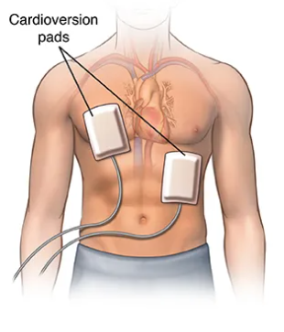
Electrical Cardioversion
Electrical cardioversion involves placing pads on the patient and delivering a specified number of joules through the heart
An initial energy of 200 J or greater is recommended for electrical cardioversion when using a biphasic defibrillator
Miller. Alex's Asteroid Astrology. 2020.
Guideline for the Diagnosis and Management of AFib. ACC/AHA/ACCP/HRS. 2023.
Notes:
Electrical cardioversion involves placing pads on the patient and delivering a specified number of joules of energy through the heart. Pads are commonly placed in the anterior-lateral position with one pad on the right side of the chest adjacent to the sternum and the other pad placed laterally below the pectoral muscle as seen on the image on the slide. Another common placement option is to place the pads in an anterior-posterior position. It is recommended to defer to manufacturer specific energy requirements for cardioversions. If specific energy requirements are unknown it is recommended to use the maximum energy available, this is commonly 200 J with Biphasic defibrillators. Biphasic defibrillators are more common than monophasic in clinical practice. Biphasic defibrillators send the electrical wave in both directions while monophasic only sends the wave from one pad to another. Different Advocate health sites may have different defibrillators. Always differ to manufacturer specific energy recommendations.
Joglar, J. A., Chung, M. K., Armbruster, A. Et At. (2023). 2023 ACC/AHA/ACCP/HRS guideline for the diagnosis and management of atrial fibrillation: A report of the American College of Cardiology/American Heart Association Joint Committee on clinical practice guidelines. Circulation, 149(1). https://doi.org/10.1161/CIR.0000000000001193
Miller, A. (2020, September 8). HHW cardioversion - Alex’s Asteroid Astrology. Alex’s Asteroid Astrology. https://alexasteroidastrology.com/astrology-of-cardioversion-and-basement-flood/front-view-of-male-figure-a-with-cardioversion-pads-diagram-of-electrocardiography-graphs-showing-an-irregular-heart-rhythm-and-a-regular-heart-rhythm/
If used, picture citations:
cardioversion - Search Images
Pads - HHW cardioversion – Alex's Asteroid Astrology | Alex's Asteroid Astrology
The 2025 American Heart Association Adult Advanced Life Support guidelines recommend 200 J initial energy selection for cardioversion of AF based upon results of randomized trials demonstrating >90 percent cumulative cardioversion success with 200 J with biphasic defibrillators and lower risk of provoking ventricular fibrillation with cardioversion using ≥200 J than with low-energy monophasic shocks
Wigginton, J. G., Agarwal, S., Bartos, J. A., Coute, R. A., Drennan, I. R., Haamid, A., Kudenchuk, P. J., Link, M. S., Panchal, A. R., Pelter, M. M., Del Rios, M., Rodriguez, A. J., Perman, S. M., Sanko, S., Kotini-Shah, P., & Kurz, M. C. (2025). Part 9: Adult Advanced Life Support: 2025 American Heart Association Guidelines for Cardiopulmonary Resuscitation and Emergency Cardiovascular Care. Circulation, 152(16_suppl_2), S538–S577. https://doi-org.ezproxy.library.wisc.edu/10.1161/CIR.0000000000001376

Slide 10
Indications for Cardioversion
Arrythmias with cardioversions as a treatment option:
  Atrial fibrillation
  Atrial flutter
  Supraventricular tachycardia
  Ventricular tachycardia
  Ventricular fibrillation
Commonly used in tachycardia with HR greater than 150 bpm
Cardioversion and defibrillation for specific arrhythmias. UpToDate. 2025
Notes:
The most common arrythmia treated with cardioversion is Afib, but is also used for Atrial flutter, supraventricular tachycardia, ventricular tachycardia, and ventricular fibrillation. It is an option to be used in tachyarrhythmias with a HR greater than 150 bpm.
Cardioversion and defibrillation for specific arrhythmias.UpToDate. (2025). Uptodate.com. https://www.uptodate.com/contents/cardioversion-and-defibrillation-for-specific-arrhythmias

Slide 11
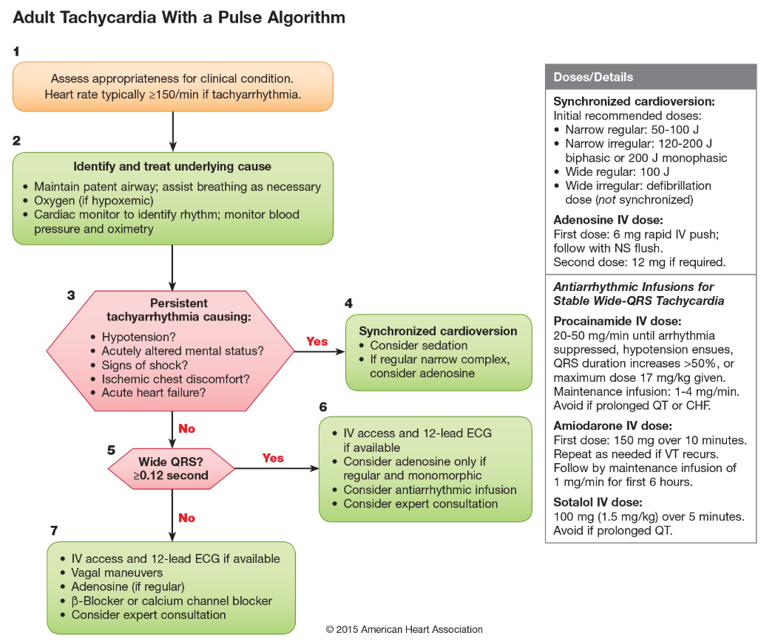
Indications for Cardioversion
Hemodynamic Instability
Algorithms. American Heart Association. 2025
Notes:
So, according to our tachyarrhythmia with a pulse ACLS algorithm as you can see on the slide , if we cannot treat the underlying cause we will need to assess the need for synchronized cardioversion.
American Heart Association. (2025). Algorithms. Cpr.heart.org. https://cpr.heart.org/en/resuscitation-science/cpr-and-ecc-guidelines/algorithms

Slide 12
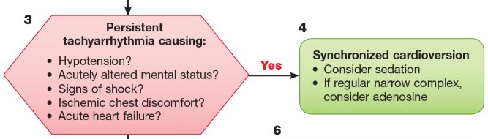
Indications for Cardioversion
Hemodynamic Instability
Algorithms. American Heart Association. 2025
Notes:
So, for Patient's with hemodynamic instability will be the patients in which we will perform a cardioversion in. Patients with hypotension, Patients with acutely altered mental status, Patient's with signs of shock, patients with ischemic chest discomfort including chest pain with palpatations, and those in acute heart failure are the patients in which we would perform these cardioversion in.

Slide 13
Prevalence of Atrial Fibrillation
In the United States, it’s estimated that roughly 3-6 million people have afib
Roughly one third of patients with afib are asymptomatic
Numbers are projected to reach 6-16 million by 2050
Prevalence increases with ages greater than 65
Kornej, J Et. Al. Epidemiology of AFib. 2020
Notes:
atrial fibrillation is one of the most common arrhythmias treated with synchronized cardioversions. In the united states it's estimated that roughly 3-6 million people have atrial fibrillation. It is estimated that one third of patients with atrial fibrillation are asymptomatic so the true number of people with atrial fibrillation is likely much higher than the reported 3-6 million estimation. Numbers are projected to reach 6 to 16 million people by 2050. The prevalence of Afib also increases with age. It is estimated that the percentage of the population of those 65 and older with Afib will increase from 12% in 2010 to 22% in 2040.
Kornej, J., Börschel, C. S., Benjamin, E. J., & Schnabel, R. B. (2020). Epidemiology of Atrial Fibrillation in the 21st Century: Novel Methods and New Insights. Circulation research, 127(1), 4–20. https://doi.org/10.1161/CIRCRESAHA.120.316340
Cardioversion in Non-Valvular Atrial Fibrillation – PMC - Electrical cardioversion results in sinus rhythm in more than 85% of patients

Slide 14
Atrial Fibrillation
Electrical cardioversion can also be used in hemodynamically stable patients
  Initial rhythm control strategy
  Unsuccessful pharmacological cardioversion
In recent onset afib, there is a greater than 85% conversion rate with electrical cardioversion
Pharmacological cardioversion has a 70% success rate
Guideline for the Diagnosis and Management of AFib. ACC/AHA/ACCP/HRS. 2023.
Klein. Cardioversion in Non-valvular Afib. 2015.
Notes:
Electrical cardioversions can be used in hemodynamically unstable patients as we had discussed on a previous slide. Afib guidelines also recommend the use of electrical cardioversion in hemodynamically stable patients, It can be used as an initial rhythm strategy or after the use of pharmacological agents fail to convert the patient. In recent onset Afib there is an 85% conversion rate with electrical cardioversion while a pharmacological conversion has a 70% success rate.
Joglar, J. A., Chung, M. K., Armbruster, A. Et At. (2023). 2023 ACC/AHA/ACCP/HRS guideline for the diagnosis and management of atrial fibrillation: A report of the American College of Cardiology/American Heart Association Joint Committee on clinical practice guidelines. Circulation, 149(1). https://doi.org/10.1161/CIR.0000000000001193
Klein, H. H., & Trappe, H. J. (2015). Cardioversion in Non-Valvular Atrial Fibrillation. Deutsches Arzteblatt international, 112(50), 856–862. https://doi.org/10.3238/arztebl.2015.0856
Cardioversion in Non-Valvular Atrial Fibrillation – PMC - Electrical cardioversion results in sinus rhythm in more than 85% of patients

Slide 15
Cardioversion Complications
ST segment and T wave changes
Arrhythmia and conduction abnormalities
Myocardial dysfunction
Pulmonary edema
Necrosis
Cutaneous burns
Stroke
Cardioversion and defibrillation for specific arrhythmias. UpToDate. 2025​
Notes:
Although, good success rates, cardioversions does have some complications. Transient changes in the electrocardiogram are common after a cardioversion. These include changes in the ST segment and T wave. They usually last less then 5 minutes. Cardioversions also run the risk of converting from one arrhythmia into another. When converting from an atrial arrhythmia there was found to be 30 percent risk of developing a supraventricular tachycardia. Most commonly sinus tachycardia. Cardioversions can carry the risk of myocardial dysfunction or "stunning" to the the atria or ventricles. This can lead to pulmonary edema. High energy shocks can cause myocardial necrosis which may reflect with small increases in CK and troponin levels. Cutaneous burns are common with improper placement of the electrodes on the body. There is an increased risk of ischemic Stroke when cardioverting a patient with atrial fibrillation.
Cardioversion and defibrillation for specific arrhythmias - UpToDate
LEMBERG, L., CASTELLANOS, A., Jr, SWENSON, J., & GOSSELIN, A. (1964). ARRHYTHMIAS RELATED TO CARDIOVERSION. Circulation, 30, 163–170. https://doi-org.ezproxy.library.wisc.edu/10.1161/01.cir.30.2.163

Slide 16
Atrial Fibrillation Thromboembolism
Anticoagulation is needed prior to cardioversion if:
  Onset of afib is greater than 48 hours
    Anticoagulation is recommended for 3 weeks before and 4 weeks after cardioversion
No anticoagulation is needed prior to cardioversion if:
  Transesophageal echocardiogram is used to rule out thrombus
  Onset of afib is less than 48 hours
Guideline for the Diagnosis and Management of AFib. ACC/AHA/ACCP/HRS. 2023.
Notes:
Cardioverting a patient with atrial fibrillation has an increased risk of causing a thromboembolism to move through the body. This includes the thromboembolism to travel to the brain which is how we get our complication of stroke with cardioversions as discussed briefly on the previous slide . We want to confirm or remove any clots from the body specifically the heart in patients with Afib before cardioverting. Recommendations for therapeutic anticoagulation include Afib with onset greater than 48 hours to be anticoagulated for 3 weeks before and 4 weeks after cardioversion. A transesophageal echocardiogram or TEE can be used to rule out any thrombus formation, the patient should be sedated for this and it is common to cardiovert quickly after the completion of the TEE. This is sometimes referred to as a TEE guided cardioversion. If the onset of Afib is less than 48 hours no anticoagulation is needed prior to cardioversion.
Joglar, J. A., Chung, M. K., Armbruster, A. Et At. (2023). 2023 ACC/AHA/ACCP/HRS guideline for the diagnosis and management of atrial fibrillation: A report of the American College of Cardiology/American Heart Association Joint Committee on clinical practice guidelines. Circulation, 149(1). https://doi.org/10.1161/CIR.0000000000001193

Slide 17
Clinical Guidelines
2024 American College of Emergency Physicians (ACEP) Guidelines for Unscheduled Procedural Sedation
2018 American Society of Anesthesiologists (ASA) Practice Guidelines for Moderate Procedural Sedation and Analgesia
2023 American Heart Association (AHA) Guideline for the Diagnosis and Management of Arial Fibrillation
Clinical guidelines offer very limited recommendations on which agents to use for procedural sedation during cardioversion. While they acknowledge that sedation is warranted, they do not provide specific guidance on agent selection.
Notes:
Clinical guidelines for procedural sedation include the 2024 American College of emergency physicians or ACEP guidelines for unscheduled procedural sedation, the 2018 American society of anesthesiology or ASA guidelines for moderate procedural sedation and analgesia, and the 2023 American heart association or AHA guideline for the diagnosis and management of Atrial Fibrillation. Clinical guidelines offer very limited recommendations on which agents to use for procedural sedation during cardioversion. While they acknowledge that sedation is warranted, they do not provide specific guidance on agent selection. It is recommended to individualize a patient's sedation regimen.
Anesthesiology - ASA
unscheduled-procedural-sedation---a-multidisciplinary-consensus-practice-guideline.pdf - 2024 ACEP statement
Unscheduled Procedural Sedation: A Multidisciplinary Consensus Practice Guideline - 2019 ACEP statement
2023 ACC/AHA/ACCP/HRS Guideline for the Diagnosis and Management of Atrial Fibrillation: A Report of the American College of Cardiology/American Heart Association Joint Committee on Clinical Practice Guidelines - AHA guidelines specifically for electrical cardioversion

Slide 18
Procedural Sedation
“the use of anxiolytic, sedative, hypnotic, analgesic, and/or dissociative medication(s) to attenuate anxiety, pain, and/or motion. These agents are administered in order to facilitate amnesia or decreased awareness and/or patient comfort and safety during a diagnostic or therapeutic procedure.”
General goals of sedation:
  Reduce pain perception
  Decrease anxiety
  Maximizing amnesia
  Protect the patient from injuring themselves
Green. Unscheduled Procedural Sedation. 2024.
Procedural Sedation in Adults in the emergency department. UpToDate. 2025.
Notes:
What is procedural sedation? The definition of procedural sedation according to the 2024 ACEP guidelines are the use of anxiolytic, sedative, hypnotic, analgesic, and/or dissociative medication(s) to attenuate anxiety, pain, and/or motion. These agents are administered in order to facilitate amnesia or decreased awareness and/or patient comfort and safety during a diagnostic or therapeutic procedure.” So our General goals of Sedation include reducing pain perception, Decreasing anxiety, maximizing amnesia, and protecting the patient from injuring themselves.
Green, S. M., Roback, M. G., Krauss, B. S., Miner, J. R., Schneider, S., Kivela, P. D., Nelson, L. S., Chumpitazi, C. E., Fisher, J. D., Gesek, D., Jackson, B., Kamat, P., Kowalenko, T., Lewis, B., Papo, M., Phillips, D., Ruff, S., Runde, D., Tobin, T., Vafaie, N., … O'Connor, R. E. (2019). Unscheduled Procedural Sedation: A Multidisciplinary Consensus Practice Guideline. Annals of emergency medicine, 73(5), e51–e65. https://doi.org/10.1016/j.annemergmed.2019.02.022

Slide 19
Sedation Complications
Respiratory distress
Cardiovascular side effects
Aspiration
Nausea and vomiting
Procedural Sedation in Adults in the emergency department. UpToDate. 2025.
Notes:
Procedural Sedation is beneficial to prevent a traumatic experience for patients, but it is not without complications. Respiratory distress can occur when over sedation occurs. Some of our preferred sedation medications can cause cardiovascular side effects such as hypotension. Aspiration can occur when we sedate a patient. Generally it is preferred for patient's to be taking no food prior to the procedure when possible. It is not recommended to delay a cardioversion for this reason. Nausea and vomiting can occur after the patient comes off of sedation. Patients may require the use of antiemetics.
Procedural sedation in adults in the emergency department: General considerations, preparation, monitoring, and mitigating complications. 2025. UpToDate. Procedural sedation in adults in the emergency department: General considerations, preparation, monitoring, and mitigating complications - UpToDate

Slide 20

Introduction to Patient Case
A.J., a 45-year-old female patient, presents to the emergency department with new onset afib with RVR on EKG. She has been experiencing some dizziness, along with SOB and both chest pain and palpations for approximately half the day (~12 hours), which she believes seems to be worsening with time.
Vitals in the ED:
BP: 118/85 mmHg
HR: 185 beats per minute
SpO₂: 92%
RR: 22 breaths per minute
Notes:
Cardioversion Indications:
She is in a tachyarrhythmia,
Less than 48 hours
Hemodynamically unstable (borderline hypotension, tachycardic, worsening symptoms (SOB, chest pain, chest palps, hypoxic, tachypneic)
Burns, E., & Buttner, R. (2024, August 1). Atrialfibrillation. Life in the Fast Lane.https://litfl.com/atrial-fibrillation-ecg-library/
Image link: https://jnj-content-lab2.brightspotcdn.com/dims4/default/a93b48d/2147483647/strip/true/crop/1441x1080+246+0/resize/1005x753!/quality/90/?url=https:%2F%2Fjnj-production-jnj.s3.us-east-1.amazonaws.com%2Fbrightspot%2F64%2Fae%2F43202f8c45b08770f7baec2681b1%2F1123-afib-ekg.png

Slide 21
Assessment Question #1
AJ is symptomatic due to her new onset afib and may need a cardioversion. As a healthcare team we have the choice between electrical or pharmacological conversion. Which of the following patient characteristics would help us decide we need to perform a synchronized electrical cardioversion?
Age of 45 years old
Heart rate of 185 beats per minute
Chest pain with palpitations
Blood pressure 118/85 mmHg
Notes:
The correct answer is C chest pain with palpitation. A would be incorrect because age does not guide our decisions for cardioversion when deciding between electrical or pharmacological. B would be an indication for cardioversion as our patient has Afib with rapid ventricular response.

Slide 22
Interprofessional
Roles & Responsibilities
Objective: Recognize interprofessional roles involved in procedural sedation for cardioversion
Required Personnel
Supporting Personnel
Role of Pharmacist
Cardioversion Workflow
Notes:
Procedural Sedation Documentation Downtime Chart Form (IL & WI Divisions) v.1
Procedural Sedation Documentation Downtime Chart Form (IL & WI Divisions) v.1

Slide 23
Required Personnel for Procedural Sedation
Per the 2024 ACEP Guidelines on unscheduled procedural sedation
Minimum Requirements for Healthcare Personnel
  Two trained licensed health care practitioners are required to be at bedside
    Sedation provider
    Sedation monitor
  Requires proficiency in patient monitoring, cognitive and rescue skills
Unscheduled Procedural Sedation: A Multidisciplinary Consensus Practice Guideline​
American College of Emergency Physicians. 2024

Slide 24
Advocate Health Sedation Policy by Region: Authorized Personnel for Sedation
Advocate Health Midwest- Wisconsin | Advocate Health Midwest- Illinois | Advocate Health- Southeast
Anesthesia Credentialed Physicians/APPs | Credentialed Physicians/APPs | Non-emergency room setting Physician or dentist Emergency room setting Emergency Medicine Physicians and credentialed APPs
Advocate Health Care. Procedural Sedation Policy– Wisconsin Division. 2024
Advocate Health Care. Procedural Sedation: Adult, Pediatric, Neonatal Policy – Illinois Division. 2025
Atrium Health Care. Policy and clinical practice guidelines for procedural sedation in adult and pediatric patients. 2022
Advocate Health Care. Moderate and deep sedation in adult and pediatric patients for emergency physicians and pediatric emergency physicians in emergency departments- Greater Charlotte Market. 2025
Notes:
(non-anesthesiologists) approved by Anesthesia Services & Medical Executive Committe
"practitioners intending to produce a given level of sedation should be able to rescue patients whose level of sedation becomes deeper than initially intended." -Illinois policy

Slide 25
Roles and Responsibilities of Personnel During Moderate Sedation
Advocate Health Midwest- Wisconsin and Illinois Procedural Sedation Policies | Advocate Health Southeast- ED Sedation Policy | Advocate Health Southeast- Procedural Sedation Policy
Physician Pre-procedural Assessment ASA physical status classification Airway evaluation Plan for sedation History of anesthesia/sedation issue Registered Nurse Past Medical History Physical Assessment | Emergency Medicine Practitioner Directs and is responsible for Pre-, Intra-, and Post-Anesthetic patient care during procedural sedation. may not simultaneously serve as the person monitoring the patient Registered Nurse Medication administration Assess patient response to sedation Complete procedural (pre, intra, and post) documentation Remain with patient until patient returns to baseline Respiratory Therapy (RT) or ED Paramedic Monitor airway Assist with management of airway under direction of practitioner | Practitioner Directs and is responsible for Pre-, Intra-, and Post-Anesthetic patient care during procedural sedation. may not simultaneously serve as the person monitoring the patient. Rescue patient whose level of sedation becomes deeper than initially intended Monitor SaO2 (SpO2 via pulse oximetry), BP, HR & rhythm, RR, and (LOC) continuously throughout the case with documentation at a minimum of every five (5) minutes
Advocate Health Care. Procedural Sedation Policy– Wisconsin Division. 2024​
Advocate Health Care. Procedural Sedation: Adult, Pediatric, Neonatal Policy – Illinois Division. 2025​
Atrium Health Care. Policy and clinical practice guidelines for procedural sedation in adult and pediatric patients. 2022​
Advocate Health Care. Moderate and deep sedation in adult and pediatric patients for emergency physicians and pediatric emergency physicians in emergency departments- Greater Charlotte Market. 2025

Slide 26
Supporting Personnel for Procedural Sedation
Team Member | Role
Nurse | Procedural preparation, medication administration, patient monitoring, establish IV access
Pharmacist | Appropriate medication selection, dosing, preparing medications, medication administration if certified
Respiratory Therapist | Airway management, oxygen delivery, ventilation support, monitoring, respiratory equipment
Guideline for the Diagnosis and Management of AFib. ACC/AHA/ACCP/HRS. 2023
Notes:
2023 ACC/AHA/ACCP/HRS Guideline for the Diagnosis and Management of Atrial Fibrillation: A Report of the American College of Cardiology/American Heart Association Joint Committee on Clinical Practice Guidelines
Patanwala AE, Thomas MC, Casanova TJ, Thomas R. Pharmacists' role in procedural sedation and analgesia in the emergency department. Am J Health Syst Pharm. 2012;69(15):1336-1342. doi:10.2146/ajhp110707
https://centralgaheart.com/wp-content/uploads/2018/03/Blausen_0169_Cardioversion.png

Slide 27
Workflow of a Cardioversion
Determine indication and plan of care
Informed consent
Pre-procedure assessment
  Anticoagulation status
  Electrolytes
  EKG
Prepare equipment
Provide medications
Charge device and deliver shock
Patient monitoring
Guideline for the Diagnosis and Management of AFib. ACC/AHA/ACCP/HRS. 2023​
Notes:
Sources:
2023 ACC/AHA/ACCP/HRS Guideline for the Diagnosis and Management of Atrial Fibrillation: A Report of the American College of Cardiology/American Heart Association Joint Committee on Clinical Practice Guidelines
Unscheduled Procedural Sedation: A Multidisciplinary Consensus Practice Guideline

Slide 28
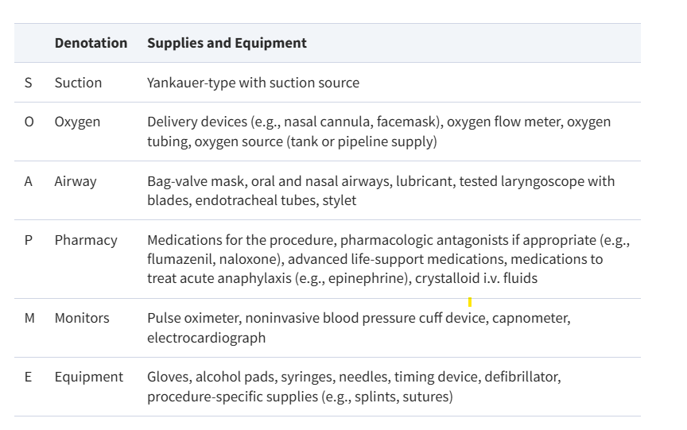
Workflow of a Cardioversion- SOAP ME
Pharmacists' role in procedural sedation and analgesia in the emergency department Am J Health Syst Pharm. 2012​

Slide 29
Role of a Pharmacist
Agent selection
Discuss pharmacologic plan
Obtain medication, syringes, needles, alcohol swabs, vials, antidotes
Provide Medications
  May administer medications per 2015 Wisconsin Act 290
  Check state regulations or site specific policy
Patient monitoring
Pharmacists' role in procedural sedation and analgesia in the emergency department Am J Health Syst Pharm. 2012

Slide 30
Assessment Question #2
During procedural sedation for electrical cardioversion, which of the following is true per the 2024 ACEP Guidelines on unscheduled procedural sedation?
Only one trained licensed health care practitioners is required to be at bedside
A pharmacist must lead the cardioversion
A minimum of two trained licensed health care practitioners are required to be at bedside, one as the sedation provider and one as the sedation monitor
Per the guidelines, an anesthesiologist must be present when performing sedation for a cardioversion in the emergency department.
Notes:
Leigh Anne 12 minutes and 49 seconds
Total 22:12

Slide 31
Pharmacotherapy
Objective: Assess specific factors to determine the most appropriate sedative agent for cardioversion
Types of Sedation
Medication Profiles
Patient-Population Specific Considerations
Notes:
Hello everyone I am Lexi Thompson and next, I will transition us into the pharmacotherapy section of the presentation which will cover our third objective which is to assess specific factors to determine the most appropriate sedative agent for cardioversion.
In this portion, I'll first review the different types of procedural sedation and then discuss 3 agents commonly used. After introducing each medication, I will discuss some specific considerations to help mitigate risks and improve medication selection

Slide 32
Types of Sedation
Sedation Type | Definition & Responsiveness | Amnesia | Cardiac Function | Airway | Spontaneous Ventilation
Minimal | Drug-induced state with normal response to verbal commands | No | Unaffected | Unaffected / Maintained | Unaffected / Maintained
Moderate | Drug-induced depression of consciousness with response to verbal commands or tactile stimulation | Frequently | Usually Maintained | Adequate | Adequate
Deep | Drug-induced depression of consciousness that cannot be easily aroused with stimuli | Profound | Usually Maintained | Intervention may be required | Likely inadequate
General Anesthesia | Drug-induced depression of consciousness, unarousable | Profound | Potentially impaired | Intervention often required | Often inadequate
Dissociative | Trance-like cataleptic state | Profound | Retention | Retention | Retention
Green S et al. Ann Emerg Med. 2019
Godwin S et al. Ann Emerg Med. 2014
Notes:
So, sedation is defined to be a drug induced state that allows the patient to undergo unpleasant medical procedures, like cardioversion.
Sedation is a continuum, and there are five types that one can achieve: minimal, moderate, deep, general anesthesia and dissociative. As you can see, each level of sedation is characterized by its impact on patient responsiveness, airway control, spontaneous ventilation, and cardiac function. Sedation carries a higher risk and has strict administration and monitoring policies because you can essentially achieve any of these states, besides dissociative, very quickly by adjusting the dose and/or frequency of administration. So, as you can see the deeper one becomes sedated, the more amnesia is achieved and the greater the risk for complications that may require intervention and vice versa.
Citations:
Unscheduled Procedural Sedation: A Multidisciplinary Consensus Practice Guideline – ClinicalKey
Clinical Policy: Procedural Sedation and Analgesia in the Emergency Department – ClinicalKey

Slide 33

Types of Sedation
Sedation Type | Definition & Responsiveness | Amnesia | Cardiac Function | Airway | Spontaneous Ventilation
Minimal | Drug-induced state with normal response to verbal commands | No | Unaffected | Unaffected / Maintained | Unaffected / Maintained
Moderate | Drug-induced depression of consciousness with response to verbal commands or tactile stimulation | Frequently | Usually Maintained | Adequate | Adequate
Deep | Drug-induced depression of consciousness that cannot be easily aroused with stimuli | Profound | Usually Maintained | Intervention may be required | Likely inadequate
General Anesthesia | Drug-induced depression of consciousness, unarousable | Profound | Potentially impaired | Intervention often required | Often inadequate
Dissociative | Trance-like cataleptic state | Profound | Retention | Retention | Retention
= our focus
= procedural sedation
Green S et al. Ann Emerg Med. 2019
Godwin S et al. Ann Emerg Med. 2014
Notes:
For unscheduled procedural sedation which is most common for procedures like cardio version, minimal, moderate and dissociative are preferred which I why I have them starred on the slide.
When performing cardioversion, the goal is typically to achieve moderate sedation, which I’ve highlighted in blue. This level provides a short-term drug-induced state with amnesia and reduced responsiveness, helping the patient remain still and also unaware of the procedure. At the same time, it also maintains stable cardiac function, airway control, and ventilation—all things that allow clinicians to efficiently restore normal sinus rhythm.
Minimal sedation wouldn't be ideal for cardioversion because the patient would remain fully responsive and recall the entire procedure and dissociative which is achieved with ketamine is normally reserved for pediatric cases, although it can be used in adults if needed just isn't as common.
Citations:
Unscheduled Procedural Sedation: A Multidisciplinary Consensus Practice Guideline – ClinicalKey
Clinical Policy: Procedural Sedation and Analgesia in the Emergency Department – ClinicalKey

Slide 34
Sedative Agents
Propofol
Etomidate
Methohexital
Notes:
Therefore, this presentation will focus on three agents: propofol, etomidate, and methohexital.
While moderate sedation is generally the goal for cardioversion, it’s essential to verify with your site or regional policies for precise definitions and specific requirements for procedural or non-procedural sedation as there may be some differences from site to site.

Slide 35
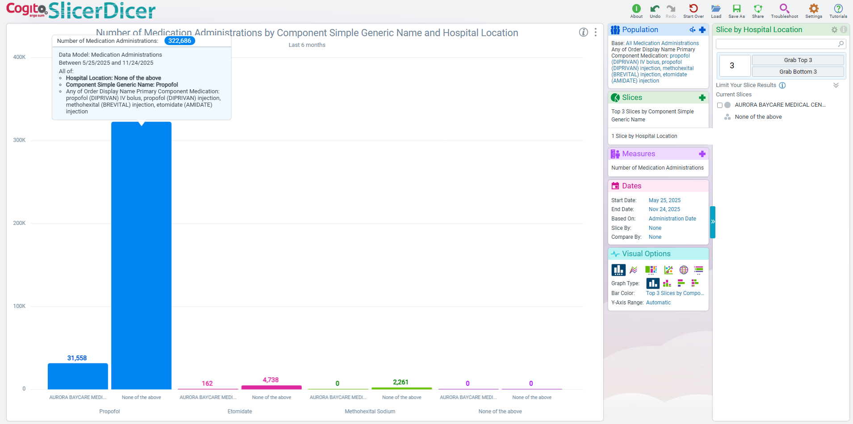
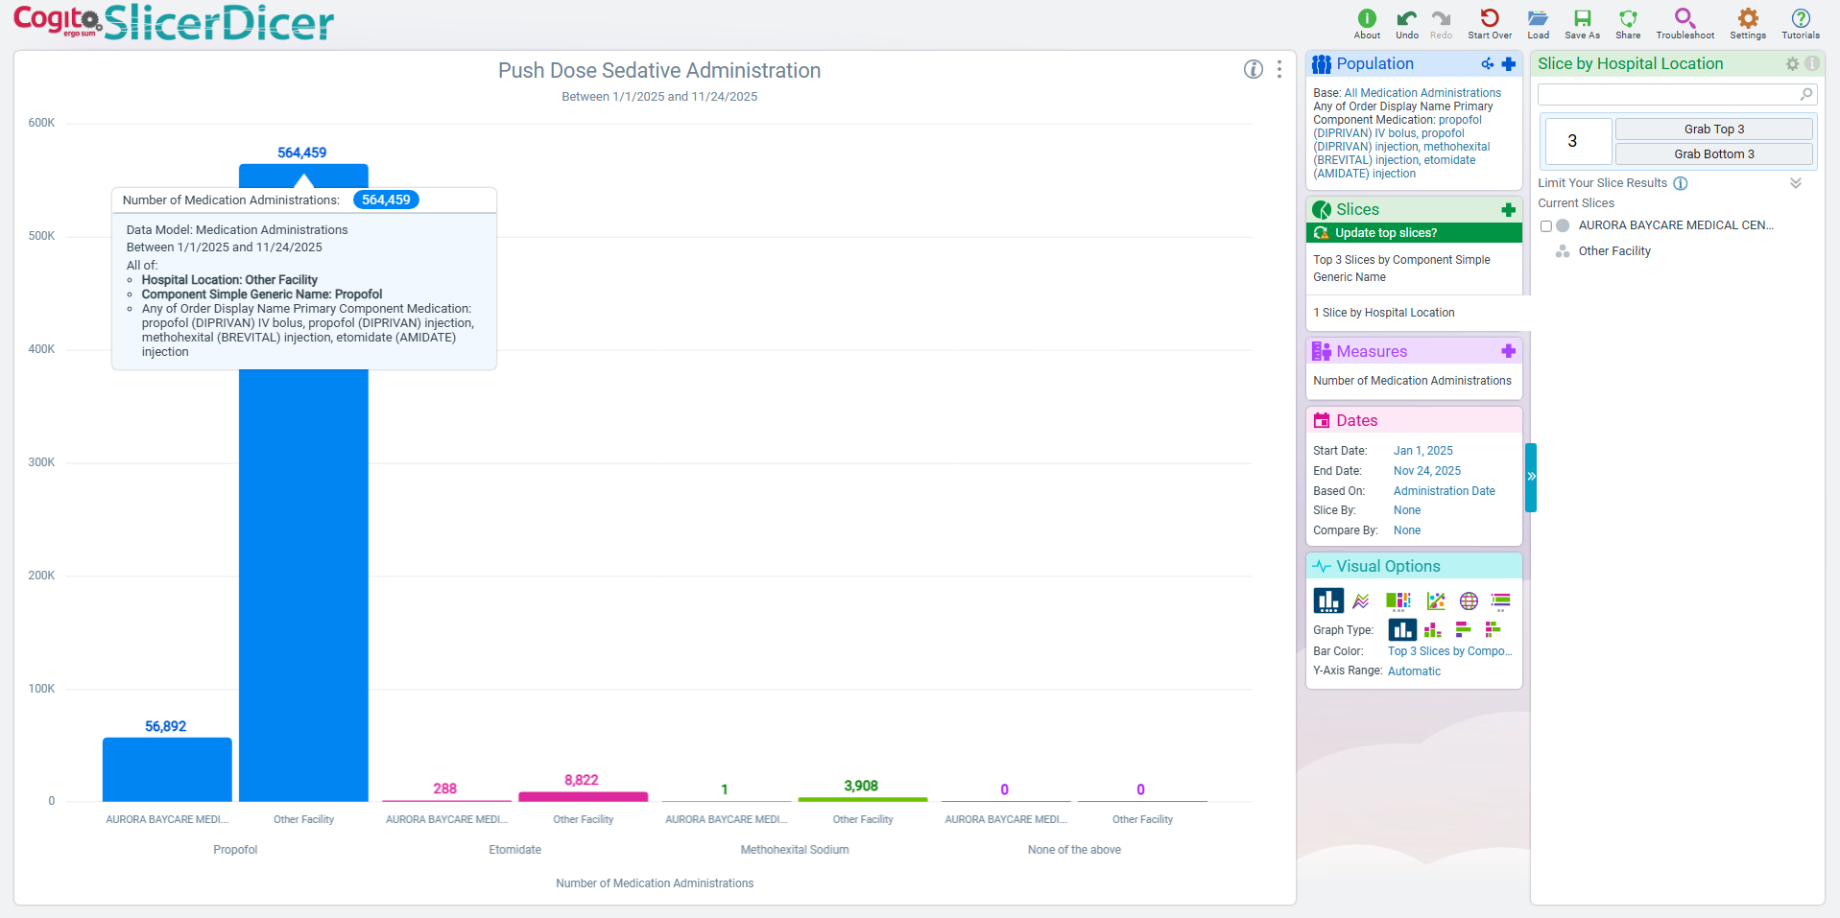
General Prevalence of Sedation Use
Insight on the average amount of IV bolus administrations of Propofol, Etomidate, and Methohexital amongst Advocate Health Midwest hospitals from May 2025 to November 2025
Propofol | Etomidate | Methohexital
~320,000 | ~4,700 | ~2,200
*Southeast region data is not accessible to Midwest residents
Notes:
Before introducing each medication, I wanted to give some insight on prevelance of these agents across Advocate Midwest from May to November 2025. Of note, this is showing overall sedation with IV bolus administrations and is not specifically just for cardioversion.
But according to Slicer Dicer, propofol is by far the most commonly used agent for sedation—approximately 70 times more common than etomidate and 145 times more common than methohexital. Just wanted to emphasize that when in comparison, propofol and etomidate are the primarily agents used for sedation while methohexital use is quite low and more rare.

Slide 36
Propofol
Sedative hypnotic with general anesthetic properties
Mechanism of Action:
  Agonism of GABA_{A} receptors
  Inhibition of NMDA receptors
Procedural Sedation Dose:
  Adults: 1 to 2 mg/kg IV bolus
Propofol. Medication Guide. FDA. 2022.
Notes:
The first agent I will discuss is propofol, a sedative-hypnotic with general anesthetic properties.
Propofol produces its sedative effects by activating GABA-A receptors, which reduces receptor dissociation and prolongs the opening of GABA-mediated chloride channels. It also inhibits NMDA receptors, which both then collectively enhance inhibitory neurotransmission and suppress excitatory signaling.
For dosing, it is weight-based, typically 1 to 2 mg/kg administered as an IV bolus in adults.
Citations:
Propofol. Medication Guide. 2022. https://www.accessdata.fda.gov/

Slide 37


Propofol
Pharmacokinetics
Adverse Effects
  Highly lipophilic
  Rapid onset: ~30 seconds
  Duration: 3 to 10 minutes
  Biphasic half-life
  Hypotension
  Hypersensitivity
  Respiratory depression
Analgesia | Amnesia | Sedation
Propofol. Medication Guide. FDA. 2022
Notes:
From a pharmacokinetic standpoint, because cardioversions are brief procedures, agents with a rapid onset and short duration of action are preferred.
Propofol meets this criteria as it is highly lipophilic, allowing it to rapidly cross the blood–brain barrier and produce its effect within 30 seconds. It also has a short duration of typically 3 to 10 minutes. Propofol is interesting in the fact that it has a biphasic half-life, so more than half of its rapid decline is attributed to redistribution from the brain to periphery rather than elimination. However, after an IV bolus, tissue and plasma concentrations reach equilibrium quickly, preventing any prolonged or unwanted effects.
And then for adverse effects – propofol can cause, hypotension, some hypersensitivities that I will explain further in upcoming slides, and respiratory depression, and even hypertriglyceridemia because it is a 10% lipid emulsion so always something to consider especially when needing prolonged or deeper sedation.

Slide 38
Patient-Population Specific Considerations
FOR PROPOFOL
Notes:
Now that we have reviewed propofol’s drug profile, I want to educate on some key considerations when using the drug. I think identifying specific factors that influence a drug’s effectiveness is crucial for minimizing risk and ensuring safe medication use.

Slide 39
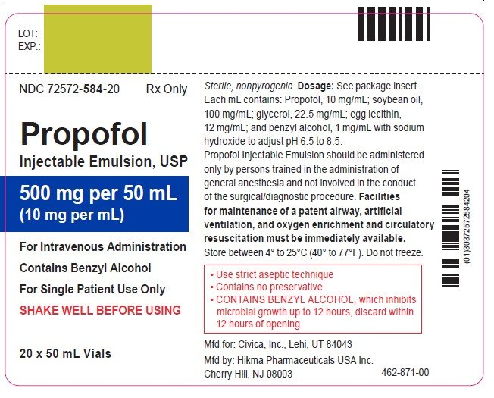
Patient Specific Consideration
Hypersensitivity
The manufacturer lists known hypersensitivity to propofol, egg, or soybean as a contraindication for use
Literature suggests that patients with egg/soybean allergy does not significantly increase the relative risk of allergic reactions with propofol use
Per AAAAI guidelines, patients with a soy or egg allergy can receive propofol without any special precautions
Propofol: Package Insert / Prescribing Info. Drugs.com. 2024
Iwakiri M et al., PubMed. 2023
Soybean and Egg Allergy. AAAAI. 2022
Asserhoj L et al., British Journal of Anaesthesia. 2016
Notes:
The first consideration is patient-specific and refers to the hypersensitivity adverse reaction I mentioned earlier.
Propofol formulations include soybean oil and egg phospholipids as you can see highlighted in the picture on the right. For this reason, the manufacturer does list an egg or soybean allergy as a contraindication. However, most evidence shows that there is no direct link between these food allergies and propofol and that people with these allergies do not have an increased risk of an allergic reaction to propofol. Normally, food allergies are typically reactions to the proteins of the components rather than the oils and fats so not as of a concern in this case.
Therefore, with this evidence, the American Academy of Allergy, Asthma & Immunology even came out with a statement that says patients with egg or soy allergies do not need any special precautions and can safely receive propofol.
Cites Used:
Allergic reactions to propofol in adult patients with egg or soybean allergy: a retrospective cohort study from a large database of a single institute – PMC
Soy-allergic and Egg-allergic can Receive Anesthesia | AAAAI
No evidence for contraindications to the use of propofol in adults allergic to egg, soy or peanut - ScienceDirect

Slide 40
Patient Specific Consideration
Hypotension
Propofol may cause severe hypotension, to the effect of ≥30% decrease in MAP
Pathophysiology is not completely understood
May involve several mechanisms
  ↓ preload, afterload, and contractility
  ↑ peripheral vasodilation
  Inhibition of sympathetic nervous system outflow & impairing baroreflex regulatory mechanisms
Mitigate with the use of push dose vasopressors
  Phenylephrine 100mcg
  Epinephrine 5-20mcg
Nam E et al., Clinical Key. 2022 Tobias J et al., SJA. 2011
Singer S et al., Clinical Key. 2022
Ebert T et al., Anesthesiology. 1992
Notes:
The second consideration focuses on blood pressure. Propofol induced hypotension can be severe, to the effect of a decreasing mean arterial pressure by 30% or more, especially with bolus dosing.
The exact pathophysiology behind this is not fully understood, but evidence suggests multiple contributing mechanisms, including reductions in preload, afterload, and myocardial contractility. More recent literature tho indicates that the primary driver is propofols ability to inhibit sympathetic outflow and impair the body's baroreflex.
In simpler terms, the baroreflex acts as a negative feedback loop in the body by using arterial baroreceptors that continuously monitor blood pressure and signal the autonomic nervous system to adjust accordingly. So, when MAP drops, these receptors normally trigger increased sympathetic signaling to the periphery to cause vasoconstriction and increase cardiac output to restore normal pressure.
So propofol has been shown to significantly impair this compensatory mechanism and therefore, is something to consider in patients who are already hypotensive, or those who are hypovolemic, septic or in shock.
Some ways to mitigate this is the use of push dose vasopressors – commonly seen with phenylephrine or epinephrine. So these are just IV bolus doses to agonize alpha and or both alpha and beta to mitigate hypotension. Both medications have proven efficacy and safety in the literature for this use.
Cites Used:
Comparison of push-dose phenylephrine and epinephrine in the emergency department - ScienceDirect
The safety and efficacy of push dose vasopressors in critically ill adults - ClinicalKey
Sympathetic responses to induction of anesthesia in humans with propofol or etomidate - PubMed
Procedural sedation: A review of sedative agents, monitoring, and management of complications - PMC
My other notes:
Phenylephrine pre-filled syringes 100mcg/ml (10ml), and epinephrine 10mcg/mg (10ml)
Hemodynamic stability depends not only on the basal autonomic tone but also on baroreceptor-mediated regulation of autonomic outflow, which influences cardiac function and vascular resistance.

Slide 41
Population Specific Consideration
Chronic Alcoholism
Chronic alcohol users may require larger doses of propofol to induce sedation
Hypothesized Pathophysiology
  Cross Tolerance
    Constant ↑ inhibitory effects on neurons lead to neuroadaptation and tolerance to other GABAergic drugs
  Changes in Liver Solubility
    Alcohol can alter lipid metabolism and fatty infiltration
Long-Term Alcohol Use. Connecticut Anesthesia Assoc. 2024 Servin F et al., Anesthesiology. 2003
Fassoulaki, A et al., Anesthesia & Analgesia. 1993
Fassoulaki, A et al. British Journal of Anaesthesia. 1986
Notes:
Another important consideration is for patients with chronic alcohol use. These individuals often need higher doses of propofol to achieve adequate sedation due to two main factors: cross-tolerance and increased liver uptake.
Since chronic alcohol use also enhances the activity of GABA, it is constantly producing an increased inhibitory effect on neurons, which can lead to neuroadaptation and tolerance to other GABAergic medications, like propofol, often requiring larger doses to achieve sedation.
Additionally, its also been seen that with the frequent ingestion of alcohol, lipid metabolism and fatty infiltration of the liver can be altered, causing up to a 4-fold increase in liver solubility of anesthetics. This just means that it can potentially increase initial uptake of propofol by the liver, and therefore lower the concentrations available for central nervous system uptake to produce a sedative effect.
Cites Used:
The Effect of Long-Term Alcohol Use on Propofol - Connecticut Anesthesia Associates (saved in your folder for reference)
Anesthesia & Analgesia
ALCOHOL INCREASES THE SOLUBILITY OF ANAESTHETICS IN THE LIVER - ScienceDirect
Chronic alcoholism increases the induction dose of propofol - LIANG - 2011 - Acta Anaesthesiologica Scandinavica - Wiley Online Library
Anesthesiology
My notes:
(increase in rapid intercompartmental clearance and greater interindividual variability in the central volume of distribution

Slide 42
Population Specific Consideration
Biological Red Hair Color
Some evidence suggests that women with red hair may have altered responsiveness to hypnotics and may require larger doses to induce an effect
Linked to variants of the melanocortin-1 receptor (MC1R) gene, normally responsible for regulating the pigmentation of skin and hair color
Conflicting evidence; most studies focus on the phenotype and show no statistically significant association between hair color and propofol pharmacokinetics or pharmacodynamics
Augustinsson A et al., Journal of Personalized Medicine. 2024 Doufus A et al., Anesthesia & Analgesia. 2013
Liem E et al., Anesthesiology. 2004
Myles PS et al., Anaesthesia and Intensive Care. 2012 Lichtenwalter K. Pain. 2021
Notes:
Another interesting population specific consideration is women with natural red hair.
Literature suggests that women with red hair may have altered sensitivity to anesthetics due to dysfunction of the melanocortin-1 receptor which regulates hair and skin pigmentation. In this population, this dysfunction leads to increased pheomelanin production, resulting in their red hair characteristic. Because this receptor is encoded by a highly polymorphic gene, individuals may carry different variant alleles, which is believed to be the underlying cause in the altered sensitivity.
One study did find that there was a 19% increase in anesthetic requirements for inhaled agents, however, when it comes to propofol, most evidence shows no significant differences in doses with hair color. The literature is conflicting and focuses primarily on phenotype rather than genetic testing of specific receptor variants that could be influencing the kinetics and dynamics of propofol. So, this is just something to keep in mind if you notice a patient requiring higher doses.
Cites Used:
Why Do Redheads Need More Anesthesia?
Red-Haired People’s Altered Responsiveness to Pain, Analgesics, and Hypnotics: Myth or Fact?—A Narrative Review
Anesthetic Requirement is Increased in Redheads - PMC (showed significance, not with propofol tho)
The Effect of Hair Colour on Anaesthetic Requirements and Recovery Time after Surgery (no significance, specifically with propofol)
Anesthesia & Analgesia - (Red hair phenotype does not affect the pharmacokinetics or pharmacodynamics of propofol)
Intraoperative awareness risk, anesthetic sensitivity, and anesthetic management for patients with natural red hair: a matched cohort study - PMC
Detangling red hair from pain: phenotype-specific contributions from different genetic variants in melanocortin-1 receptor - PMC

Slide 43
Population Specific Consideration
Elderly Patients
Elderly patients ≥65 years old are more susceptible to adverse effects associated with propofol
Higher prevalence of respiratory depression, apnea, and the need for clinical intervention with the use of propofol in the elderly
Administering smaller propofol IV bolus doses of 0.5 mg/kg and subsequent boluses of 0.25 mg/kg may limit both respiratory and cardiovascular complications
​
Krauss B et al., Ann Emerg Med. 2016
Homfray G et al., British Journal of Anaesthesia. 2018
Notes:
And lastly, one more important consideration for propofol use is age. Literature suggests that elderly patients, tend to be more sensitive to propofol, which makes them more susceptible to adverse effects specifically respiratory depression, apnea, and cardiovascular complications.
New literature has shown that smaller initial bolus doses—around 0.5 mg/kg—and smaller subsequent doses of about 0.25 mg/kg have minimized these risks and complications
Cites:
Procedural sedation of elderly patients by emergency physicians: a safety analysis of 740 patients - ScienceDirect
Characteristics of and Predictors for Apnea and Clinical Interventions During Procedural Sedation - ClinicalKey

Slide 44
Etomidate
Nonbarbiturate, sedative hypnotic with general anesthetic properties
Mechanism of Action:
  Agonism of GABA_{A} receptors
Procedural Sedation Dose:
  Adults: 0.1 to 0.2 mg/kg IV bolus
Etomidate. Medication Guide. FDA. 2022
Notes:
The second agent I'll discuss is etomidate.
Etomidate is a non-barbiturate, sedative-hypnotic with general anesthetic properties. Its primary mechanism also involves agonism of the GABAa receptors which again enhances our inhibitory neurotransmission and reduces our excitatory signaling. For procedural sedation, dosing is weight-based, typically 0.1 to 0.2 mg/kg administered as an IV bolus for adults.
Cites used:
Lexicomp
FDA Etomidate Medication Guide

Slide 45
Etomidate
Pharmacokinetics
Adverse Effects
  Myoclonus
  Adrenal suppression
  Respiratory depression
  Onset IV: ~30 to 60 seconds
  Duration: ~5 to 15 minutes
  Limited effects on cardiovascular and hemodynamic function
Analgesia | Amnesia | Sedation
Etomidate. Medication Guide. FDA. 2022.
Notes:
From a pharmacokinetic standpoint, it also has a rapid onset within a minute, and a little longer duration of action of about 5 to 15 minutes.
Etomidate’s is different from propofol in the fact that it has limited effects on cardiovascular and hemodynamic function. It has relatively no effect on altering heart rate or blood pressure. However, it's most significant concerns are with its ability to cause myoclonus, and adrenal suppression which I will go more into in the next slides. It has been also seen to cause respiratory depression as well.
Cites Used:
Procedural sedation: A review of sedative agents, monitoring, and management of complications - PMC
Etomidate FDA guide
Lexicomp

Slide 46
Patient-Population Specific Considerations
FOR ETOMIDATE
Notes:
Again, now that we’ve reviewed etomidate's drug profile, I want to point out some considerations with etomidate as well.

Slide 47
Patient Specific Consideration
History of Seizures
Etomidate may cause myoclonic jerking 30-60% of the time upon administration
Hypothesized pathophysiology is likely due to disinhibition of extrapyramidal motor activity and cortical activity
May increase epileptiform spikes on EEG
Minimal and conflicting evidence supporting the risk of etomidate precipitating a seizure; the risk remains unknown
Etomidate. Medication Guide. FDA. 2022
Barrie M et al., AMP EM. 2016
Etomidate for RSI: Seizure Considerations. Pharmacy Pearls
Notes:
Something else to potentially to consider is a history of seizures as etomidate has shown to cause myoclonic jerking 30-60% of the time with administration. The hypothesized pathophysiology is likely due to the disinhibition of extrapyramidal motor activity and cortical activity.
There has been very minimal literature on this and the literature that is available is conflicting on whether can precipitate a seizure. There has been some indicating that there is an increase in epileptiforms spikes on EEG but overall, the risk still remains unknown.
So again, just something to be aware of.
Per Lexicomp
Premedication with opioids or benzodiazepines can decrease myoclonus. Etomidate can enhance somatosensory evoked potential recordings.
Cites:
Etomidate-for-Induction-and-seizure-pharmacy-friday-Copy.pdf
Etomidate for RSI in the Seizing Patient | AMP EM
My notes:
Etomidate acts on GABA receptors, enhancing inhibitory transmission but also causing paradoxical cortical excitability. This imbalance can activate epileptiform activity and lower the threshold for seizure induction
Etomidate can activate seizure foci and increase epileptiform spikes on EEG.

Slide 48
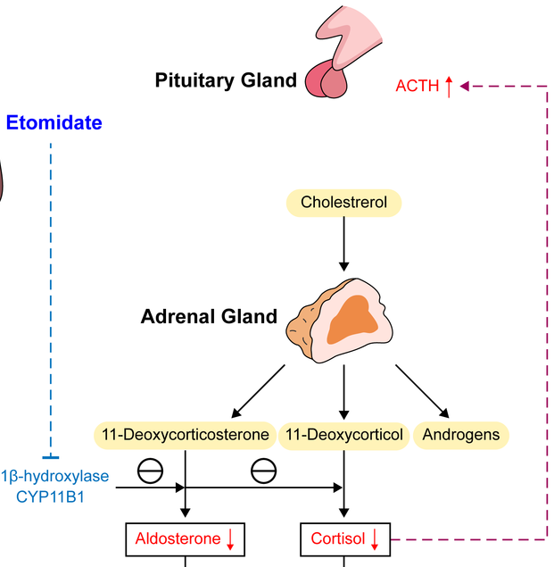
Patient Specific Consideration
Adrenal Insufficiency
Avoid etomidate in patients with adrenal insufficiency
Doses of 0.3 mg/kg have shown to reduce plasma cortisol and aldosterone levels
Inhibits the function of the enzyme 11-β hydroxylase in adrenal cortex
Temporary inhibition; persists for ~6 to 8 hours
Wu W, Xia C, Gan L, Liao S. Etomidate Induced Adrenal Insufficiency.; 2024.
Etomidate. Medication Guide. FDA. 2022
Albert SG et al., Journal of Intensive Care Medicine. 2020
Tobias J et al., SJA. 2011
Notes:
So as I was saying before, etomidate has been shown to show some adrenal suppression, and therefore should be cautioned in patients with already diagnosed adrenal insufficiency (like addisons disease).
This is likely due to etomidate's ability to inhibit the function of the enzyme 11-beta hydroxylase in the adrenal cortex, which is necessary to produce cortisol, and aldosterone hormones.
Studies have shown that these plasma levels have been reduced with more higher end doses of 0.3mg/kg. We do not push a dose that high for procedural sedation, so we may not see this in this indication, but still a good consideration to be aware about.
This has been shown to cause temporary inhibition. However with just one dose, inhibition has been shown to persist for approximately 6 to 8 hours and even longer in some cases. Some literature also suggests avoiding in septic shock and trauma patients due to this risk that has been seen with it causing poorer outcomes.
Cites Used:
Etomidate, Adrenal Insufficiency and Mortality Associated With Severity of Illness: A Meta-Analysis
Procedural sedation: A review of sedative agents, monitoring, and management of complications – PMC
Medication Guide
Image link: https://www.researchgate.net/publication/381375355/figure/fig3/AS:11431281251538065@1718255033445/Mechanism-and-consequences-of-etomidate-ACTH-adrenocorticotrophic-hormone-CYP11B1.tif
My Notes:
Reduced plasma cortisol and aldosterone levels have been reported following induction doses of etomidate. These results persist for approximately 6-8 hours and appear to be unresponsive to ACTH stimulation. This probably represents blockage of 11 beta-hydroxylation within the adrenal cortex. - from medication guide
Etomidate inhibits the function of the enzyme, 11-β hydroxylase, which is necessary for the production of cortisol, aldosterone, and corticosterone. Temporary inhibition, lasting 12–24 h, has been shown to occur after even a single dose of etomidate.[47] Although controversial, this effect has led some authorities to caution against the use of even a single dose of etomidate in certain patient populations, particularly those suffering from septic shock. Exposure to single dose etomidate has also been shown to be a modifiable risk factor in trauma patients. Trauma patients receiving single dose etomidate for rapid sequence intubation (RSI) were found to have an increased risk for the development of adrenal insufficiency and ultimately to have poorer outcomes than a similar group who did not receive etomidate.[
Trauma patients receiving single dose etomidate for rapid sequence intubation (RSI) were found to have an increased risk for the development of adrenal insufficiency and ultimately to have poorer outcomes than a similar group who did not receive etomidate.
Avoid etomidate in trauma or septic patients or those with adrenal insufficiency, as it may worsen or exacerbate the condition
(i.e. patients suffering from septic shock and trauma patients as even a single dose put that at higher risk of developing insufficiency and ultimately having poorer outcomes)

Slide 49
Methohexital
Barbiturate anesthetic
Mechanism of Action:
  Agonism of GABA_{A} receptors
Procedural Sedation Dose:
  Adults: 0.75 to 1 mg/kg IV bolus; may re-dose with 0.5 mg/kg every 2 to 5 minutes based on response and tolerability
Methohexital. Medication Guide. FDA
Syed Q et al., PubMed. 2023
Notes:
The last agent I'll discuss is methohexital, which is a barbiturate anesthetic. Its primary mechanism also involves agonism of the GABAa receptors which again enhances our inhibitory neurotransmission. For procedural sedation, dosing is weight-based, typically0.75 to 1mg/kg administered as an IV bolus for adults.

Slide 50
Methohexital
Pharmacokinetics
Adverse Effects
  Lipophilic
  Onset IV: ~30 seconds
  Duration: 5 to 15 minutes
  Hiccups
  Cough
  Laryngospasm
  Respiratory depression
  Apnea
  Twitching
Analgesia | Amnesia | Sedation
Methohexital. Medication Guide. FDA
Syed Q et al., PubMed. 2023
Notes:
Methohexital is also very lipophilic and has a rapid onset within 30 seconds, with a duration of 5 to 15 minutes. Since this medication has very low prevelance and is not as commonly used I will only discuss the adverse effects with this medication and not go further in depth into additional considerations with each effect. Therefore, methohexital has been seen to cause hiccups, cough, laryngospasms, respiratory depression and apnea. It also does have some association with residual muscle twitching and increased skeletal muscle tone. So all things to consider and be aware about if chosing to use this medication over etomidate or propofol.

Slide 51
Back to A.J.
New vitals were taken, and A.J. has provided the emergency department staff with some past medical and social history.
Features: Female, Caucasian race, brown hair, brown eyes
PMH: HFpEF (EF from 12/28/25 was 61%), GERD, OSA
Medications: empagliflozin 10mg daily, pantoprazole 40mg daily
Allergies: egg allergy (anaphylaxis)
Social History: Consumes 5-10 beers with dinner, never smoked
Current Vitals: BP: 90/85 mmHg; HR 187 beats per minute; SpO₂ 99% on 2L NC; RR: 19 breaths per minute; Wt: 120kg; Ht: 162cm

Slide 52
Assessment Question #3
After consulting with the EP team, the ED physicians determined that the patient was a candidate for DCCV. Based on the patient's characteristics, hemodynamic status and past medical history, which sedative agent would be the most appropriate? (Wt: 120kg)
Propofol 60mg IV bolus
Propofol 120mg IV bolus
Etomidate 12mg IV bolus
Methohexital 70 mg IV bolus

Slide 53
Literature Analysis on Efficacy
Differences in Efficacy amongst Sedative Agents Discussed

Slide 54
Propofol vs. Etomidate
Study | Methods / Outcome Measures | Results
Cardioversion: What to choose? Etomidate or Propofol (2015) | Methods: Single centered, prospective, randomized, single blind trial Objective: To compare propofol and etomidate as sedative agents during cardioversion Eligible Population: Included 60 patients of >18 years age, belonging to ASA I/II/III grade with ejection fraction >35% and undergoing elective EC. 30 patients received 1mg/kg IV bolus propofol with fentanyl 30 patients received 0.1mg/kg IV bolus etomidate with fentanyl | Incidence of hypotension (p= 0.233) Propofol: 33.3% Etomidate: 16.6% Incidence of respiratory depression (p=0.024) Propofol: 20% Etomidate: 0% Diastolic blood pressure (p= 0.032) Etomidate: 68.90 ± 11.54mm Propofol: 62.87 ± 9.68 mmHg Myoclonus was prevalent in the etomidate vs propofol group (26.6% vs. 0%, p= 0.004) Mean left atrial size (p=0.006) Propofol: 35.967 ± 8.74 mm Etomidate: 42.633 ± 9.40 mm Cardioversion success rate (p=0.739) Propofol: 80% Etomidate: 83.35% Time required to achieve RSS = 2 was higher in the propofol group (659.1 + 150.7 vs. 435.7 + 148.06 seconds, P < 0.001) denoting early recovery with etomidate
Main Takeaway: Both sedative agents provide adequate sedation for cardioversion but differ in adverse effects and recovery time.
Desai PM, Kane D, Sarkar MS. Cardioversion: What to choose? Etomidate or propofol. Ann Card Anaesth. 2015​
Notes:
Citations:
Cardioversion: What to choose? Etomidate or propofol – PMC
My Notes
* Incidence of hypotension, respiratory depression, nausea, vomiting and myoclonus and time taken to regain consciousness/simple commands were compared.
In addition to this, time taken to regain consciousness, follow simple commands (corresponding to Ramsay sedation score[8] [RSS = 2] denoting recovery; was also compared. We defined hypotension as more than 20% fall in SBP and respiratory depression was considered when RR <8/min or apnea >10 s occurred.
SBP decreased at all time intervals but significant difference was observed at 2 min (95.33 ± 12.04 Group P vs. 106.13 ± 15.27 mmHg Group E; P = 0.004) and 5 min (98.30 ± 11.64 Group P vs. 105.43 ± 13.81 mmHg Group E; P = 0.035). DBP (Group P 62.87 ± 9.68 vs. Group E 68.90 ± 11.54 mmHg; P = 0.032) and MAP (Group P 74.13 ± 10.06 vs. Group E 81.23 ± 12.21 mmHg; P = 0.017) at 2 min showed significant fall in Group P; although clinically insignificant [Figure 1–4]. Oxygen saturation (SpO₂) was comparable in both groups at all times.

Slide 55
Propofol vs. Etomidate
Study | Methods / Outcome Measures | Results
Etomidate vs. Propofol for Procedural Sedation in the Emergency Department (2007) | Methods: RCT, non-blinded prospective trial of adults undergoing painful procedures in the ED, requiring procedural sedation with either propofol or etomidate. Objective: To compare the efficacy, adverse effects and recovery duration between etomidate and propofol when using in the ED. Population: Etomidate=105 (mean total dose: 0.26 mg/ kg) Propofol=109 (mean total dose: 1.8 mg/kg) Total =214 | Procedural Success [difference: -7.4; 95% CI (-14.3 to -1.1)] Etomidate: 89.5% Propofol: 97.2% Subclinical Respiratory Depression [difference –7.9%; 95% CI (-20.9 to 5.1)] Etomidate: 34.3% Propofol: 42.2% Myoclonus [difference: 18.2%; 95% CI (10.1 to 26.2)] Etomidate: 20% Propofol:1.8% Mean SBP: [difference: 8.7mmHg (95% CI: 3.7 To 13.6)] Etomidate: 129.6 Propofol: 120.9 Mean Recovery Time: [difference: 2 minutes (95% CI (0.4 to 3.6)] Etomidate: 8.8 minutes Propofol : 6.8 minutes
Main Takeaway: Both sedative agents provide adequate sedation for cardioversion but differ in adverse effects and recovery time.
Miner JR, Danahy M, Moch A, Biros M. Randomized clinical trial of etomidate versus propofol for procedural sedation in the emergency department. Ann Emerg Med. 2007
Notes:
Citations:
Randomized Clinical Trial of Etomidate Versus Propofol for Procedural Sedation in the Emergency Department - ScienceDirect

Slide 56
Methohexital vs. Propofol vs. Etomidate
Study | Methods / Outcome Measures | Results
Methohexital for procedural sedation of cardioversions in the emergency department (2022) | Methods: A single-center, retrospective study of adult patients who underwent procedural sedation for electrical cardioversion in the ED Objective: To compare the use of methohexital to propofol and etomidate for procedural sedation for electrical cardioversions in the ED. Population: Methohexital= 50 (mean cumulative dose: 73.3 ± 29.7 mg) Propofol= 50 (mean cumulative dose: 78.5 ± 15.4 mg) Etomidate= 50 (mean cumulative dose: 14.9 ± 6.8 mg) Total= 150 | Primary Objective: Time from dose sedative to goal Aldrete score (p= 0.863) Methohexital: 10.5 minutes (7-18.5 minutes) Propofol: 12 minutes (9-16.8 minutes) Etomidate: 11 minutes (8-15 minutes) Secondary Objectives: Time from first sedative agent to discharge from the ED (p = 0.897) Methohexital: 90.3 ± 40.3 min Propofol: 89 ± 57.4 min Etomidate: 94 ± 42.5 min Mean change in SBP (mmHg) (p = 0.0001). Methohexital: −9.2 ± 25.5 mmHg Propofol: −21.7 ± 25.1 mmHg Etomidate +1.88 ± 20.9 mmHg
Main Takeaway: Methohexital was found to have a similar efficacy and safety when compared to propofol and etomidate.
Bauer J, Beauchamp L, Pavich E. Methohexital for procedural sedation of cardioversions in the emergency department. Am J Emerg Med. 2022
Notes:
Citations:
Methohexital for procedural sedation of cardioversions in the emergency department - ScienceDirect

Slide 57
Assessment Question #4
If etomidate is unavailable for use in A.J.’s procedural sedation during electrical cardioversion, which of the following statements about administering propofol would be considered true based on her clinical patient-specific factors?
Her egg allergy should be considered an absolute contraindication, and therefore special precautions should be taken with administration
Phenylephrine 100 mcg IV push may be administered to mitigate arterial hypotension
Her brown hair may cause altered responsiveness to hypnotics, requiring larger doses
Her chronic alcohol use may decrease liver solubility of propofol, requiring lower doses

Slide 58
Summary
Clinical scenarios where cardioversion are indicated are usually patients with hemodynamic instability or patients with atrial fibrillation
A minimum of two health care professionals must be present during a cardioversion
Many patient specific factors can affect what sedation agent we use
Current literature has identified propofol, etomidate, and methohexital have similar safety and efficacy for sedation
Notes:
In Summary, Clinical scenarios where cardioversion are indicated are usually patients with hemodynamic instability or patients with atrial fibrillation. A minimum of two health care professionals must be present during a cardioversion. Many patient specific factors can affect what sedation agent we use. And current literature has identified propofol, etomidate, and methohexital have similar safety and efficacy.

Slide 59
References
Joglar, J. A., Chung, M. K., Armbruster, A. Et At. (2023). 2023 ACC/AHA/ACCP/HRS guideline for the diagnosis and management of atrial fibrillation: A report of the American College of Cardiology/American Heart Association Joint Committee on clinical practice guidelines. Circulation, 149(1). https://doi.org/10.1161/CIR.0000000000001193
Miller A. HHW Cardioversion. Alex’s Asteroid Astrology. 2020 https://alexasteroidastrology.com/astrology-of-cardioversion-and-basement-flood/front-view-of-male-figure-a-with-cardioversion-pads-diagram-of-electrocardiography-graphs-showing-an-irregular-heart-rhythm-and-a-regular-heart-rhythm/.
Cardioversion and defibrillation for specific arrhythmias. UpToDate. (2025). Uptodate.com. https://www.uptodate.com/contents/cardioversion-and-defibrillation-for-specific-arrhythmias
Algorithms. 2025 American Heart Association Guidelines for Cardiopulmonary Resuscitation and Emergency Cardiovascular Care. 2025. https://cpr.heart.org/en/resuscitation-science/cpr-and-ecc-guidelines/algorithms.
Kornej, J., Börschel, C. S., Benjamin, E. J., & Schnabel, R. B. (2020). Epidemiology of Atrial Fibrillation in the 21st Century: Novel Methods and New Insights. Circulation research, 127(1), 4–20. https://doi.org/10.1161/CIRCRESAHA.120.316340
Klein, H. H., & Trappe, H. J. (2015). Cardioversion in Non-Valvular Atrial Fibrillation. Deutsches Arzteblatt international, 112(50), 856–862. https://doi.org/10.3238/arztebl.2015.0856
Green SM, Roback MG, Krauss BS, et al. Unscheduled procedural sedation: A multidisciplinary consensus practice guideline. Annals of Emergency Medicine. 2024;73(5).
Procedural sedation in adults in the emergency department: General considerations, preparation, monitoring, and mitigating complications. 2025. UpToDate. Procedural sedation in adults in the emergency department: General considerations, preparation, monitoring, and mitigating complications - UpToDate
Advocate Health Care. Procedural Sedation Policy– Wisconsin Division. PolicyTech document ID 23118. 2024
Advocate Health Care. Procedural Sedation: Adult, Pediatric, Neonatal Policy – Illinois Division. PolicyTech document ID 7252. 2025
Atrium Health Care. Policy and clinical practice guidelines for procedural sedation in adult and pediatric patients. 2022
Advocate Health Care. Moderate and deep sedation in adult and pediatric patients for emergency physicians and pediatric emergency physicians in emergency departments- Greater Charlotte Market. 2025
Patanwala AE, Thomas MC, Casanova TJ, Thomas R. Pharmacists' role in procedural sedation and analgesia in the emergency department. Am J Health Syst Pharm. 2012;69(15):1336-1342. doi:10.2146/ajhp110707

Slide 60
References
Godwin SA, Caro DA, Wolf SJ, et al. Clinical policy: Procedural sedation and analgesia in the emergency department. Annals of Emergency Medicine. 2005;45(2):177-196. doi:https://doi.org/10.1016/j.annemergmed.2004.11.002
Masaki Iwakiri, Inoue R, Uchida K. Allergic reactions to propofol in adult patients with egg or soybean allergy: a retrospective cohort study from a large database of a single institute. JA Clin Rep. 2023;9(1). doi.org/10.1186/s40981-022-00591-8
Soy-allergic and Egg-allergic can Receive Anesthesia | AAAAI. Aaaai.org. Published 2022. https://www.aaaai.org/Tools-for-the-Public/Conditions-Library/Allergies/soy-egg-anesthesia
Asserhøj LL, Mosbech H, Krøigaard M, Garvey LH. No evidence for contraindications to the use of propofol in adults allergic to egg, soy or peanut†. British Journal of Anaesthesia. 2016;116(1):77-82. https://doi.org/10.1093/bja/aev360
Nam E, Fitter S, Moussavi K. Comparison of push-dose phenylephrine and epinephrine in the emergency department. The American Journal of Emergency Medicine. 2022;52:43-49. doi.org/10.1016/j.ajem.2021.11.033
Singer S, Pope H, Fuller BM, Gibson G. The safety and efficacy of push dose vasopressors in critically ill adults. The American Journal of Emergency Medicine. 2022;61:137-142. doi.org/10.1016/j.ajem.2022.08.055
Ebert Thomas J, Muzi M, Berens R, Goff D, Kampine John P. Sympathetic responses to induction of anesthesia in humans with propofol or etomidate. Anesthesiology. 1992;76(5):725-733. doi.org/10.1097/00000542-199205000-00010
Tobias J, Leder M. Procedural sedation: A review of sedative agents, monitoring, and management of complications. Saudi Journal of Anaesthesia. 2011;5(4):395. doi.org/10.4103/1658-354x.87270
The effect of long-term alcohol use on propofol. Connecticut Anesthesia Associates. 2024. https://ctanesth.com/effect-long-term-alcohol-use-propofol/
Fassoulaki, Argyro MD, PhD, DEAA; Farinotti, Robert PhD; Servin, Frédérique MD; Desmonts, Jean Marie MD. Chronic alcoholism increases the induction dose of propofol in humans. Anesthesia & Analgesia 77(3):p 553-556, September 1993.
Fassoulaki A, Eger El. Alcohol increases the solubility of anaesthetics in the liver. British Journal of Anaesthesia. 2017;58(5):551-554. doi.org/10.1093/bja/58.5.551
Liang C, Chen J, Gu W, Wang H, Xue Z. Chronic alcoholism increases the induction dose of propofol. Acta Anaesthesiologica Scandinavica. 2011;55(9):1113-1117. doi.org/10.1111/j.1399-6576.2011.02497.x
Servin Frédérique S, Bougeois B, Gomeni R, Mentré F, Farinotti R, Desmonts JM. Pharmacokinetics of propofol administered by target-controlled infusion to alcoholic patients. Anesthesiology. 2003;99(3):576-585. doi.org/10.1097/00000542-200309000-00012
Augustinsson A, Franze E, Almqvist M, Warrén Stomberg M, Sjöberg C, Jildenstål P. Red-haired people’s altered responsiveness to pain, analgesics, and hypnotics: myth or fact?—a narrative review. Journal of Personalized Medicine. 2024;14(6):583. doi.org/10.3390/jpm14060583

Slide 61
References
Liem Edwin B, Lin CM, Suleman MI, et al. Anesthetic Requirement Is Increased in Redheads. Anesthesiology. 2004;101(2):279-283. doi:https://doi.org/10.1097/00000542-200408000-00006
Myles PS, Buchanan FF, Bain CR. The Effect of Hair Colour on Anaesthetic Requirements and Recovery Time after Surgery. Anaesthesia and Intensive Care. 2012;40(4):683-689. doi:https://doi.org/10.1177/0310057x1204000415
Doufas AG, Orhan-Sungur M, Komatsu R, et al. Bispectral index dynamics during propofol hypnosis is similar in red-haired and dark-haired subjects. Anesthesia & Analgesia. 2013;116(2):319-326. https://doi.org/10.1213/ane.0b013e31827533b4
Zorina-Lichtenwalter K, Maixner W, Diatchenko L. Detangling red hair from pain: phenotype-specific contributions from different genetic variants in melanocortin-1 receptor. Pain. 2019;161(5):938-948. https://doi.org/10.1097/j.pain.0000000000001780
Homfray G, Palmer A, Grimsmo-Powney H, Appelboam A, Lloyd G. Procedural sedation of elderly patients by emergency physicians: a safety analysis of 740 patients. British Journal of Anaesthesia. 2018;121(6):1236-1241. https://doi.org/10.1016/j.bja.2018.07.038
Krauss BS, Andolfatto G, Krauss BA, Mieloszyk RJ, Monuteaux MC. Characteristics of and Predictors for Apnea and Clinical Interventions During Procedural Sedation. Annals of Emergency Medicine. 2016;68(5):564-573. https://doi.org/10.1016/j.annemergmed.2016.07.010
Syed Q, Kohli A. Methohexital. Nih.gov. Published July 10, 2023. Accessed December 29, 2025. https://www.ncbi.nlm.nih.gov/books/NBK544291/&lang=en/
Etomidate for RSI: Seizure Considerations. Accessed December 29, 2025. https://pharmacyacute.com/wp-content/uploads/2023/02/Etomidate-for-Induction-and-seizure-pharmacy-friday-Copy.pdf
Adams Z, Barrie M, Rozycki E. Etomidate for RSI in the Seizing Patient. AMP EM. Published April 21, 2016. Accessed December 29, 2025. https://osuemed.wordpress.com/2016/04/21/etomidate-for-rsi-in-the-seizing-patient
Albert SG, Sitaula S. Etomidate, adrenal insufficiency and mortality associated with severity of illness: a meta-analysis. Journal of Intensive Care Medicine. 2020;36(10):1124-1129. https://doi.org/10.1177/0885066620957596.
AMIDATE ® (Etomidate) . https://www.accessdata.fda.gov/drugsatfda_docs/label/2017/018227s032lbl.pdf
BREVITAL ® (Methohexital Sodium). https://www.accessdata.fda.gov/drugsatfda_docs/label/2017/011559s051lbl.pdf
DIPRIVAN® (propofol). https://www.accessdata.fda.gov/drugsatfda_docs/label/2022/019627s069lbl.pdf
Desai PM, Kane D, Sarkar MS. Cardioversion: what to choose? etomidate or propofol. Ann Card Anaesthesia 2015;18(3):306-311. doi:10.4103/0971-9784.159798
Miner JR, Danahy M, Moch A, Biros M. Randomized clinical trial of etomidate versus propofol for procedural sedation in the emergency department. Ann Emerg Med. 2007;49(1):15-22. doi:10.1016/j.annemergmed.2006.06.042
Bauer J, Beauchamp L, Pavich E. Methohexital for procedural sedation of cardioversions in the emergency department. Am J Emerg Med. 2022;58:79-83. doi:10.1016/j.ajem.2022.05.036

Slide 62
Questions?
Alexis Thompson
Alexis.thompson3@aah.org
Dylan Valley
Dylan.valley@aah.org
Leigh Anne Sieracki
Leigh.sieracki@aah.org

