Slide 1
Facts vs Fiction: Debunking Oncology Myths
Joshua Gaynier, PharmD, PGY1 Pharmacy Resident
Atrium Health Navicent the Medical Center
12/3/2025

Slide 2
Disclosures
  The planners and speaker have indicated that there are no relevant financial relationships with any ineligible companies to disclose. ​

Slide 3
Learning Objectives
Distinguish between the different types of misinformation
Recognize the psychological, social, and technological factors associated with oncology misinformation
Identify evidence-based techniques for effectively correcting oncology misinformation
Recognize common myths and misconceptions in oncology including the use of fenbendazole, ivermectin, and alternative dietary regimens such as the Gerson therapy.

Slide 4
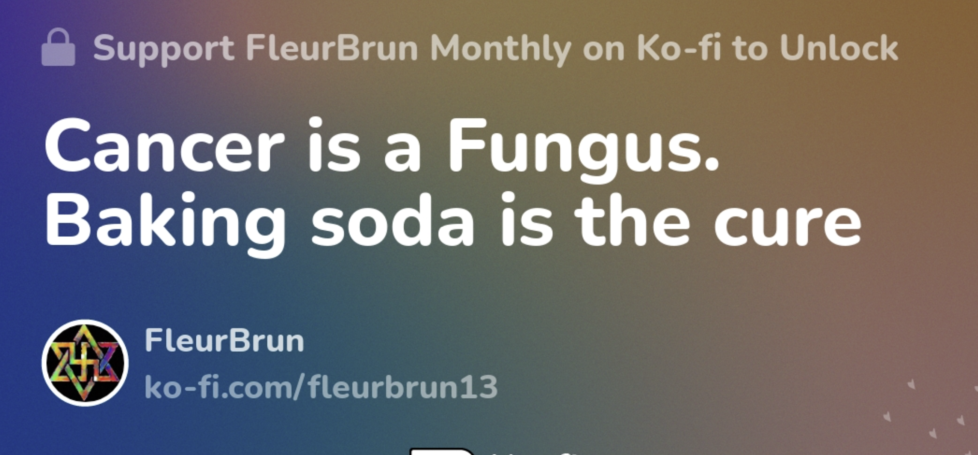
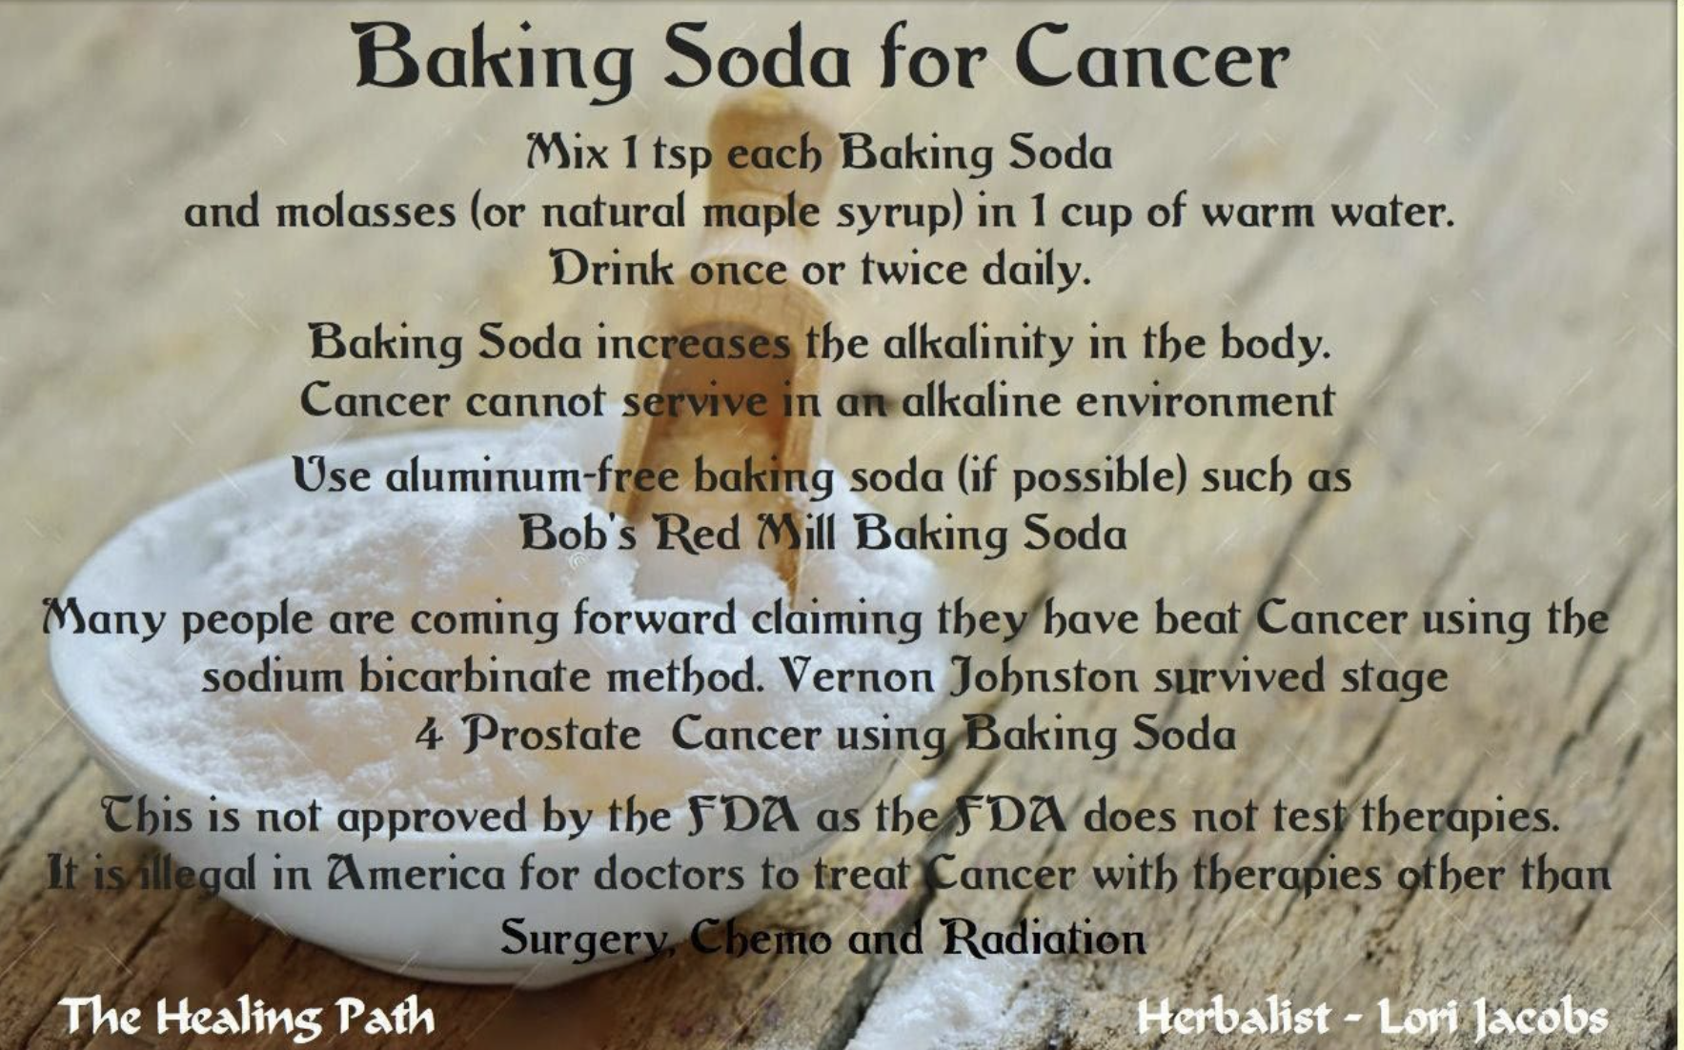
My Healing Path. (11/10/25). Baking soda for cancer.

Slide 5
What is the Problem?

Slide 6
Current Problems Healthcare Providers Face
Misinformation is defined as information that is false, inaccurate or misleading
Pharmacists frequently encounter harmful cancer misinformation from patients
Refreshing pharmacists’ skills in evaluating evidence-based information is crucial, especially in the age of social media
A structured approach to correcting oncology misinformation
Loeb S. CA Cancer J Clin. 2024;74(5):453-464

Slide 7
Combating Cancer Misinformation Pre-internet
Public Health Campaigns: Government-led efforts using printed materials and community outreach to educate the public
Credible institutions: National health agencies, hospitals, and universities were seen as the most reliable sources of health information.
Trusted voices: Doctors, nurses, and pharmacists served as primary resources
Loeb S. CA Cancer J Clin. 2024;74(5):453-464
Office of the Surgeon General, 1964

Slide 8
Prevalence of Oncology Misinformation
 | Xu et al, 2022 | Loeb et al, 2019 | Loab et al, 2021 | Meteran et al, 2023
Methods | Examined 62 still-images and 64 video Instagram posts using #prostatecancer to identify misinformation | Examined the first 150 YouTube videos on screening and treatment of prostate cancer to identify misinformation | Reviewed the first 150 YouTube videos on bladder cancer to identify any misinformation | Reviewed 167 YouTube videos on lung cancer to identify misinformation
Design | Content was review by experts using two validated tools | Used two validated scoring tools | Used two validated instruments | No validated tool used but allocated a number by two experts to either it being misleading, useful, or nether
Results | 30% of the posts were objective information; of this, 40% contained misinformation. | 77% of the total videos contained misinformation or biased content | 21% of the videos contained misinformation | Found 6% misleading, and 62% as useful. However, misleading videos were significantly more popular
Xu AJ. Prostate Cancer Prostatic Dis. 2022;25:791-793.
Loeb S. Eur Urol. 2019;75(4):564-567.
Loeb et al. Eur Urol. 2021;79(1):56–59.

Slide 9
Prevalence of Oncology Misinformation
 | Xu et al, 2022 | Loeb et al, 2019 | Loab et al, 2021 | Meteran et al, 2023
Methods | Examined 62 still-images and 64 video Instagram posts using #prostatecancer to identify misinformation | Examined the first 150 YouTube videos on screening and treatment of prostate cancer to identify misinformation | Reviewed the first 150 YouTube videos on bladder cancer to identify any misinformation | Reviewed 167 YouTube videos on lung cancer to identify misinformation
Design | Content was review by experts using two validated tools | Used two validated scoring tools | Used two validated instruments | No validated tool used but allocated a number by two experts to either it being misleading, useful, or nether
Results | 30% of the posts were objective information; of this, 40% contained misinformation. | 77% of the total videos contained misinformation or biased content | 21% of the videos contained misinformation | Found 6% misleading, and 62% as useful. However, misleading videos were significantly more popular
Summary: Every study that examined social media platforms found the presence of misinformation. Notably, the inaccurate content received more views and engagement than the correct information.
Xu AJ. Prostate Cancer Prostatic Dis. 2022;25:791-793.
Loeb S. Eur Urol. 2019;75(4):564-567.
Loeb et al. Eur Urol. 2021;79(1):56–59.

Slide 10
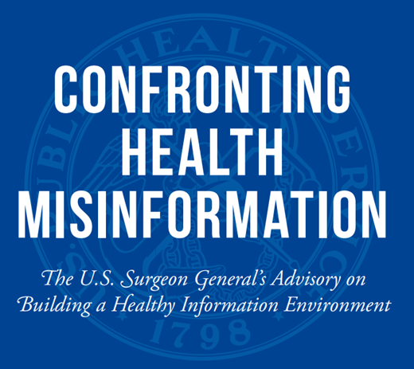
Surgeon General Advisory on Misinformation
Bring attention to a public health issue
Goal: Limiting the prevalence and impact of misinformation by addressed all aspects of the problem
Healthcare Professionals are called to engage patients who are misinformed
Office of the Surgeon General, 2021 PMID: 34283416

Slide 11
Source of the Problem

Slide 12
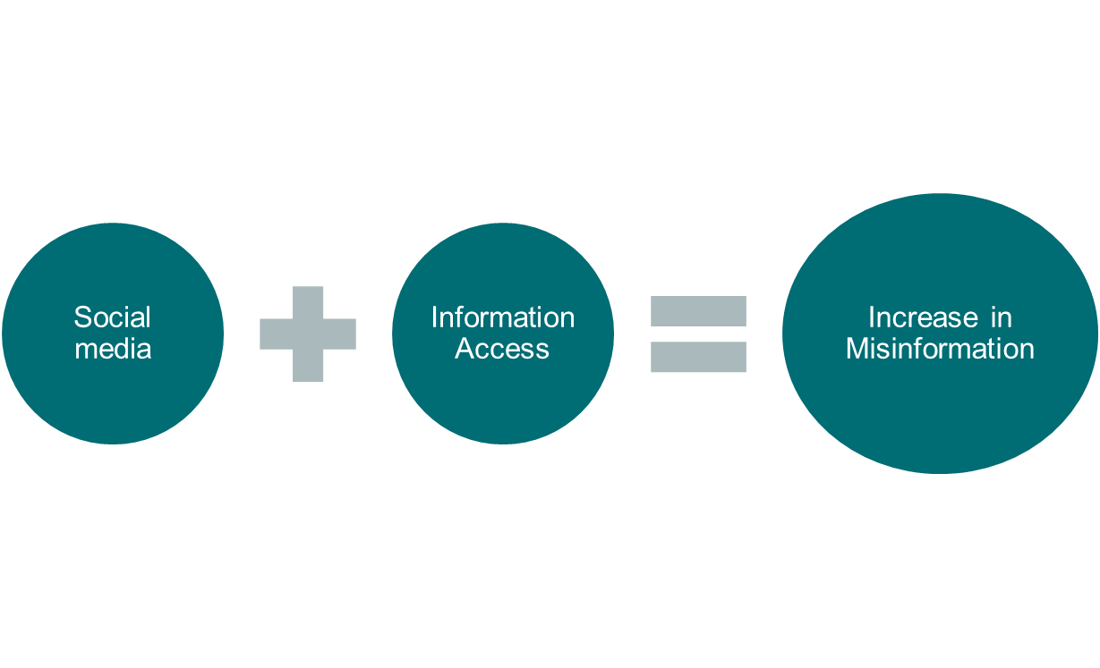
Source of Misinformation
Del Vicario M. Proc Natl Acad Sci USA. 2016;113(3):554-559.

Slide 13
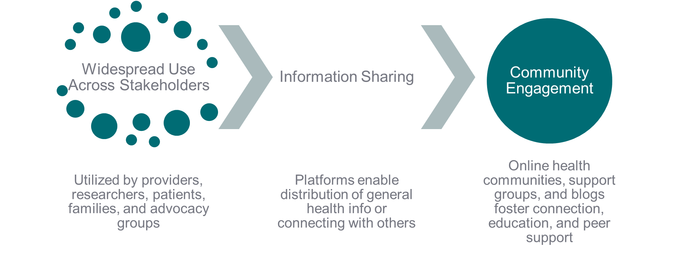
Positive Side of Social Media
Loeb S. CA Cancer J Clin. 2024;74(5):453-464

Slide 14
Underlining Causes of Oncology Misinformation
Echo chamber effect
Bias of information toward like-minded peers that reinforces a shared narrative
Confirmation bias
Acceptance of claims because they match the individual's belief system
No verification of credentials
Anyone can post on social medias without verification Systematic review showed
Anecdotal reports
Individual narratives are featured on social media and even if authentic can mischaracterize cancer related issues
Cinelli M. Proc Natl Acad Sci USA. 2021;118(9):e2023301118

Slide 15
Clinical Significance of Misinformation
70% of cancer patients seek cancer related information online
30-80% of online cancer content contains misinformation
77% of that misinformation is harmful
Hesse BW, J Health Commun. 2006;11 Suppl, PMID: 16641070.

Slide 16
Exponential Growth of Social Media
Around 5 billion people worldwide use social media as of 2025
Over 241 million new users year-over-year (~4.7% growth)
246 million users from the United States (~73% of the USA population)
Social media impacts almost every American and billions globally
  Imperative to refresh our strategies for combating a new type of misinformation
Loeb S. CA Cancer J Clin. 2024;74(5):453-464

Slide 17
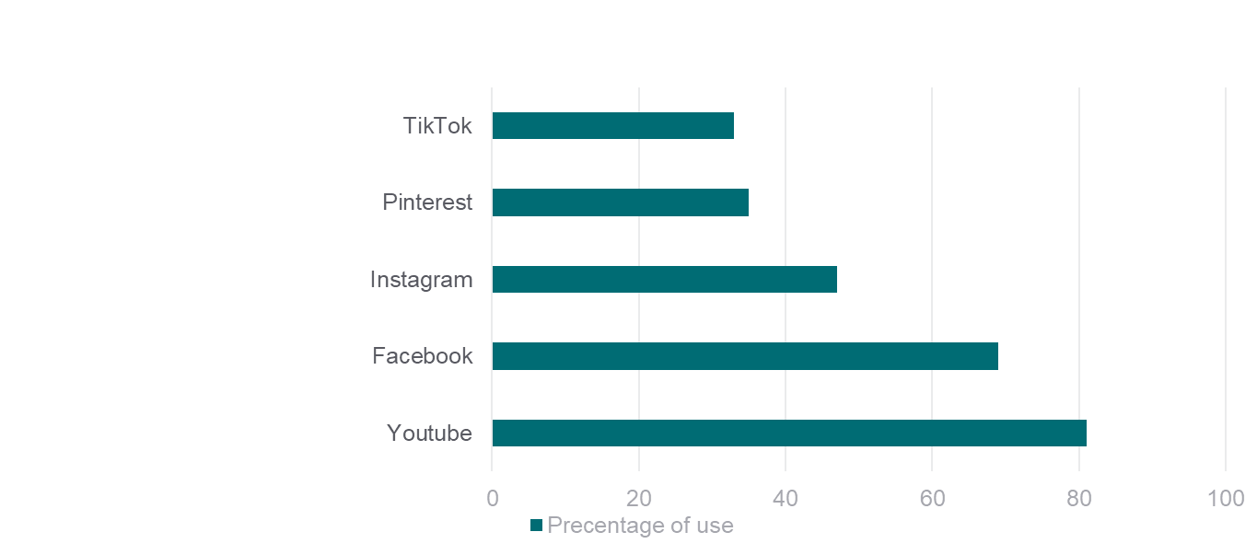
Active Social Media Users by Platform
Out of all users:
YouTube 81%
Facebook 69%
Instagram 47%
Pinterest 35%
TikTok 33%
All platforms are not held to medical accuracy standards.
Pew Research Center. Social Media Fact Sheet. Pew Research Center, 2024

Slide 18
Clinical Significance of Misinformation
False Hope: 40% of individuals believe that an unproven therapy
can cure cancer
2-fold increased mortality when patients use alternative therapies alone
Misinformation spreads 6x faster than factually correct information on social media platforms
Lazard AJ. JMIR Cancer. 2023;9:e43749.

Slide 19
Assessment Question #1
All the following are underlying causes of misinformation except?
Echo Chamber effect
Anecdotal Report
Confirmation Bias
CDC Annual Report

Slide 20
Understanding Misinformation

Slide 21
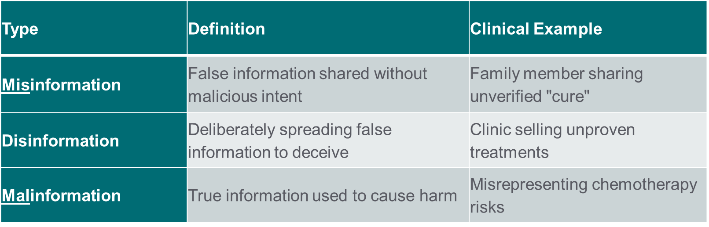
Types of Misinformation
Lazard AJ. JMIR Cancer. 2023;9:e43749.

Slide 22
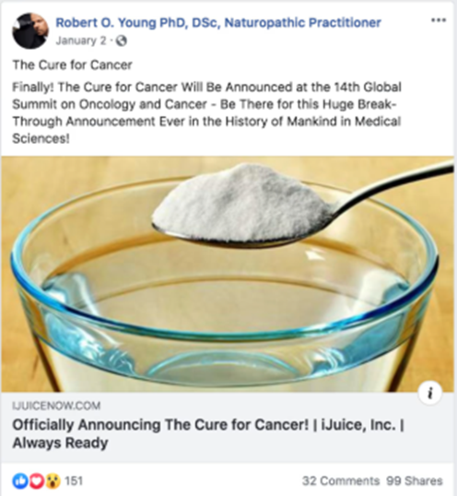
Technical Factors: Social Media Algorithms
Fundamentally Favors Engagement:
Algorithms optimize for engagement over accuracy
Creates a bias towards sensational posts
  Post that generate strong emotional reactions whether positive or negative will be promoted
Misinformation spreads approximately six times faster than traditional medical information.
Horwitz, J., & Seetharaman, D. (2019, June 24) The Wall Street Journal.
Lazard AJ. JMIR Cancer. 2023;9:e43749.

Slide 23
Psychological: Emotional and Motivational Factors
  Fear and anxiety: This could be about their diagnosis or side effects of treatment
    Increase susceptibility to misinformation by 33%
  Desire for control: Creates a paradox when facing uncertain futures.
    Patients feel they are doing something for their health.
  Hope bias: You are more likely to accept an unproven treatment even if there is a small to little chance that it may cure your cancer
Teplinsky E. JCO Oncol Pract. 2022;18(8):584-589.

Slide 24
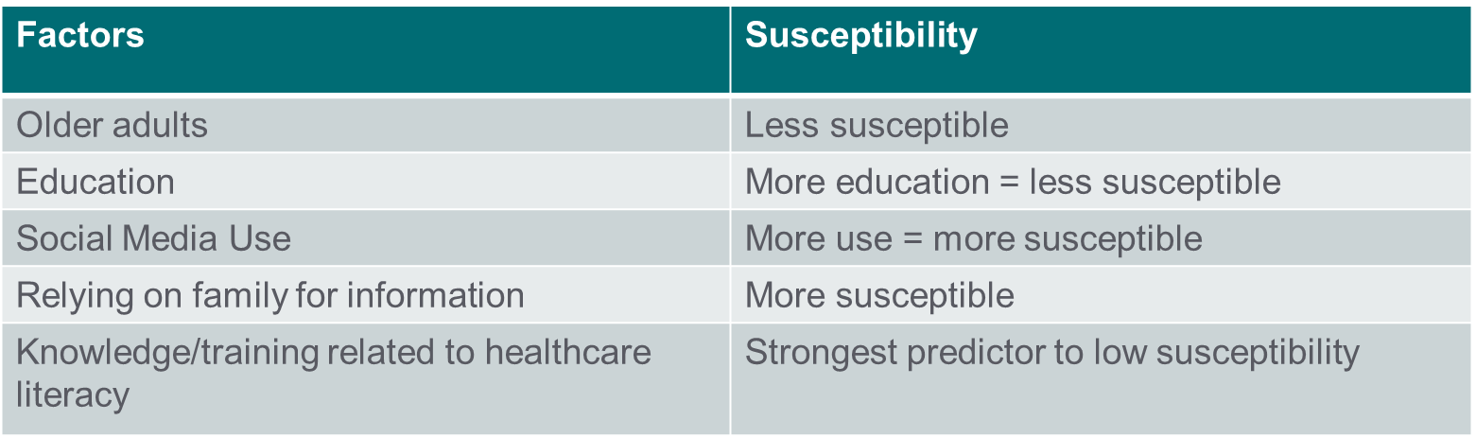
Social Factors: Susceptibility to Misinformation
Loeb S. CA Cancer J Clin. 2024;74(5):453-464

Slide 25
Assessment Question #2
What is hope bias?
Believing that a therapy is effective because it is widely discussed on social media
Allowing fear and uncertainty about the future to influence choices
Seeking treatments primarily to maintain a sense of control over the illness, even when evidence is lacking
Overestimating the likelihood of a positive outcome despite limited or no scientific support

Slide 26
Combating Misinformation

Slide 27
Combating Cancer Misinformation Post-internet
Promoting Credible sources
  Verified websites such as hospitals and government agencies
Algorithmic Accountability
  Social media platforms flag misinformation
Trusted Digital Voices​
  Healthcare professionals share accurate cancer info on popular social media platforms.
Office of the Surgeon General, 2021 PMID: 34283416

Slide 28
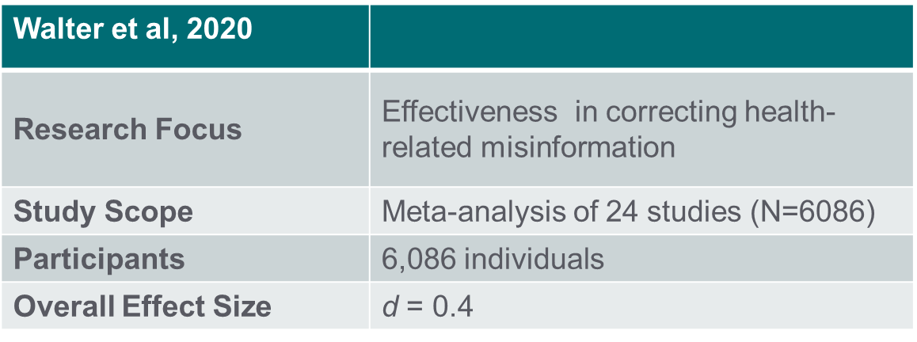
Does Correcting Misinformation Work?
Group | Category | Value
Misinformation source | News agency | 0.48
 | Peer | 0.24
Correction source | Experts | 0.42
 | Non-experts | 0.24
Correction type | Factual elaboration | 0.28
 | Simple rebuttal | 0.48
Correction format | Text | 0.38
 | Text and image | 0.44
Walter N. Health Commun. 2020
Walter N. Health Commun. 2020

Slide 29
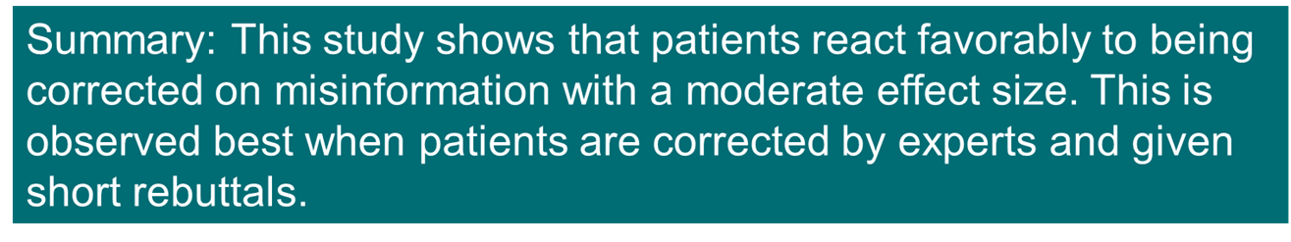
Does Correcting Misinformation Work?
Group | Category | Value
Misinformation source | News agency | 0.48
 | Peer | 0.24
Correction source | Experts | 0.42
 | Non-experts | 0.24
Correction type | Factual elaboration | 0.28
 | Simple rebuttal | 0.48
Correction format | Text | 0.38
 | Text and image | 0.44
Walter N. Health Commun. 2020
Walter N. Health Commun. 2020

Slide 30
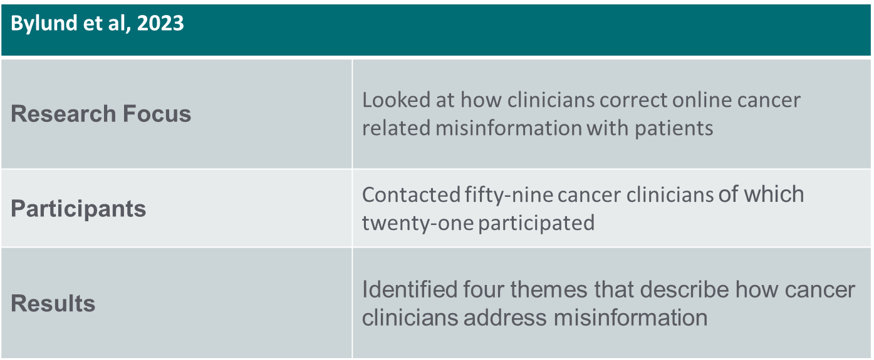
Four Step Approach
Bylund CL. JCO Oncol Pract. 2023;19(3):e392-e402.

Slide 31
Four Step Approach
1) Understand
2) Correct the Misinformation
3) Advise About Future Online Searches
4) Preserve the Clinician-Patient Relationship
Bylund CL. JCO Oncol Pract. 2023;19(3):e392-e402.

Slide 32
Patient Case
Patient Background:
    RM 58-year-old male accountant with stage 4 colon cancer with liver metastases, RAS wild-type, MSS, ECOG PS 1 and is scheduled: FOLFOX + bevacizumab
Chief Concern:
    Patient is concerned about starting chemotherapy and wants to discuss alternate therapies and asks “My cousin said fenbendazole and ivermectin cure cancer what have you heard about this?”
RAS: Rat sarcoma viral oncogene homolog; MSS: Microsatellite stable; ECOG PS 1: Eastern Cooperative Oncology Group Performance Status 1; FOLFOX: Folinic acid, 5-Fluorouracil, Oxaliplatin

Slide 33
Four Step Approach
1) Understand
2) Correct the Misinformation
3) Advise About Future Online Searches
4) Preserve the Clinician-Patient Relationship
Bylund CL. JCO Oncol Pract. 2023;19(3):e392-e402.

Slide 34
Combating Cancer Misinformation Pre-internet
Step 1: Understand
Do not discount or disparage the information the patient presents
Ask about the source of the information
  1)This lets you test the veracity of their claim
Be honest about what you know about the information
Educate yourself if you are unfamiliar
Bylund CL. JCO Oncol Pract. 2023;19(3):e392-e402.

Slide 35
Applying Step 1
Understand
Patient Case: Step 1
You ask: Thank you for bringing this up → Tell me more about what your cousin shared → What specific information convinced your cousin that this therapy could cure cancer?
RM responds: Their cousin had heard from a popular podcast that claimed fenbendazole and ivermectin cured their friend's cancer

Slide 36
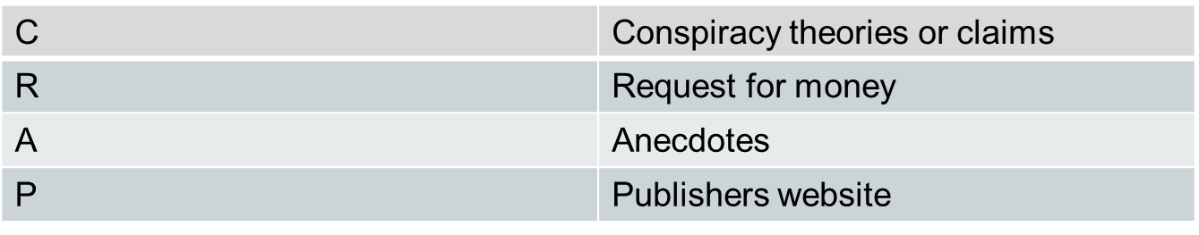
Four Step Approach
Understanding is Identifying
Step 1: Understand
Identifying the source of the information is a key step in understanding the patient’s claim
Websites ending in .gov or .edu?
  This indicates that it is either a government and educational website
Are the authors credentialed healthcare providers?
  If not try, to determine if the author is sharing personal experiences or giving their opinion
Bylund CL. JCO Oncol Pract. 2023;19(3):e392-e402.

Slide 37
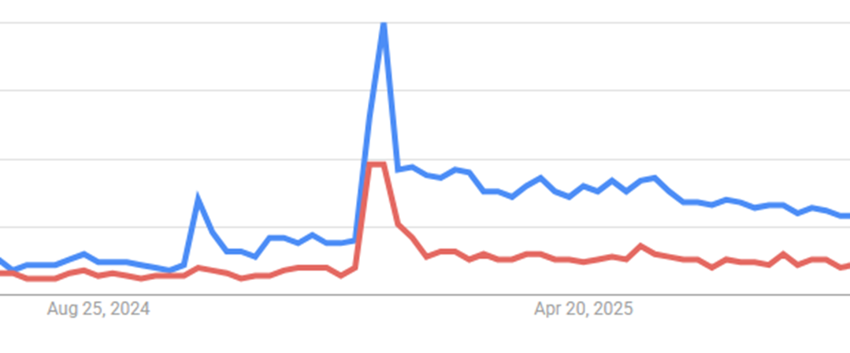
Applying Step 1
Understanding is Identifying
Patient Case: Step 1
You ask RM to verify the source
RM provides you a video → Joe Rogan's experience featuring Mel Gibson with over 11.5 million views published on 1/9/25 → Not a trusted source
Google Search Trends: Blue Ivermectin cancer, Red Fenbendazole cancer

Slide 38
Applying Step 1
Patient Case: Step 1
Familiarize yourself with the subject:
Start with the Prescribing Information (PI):
  Ivermectin and fenbendazole are approved as broad spectrum antiparasitic agents
  Mechanism of action:
    Ivermectin selectively binds to glutamate chloride channels of invertebrate nerve and muscle cells increasing permeability resulting in paralysis and death.
    Fenbendazole binds to microtubules of parasites inhibiting their formation resulting in their death
PubMed Search: There is preclinical data for their use in cancer, however, currently there are no published clinical trials
Stromectol (ivermectin) [package insert]. Merck Sharp & Dohme Corp. 2022
C Canine (fembendaze) [veterinary package insert]. Merck Sharp & Dohme Corp. 2022

Slide 39
Four Step Approach
1) Understand
2) Correct the Misinformation
3) Advise About Future Online Searches
4) Preserve the Clinician-Patient Relationship
Bylund CL. JCO Oncol Pract. 2023;19(3):e392-e402.

Slide 40
Four Step Approach
Step 2: Correct the Misinformation
Explicitly state the information is misinformation
Explain why the information is incorrect
Emphasize the importance of a scientific base for quality
Bring it back to the patient in the end
Bylund CL. JCO Oncol Pract. 2023;19(3):e392-e402.

Slide 41
Applying Step 2
Correct the Misinformation
Patient Case: Step 2
Calling misinformation for what it is:
You state: Currently, there are no published clinical trials supporting the use of ivermectin or fenbendazole for cancer treatment. Claims suggesting otherwise are unfortunately based on misinformation.
RM asks: That is disappointing. Should I trust what Mel Gibson says?
Your response: While Mel Gibson is a talented actor, he is not a medical professional. His statements are based on personal anecdotes rather than scientific evidence, so he is not a reliable source for medical advice.
Bylund CL. JCO Oncol Pract. 2023;19(3):e392-e402.

Slide 42
Applying Step 2
Correct the Misinformation
Patent Case: Step 2
Bringing it Back to the Patient:
RM asks: What if I add ivermectin to my treatment plan?
Your response: I understand why you are looking for every possible option, however, studies done in a lab don’t always translate into proven benefits for people
  What we do know: FOLFOX combined with bevacizumab has strong evidence for improving survival
  What we do not know: Adding ivermectin could cause unknown consequences such as delays in therapy or increased side effects
Bylund CL. JCO Oncol Pract. 2023;19(3):e392-e402.

Slide 43
Four Step Approach
1) Understand
2) Correct the Misinformation
3) Advise About Future Online Searches
4) Preserve the Clinician-Patient Relationship
Bylund CL. JCO Oncol Pract. 2023;19(3):e392-e402.

Slide 44
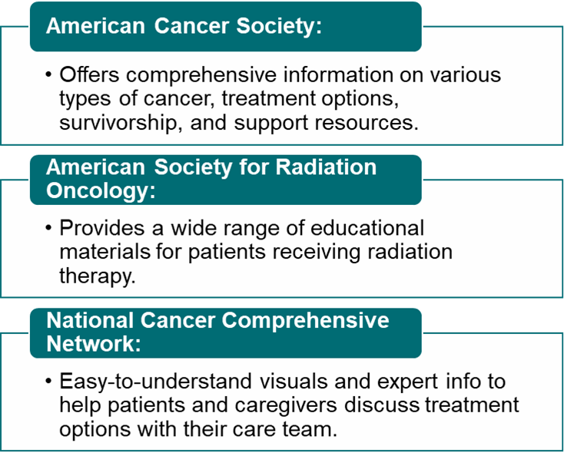
Four Step Approach
Step 3: Advise About Future Online Searches
Suggest sites or sources of information
Take into account the patient’s health literacy level
Bylund CL. JCO Oncol Pract. 2023;19(3):e392-e402.

Slide 45
Applying Step 3
Advise About Future Online Searches
Patent Case: Step 3
RM asks: Thank you for helping me identify misinformation. I would like to do my own research; where can I find trusted sources?
Your Response: I am glad you want to look into this yourself. For reliable cancer information, I recommend starting with:
  American Cancer Society
  NCCN Patient Guidelines
  Reminder of the CRAP test

Slide 46
Four Step Approach
1) Understand
2) Correct the Misinformation
3) Advise About Future Online Searches
4) Preserve the Clinician-Patient Relationship
Bylund CL. JCO Oncol Pract. 2023;19(3):e392-e402.

Slide 47
Four Step Approach
Step 4: Preserve the Clinician-Patient Relationship
Be open-minded and supportive
Praise the patient's efforts
Do not criticize or discourage the patient
In the end it is the patient's ultimate choice
Bylund CL. JCO Oncol Pract. 2023;19(3):e392-e402.

Slide 48
Applying Step 4
Preserve the Clinician-Patient Relationship
Patient Case: Step 4
RM: I do not want to try ivermectin, but I still want to explore my options.
Your response: I respect your decision as it is important to feel confident in your treatment plan. There are evidence based alternatives such as clinical trials that I would recommend.
Bylund CL. JCO Oncol Pract. 2023;19(3):e392-e402.

Slide 49
Key Takeaways
Patient Interaction
When Patients Bring Misinformation:
  Do not dismiss: Acknowledge their engagement
  Explore source: Understand where it came from
  Correct clearly: Use evidence not judgment
  Guide future searches: Provide reliable resources
  Keep door open: Maintain the relationship
Remember: Fear drives patients to seek hope from anywhere

Slide 50
References
Bylund, C.L., Mullis, M.D., Alpert, J., Markham, M.J., Onega, T., Fisher, C.L., & Johnson, S.B. (2023). Clinician communication with patients about cancer isinformation: A qualitative study. JCO Oncology Practice, 19(3), e392-e402.​
Cinelli, M., De Francisci Morales, G., Galeazzi, A., Quattrociocchi, W., & Starnini, M. (2021). The echo chamber effect on social media. Proceedings of the National Academy of Sciences, 118(9), e2023301118.​
Del Vicario, M., Bessi, A., Zollo, F., Petroni, F., Scala, A., Caldarelli, G., Stanley, H.E., & Quattrociocchi, W. (2016). The spreading of misinformation online. Proceedings of the National Academy of Sciences, 113(3), 554-559.​
Hesse BW, Moser RP, Rutten LJ, Kreps GL. The health information national trends survey: research from the baseline. J Health Commun. 2006;11 Suppl 1:vii-xvi. doi: 10.1080/10810730600692553. PMID: 16641070.
Johnson, S.B., Bylund, C.L. (2023). Identifying cancer treatment misinformation and strategies to mitigate its effects with improved radiation oncologist-patient communication. Practical Radiation Oncology, 13(4), 282-285.​
Lazard AJ, Nicolla S, Vereen RN, Pendleton S, Charlot M, Tan HJ, DiFranzo D, Pulido M, Dasgupta N. Exposure and Reactions to Cancer Treatment Misinformation and Advice: Survey Study. JMIR Cancer. 2023 Jul 28;9:e43749. doi: 10.2196/43749. PMID: 37505790; PMCID: PMC10422174.​
Loeb S, Langford AT, Bragg MA, Sherman R, Chan JM. Cancer misinformation on social media. CA Cancer J Clin. 2024 Sep-Oct;74(5):453-464. doi:10.3322/caac.21857. Epub 2024 Jun 19. PMID: 38896503; PMCID: PMC11648589.​
Loeb S, Reines K, Abu-Salha Y, French W, Butaney M, Macaluso JN Jr, Steinberg GD, Walter D, Byrne N, la Garza D, Smith AB. Quality of Bladder Cancer Information on YouTube. Eur Urol. 2021 Jan;79(1):56-59. doi: 10.1016/j.eururo.2020.09.014. Epub 2020 Oct 1. PMID: 33010986.
Loeb, S., Sengupta, S., Butaney, M., Macaluso, J.N. Jr., Czarniecki, S.W., Robbins, R., Braithwaite, R.S., Gao, L., Byrne, N., Walter, D., & Langford, A. (2019).Dissemination of misinformative and biased information about prostate cancer on YouTube. European Urology, 75(4), 564-567.​
Meteran, H., Høj, S., Sigsgaard, T., Diers, C.S., Remvig, C., & Meteran, H. (2023). The usefulness of YouTube videos on lung cancer. Journal of Public Health,45(2), e339-e345.​4
Office of the Surgeon General (OSG). Confronting Health Misinformation: The U.S. Surgeon General’s Advisory on Building a Healthy Information Environment [Internet]. Washington (DC): US Department of Health and Human Services; 2021. PMID: 34283416.
Pew Research Center. Social Media Fact Sheet. Pew Research Center, 2024
Teplinsky E, Ponce SB, Drake EK, Garcia AM, Loeb S, van Londen GJ, Teoh D, Thompson M, Schapira L; Collaboration for Outcomes using Social Media inOncology (COSMO). Online Medical Misinformation in Cancer: Distinguishing Fact From Fiction. JCO Oncol Pract. 2022 Aug;18(8):584-589. doi:10.1200/OP.21.00764. Epub 2022 Mar 31. PMID: 35357887; PMCID: PMC9377685.​
Walter, N., Brooks, J.J., Saucier, C.J., & Suresh, S. (2020). Evaluating the impact of attempts to correct health misinformation on social media: A meta-analysis. Health Communication.​
Xu, A.J., Myrie, A., Taylor, J.I., et al. (2022). Instagram and prostate cancer: Using validated instruments to assess the quality of information on socialmedia. Prostate Cancer and Prostatic Diseases, 25, 791-793.​

Slide 51
Questions?
Josh Gaynier
Joshua.Gaynier@advocatehealth.org

