Slide 1
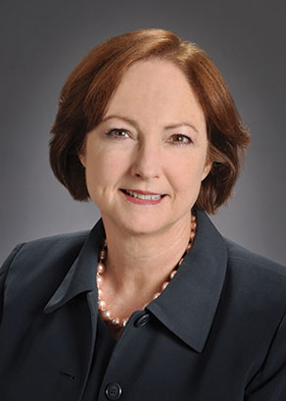
MAKING H-HOPE STANDARD OF CARE IN YOUR NICU
March 2023| Virtual
Currently the nurses are not trained in the delivery of H-HOPE massage+ as standard of care to parents or infants. Peer reviewed literature and data from outside sources supports many benefits of learning and implementing this type of care. Massage+ has been shown to increase social communication, shorten hospital stay, promote feeding skills, improve growth, and participatory guidance improves parents’ confidence and promotes a positive bond between parent and infants
Speaker(s):
Rosemary White-Traut PhD, RN, FAAN
Objectives: ​​
Provide participants with the knowledge about the importance of the H-HOPE intervention to infants, parents, and the healthcare institution
Learn and demonstrate the techniques necessary to deliver the components of H-HOPE to parents and infants (parents+ session and massage+)
Explore strategies important for implementation of H-HOPE in their nursery
Target Audience:​ Nurses, therapists and medical providers in the neonatal intensive care unit.
Learners will earn credit after viewing video and completing return demonstration.
Disclosure:​ The planner(s) and speaker(s) have indicated that there are no relevant financial relationships with any ineligible companies to disclose.
Accreditation Statement:
In support of improving patient care, Advocate Aurora Health is jointly accredited by the Accreditation Council for Continuing Medical Education (ACCME), the Accreditation Council for Pharmacy Education (ACPE), and the American Nurses Credentialing Center (ANCC), to provide continuing education for the healthcare team.
Credit Statement(s):
American Nurses Credentialing Center (ANCC): Advocate Aurora Health designates this (live/enduring) activity for a maximum of (2) ANCC contact hours. Nurses should claim only the credit commensurate with the extent of their participation in the activity.
Created by M. Christoffel MSN, RNC-NIC Created 2/24/2023 Post through 3/17/2024

