Slide 1
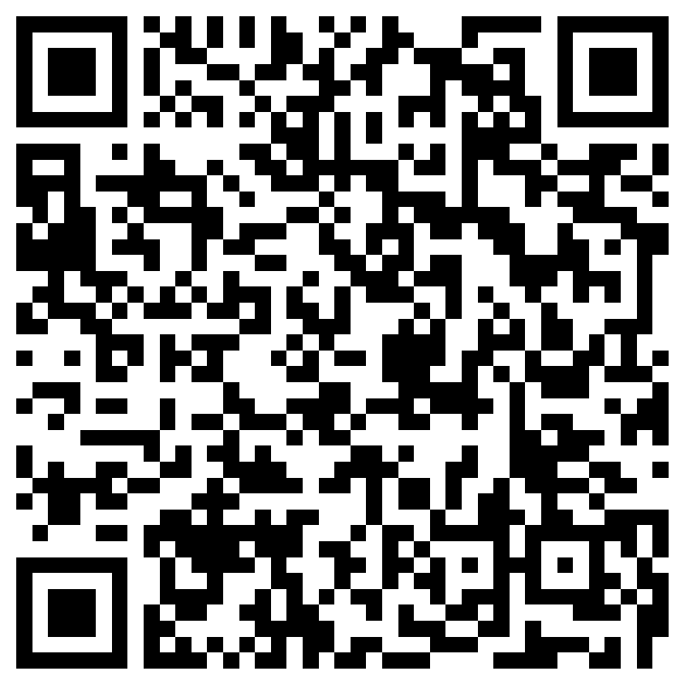
TELEICU JOURNAL CLUB 2022: SURVIVING SEPSIS CAMPAIGN: INTERNATIONAL GUIDELINES FOR MANAGEMENT OF SEPSIS AND SEPTIC SHOCK 2021
Evans, L., Rhodes, A., Alhazzani, W., Antonelli, M., Coopersmith, C. M., French, C., Machado, F. R., Mcintyre, L., Ostermann, M., Prescott, H. C., Schorr, C., Simpson, S., Wiersinga, W. J., Alshamsi, F., Angus, D. C., Arabi, Y., Azevedo, L., Beale, R., Beilman, G., . . . Levy, M. (2021). Surviving sepsis campaign: International guidelines for management of sepsis and septic shock 2021. Critical Care Medicine, 49(11), e1063-e1143. https://doi.org/10.1097/CCM.0000000000005337
Independent Study: ​September 20-October 31, 2022
Resource for Questions: Arlene Abadilla, RN, BSN, CCRN, TNCC (arlene.abadilla@aah.org) Jennifer Bilotta, RN, BSN, CCRN, TNCC (jennifer.bilotta@aah.org) Jinju Kim, RN, BSN, CCRN, TNCC (Jinju.kim@aah.org)
​
Desired Learner Outcome(s): Using a Likert scale, after participating in this event, learners will have an increased knowledge on early identification and appropriate management of sepsis and septic shock by passing the posttest with 80% or greater.
​
Continuing Nursing Education Hours:​
2.1 contact hours will be awarded upon successful completion of this program. ​
Criteria for Successful Completion: ​
Read the article. ​Article hyperlink: Surviving Sepsis Campaign: International Guidelines for Mana... : Critical Care Medicine (lww.com)
Complete online quiz via Microsoft with 80% passing grade. May be retaken.
Post-test QR code:
Credit awarded commensurate with participation.
Evaluations will be completed after the event. ​
Participants will have 28 days to complete the evaluation. ​
Upon submission of the evaluation, the participant will receive their certificate. ​
Disclosure: ​
None of the planners or presenters for this educational activity have relevant financial relationships to disclose with ineligible companies.​
Accreditation Statement: ​
Advocate Aurora Health is approved as a provider of nursing continuing professional development by the Ohio Nurses Association, an accredited approver by the American Nurses Credentialing Center's Commission on Accreditation. (OBN-001-91)​
Created by Arlene Abadilla/Nursing Created 8/16/2022 Revised 8/26/2022 Post until October 31, 2022

