Slide 1
Nursing Grand Rounds 2022 Q3
July: “Challenging Cases: Teamwork on the Frontline”
August: “OR Traffic Study: Multi-site Results”
September: “Pediatric Sepsis: Are you Sepsis Savvy?”
Marketing approach to support easy access.
We distribute the fliers in three (3) formats:
“Nursing Grand Rounds” Flier
Traditional flier for email and bulletin board posting
Contains ONA Contact Hour Information for Live/Virtual
Event and Self-Paced Learning Module
2) “Save the Date” Flier
Simple flier for display in the Unit Conference Rooms
Communication Board Announcement
Powerpoint flier for use in electronic boards

Slide 2
Nursing Grand Rounds-2022-Q3
SAVE THE DATE: July 21st, 2022 4:00-5:00 pm
Challenging Cases:
Teamwork on the Frontline
^{Presenters}:
Jake Brumbaugh, BSN, BM, RN
Aurora St. Luke’s Medical Center
Elizabeth Johnson, BSN, RN, CCRN
Advocate Children’s Hospital – PICU
Jamie Miller MSN, RN, NPD-BC &
Leah Stein-Fredbeck, BSN, RNC-OB
Advocate Condell Medical Center
^{Overview:}
AAH Team Members save lives every day! The NGR Committee wanted to give clinical nurses a chance to tell stories about challenging cases to celebrate teamwork and prepare for future experiences. This presentation will feature three nurses who will describe the patient problem, interventions, and lessons they learned that need to be shared.
Objectives: Participants will be able to:
^{1. Describe} the patient situations and how teamwork helped to address the problem.
2. Discuss lessons learned and recommendations for future use.
Desired Outcome: At the end of the presentation, participants will use a Likert Scale to rate their knowledge increase on using teamwork to manage challenging cases.
Continuing Nursing Education Hours: 1.0 contact hour will be awarded upon successful completion of each program.
Criteria for Successful Completion of each Program: Credit awarded commensurate with participation When evaluation submitted, participant will receive their certificate.
Disclosure: None of the planners or presenters for this educational activity have relevant financial relationships to disclose with ineligible companies.
Nursing Grand Rounds is sponsored by System Nursing Research Council
Virtual Sessions are held the 3rd Thursday of the month from 1600 – 1700 using
Microsoft Teams Webinar. You can access via QR code on flyers or on
AAH Nursing Hub-Shared Governance- Nursing Grand Rounds-July
The recorded sessions will be available as self-learning program (SLP)
in Workday from 8/1/22 to 12/31/22.
Questions? Please contact: Mary Hook, PhD, RN-BC – Lead Nurse Planner 414-218-0990 mary.hook@aah.org OR Cynde Garza – Project Coordinator Cynthia.Garza@aah.org
Accreditation Statement: Advocate Aurora Health is approved as a provider of nursing continuing professional development by the Ohio Nurses Association, an accredited approver by the American Nurses Credentialing Center's Commission on Accreditation. (OBN-001-91)​.
Created by M Hook Created 05/06/2022 Post until 12/31/2022

Slide 3
Nursing Grand Rounds
SAVE THE DATE
Thursday, July 21st 4pm -5pm
Challenging Cases: Teamwork on
the Frontline
Presenters:
Jake Brumbaugh, BSN, BM, RN – Aurora St Luke’s Medical Center
Elizabeth Johnson, BSN, RN, CCRN - Advocate Children’s Hospital – PICU
Jamie Miller MSN, RN, NPD-BC &
Leah Stein-Fredbeck, BSN, RNC-OB - Advocate Condell Medical Center
^{Overview:} AAH Team Members save lives every day! The NGR Committee wanted to give clinical nurses a chance to tell stories about challenging cases to celebrate teamwork and prepare for future experiences. This presentation will feature four nurses who will describe the patient problem, interventions, and lessons they learned that need to be shared. Participants will be able to describe the patient situations and how teamwork helped to address the problem, lessons learned and recommendations for future use.
1.0 contact hour will be awarded upon successful completion of program
Scan here to register and receive a calendar invite or join day of
Visit Events on AAH Nursing Hub->Shared Governance->Nursing Grand Rounds for a hyperlink to register
Created by Hook/Garza Created 05.11.22 Revised Post until 072122

Slide 4
Electronic Communication Board Insert

Slide 5
Photo source: HD photo by krakenimages (unsplash.com)

Slide 6
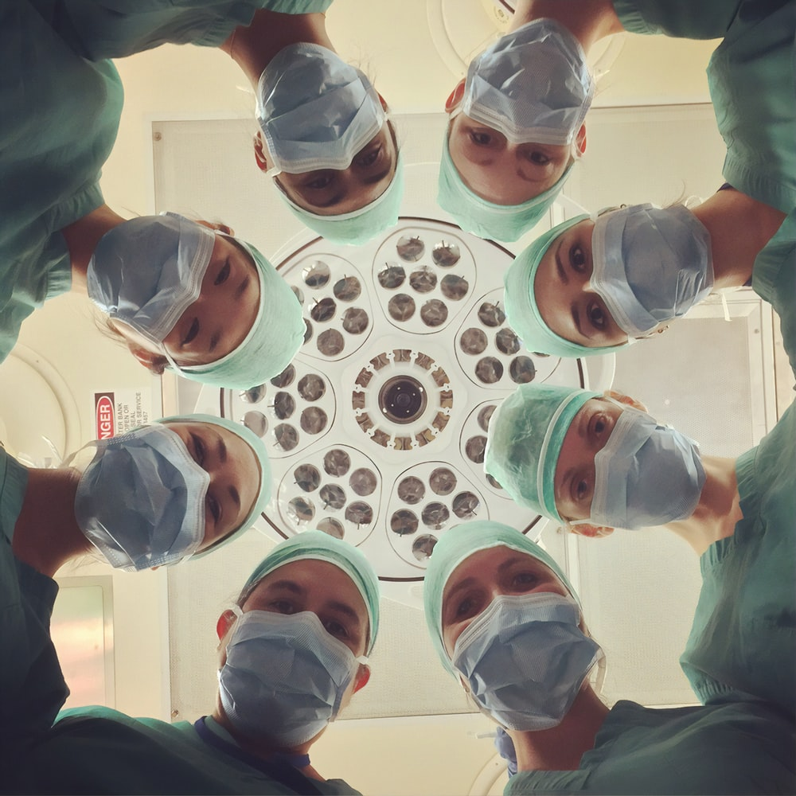
Nursing Grand Rounds-2022-Q3
SAVE THE DATE: August 18, 2022 4:00-5:00 pm
OR Traffic Study:
Multi-site Results
^{Presenters}:
Kimberly M. Mitchell MSN, RN, ACNS-BC, CNS-CP, CNOR
Margaret Kuehl, MSN, RN, CNOR
Mark Crucero MSN, RN, CNOR, CSSM, CNAMB, NE-BC
Stephanie Gore BSN, RN, CNOR
^{Overview:}
Hospital-acquired surgical site infections (SSI) are costly and may occur despite use of best practices for prevention in the operating room (CDC, 2020). This presentation will feature results from a multi-site research study designed to describe use of best practices, OR “traffic” patterns, and airborne microbial counts for colon and abdominal hysterectomy procedures.
Objectives: Participants will be able to:
^{1. Describe the study aims &} design describing care, traffic, and airborne microbial counts.
2. Discuss study findings and implications for patient care.
Desired Outcome: At the end of the presentation, participants will be asked to use a Likert Scale to rate their knowledge about findings and implications of the OR Traffic study.
Continuing Nursing Education Hours: 1.0 contact hour will be awarded upon successful completion of each program.
Criteria for Successful Completion of each Program: Credit awarded commensurate with participation When evaluation submitted, participant will receive their certificate.
Disclosure: None of the planners or presenters for this educational activity have relevant financial relationships to disclose with ineligible companies.
Nursing Grand Rounds is sponsored by System Nursing Research Council
Virtual Sessions are held the 3rd Thursday of the month from 1600 – 1700 using
Microsoft Teams Webinar. You can access via QR code on flyers or on
AAH Nursing Hub-Shared Governance- Nursing Grand Rounds-August
The recorded sessions will be available as self-learning program (SLP)
in Workday from 9/1/22 to 12/31/22.
Questions? Please contact: Mary Hook, PhD, RN-BC – Lead Nurse Planner 414-218-0990 mary.hook@aah.org OR Cynde Garza – Project Coordinator Cynthia.Garza@aah.org
Accreditation Statement: Advocate Aurora Health is approved as a provider of nursing continuing professional development by the Ohio Nurses Association, an accredited approver by the American Nurses Credentialing Center's Commission on Accreditation. (OBN-001-91)​.
Created by M Hook Created 06/03/2022 Post until 12/31/2022

Slide 7
Nursing Grand Rounds
SAVE THE DATE
Thursday, August 18th 4pm -5pm
OR Traffic Study: Multi-site Results
Presenters:
Kimberly M. Mitchell, MSN, RN, ACNS-BC, CNS-CP, CNOR
^{Margaret Kuehl, MSN, RN, CNOR}
Mark Crucero, MSN, RN, CNOR, CSSM, CNAMB, NE-BC
^{Stephanie Gore, BSN, RN, CNOR}
^{Overview:} Hospital-acquired surgical site infections (SSI) are costly and may occur despite use of best practices for prevention in the operating room (CDC, 2020). This presentation will feature results from a multi-site research study designed to describe use of best practices, OR “traffic” patterns, and airborne microbial counts for colon and abdominal hysterectomy procedures.
1.0 contact hour will be awarded upon successful completion of program
Scan here to register and receive a calendar invite or join day of
Visit Events on AAH Nursing Hub->Shared Governance->Nursing Grand Rounds for a hyperlink to register
Created by Hook/Garza Created 05.11.22 Revised Post until 081822

Slide 8
Electronic Communication Board Insert

Slide 9
https://unsplash.com/photos/701-FJcjLAQ

Slide 10
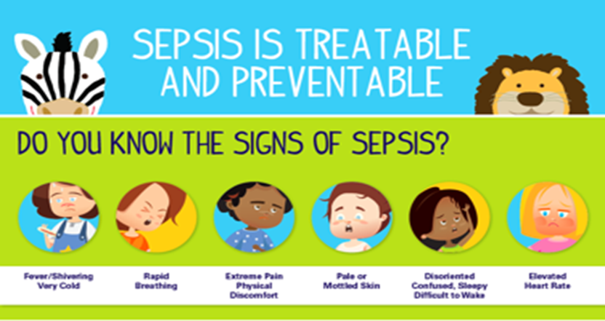
Nursing Grand Rounds-2022-Q3
SAVE THE DATE: September 15, 2022 4:00-5:00 pm
Pediatric Sepsis:
Are You Sepsis Savvy?
^{Presenters}:
Emily C. Dawson, MD
Megan Morgan, MSN, APRN, PCNS-BC, CPN
Allison Palhegyi, BSN, RN, CPEN
Advocate Children’s Hospital
^{Overview:}
In the US, more than 75,000 cases of sepsis each year with as many as 7,000 pediatric deaths. Many children who survive sepsis are left with long-term problems. This presentation will review the importance of early recognition and treatment within the first one hour to ensure the best outcomes for children.
Objectives: Participants will be able to:
^{1. Describe} sepsis as it relates to the pediatric population.
2. Understand the importance of time sensitive treatments in pediatric sepsis.
Desired Outcome: At the end of the presentation, participants will be asked to use a Likert Scale to rate their knowledge increase of care strategies to manage pediatric sepsis.
Continuing Nursing Education Hours: 1.0 contact hour will be awarded upon successful completion of each program.
Criteria for Successful Completion of each Program: Credit awarded commensurate with participation When evaluation submitted, participant will receive their certificate.
Disclosure: None of the planners or presenters for this educational activity have relevant financial relationships to disclose with ineligible companies.
Nursing Grand Rounds is sponsored by System Nursing Research Council
Virtual Sessions are held the 3rd Thursday of the month from 1600 – 1700 using
Microsoft Teams Webinar. You can access via QR code on flyers or on
AAH Nursing Hub-Shared Governance- Nursing Grand Rounds-Sept
The recorded sessions will be available as self-learning program (SLP)
in Workday from 10/1/22 to 12/31/22.
Questions? Please contact: Mary Hook, PhD, RN-BC – Lead Nurse Planner 414-218-0990 mary.hook@aah.org OR Cynde Garza – Project Coordinator Cynthia.Garza@aah.org
Accreditation Statement: Advocate Aurora Health is approved as a provider of nursing continuing professional development by the Ohio Nurses Association, an accredited approver by the American Nurses Credentialing Center's Commission on Accreditation. (OBN-001-91)​.
Created by M Hook Created 05/06/2022 Post until 09/15/2022

Slide 11
Nursing Grand Rounds
SAVE THE DATE
Thursday, September 15th 4pm -5pm
Pediatric Sepsis:
Are you Sepsis Savvy?
Presenters:
^{Emily C. Dawson, MD}
Megan Morgan, MSN, APRN, PCNS-BC, CPN
Allison Palhegyi, BSN, RN, CPEN
^{Overview:} In the US, more than 75,000 cases of sepsis each year with as many as 7,000 pediatric deaths each year. Many children who survive sepsis are left with long-term problems. This presentation will review the importance of early recognition and treatment within the first one hour to ensure the best outcomes for children.
1.0 contact hour will be awarded upon successful completion of program
Scan here to register and receive a calendar invite or join day of
Visit Events on AAH Nursing Hub->Shared Governance->Nursing Grand Rounds for a hyperlink to register
Created by Hook/Garza Created 05.11.22 Revised Post until 091522

Slide 12
Electronic Communication Board Insert

