Slide 1
Vulnerable Acutely Ill Older Adults: Lessons Learned from Covid-19
Emily Chai, MD
Professor, Icahn School of Medicine at Mount Sinai
Vice Chair, Inpatient Geriatrics and Palliative Medicine
Nov 2020

Slide 2
Objectives
At the end of the sessions, participants will:
Understand the impact COVID had on our older adult patients
Appreciate the challenges in caring for older adults in the COVID pandemic
Identify areas for improvement in the care of our older patients

Slide 3
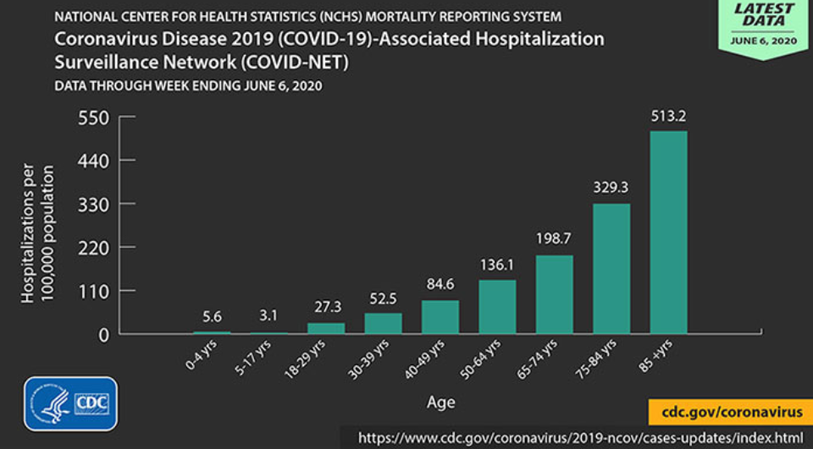
https://www.cdc.gov/coronavirus/2019-ncov/downloads/covid-data/hospitalization-death-by-age.pdf
Notes:
85+ 38.00%
75+ 62.39%
65+ 77.10%
50+ 87.18%

Slide 4
https://www.cdc.gov/coronavirus/2019-ncov/downloads/covid-data/hospitalization-death-by-age.pdf

Slide 5
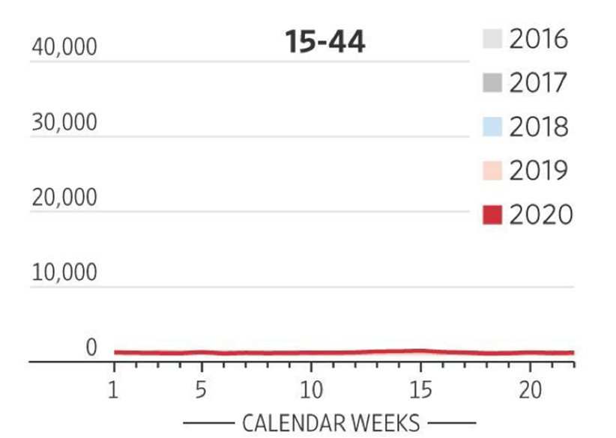
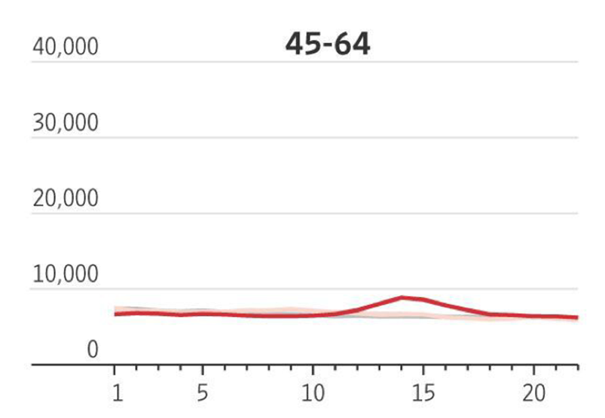
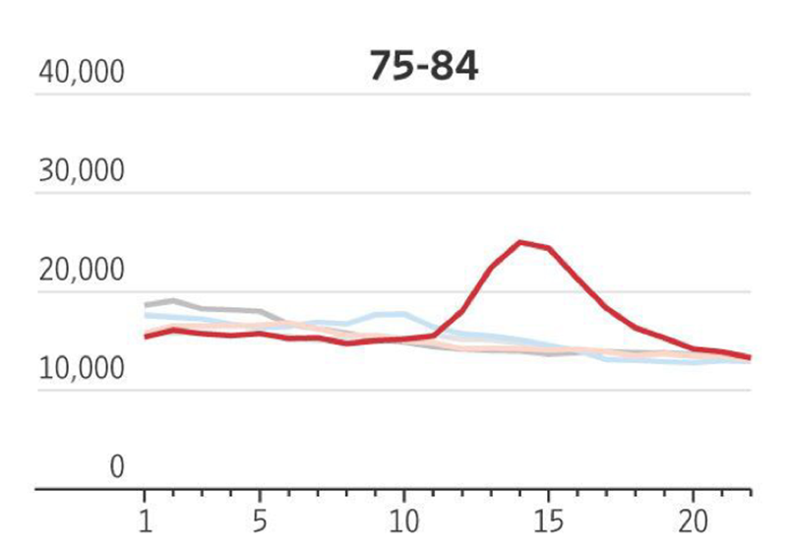
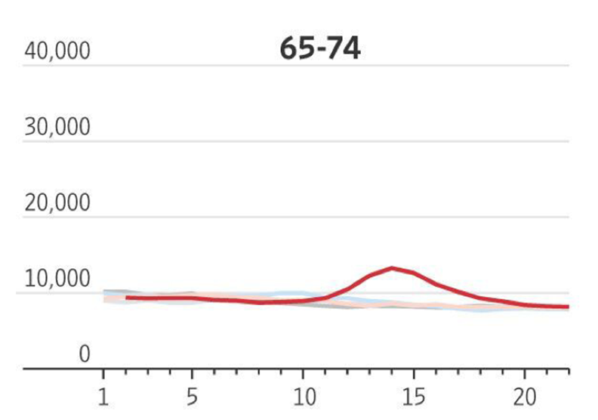
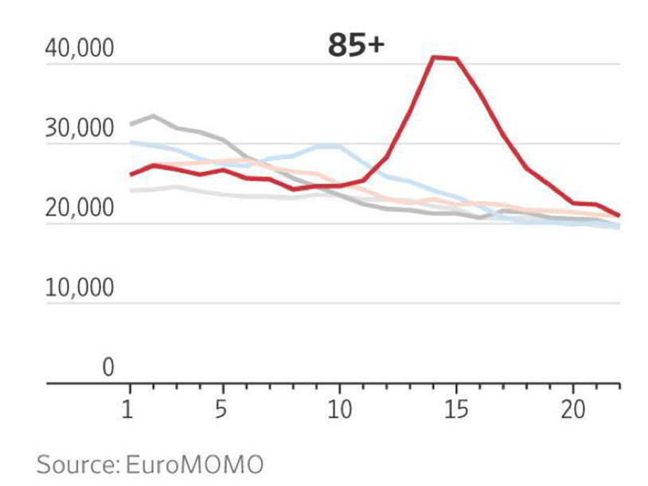
“Almost 80% of deaths linked to the coronavirus in Europe were in people over 75”
The Wall Street Journal June 27, 2020

Slide 6
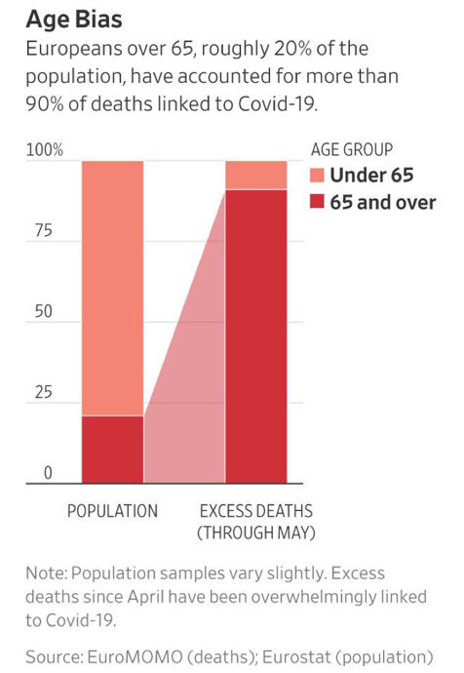
The Wall Street Journal June 27, 2020

Slide 7
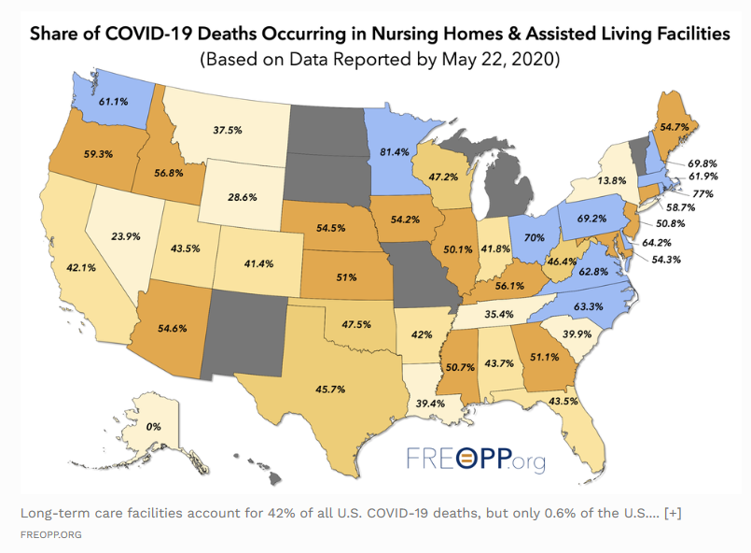
Forbes.com
Notes:
Let that sink in: 42% of all COVID-19 deaths are taking place in facilities that house 0.62% of the U.S. population.
And 42% could be an undercount. States like New York exclude from their nursing home death tallies those who die in a hospital, even if they were originally infected in a long-term care facility. Outside of New York, more than half of all deaths from COVID-19 are of residents in long-term care facilities.
The most charitable interpretation of these orders is that they were designed to ensure that states would not overcrowd their ICUs. But well after hospitalizations peaked, governors like New York’s Andrew Cuomo were doubling down on their mandates.
As recently as April 23, Cuomo declared that nursing homes “don’t have a right to object” to accepting elderly patients with active COVID infections. “That is the rule and that is the regulation and they have to comply with that.” Only on May 10—after the deaths of nearly 3,000 New York residents of nursing homes and assisted living facilities—did Cuomo stand down and partially rescind his order.

Slide 8
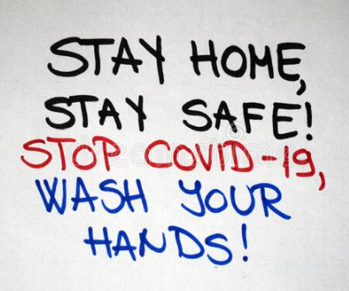
Mrs. L
79yo woman with HTN, mild OA and seasonal allergies. She heeded the recommendations of “Stay Home” and “ Wash Your Hands”.
She has not left the house since mid February when the first case was noted in NYC. She came down with COVID in April.
How?
Notes:
She moved in with her divorced daughter so she can help with the grandkids a few years ago.

Slide 9
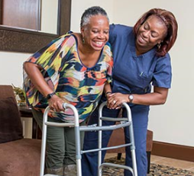
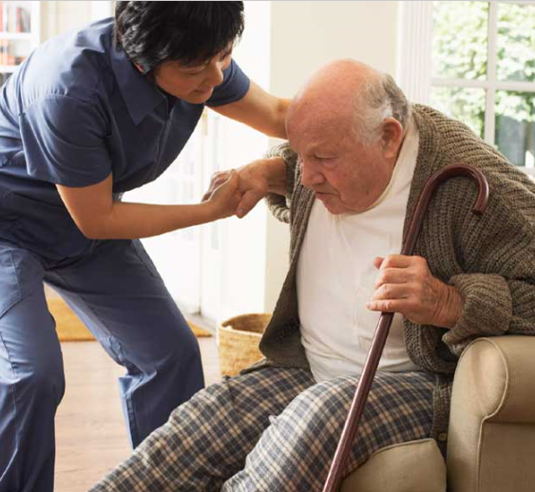
Lesson Learned
Caregivers need resources.
Many older adults do not live alone.
They are caregivers or require caregivers if not fully independent .
While they are staying “home”, others are in and out of their “homes”.
If they did stay “home”, who is going to help them with:
shopping?
meals?
Activities of Daily Living?

Slide 10
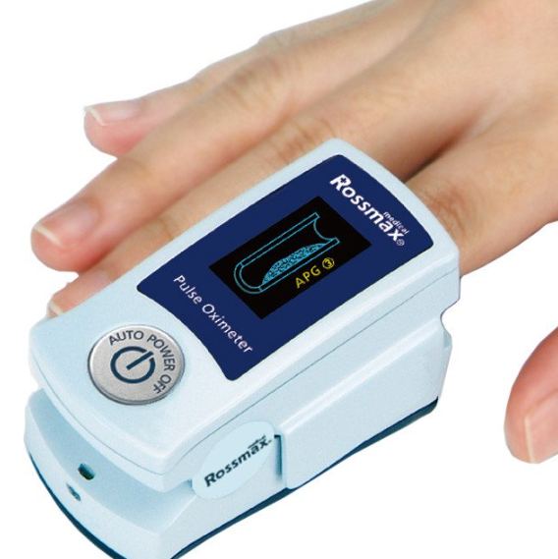
Mrs. L continued
Her daughter called because the patient’s pulse oximeter reading was 82%.
History revealed that the patient has been lethargic, tired and sleeping more the past 10 days or so. No fever, no cough, no SOB until she walked to the kitchen from her room while she talked on the phone.

Slide 11
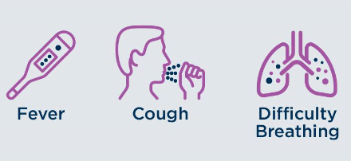
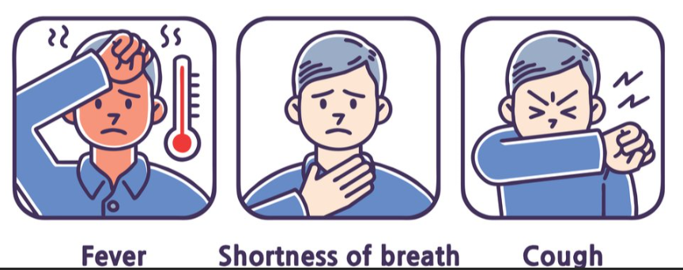
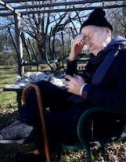
Lesson Learned
Presenting symptoms of COVID-19 may be different in older adults
Notes:
Some Older Adults present with only:
lethargy- sleeping more
extreme fatigue
confusion
decreased appetite
diarrhea

Slide 12
Mrs. L continued
Patient was asked to come to the emergency room and patient refused stating that “she is going to die” if she goes into the hospital.
Lesson Learned:
Older adults do not seek appropriate medical care because of fear of contracting the virus, fear of being at the bottom of hospital triage list and fear of further isolation given hospital visitor policies.

Slide 13
Mrs. L continued
Mrs. L’s daughter ultimately convinced her to come in to the ED. The daughter was asked to give a brief history and then told to leave given the visitor restriction policy.
Given patient’s poor respiratory status, patient was unable to give a coherent history. When the ED placed CPAP on the patient, she pulled it off. Is this an indication that she does not want treatment? Should she be supported with a ventilator if that is needed? She is 79 years old.

Slide 14
https://www.nationalreview.com/corner/deadly-covid-discrimination-against-the-elderly-in-sweden/

Slide 15
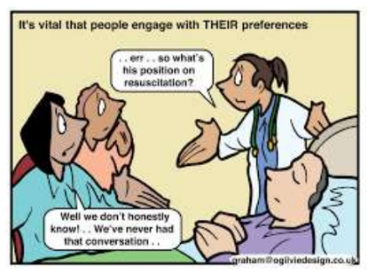
Lesson Learned--Rationing based on Age?
COMMUNICATION IS KEY-- Elucidating values, goals and treatment preferences are paramount in a pandemic
Understanding the hospital’s capacity is important.
Telemedicine-(PATCH)
Embedded PC/Geri in ED
Embedded PC/Geri in ICU
Notes:
She values time with her family. She travels all over the world independently. When her daughter initially called EMS, she said that she is not going to the hospital because she will die there. When asked about the medical treatments she would want, she said, “ talk to my daughters”.
The New York State guidelines for ventilator allocation rejected the use of advanced age as a criterion as discrimination against older adults. The guidelines specified that clinical factors must inform allocation, the use of age as a stand-alone factor is not necessary.
In a recent Journal of the American Medical Association article, a framework for allocation of ventilators and critical care beds focused on factors influencing likelihood to survive intensive care treatments and the presence of comorbid illnesses.
Age was only considered in cases in which inadequate resources were available for individuals in the same previously determined priority group. In this more dire situation, providing individuals equal opportunity to experience life stages is considered a tiebreaker.

Slide 16
Mrs. L continued
Patient was treated with standardized COVID-19 management plans. She was in a negative pressure 2 person room, with BIPAP. She had no visitors. She cannot identify the healthcare professionals coming into her rooms due to PPE. She cannot hear and understand what is being said b/c of BIPAP and the negative pressure pumps. ( English was not her first language although she typically speaks conversational English without a problem.)
She got more anxious and agitated.

Slide 17
Lesson Learned
DELIRIUM worsened by the COVID 19
Severe sensory deprivation
Can’t hear
Can’t see
Can’t taste and smell ( COVID-19)
Can’t touch- isolation
Amplifier
Headsets
Reverse stethoscope
Notes:
I would say that for older adults, these sensory deprivation is worse than in youger patients because they did not have the reserves that younger adults have.

Slide 18
Mrs. L continued
Her anxiety and delirium made her respiratory status more tenuous and 3 days after admission, she was intubated. She developed renal failure, hypotension and 14 days later, her heart stopped.

Slide 19
Prognostic Data in Older Adults
Prognostic data -- high morbidity and mortality
For individuals of all ages surviving a critical case of COVID-19, hospitalizations are long (median 17 days) as is the duration of mechanical ventilation (median 10 days) and may be even lengthier for older adults.
Onder G, Rezza G, Brusaferro S. Case-fatality Rate and Characteristics of Patients dying in relation to COVID-19 in Italy. Published online March 23, 2020. doi:10.1001/jama.2020.4683
Zhou F, Yu T, Du R et al. Clinical course and risk factors for mortality of adult inpatients with COVID-19 in Wuhan, China: a retrospective cohort study. The Lancet. 2020;395:1054-1062.doi:10.1016/S0140-6736(20)30566-3
Wu Z, McGoogan JM. Characteristics of and Important Lessons From the Coronavirus Disease 2019 (COVID-19) Outbreak in China: Summary of a Report of 72 314 Cases From the Chinese Center for Disease Control and Prevention. JAMA. 2020; 323(13):1239– doi:10.1001/jama.2020.2648

Slide 20
Where were patients dying in New York City?
https://www1.nyc.gov/site/doh/covid/covid-19-data-deaths.page, accessed 10/11/20

Slide 21
Home PPE Oxygen Caregivers ( HHAs) [PC@Home, H@H, Hospice]
ALF
(NH/SNF)
Education: ACP/Symptoms
PPE
Oxygen
Isolated COVID units
Telemedicine consultation
Telemedicine
Recovery?
Physical location
Integrated into existing space
Hospital/Health System
Hospice Agencies
Electronic consents
Staffing
PPE
oxygen
Home
Lack of caregivers
Lack of PPEs
Lack of oxygen
[PC@Home, H@H, Hospice]
Telemedicine: access and readiness
ALF
Limited COVID units
PPE
Oxygen
Staffing
Telemedicine consultation

Slide 22
Lesson Learned
Delays in policy response and implementation that directly addresses the needs of older adults– in NH, ALF and in the home made HOSPITALS the only point of care.
Delays in PPE for settings caring for older adults
Delays in visitor restriction
Failure to prioritize older adults and caregivers for testing
Proper quarantine for staff and patients
Notes:
ew York, New Jersey, Michigan forced nursing homes to accept infected patients
Instead, states like New York, New Jersey, and Michigan actually ordered nursing homes to accept patients with active COVID-19 infections who were being discharged from hospitals.
The most charitable interpretation of these orders is that they were designed to ensure that states would not overcrowd their ICUs. But well after hospitalizations peaked, governors like New York’s Andrew Cuomo were doubling down on their mandates.
As recently as April 23, Cuomo declared that nursing homes “don’t have a right to object” to accepting elderly patients with active COVID infections. “That is the rule and that is the regulation and they have to comply with that.” Only on May 10—after the deaths of nearly 3,000 New York residents of nursing homes and assisted living facilities—did Cuomo stand down and partially rescind his order.
Contrast the decisions by governors like Cuomo with those of Florida Gov. Ron DeSantis. In Florida, all nursing home workers were required to be screened for COVID-19 symptoms before entering a facility. On March 15, before most states had locked down, DeSantis signed an executive order that banned nursing home visitations from friends and family, and also banned hospitals from discharging SARS-CoV-2-infected patients into long-term care facilities.
Florida also prioritized long-term care facilities for personal protective equipment, or PPE, with the understanding that it was just as important, if not more so, to protect workers at nursing homes and assisted living facilities. “If I can send PPE to the nursing homes, and they can prevent an outbreak there, that’s going to do more to lower the burden on hospitals than me just sending them another 500,000 N95 masks,” said DeSantis.
It showed up when the management of your parent’s assisted living, memory care, or skilled nursing facility asked for help from their state or county government in securing personal protective equipment (PPE) for their staff and residents. They were told to get in line behind hospitals, medical personnel, government facilities, and military installations. Test kits? Same story. They are victims of our government’s unwillingness to prioritize the health and safety of older adults and those who care for them.

Slide 23
Mrs. M
88 yo Russian woman with moderate dementia and moderate OA and uses a walker. She has 2.5 weeks of increasing lethargy, fatigue and decreased appetite. She has been cared for by different aides coming in and out of her home. Fatigue was initially attributed to progression of her dementia. Her daughter finally called because pt was cognitively back to her baseline but continued not to eat and drink. Home labs revealed that she was hypernatremic, hyperkalemic and in AKI with severe dehydration. She was brought into the hospital for evaluation. She was noted to have a DVT, was COVID negative and Ab positive.

Slide 24
Lesson Learned: Dementia and COVID 19
Patients with dementia who cannot express themselves may have symptoms that look like the delirium associated with dementia-- COVID 19 can go undiagnosed.
Notes:
Many people with dementia who fall ill also can’t express their symptoms, and early coronavirus markers may look similar to their other pre-existing conditions. That means the illness can go undiagnosed in the early stages

Slide 25
Mrs. M
Her electrolytes were corrected and her AKI improved. She was started on heparin and transitioned to a novel anticoagulants (NOACs)
Her mental status was back to baseline. She was extremely debilitated. The team had an elaborate discharge plan in place for the patient to go home.

Slide 26
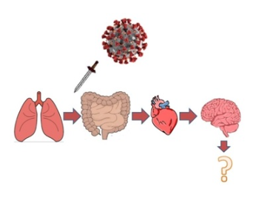
Lesson learned: There is so much we do not know
Older adults may survived COVID but not the sequela:
Renal failure
Chronic resp failure
Heart failure from Cardiomyopathy
Brain failure from CVAs
Debility from the prolong hospitalization and the limited access to early rehabilitation
Emotional distress from social isolation
Transitional care planning or COVID recovery planning is crucial for survivors who leave the hospital
Post hospitalization care is more complicated --emotional, psychological and spiritual distress
Even if they come into the hospital functional, they leave with debility and often cannot go back to the “ home” known to them.
Notes:
Post hospitalization care is more complicated than the delirium or the debility that we typically see—emotional, psychological and spiritual distress that may not be as readily observed
Even if they come into the hospital functional, they leave with debility and often cannot go back to the “ home” known to them. Many have no place to go once their disease improves. They end up dying in the hospital because of restrictions in facility OR in the home due to lack of caregivers.

Slide 27
Telemedicine and Older Adults
What if Mrs. M went home? Could she have benefited from telemedicine?
Challenges:
Cognitive and functional impairment
Hearing loss
Visual impairment-- loss of some visual cues: gestures, lip reading and facial expressions
Limited technology access and proficiency

Slide 28
Assessing Telemedicine Unreadiness Among Older Adults in the United States During the COVID-19 Pandemic
Older adults account for about 25% of all physician office visits
For 2018, about 13 million (38%) older adults were not ready
72% of adults 85+ years met criteria for unreadiness
Unreadiness was more prevalent in patients who were:
Older
Men
not married
Black or Hispanic individuals
resided in a nonmetropolitan area
had less education
lower income
poorer self-reported health
Lam K, Lu AD, Shi Y, Covinsky KE. Assessing Telemedicine Unreadiness Among Older Adults in the United States During the COVID-19 Pandemic. JAMA Intern Med. Published online August 03, 2020.
Notes:
Assuming individuals in the role of social supports knew
howtosetupavideovisit, the estimatednumberof older adults
whowere still unready was 10.8 million (32%).

Slide 29
What did we learned?
Covid-19 pandemic affects older adults differently
Isolation works to decrease the spread of disease but public policy does not adequately address the needed help in dependent older adults
Delayed management and treatment due to complicated presenting features and limited resources
Hazards of hospitalization exacerbated
Transitional care planning or COVID recovery planning is crucial for older survivors
Telemedicine which was the cornerstone of medical care for many patients during COVID left many older adults behind.
Notes:
Pandemic may exacerbated Ageism – they are older so they should forego the ventilator. While many pandemic protocols do take age and prognosis into consideration. We saw this when resources were not limited and at the very beginning of the pandemic
Isolation which works to decrease the spread of disease does not work in dependent older adults, alternative plans need to be in place ( food, socialization—all these complicated by disability, sensory impairments) Looks for non verbal signs of communication
In the acutely ill older adult: delay in presentation due to limited resources, traveling challenges, complicated presenting features and coexisting co morbidities may delay management and treatment
Pandemic exacerbated the hazards of hospitalization→ lessons learned: sensory impairment adjustments, Increased PT, Increase staff to manage debility
Advance care planning is crucial in pandemic: system planning is needed to ensure older adults have what they need in the community to stay safe and individualized ACP which involves the values and preferences of older adults to ensure that treatments are aligned with wishes.
Transitional care planning or COVID recovery planning is crucial for survivors who leave the hospital ( the work post hospitalization is more complicated than the delirium or the debility that we typically see—emotional, psychological and spiritual distress that may not be as readily observed) Even if they come in functional, they leave with debility and often cannot go back to the “ home” known to them.
Telemedicine which was the cornerstone of medical care for all patients during COVID left many older adults behind.

Slide 30
Home PPE Oxygen Caregivers ( HHAs) [PC@Home, H@H, Hospice]
ALF
(NH/SNF)
Education: ACP/Symptoms
PPE
Oxygen
Isolated COVID units
Telemedicine consultation
Telemedicine
Recovery?
Physical location
Integrated into existing space
Hospital/Health System
Hospice Agencies
Electronic consents
Staffing
PPE
oxygen
Home
Lack of caregivers
Lack of PPEs
Lack of oxygen
[PC@Home, H@H, Hospice]
Telemedicine: access and readiness
ALF
Limited COVID units
PPE
Oxygen
Staffing
Telemedicine consultation

Slide 31
Notes:
This is just a reminder that “There is still so much we don’t know about COVID 19”

