Slide 1
An Introduction to Behavioral Health Pharmacotherapy for Non-Prescribing Clinicians
December 11, 2019
Krista Rice, PharmD | Amanda Dresser, PharmD, BCPS

Slide 2
Objectives
Describe the mechanism of action for Selective Serotonin Reuptake Inhibitors (SSRIs)
List three potential adverse drug reactions (ADRs) associated with antipsychotic medications
Identify three types of medications which have drug-drug interactions with lithium

Slide 3
Outline
Introduction
Anxiolytics
Antidepressants
Antipsychotics
Mood Stabilizers
Medications for substance-related disorders

Slide 4
Introduction

Slide 5
Introduction
Definitions
Drug
a natural product, chemical substance, or pharmaceutical preparation intended for administration to a human or animal to diagnose or treat a disease
Pharmacology
the study of drugs and their effects on life processes
Pharmacotherapeutics
medical science concerned with the use of drugs in the treatment of disease
Stevens, Craig W., and George M. Brenner. Brenner and Stevens' Pharmacology. Elsevier, 2018.

Slide 6
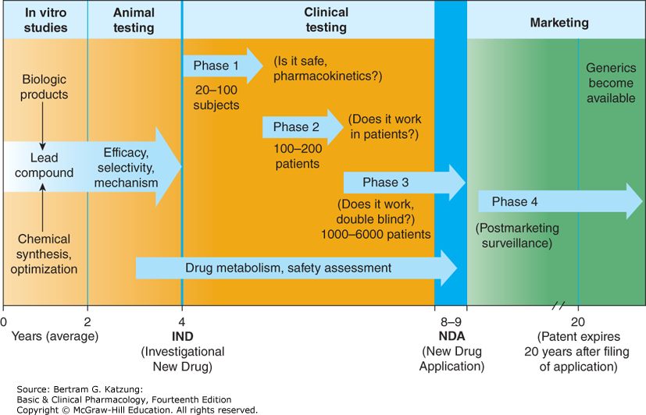
Introduction
Food and Drug Administration (FDA)
Drug development
and regulation
Black Box Warning

Slide 7
Introduction
Tablets | Capsules | Liquids (Solutions, Suspensions, Syrups, Elixirs)
Drug preparations
Several medications have a controlled-release formulation
Examples:
CD = controlled delivery
CR = controlled release
LA = long acting
SR = sustained release
ER = extended release
XL = extended release
XR = extended release
Skin Patches | Aerosols | Topical products (Ointments, Creams, Lotions) | Suppositories
Image: https://health.clevelandclinic.org/get-prescribed-counter-medications/

Slide 8
Introduction
Routes of Administration
Examples:
Oral (PO)
Sublingual (SL)
nasal
topical
Intravenous (IV)
Subcutaneous (SQ)
Intramuscular (IM)
Inhalation
Notes:
-

Slide 9
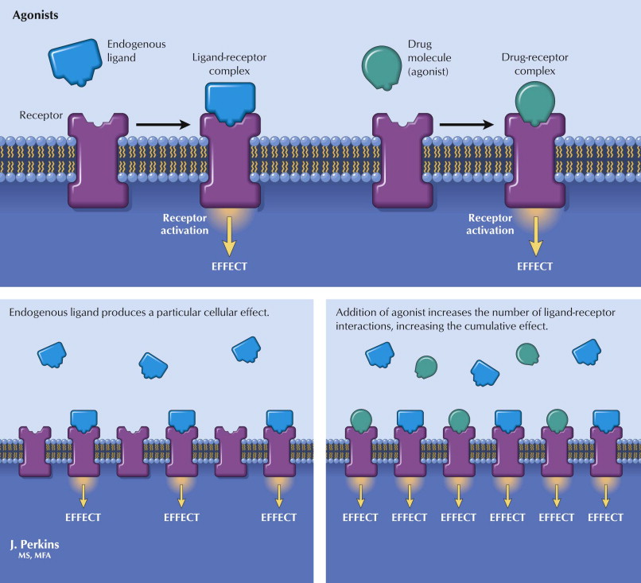
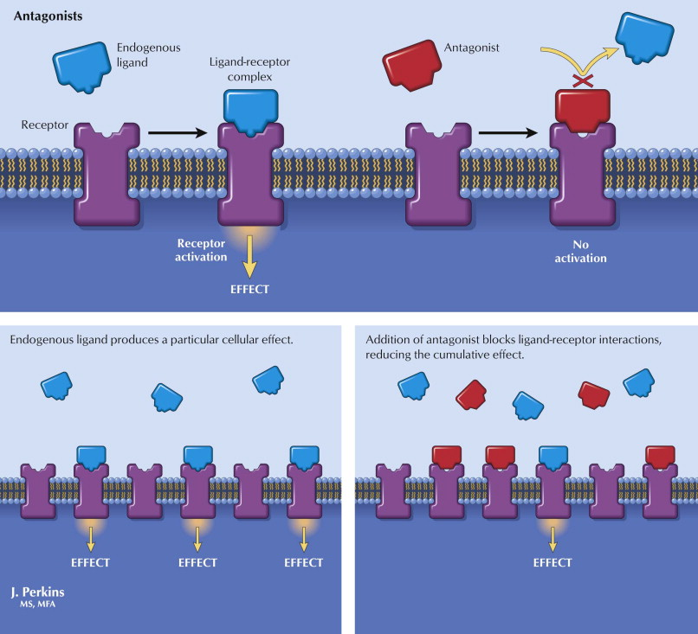
Introduction
Raffa, R. B., Rawls, S. M., Beyzarov, E. P., & Netter, F. H. (2014). Netters illustrated pharmacology. Philadelphia, PA: Saunders/Elsevier.

Slide 10
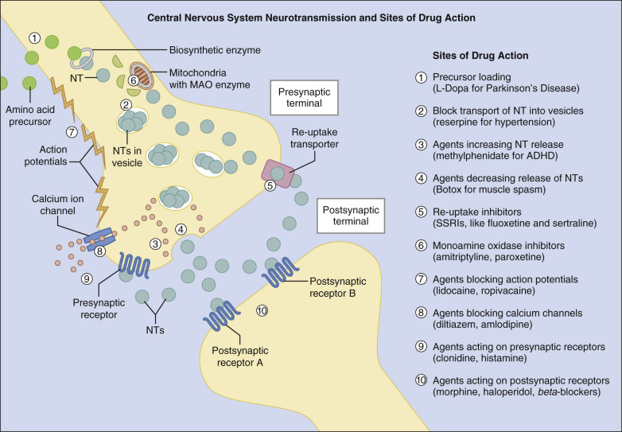
Introduction
Central Nervous System (CNS)
Brain and spinal cord
Neurons (cells)
Neurotransmitters
Acetylcholine
GABA
Glutamate
Dopamine
Norepinephrine
Serotonin
Stevens, Craig W., and George M. Brenner. Brenner and Stevens' Pharmacology. Elsevier, 2018.

Slide 11
Introduction
Drug Interactions
Defined as a change in the pharmacologic effect of a drug that results when it is given concurrently with another drug or with food
Examples:
Altered absorption/excretion
Additive or antagonistic effects
Stevens, Craig W., and George M. Brenner. Brenner and Stevens' Pharmacology. Elsevier, 2018.

Slide 12
Introduction
This presentation will not discuss:
Child and adolescent dosing of medications
Use of medications during pregnancy or breastfeeding
Non FDA-approved uses for medications

Slide 13
Anxiolytics

Slide 14
Antidepressants
Antidepressants with FDA Approved Indications for Select Anxiety Disorders
 | General anxiety disorder (GAD) | Panic disorder (PD) | Post-traumatic stress disorder (PTSD) | Obsessive-compulsive disorder (OCD) | Social anxiety disorder (SAD)
Sertraline |  | X | X | X | X
Paroxetine | X | X | X | X | X
Escitalopram | X
Fluoxetine |  | X |  | X
Fluvoxamine |  |  |  | X
Venlafaxine XR | X | X |  |  | X
Duloxetine | X
Clomipramine |  |  |  | X
2016-2017 Psychiatric Pharmacotherapy Review. College of Psychiatric and Neurologic Pharmacists, 2016.

Slide 15
Benzodiazepines
FDA Approved Benzodiazepines for Anxiety Disorder
Alprazolam | Chlordiazepoxide | Clorazepate
Clonazepam | Diazepam | Lorazepam
 | Oxazepam

Slide 16
Benzodiazepines
Effective in the acute treatment of anxiety and provide rapid relief of symptoms
Should only be used for 2-3 weeks until the antidepressant begins to work
Long term use not recommended because of concerns for physiological and psychological dependence
2016-2017 Psychiatric Pharmacotherapy Review. College of Psychiatric and Neurologic Pharmacists, 2016.

Slide 17
Other Anxiolytics
FDA approved | Not FDA approved
Buspirone (GAD) | Other antidepressants
Hydroxyzine (GAD) | Gabapentin
 | Pregabalin
 | Tigabine
 | Second generation antipsychotics
 | Anticonvulsants
 | Prazosin
 | Clonidine
 | Beta blockers
2016-2017 Psychiatric Pharmacotherapy Review. College of Psychiatric and Neurologic Pharmacists, 2016.

Slide 18
Mechanisms of Action
States of fear and anxiety are associated with an increase in norepinephrine (NE) release
Anxiolytic medications decrease NE activity
Increased release of other inhibitory neurotransmitters
Gamma-Amino Butyric Acid (GABA)
Serotonin (5-HT)
2016-2017 Psychiatric Pharmacotherapy Review. College of Psychiatric and Neurologic Pharmacists, 2016.

Slide 19
Dosing
Benzodiazepine | Usual dose range (given in divided doses)
Alprazolam | 0.75 to 2 mg/day
Chlordiazepoxide | 15 to 40 mg/day (mild-moderate) 60 to 100 mg/day (severe)
Clonazepam | 1 mg/day
Clorazepate | 15 to 60 mg/day
Diazepam | 4 to 40 mg/day
Lorazepam | 2 to 3 mg/day
Oxazepam | 30 to 60 mg/day (mild-moderate) 45 to 120 mg/day (severe)
2016-2017 Psychiatric Pharmacotherapy Review. College of Psychiatric and Neurologic Pharmacists, 2016.

Slide 20
Side Effects
Antidepressants:
Dizziness, GI issues, sleep disturbances
Benzodiazepines:
Effects on central nervous system (CNS)
Drowsiness, sedation, psychomotor impairment
Disorientation, depression, confusion, irritability, aggression
Impairment of memory and recall
Abuse, dependence, withdrawal
2016-2017 Psychiatric Pharmacotherapy Review. College of Psychiatric and Neurologic Pharmacists, 2016.

Slide 21
Discontinuing Benzodiazepines
Need to slowly taper off benzodiazepines to avoid withdrawal symptoms
Common Withdrawal Symptoms | Less Common Withdrawal Symptoms
Anxiety | Seizures
Insomnia | Paranoid delusions
Restlessness | Hallucinations
Muscle tension | Nightmares
Irritability | Tinnitus
 | Diaphoresis
 | Blurred vision
 | Nausea
2016-2017 Psychiatric Pharmacotherapy Review. College of Psychiatric and Neurologic Pharmacists, 2016.

Slide 22
Discontinuing Benzodiazepines
Recommend 25% dose reduction per week until 50% of dose is reached, then reduce by 1/8 every 4-7 days
2016-2017 Psychiatric Pharmacotherapy Review. College of Psychiatric and Neurologic Pharmacists, 2016.

Slide 23
Knowledge Check #1
The following medications are FDA approved to treat anxiety EXCEPT
Buspirone
Gabapentin
Hydroxyzine
Sertraline

Slide 24
Knowledge Check #2
A patient is being discharged from your hospital and the doctor wants to stop the alprazolam the patient had previously been taking the last 4 months. What is the most appropriate way to do this?
Discontinue the alprazolam at discharge
Taper the alprazolam over 1 week
Taper the alprazolam over 3 weeks
Taper the alprazolam over 6 weeks

Slide 25
Antidepressants

Slide 26
Antidepressants
Commonly prescribed antidepressants
Selective Serotonin Reuptake Inhibitors (SSRIs)
Serotonin Norepinephrine Reuptake Inhibitors (SNRIs)
Others
Bupropion
Mirtazapine
Vilazodone
Vortioxetine

Slide 27
Antidepressants - SSRIs
 | FDA Approved Indications for SSRIs
 | Depression | Generalized Anxiety Disorder | Bipolar Major Depression | Bulimia Nervosa | Obsessive Compulsive Disorder | Panic Disorder | Premenstrual Dysphoric Disorder | Post-traumatic Stress Disorder | Social Anxiety Disorder
 |  |  |  |  |  |  |  |  |  | Usual dose range
Citalopram | x |  |  |  |  |  |  |  |  | 20-40 mg/day
Escitalopram | x | x |  |  |  |  |  |  |  | 10-20 mg/day
Fluoxetine | x |  | x* | x | x | x | x |  |  | 10-80 mg/day
Fluvoxamine |  |  |  |  | x |  |  |  |  | 50-300 mg/day
Paroxetine | x | x |  |  | x | x | x | x | x | 10-50 mg/day
Sertraline | x |  |  |  | x | x | x | x | x | 25-200 mg/day
*In combination with olanzapine
Stahl, S. M. (2014). Stahl's essential psychopharmacology Prescriber's Guide (5th ed.). Cambridge University Press.

Slide 28
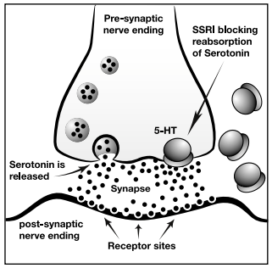
Antidepressants - SSRIs
Mechanism of Action (MOA)
YouTube Clip: https://www.youtube.com/watch?v=uiXcAbrO8kU
Lattimore, KA, et al. J Perinatol. 2005;25(9):595-604.

Slide 29
Antidepressants- SNRIs
 | FDA Approved Indications for SNRIs
 | Depression | Generalized Anxiety Disorder | Fibromyalgia | Chronic Musculoskeletal Pain | Diabetic Peripheral Neuropathy | Panic Disorder | Social Anxiety Disorder
 |  |  |  |  |  |  |  | Usual dose range
Duloxetine | x | x | x | x | x |  |  | 40-120 mg/day
Venlafaxine | x | x |  |  |  | x | x | 75-225 mg/day
Desvenlafaxine | x |  |  |  |  |  |  | 50-100 mg/day
Milnacipran |  |  | x |  |  |  |  | 12.5 mg-300 mg/day
Levomilnacipran | x |  |  |  |  |  |  | 20-120 mg/day
Stahl, S. M. (2014). Stahl's essential psychopharmacology Prescriber's Guide (5th ed.). Cambridge University Press.

Slide 30
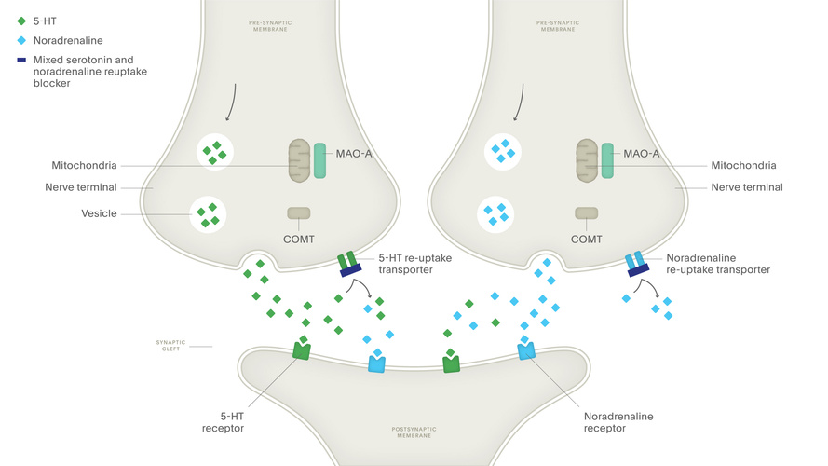
Antidepressants - SNRIs
Image: https://institute.progress.im/en/content/mechanism-action-selective-serotonin-and-noradrenaline-re-uptake-inhibitors-snris

Slide 31
Antidepressants - Others
 | FDA Approved Indications for SNRIs
 | Depression | Seasonal Affective Disorder | Smoking Cessation
 |  |  |  | Usual dose range | MOA
Bupropion | x | x (XL) | x (SR) | IR/SR: 200-450 mg/day XL: 150-450 mg/day | ↑ dopamine and norepinephrine
Mirtazapine | x |  |  | 7.5 – 45 mg/day | ↑ serotonin and norepinephrine, blocks H1 histamine receptors
Vilazodone | x |  |  | 10-40 mg/day | SSRI, additional effects on serotonin receptors
Vortioxetine | x |  |  | 5-20 mg/day | SSRI, additional effects on serotonin receptors
Stahl, S. M. (2014). Stahl's essential psychopharmacology Prescriber's Guide (5th ed.). Cambridge University Press.

Slide 32
Antidepressants
Start at low dose
Titrate to a dose that is tolerable and effective
May take 4-6 weeks to notice a therapeutic effect
Side effects may precede therapeutic benefit

Slide 33
Antidepressants – Side Effects
Common Side Effects Associated with Antidepressants
Anxiety | Dizziness | Constipation
Insomnia | Nausea/Vomiting | Dry mouth
Sedation | Diarrhea | Increased blood pressure (SNRIs, bupropion)
Headache | Sexual dysfunction (less with mirtazapine and bupropion) | Fast heart rate/Palpitations (SNRIs, bupropion)
 | Increased appetite (mirtazapine)
2016-2017 Psychiatric Pharmacotherapy Review. College of Psychiatric and Neurologic Pharmacists, 2016.

Slide 34
Antidepressants – Side Effects
Black Box Warning
Increased risk of suicidal thinking and behavior
Children
Adolescents
Young adults (age 18-24)

Slide 35
Serotonin Syndrome
Excess stimulation of serotonin receptors
Typically occurs within hours
After starting medication regimen
After dose increase
Two or more serotonergic medications being used
Drug-drug interactions
Signs and Symptoms of Serotonin Syndrome
Agitation | Akathisia | Muscle rigidity | Confusion | High blood pressure | Overactive reflexes
Sweating | Diarrhea | Fever | Clonus | Tremor | Increased heart rate
Bartlett, D. (2017). Drug-Induced Serotonin Syndrome. Critical Care Nurse, 37(1), 49–54

Slide 36
Serotonin Syndrome
Agents That Cause Serotonin Syndrome
Amphetamine | Buspirone
Cocaine | Dextromethorphan
Fentanyl | Linezolid
Lysergic acid diethylamide (LSD) | Monoamine oxidase inhibitors (MAOIs)
3,4- Methylene dioxymethamphetamine (MDMA; ecstasy) | SSRIs
SNRIs | St. John’s Wort
Sumatriptan | Tramadol
Tricyclic antidepressants | Tryptophan
Bartlett, D. (2017). Drug-Induced Serotonin Syndrome. Critical Care Nurse, 37(1), 49–54

Slide 37
Serotonin Syndrome
Treatment
Stop offending medication(s)
Symptom management and supportive care
Often resolves within 24 hours
Fatalities are rare
Bartlett, D. (2017). Drug-Induced Serotonin Syndrome. Critical Care Nurse, 37(1), 49–54

Slide 38
Discontinuation Syndrome
F | Flu-like symptoms | Lethargy, fatigue, headache, achiness, sweating
I | Insomnia | Vivid dreams or nightmares
N | Nausea | Vomiting
I | Imbalance | Dizziness, vertigo
S | Sensory disturbances | Burning, tingling, shock-like sensations
H | Hyperarousal | Anxiety, irritability, agitation, aggression
Tapering medications over several weeks can help reduce the risk
CMAJ 2017 May 29;189:E747.

Slide 39
Knowledge Check #1
What is the mechanism of
fluoxetine (SSRI)?
Increases dopamine in the synapse
Decreases dopamine in the synapse
Increases serotonin in the synapse
Decreases serotonin in the synapse

Slide 40
Knowledge Check #2
PL is a 19 year old male who started taking duloxetine (SNRI) one week ago for depression. At his follow-up appointment he is discouraged because he feels his mood has not improved and is now experiencing nausea and headache from the medication.

Slide 41
Knowledge Check #2
Which of the following is FALSE?
Duloxetine increases both serotonin and norepinephrine in the synapse
The medication should be fully “kicked-in” by second week
Patient should be monitored for worsening suicidal thoughts
Nausea and headache are common side effects when starting an antidepressant

Slide 42
Antipsychotics

Slide 43
Antipsychotics
First-generation antipsychotics (FGAs)
Typical antipsychotics
Second-generation antipsychotics (SGAs)
Atypical antipsychotics
Long acting injectable (LAI) antipsychotics

Slide 44
Schizophrenia Symptoms
Positive symptoms
Hallucinations
Delusions
Negative symptoms
Flat affect
Anhedonia
Cognitive symptoms
Memory deficits
Difficulty maintaining attention
Disorganized speech
Alogia
Deficits in reasoning/executive functioning
2016-2017 Psychiatric Pharmacotherapy Review. College of Psychiatric and Neurologic Pharmacists, 2016.

Slide 45
First Generation Antipsychotics
FDA Approved Indications for FGAs
 | Bipolar Mania | Schizophrenia | Psychotic Disorder | Nonpsychotic Anxiety
Chlorpromazine | X | X | X
Fluphenazine |  | X
Haloperidol |  | X
Loxapine |  | X
Perphenazine |  | X
Thiothixene |  | X | X
Trifluoperazine |  | X |  | X
2016-2017 Psychiatric Pharmacotherapy Review. College of Psychiatric and Neurologic Pharmacists, 2016.

Slide 46
Second Generation Antipsychotics
FDA Approved Indications for SGAs
 | Schizophrenia | Bipolar Disorder | Major Depressive Disorder (MDD) | Treatment Resistant Schizophrenia
Aripiprazole | X | X | X
Asenapine | X | X
Brexpiprazole | X |  | X
Cariprazine | X | X
Clozapine |  |  |  | X
Lurasidone | X | X
Olanzapine | X | X
Paliperidone | X
Quetiapine | X | X | X
Risperidone | X | X
Ziprasidone | X | X
2016-2017 Psychiatric Pharmacotherapy Review. College of Psychiatric and Neurologic Pharmacists, 2016.

Slide 47
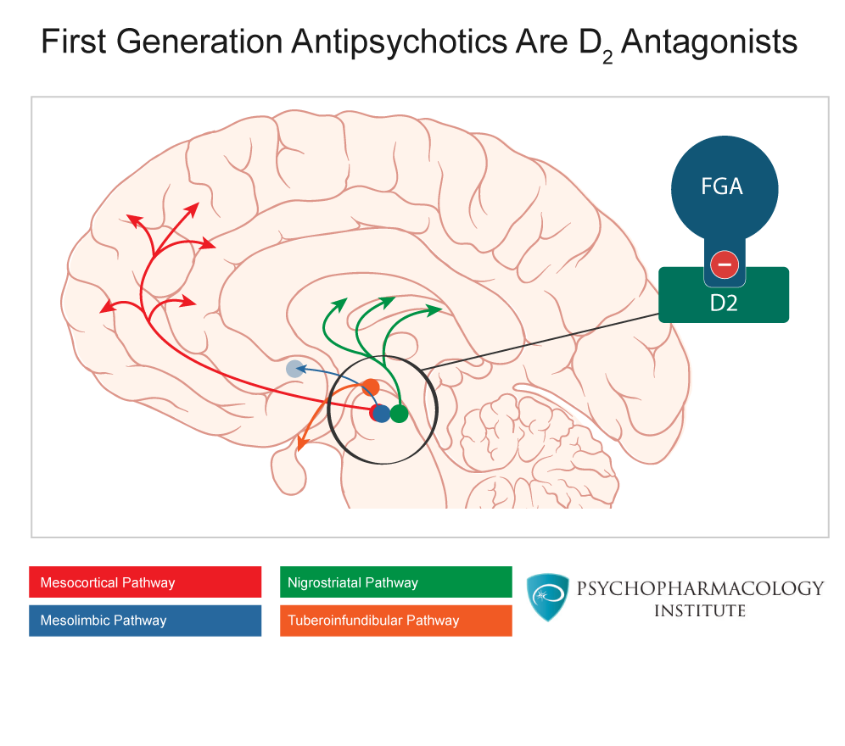
Mechanism of Action
Major Dopamine Pathways
Guzman F, Farinde A. “First Generation Antipsychotics: An Introduction.” 2018 Psychopharmacology Institute. 9 Nov 2016. psychopharmacologyinstitute.com/antipsychotics/first-generation-antipsychotics/

Slide 48
Mechanism of Action
Pathway | Significance | Effect When Blocking Pathway
Nigrostriatal pathway | Movement | Extrapyramidal symptoms
Mesocortical pathway | Motivation, pleasure, socialization | Worsening negative symptoms
Mesolimbic pathway | Speech, grasp of reality | Relief of positive symptoms
Tuberoinfundibular pathway | Prolactin hormone release | Increase in prolactin release
**Ideal medication would block dopamine only in the mesolimbic pathways**
2016-2017 Psychiatric Pharmacotherapy Review. College of Psychiatric and Neurologic Pharmacists, 2016.

Slide 49
Antipsychotics Comparison
First generation antipsychotics
D2 antagonists
Helps with positive symptoms
Higher risk of EPS
Second generation antipsychotics
5-HT2A/D2 antagonists
Better for negative symptoms?
Higher risk of metabolic side effects
2016-2017 Psychiatric Pharmacotherapy Review. College of Psychiatric and Neurologic Pharmacists, 2016.

Slide 50
Dosing
Medication | Usual oral dose range (mg/day)
Chlorpromazine | 400 to 600
Flupehnazine | 2 to 15
Haloperidol | 2 to 20
Loxapine | 20 to 80
Perphenazine | 12 to 24
Thiothixene | 10 to 20
Thioridazine | 200 to 600
Trifluoperazine | 15 to 20
Jibson M. First-generation antipsychotic medications: pharmacology, administration, and comparative side effects. UpToDate, 2018.

Slide 51
Dosing
Medication | Usual oral dose range (mg/day)
Aripiprazole | 10 to 15
Clozapine | 150 to 600
Lurasidone | 40 to 80
Olanzapine | 10 to 20
Paliperidone | 6 to 12
Quetiapine | 400 to 800
Risperidone | 2 to 6
Ziprasidone | 40 to 160
Jibson M. Second-generation antipsychotic medications: pharmacology, administration, and side effects. UpToDate, 2018.

Slide 52
Side Effects
Movement Disorders (EPS)
 | Acute Dystonic Reaction | Pseudoparkinsonism | Akathisia | Tardive Dyskinesia
Signs & Symptoms | Bizarre, involuntary muscle contractions | Cogwheel rigidity, tremor at rest, shuffling gait | Motor restlessness, inability to sit or stand still | Lip smacking, grimacing, tongue protrusion
Onset | 24-96 hours of drug initiation or dose change | Several days to several weeks after drug initiation | 90% of cases develop within the first 2.5 months of treatment | Months to years after drug initiation
Treatment | Diphenhydramine, benztropine | Benztropine, trihexyphenidyl, diphenhydramine, amantadine, propranolol | Propranolol, benzodiazepines | Discontinue medication Valbenazine
2016-2017 Psychiatric Pharmacotherapy Review. College of Psychiatric and Neurologic Pharmacists, 2016.

Slide 53
Side Effects
SGA | Weight gain/ Diabetes | Abnormal lipids | EPS | Prolactin elevation | Sedation | Anticholinergic effects | Orthostatic hypotension | QTc prolongation
Aripiprazole | Low | Very low | Low | Very low | Low | Low | Low | Very low
Clozapine | High | High | Very low | Low | High | High | High | Dose-dependent
Lurasidone | Very low | Very low | Low | Low | Low | Low | Moderate | Low
Olanzapine | High | High | Low | Low | Moderate | Moderate-High | Low | Low
Paliperidone | Moderate | Low | High | High | Low | Low | Moderate | Low-moderate
Quetiapine | Moderate-high | Moderate-high | Very low | Low | Moderate-high | Moderate | Moderate-high | Moderate-high
Risperidone | Moderate | Low | High | Moderate-high | Low | Low | Moderate | Moderate
Ziprasidone | Very low | Very low | Low | Low | Low | Low | Low | High
2016-2017 Psychiatric Pharmacotherapy Review. College of Psychiatric and Neurologic Pharmacists, 2016.

Slide 54
Side Effects
Black Box Warning
Increased mortality in elderly patients
with dementia-related psychosis
2016-2017 Psychiatric Pharmacotherapy Review. College of Psychiatric and Neurologic Pharmacists, 2016.

Slide 55
Antipsychotic Non-Adherence
Non-adherence
Patient doesn’t believe they have an illness
Unpleasant side effects
Continued disease symptoms
Lauriella J, Campbell A. Pharmacology for schizophrenia: Long-acting injectable antipsychotic drugs. UpToDate, 2019.

Slide 56
Long-Acting Injectables (LAI)
Indications for LAI antipsychotics:
Good response to an oral antipsychotic
Poor medication adherence, leading to relapse

Slide 57
First Generation LAI
 | Fluphenazine decanoate | Haloperidol decanoate
Injection interval | 2 to 4 weeks | 4 weeks
Usual dose range (adult) | 12.5 to 100 mg | 20 to 450 mg
Oral tablet overlap | 7 to 14 days | Not necessary if loading dose given
Injection site | Gluteal | Gluteal
Lauriella J, Campbell A. Dosage and administration of long-acting injectable antipsychotics for schizophrenia in adults. UpToDate, 2019.

Slide 58
Second Generation LAI
 | Abilify Maintena (aripiprazole ER) | Aristada (aripiprazole lauroxil) | Invega Sustenna (paliperidone palmitate) | Invega Trinza (paliperidone palmitate) | Risperdal Consta (risperidone microspheres)
Injection interval | 4 weeks | -4 weeks (441, 662, 882 mg) -6 weeks (882 mg only) -8 weeks (1064 mg only) | 4 weeks | 12 weeks | 2 weeks
Dose range | 300 to 400 mg | 441 to 1064 mg | 39 to 234 mg | 273 to 819 mg | 12.5 to 50 mg
Oral tablet overlap | 14 days | 21 days | None | None | 21 days
Injection site | Deltoid or gluteal | Deltoid (441 mg only) Gluteal | Deltoid only (load) Deltoid or gluteal (maintenance) | Deltoid or gluteal | Deltoid or gluteal
Lauriella J, Campbell A. Dosage and administration of long-acting injectable antipsychotics for schizophrenia in adults. UpToDate, 2019.

Slide 59
Knowledge Check #1
Second generation antipsychotics have a higher risk of metabolic side effects, which include the following EXCEPT
Weight gain
Sedation
Akathisia
Orthostatic hypotension

Slide 60
Knowledge Check #2
Patient CB was admitted to your hospital following a relapse on oral aripiprazole. Medication was working well for her but she stopped taking it. Is patient a good candidate for a long acting injectable antipsychotic?
Yes – she has responded well to oral aripiprazole
Yes – her poor adherence led to hospitalization
No – she should be switched to an alternative oral antipsychotic first
Both a and b

Slide 61
Mood Stabilizers

Slide 62
Lamotrigine
FDA Approved Indications
Psychiatric
Bipolar 1 Disorder (maintenance treatment)
Certain seizure disorders
MOA
Exact mechanism is unknown
2016-2017 Psychiatric Pharmacotherapy Review. College of Psychiatric and Neurologic Pharmacists, 2016

Slide 63
Lamotrigine
Black Box Warning
Risk of serious skin rashes including Stevens- Johnson Syndrome (SJS) and Toxic Epidermal Necrolysis (TEN)
Stop lamotrigine at the first sign of a rash
https://dailymed.nlm.nih.gov

Slide 64
SJS/TEN
Life-threatening reaction
Mortality rates up to 30%
Most often is drug-induced
Onset
Typically 4-28 days
Am J Clin Dermatol. 2015 Dec;16(6):475-93.

Slide 65
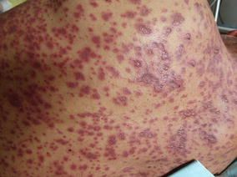
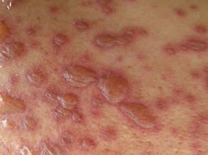
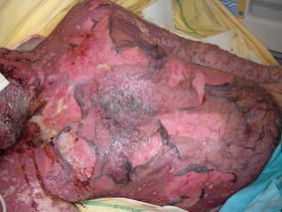
SJS/TEN
Symptoms
Initial flu-like symptoms
Skin and mucous membrane involvement
Rash (skin lesions) → blisters → skin detachment
Am J Clin Dermatol. 2015 Dec;16(6):475-93.

Slide 66
SJS/TEN
Early recognition and management = lifesaving
Treatment
Stop suspected medication
Intensive Care Unit, burn unit, etc.
Provide supportive care
Prevent dehydration, monitor for infection, temperature regulation, nutritional support, pain control, etc.
Healing can take up to several weeks
Am J Clin Dermatol. 2015 Dec;16(6):475-93.

Slide 67
Lamotrigine
Dosing
Slow titration schedule
Re-titration
Greater than five days of missed doses
SLOW
Weeks 1 & 2 | 25 mg daily
Weeks 3 & 4 | 50 mg daily
Week 5 | 100 mg daily
Week 6 | 200 mg daily

Slide 68
Lamotrigine
Patient education
Can take some time to be effective (slow-titration)
Avoid changing body products (soaps, detergents, lotions, etc.) during dose titration
Oral contraceptives can decrease lamotrigine levels
Patient should notify doctor if starting/stopping oral contraceptive
2016-2017 Psychiatric Pharmacotherapy Review. College of Psychiatric and Neurologic Pharmacists, 2016.

Slide 69
Lithium
FDA Approved Indications
Manic episodes of bipolar disorder
Maintenance treatment of bipolar disorder
MOA
Exact mechanism is unknown
Clin Pharmacokinet. 2016 Aug; 55(8):925-41.
2016-2017 Psychiatric Pharmacotherapy Review. College of Psychiatric and Neurologic Pharmacists, 2016.

Slide 70
Lithium- Dosing
Initial Dosing: 300 mg 2-3 times per day
Dose should be adjusted to target goal blood levels
Acute mania: 0.8-1.2 mEq/L
Some patients may require and tolerate levels up to 1.5 mEq/L
Maintenance: 0.6-1 mEq/L
Steady levels in the body after ~5 days
Blood levels correlate linearly with the dose
Example: if lithium dose is doubled = level will be doubled
Stahl, S. M. (2014). Stahl's essential psychopharmacology Prescriber's Guide (5th ed.). Cambridge University Press.
2016-2017 Psychiatric Pharmacotherapy Review. College of Psychiatric and Neurologic Pharmacists, 2016.

Slide 71
Lithium- Common Side Effects
Side Effect | Comments | Side Effect | Comments
Acne | 33% | Dry mouth/Thirst | 35 – 75%
Dizziness | 23% | Increased Urination | 30%
Fatigue | 26% | Acute Kidney Injury | Often related to toxicity
Thinning Hair | 19% More common in women | Hypothyroidism | 8 – 19%
Nausea | ER formulation may help | Weight gain | Average weight gain = 4 - 6 kg
Micromedex- Lithium Carbonate. Accessed October 21, 2019.
2016-2017 Psychiatric Pharmacotherapy Review. College of Psychiatric and Neurologic Pharmacists, 2016.

Slide 72
Lithium
Black Box Warning
Lithium toxicity
Three types
Permanent neurotoxicity can occur
Less likely with acute toxicity
Acute
Chronic
Acute on Chronic
2016-2017 Psychiatric Pharmacotherapy Review. College of Psychiatric and Neurologic Pharmacists, 2016.

Slide 73
Lithium
Chronic Lithium Toxicity
Plasma Lithium Concentration (mmol/L) * | Severity
1.5-2.5 | Mild Nausea, vomiting, tremor, hyperreflexia, agitation, ataxia, muscle weakness
2.5-3.5 | Moderate Stupor, rigidity, hypertonia, hypotension
Greater than 3.5 | Severe Coma, convulsions, myoclonia
Toxicity- Chronic
Possible causes
Dosing errors
Dehydration
Drug interactions
* 12 hours after last dose
J Intensive Care Med. 2017 May;32(4):249-263.

Slide 74
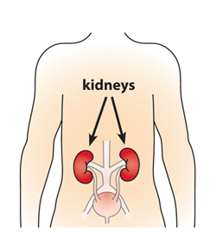
Lithium
Drug Interactions
Lithium is eliminated by the kidneys
Drug interactions arise when other medications act directly on the kidneys
Image: https://www.niddk.nih.gov/health-information/kidney-disease/chronic-kidney-disease-ckd/what-is-chronic-kidney-disease

Slide 75
Lithium
Drug Class | Examples |  | Change in Lithium Level | Comments
Non-steroidal Anti-inflammatory Drugs (NSAIDs) | Celecoxib Diclofenac Ibuprofen | Meloxicam Naproxen | Increased between 16-60% | Sulindac is an NSAID option that does not affect lithium levels
Angiotensin converting enzyme inhibitors (ACE-I) | Benazepril Enalapril | Lisinopril Ramipril | Increased by 30-40% | Delayed interaction
Angiotensin II receptor blockers (ARBs) | Candesartan Irbesartan Losartan | Olmesartan Valsartan | Increased by 30-40% | Delayed interaction
Thiazide Diuretics | Hydrochlorothiazide Chlorthalidone |  | Increased by 25-40%
Methylxanthines | Caffeine |  | Decreased by ~30%
2016-2017 Psychiatric Pharmacotherapy Review. College of Psychiatric and Neurologic Pharmacists, 2016.
Clin Pharmacokinet. 2016 Aug;55(8):925-41.

Slide 76
Lithium
Patient Education
Can take 1-3 weeks to be effective
Try to keep salt, water, and caffeine intake consistent
Avoid OTC NSAIDs
Signs and symptoms of lithium toxicity
Lithium should be slowly tapered off to avoid relapse
Stahl, S. M. (2014). Stahl's essential psychopharmacology Prescriber's Guide (5th ed.). Cambridge University Press.

Slide 77
Valproic Acid/Divalproex Sodium
FDA Approved Indications
Bipolar disorder: acute mania and mixed episodes
Certain seizure disorders
Migraine prevention
MOA
Complex
Involves increasing GABA (neurotransmitter) in the brain and blocking sodium channels
Stahl, S. M. (2014). Stahl's essential psychopharmacology Prescriber's Guide (5th ed.). Cambridge University Press.

Slide 78
Valproic Acid/Divalproex Sodium
Dosing
Loading dose strategy
20-30 mg/kg/day
For quicker resolution of mania (may start to work within 3 days)
Titration strategy
Initial: 500-750 mg/day
Titrate quickly to clinical effect
Maximum dose = 60 mg/kg/day
Stahl, S. M. (2014). Stahl's essential psychopharmacology Prescriber's Guide (5th ed.). Cambridge University Press.
2016-2017 Psychiatric Pharmacotherapy Review. College of Psychiatric and Neurologic Pharmacists, 2016.

Slide 79
Valproic Acid/Divalproex Sodium
Dosing
Checking blood levels
Therapeutic range for Mania: 50-125 mcg/mL
Check level ~3-4 days after starting medication or changing dose
Goal
Finding a dose that controls mania while avoiding significant side effects
2016-2017 Psychiatric Pharmacotherapy Review. College of Psychiatric and Neurologic Pharmacists, 2016.

Slide 80
Valproic Acid/Divalproex Sodium
Common Side Effects
Hair Loss | Nausea | Vomiting | Diarrhea
Tremor | Weight Gain | Low Platelet Count | Dizziness
Ataxia | Sedation | Double Vision | High ammonia levels
Black Box Warning
2016-2017 Psychiatric Pharmacotherapy Review. College of Psychiatric and Neurologic Pharmacists, 2016.

Slide 81
Knowledge Check #1
Which of the following statements is FALSE?
Lamotrigine should be titrated quickly if the patient is tolerating the medication
Patient should seek medical care at the first sign of skin changes or a rash while taking lamotrigine
Blood levels are not routinely checked for lamotrigine

Slide 82
Knowledge Check #2
JM is a 40 year old female being started lithium 300 mg twice daily. After 5 days, her lithium level was 0.5 mEq/L. Which of the following would be a reasonable dose adjustment?
300 mg once daily
600 mg twice daily
600 mg three time daily

Slide 83
Knowledge Check #3
SB is a 70 year old male who has been on lithium for many years. He is now complaining of nausea, vomiting, worsened tremor, and some confusion. A lithium level is checked and found to be 1.9 mEq/L. He mentions that he recently started lisinopril and amlodipine for blood pressure and OTC ibuprofen as needed for pain.

Slide 84
Knowledge Check #3
Which of the following medications may have contributed to his toxic level?
Lisinopril
Amlodipine
Ibuprofen
B and C
A and C

Slide 85
Medications for Substance-Related Disorders

Slide 86
Alcohol Intoxication
Alcohol Intoxication
Slurred speech
Incoordination
Nystagmus
Memory impairment
Stupor
2016-2017 Psychiatric Pharmacotherapy Review. College of Psychiatric and Neurologic Pharmacists, 2016.

Slide 87
Alcohol Intoxication
Blood Alcohol Concentration (BAC) | Symptoms
0.02-0.05 | Diminished fine motor coordination
0.05-0.1 | Impaired judgement and coordination
0.1-0.15 | Difficulty with gait and balance
0.15-0.25 | Lethargy, difficulty sitting upright or walking without assistance
0.3 | Loss of consciousness
0.4 | Coma, respiratory depression, death
2016-2017 Psychiatric Pharmacotherapy Review. College of Psychiatric and Neurologic Pharmacists, 2016.
Cowan E, Su M. Ethanol intoxication in adults. UpToDate. Sep 2019.

Slide 88
Alcohol Intoxication
Supportive care
Monitor vital signs
Maintain airway, breathing, circulation
Replace fluids and electrolytes as clinically needed
Thiamine (more information to follow)
Manage nausea and vomiting with antiemetics
2016-2017 Psychiatric Pharmacotherapy Review. College of Psychiatric and Neurologic Pharmacists, 2016.

Slide 89
Alcohol Withdrawal
Begins within a few hours after the last drink and peaks at 24-36 hours in most cases
Symptoms may last as long as 5 days
Common symptoms: sweating, tachycardia, anxiety, hand tremor, insomnia, psychomotor agitation, nausea/vomiting
Less common symptoms: seizures, hallucinations, delirium tremens (DT)
2016-2017 Psychiatric Pharmacotherapy Review. College of Psychiatric and Neurologic Pharmacists, 2016.

Slide 90
Alcohol Withdrawal
Supportive care with thiamine
Commonly depleted because of altered absorption or diet
Critical for the prevention and treatment of Wernicke’s encephalopathy
Wernicke’s: ataxia, ocular abnormalities, confusion
If left untreated, Wernicke’s may progress to permanent cognitive impairment called Korsakoff’s psychosis
Usual dose: 100 mg daily for 1 to 4 weeks
2016-2017 Psychiatric Pharmacotherapy Review. College of Psychiatric and Neurologic Pharmacists, 2016.

Slide 91
Alcohol Withdrawal
Benzodiazepine | Usual Dose Range
Chlordiazepoxide* | 25 to 100 mg
Diazepam* | 2.5 to 10 mg
Lorazepam | 0.5 to 2 mg
Oxazepam* | 15 to 30 mg
* FDA-approved for alcohol withdrawal syndrome
2016-2017 Psychiatric Pharmacotherapy Review. College of Psychiatric and Neurologic Pharmacists, 2016.

Slide 92
Alcohol Withdrawal
Other anticonvulsants
Valproic acid, phenobarbital, gabapentin, carbamazepine
NOT first line but may be beneficial for mild-moderate, uncomplicated withdrawal
No universally agreed-upon dosing strategies
2016-2017 Psychiatric Pharmacotherapy Review. College of Psychiatric and Neurologic Pharmacists, 2016.
Notes:
Valproic acid, phenobarbital, gabapentin, and carbamazepine are not first line agents for the treatment of alcohol withdrawal but may be beneficial for mild to moderate, uncomplicated withdrawal completed as an outpatient with close monitoring and follow-up. Dosing recommendations are based upon few studies and there are no universally agreed-upon dosing strategies.

Slide 93
Alcohol Use Disorder
Chronic, relapsing disorder that fluctuates over time and leads to clinically significant impairment or distress
Patient continues to compulsively use alcohol despite adverse substance-related problems
2016-2017 Psychiatric Pharmacotherapy Review. College of Psychiatric and Neurologic Pharmacists, 2016.

Slide 94
Naltrexone
Mechanism of action | Opioid receptor antagonist that blocks the pleasurable effects of alcohol by decreasing dopamine release Helps reduce alcohol cravings
Usual Dose | Oral: 50 mg/day Intramuscular (IM): 380 mg every 28 days
Side effects | Nausea, headache, insomnia, nervousness
Warnings/Precautions | Opioid use within the last 7 to 14 days Hepatitis and severe hepatic impairment Black box warning: dose-related hepatocellular injury
Patient education | Carry wallet card to alert medical personnel they are taking naltrexone Avoid use of opioid medications Injection may need a prior authorization and to come from mail order specialty pharmacy
2016-2017 Psychiatric Pharmacotherapy Review. College of Psychiatric and Neurologic Pharmacists, 2016.

Slide 95
Acamprosate
Mechanism of action | N-methyl-D-aspartate (NMDA) receptor antagonist that enhances GABA receptor activation Beneficial for maintaining abstinence
Usual Dose | 666 mg three times daily
Side effects | Diarrhea, insomnia
Warnings/Precautions | Renal impairment (creatinine clearance less than 30 mL/min) Suicidal ideation
Patient education | Dosing is three times daily – can coordinate with meals to enhance adherence
2016-2017 Psychiatric Pharmacotherapy Review. College of Psychiatric and Neurologic Pharmacists, 2016.

Slide 96
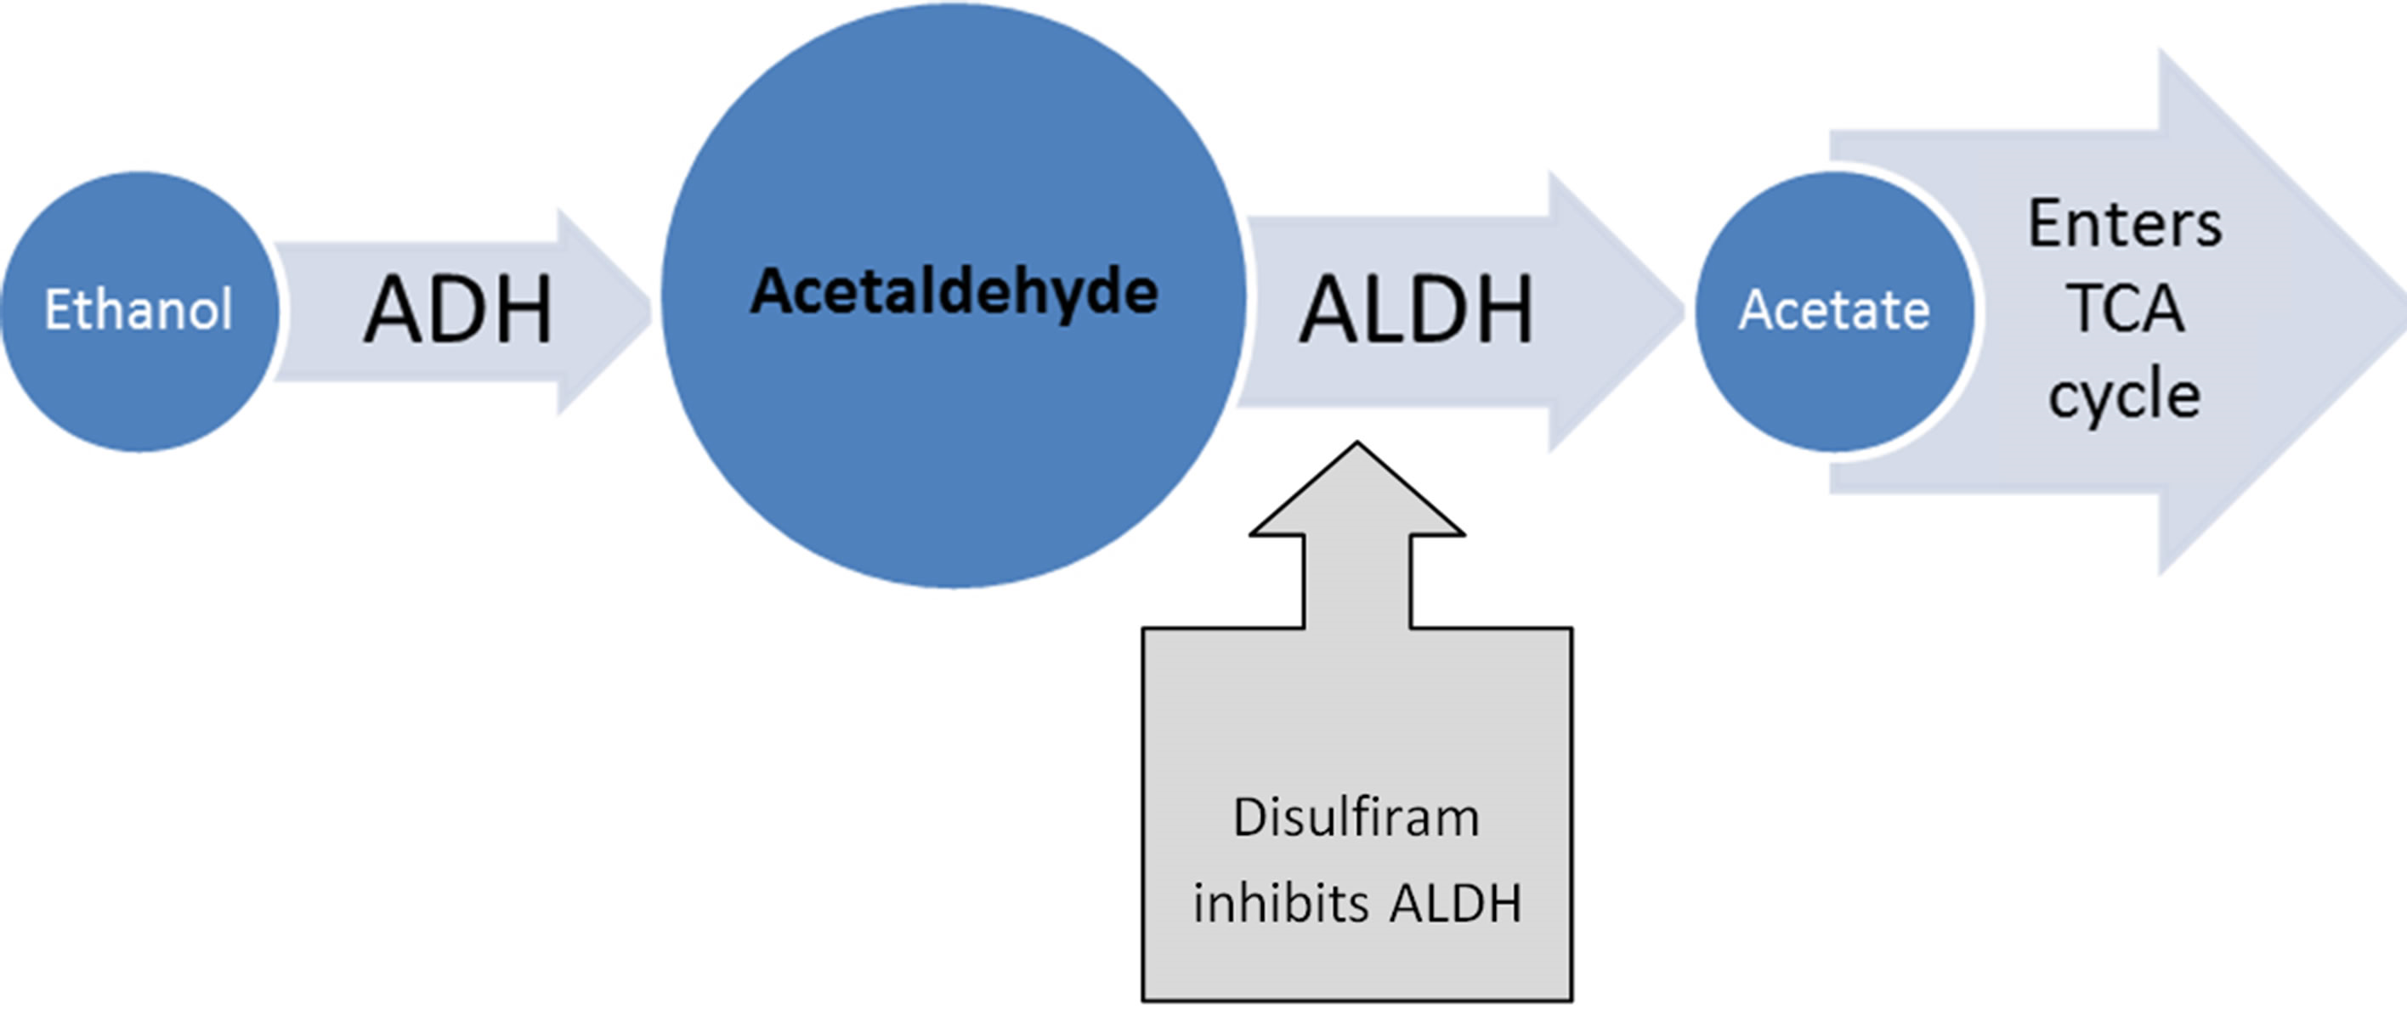
Disulfiram
Mechanism of action
Usual Dose | 250 mg/day
Side effects | Fatigue, drowsiness, garlic/metallic after-taste
Warnings/Precautions | Use of ethanol or metronidazole Severe renal or hepatic impairment Psychoses
Patient education | Avoid alcohol-containing products (cough or cold agents, topical acne treatments, mouthwashes, hand sanitizer, perfumes/colognes, cooking sauces) Can experience a reaction for up to 14 days after stopping disulfiram
Intended disulfiram-alcohol reaction: warmness/flushing of skin, increased heart rate, palpitations, nausea/vomiting, shortness of breath, sweating, anxiety, dizziness, blurred vision, confusion
2016-2017 Psychiatric Pharmacotherapy Review. College of Psychiatric and Neurologic Pharmacists, 2016.
Kalra G, De Sousa A, Shrivastava A. (2014) Disulfiram in the management of alcohol dependence: A comprehensive clinical review. Open Journal of Psychiatry, 4, 43-52.

Slide 97
Alcohol Use Disorder
 | Acamprosate | Disulfiram | Oral Naltrexone | Injectable Naltrexone
Renal failure | X | A | A | A
Significant liver disease | A | C | C | C
Chronic pain | A | A | C | C
Current opioid use | A | A | X | X
Psychosis | A | C | A | A
Unwilling to maintain abstinence | A | X | A | A
Poor adherence | C | C | C | A
High level of craving | A | A | + | +
Opioid dependence in remission | A | A | + | +
Family history of alcohol dependence | A | A | + | +
Cognitive impairment | A | X | A | A
A = Appropriate to use, X = Contraindicated, C= Use with caution, + = Preferred agent
2016-2017 Psychiatric Pharmacotherapy Review. College of Psychiatric and Neurologic Pharmacists, 2016.

Slide 98
Opioid Intoxication
Opiate intoxication
Constriction of pupils
Impaired attention or memory
Slurred speech
Drowsiness or coma
2016-2017 Psychiatric Pharmacotherapy Review. College of Psychiatric and Neurologic Pharmacists, 2016.

Slide 99
Naloxone
Mechanism of action | Opioid receptor antagonist Reverse the effects of opioids in overdose situations
Usual Dose | 0.04 to 2 mg IM/IV/subcutaneous(SQ)/intranasal (IN) every 2 to 3 minutes until patient is breathing or total dose 10 mg has been given
Side effects | Injection site reactions
Warnings/Precautions | Use with caution in patients with cardiac instability, pulmonary edema, or history of seizures
Patient education | Available without a prescription Call 911 Patients should know when to use, proper administration technique, expectations once medication is administered
2016-2017 Psychiatric Pharmacotherapy Review. College of Psychiatric and Neurologic Pharmacists, 2016.

Slide 100
Naloxone Nasal Spray
Narcan [package insert]. Radnor, PA: Adapt Pharma, Inc; 2017.

Slide 101
Naloxone Nasal Spray
Narcan [package insert]. Radnor, PA: Adapt Pharma, Inc; 2017.

Slide 102
Naloxone Nasal Spray
Narcan [package insert]. Radnor, PA: Adapt Pharma, Inc; 2017.

Slide 103
Naloxone Autoinjector
Evzio [package insert]. Cumberland, MD: Kaleo, Inc; 2019.

Slide 104
Naloxone Autoinjector
Evzio [package insert]. Cumberland, MD: Kaleo, Inc; 2019.

Slide 105
Opioid Withdrawal
Timeline depends on half-life of opioid being used
Peak withdrawal occurs between 36-72 hours and is usually complete with 5-8 days
Non-life-threatening symptoms: nausea, diarrhea, coughing, lacrimation, mydriasis, rhinorrhea, sweating, chills, irritability, muscle twitches, piloerection, yawning, drug craving
2016-2017 Psychiatric Pharmacotherapy Review. College of Psychiatric and Neurologic Pharmacists, 2016.

Slide 106
Opioid Withdrawal
Non-FDA approved adjunctive medications to help with withdrawal symptoms
Nausea, vomiting, diarrhea, cramps, sweating | Clonidine 0.1 mg PO 3 times daily
Diarrhea | Anti-diarrheal (e.g., loperamide 2 mg PO every 6 hours as needed)
Vomiting | Antiemetic (e.g., prochlorperazine10 mg PO every 6 hours as needed)
Insomnia | Sleep aid (e.g., trazodone 50-100 mg PO nightly as needed)
Anxiety | Anxiolytic (e.g., hydroxyzine 25 mg PO every 6 hours as needed)
Muscle cramps | Anti-inflammatory (e.g., ibuprofen 400-800 mg PO every 6 hours as needed), muscle relaxant (e.g., methocarbamol 500 mg PO 3 times daily as needed)
2016-2017 Psychiatric Pharmacotherapy Review. College of Psychiatric and Neurologic Pharmacists, 2016.

Slide 107
Opioid Use Disorder
Problematic pattern of opioid use with clinically significant distress or impairment
Can involve misuse of prescribed opioid medications, use of diverted opioid medications, or use of illicitly obtained heroin
Strain E. Opioid use disorder: Epidemiology, pharmacology, clinical manifestations, course, screening, assessment, and diagnosis. UpToDate, 2019.
2016-2017 Psychiatric Pharmacotherapy Review. College of Psychiatric and Neurologic Pharmacists, 2016.

Slide 108
Methadone
Mechanism of action | Full opioid agonist
Usual Dose | 80 to 120 mg
Side effects | Respiratory depression, QTc prolongation, hypotension, constipation, nausea/vomiting, sedation, dizziness
Warnings/Precautions | Respiratory depression, acute asthma, paralytic ileus, concurrent monoamine oxidase inhibitor (MAOI) use QTc prolongation Risk of abuse and/or dependence
Patient education | Avoid CNS depressants (benzodiazepines, alcohol) Onset for withdrawal symptoms within hours, duration of acute effect 24-36 hours
2016-2017 Psychiatric Pharmacotherapy Review. College of Psychiatric and Neurologic Pharmacists, 2016.

Slide 109
Buprenorphine (+/- naloxone)
Mechanism of action | Partial opioid receptor agonist Reduces drug cravings and withdrawal symptoms
Usual Dose | 16/4 mg
Side effects | Headache, insomnia, nausea/vomiting, constipation
Warnings/Precautions | Cardiovascular and respiratory depression Hepatic impairment Abuse potential
Patient education | Avoid benzodiazepines and other CNS depressants Place under tongue until dissolved. Do not swallow whole. Takes 20-40 minutes to alleviate withdrawal symptoms with a duration of action of 24-42 hours
2016-2017 Psychiatric Pharmacotherapy Review. College of Psychiatric and Neurologic Pharmacists, 2016.

Slide 110
Naltrexone
Mechanism of action | Opioid receptor antagonist that blocks opioid molecules from attaching to opioid receptors Helps reduce opioid cravings
Usual Dose | Oral: 50 mg/day Intramuscular (IM): 380 mg every 28 days
Side effects | Nausea, headache, insomnia, nervousness
Warnings/Precautions | Opioid use within the last 7 to 10 days Hepatitis and severe hepatic impairment Black box warning: dose-related hepatocellular injury
Patient education | Carry wallet card to alert medical personnel they are taking naltrexone Avoid use of opioid medications Injection may need a prior authorization and to come from mail order specialty pharmacy
2016-2017 Psychiatric Pharmacotherapy Review. College of Psychiatric and Neurologic Pharmacists, 2016.

Slide 111
Knowledge Check #1
Which of the following is FALSE regarding naltrexone use?
Naltrexone is an opioid receptor antagonist
Patient should carry wallet card to alert medical personnel that they take naltrexone
Common side effects include nausea and headache
Naltrexone can be started if last opioid use was 3-5 days ago

Slide 112
Knowledge Check #2
A patient arrives at your hospital with constricted pupils and slurred speech. Upon assessment, he is found to have low blood pressure and irregular breathing. What is the patient likely experiencing?
Opioid intoxication – give naloxone
Opioid withdrawal – give buprenorphine
Alcohol intoxication – give thiamine
Alcohol withdrawal – give lorazepam

Slide 113
Questions?

