Slide 1
01
GAPcare: The Geriatric Acute and Post-Acute Fall Prevention Program
Elizabeth M. Goldberg, MD, ScM, FACEP Associate Professor of Emergency Medicine & Health Services, Policy & Practice
Brown University
@LIZGOLDBERGMD.
ELIZABETH_GOLDBERG@BROWN.EDU

Slide 2
Objectives:
02
Describe the key interventions of the GAPcare fall prevention program
Describe lessons learned for preventing future falls for older adults who present to the emergency department
@LIZGOLDBERGMD ELIZABETH_GOLDBERG@BROWN.EDU

Slide 3
03
Funding: GEMSSTAR R03 (NIA), Paul B. Beeson Award K76 (NIA)
Acknowledgements: Dr. Roland Merchant, Prof. Vincent Mor, Prof. Linda Resnik, Prof. Renee Shield, Prof. Kate Guthrie, Sarah Marks
No disclosures
@LIZGOLDBERGMD ELIZABETH_GOLDBERG@BROWN.EDU

Slide 5
GAPcare
04
Assess the feasibility, acceptability and initial efficacy of an Emergency Department-based fall prevention intervention.
GEMSSTAR R03

Slide 6
STUDY POPULATION
INTERVENTION
RANDOMIZATION
Home safety brochure (control)
Pharmacist & physical therapist (intervention)
Adults 65+ presenting to the ED after a fall
In-ED assessment and 6 month follow-up
Notes:
Senior Couple by Milton Raposo C. Rêgo Jr. from the Noun Project
pharmacist by Eucalyp from the Noun Project
In a 2018 study of over 45,000 patients, only 28% of fall-related injuries were recalled as compared to Medicare claims
20% of falls result in injury
50 Billion dollars annually in healthcare expenses

Slide 7
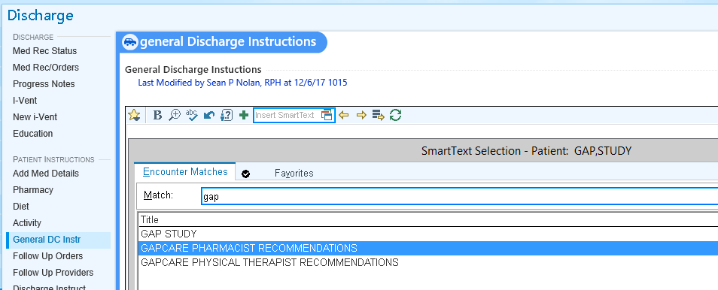
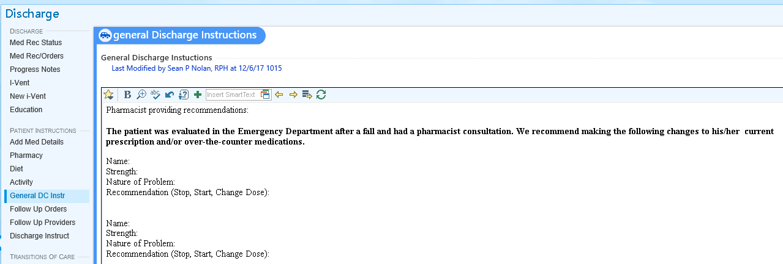
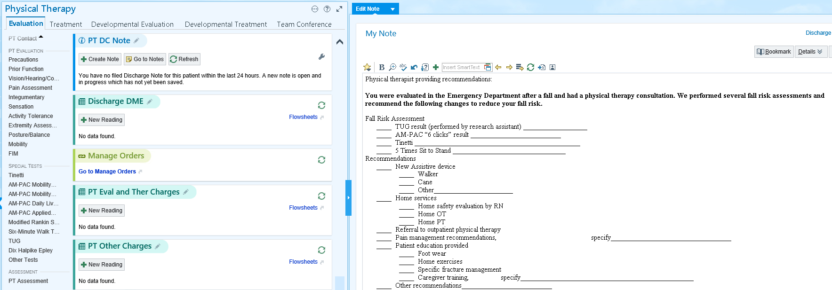

Slide 8
Enrollment
Assessed for study eligibility
(n=478)
Ineligible (n=194)
Admitted to the hospital (n=127)
Resident at skilled nursing facility (n=22)
Altered Mental Status/Intoxicated (n=21)
Other (n=43)
Randomized
(n=110)
Declined Enrollment (n=174)
Declined evaluation (n=88)
Did not think falls are a problem (n=42)
Family member present (n=27)
Other (n=119)
Allocated
Intervention Arm
(n=55)
Received pharmacy intervention (n=54)
Received PT intervention (n=46)
Usual Care Arm
(n=55)
Notes:
ED patients, sick older, not volunteer

Slide 9
Demographics & Measures by Arm
 | Control (n=55) | Intervention (n=55)
Age, median (IQR) | 78 (74, 88) | 82 (76, 90)
Female, n(%) | 37 (67.3) | 37 (67.3)
White, n(%) | 53 (96.4) | 51 (92.7)
Cognitively impaired (SIS) n (%) | 8 (14.5) | 10 (19.1)
Function (Barthel ADL) median (IQR) | 18 (16, 20) | 18 (15, 20)
Lives alone, n (%) | 18 (32.5) | 17 (30.9)
Lives in ALF, n (%) | 10 (18.2) | 12 (21.8)
Notes:
Barthel total score range is 0-20 with closer to zero being increase disability

Slide 10
,
Patients presenting for a fall and enrolled in GAPcare
RANDOMIZATION
Home safety brochure (control)
GAPcare intervention
FEASIBILITY & DISPOSITION
315 min
(IQR: 246-420)
300 min
(IQR: 222-390)
ED LOS
10 (18.8)
Hospital admission
10 (18.8)
6 (10.9)
Discharge to SNF
10 (18.8)
Notes:
PT consult length of 19 min. (IQR: 15-30) and pharmacy of 20 min. (IQR: 14-22)

Slide 11
Patients presenting for a fall and enrolled in GAPcare
GAPcare intervention (vs. usual care)
SATISFACTION WITH CARE
Patients (n=99)
96.7% (92.3%)
Caregivers (n=35)
94.1% (94.4%)
Pharmacy Consultation
95.8%
PT
Consultation
97.6%
ED Clinicians (n=48)
Notes:
Of the 110 participants, 90% completed the index visit satisfaction survey. 96.7% of these participants were satisfied or very satisfied with their care in the INT arm, compared to 92.3% in the UC arm. Participants recommended the pharmacy consult 100% of the time and PT consult 95% of the time. Thirty-five caregivers completed their survey. 94.1% of caregivers were satisfied or very satisfied with the care their loved one received in the INT arm, compared to 94.4% in the UC arm. ED clinicians responded to the survey for 48 participants. When asked whether they believed these consultations should be integrated into routine care of ED patients with falls, most ED clinicians indicated that they were in favor of integration of pharmacy consultation (95.8%) and PT consultation (97.6%) (Supplementary Table S4).

Slide 12
Healthcare utilization in follow-up

Slide 13
 | Control Group (n=55) | Intervention Group (n=55) | Incident rate ratio | p<
All ED visits | 0.82 (0.46, 1.48) | 0.38 (0.20, 0.73) | 2.15 (1.10, 4.21) | 0.03
Fall-related ED visits | 0.19 (0.06, 0.58) | 0.07 (0.02, 0.23) | 2.91 (1.19, 7.13) | 0.02
All hospitalizations | 0.43 (0.21, 0.87) | 0.22 (0.10, 0.50) | 1.92 (0.96, 3.19) | 0.12
Fall-related hospitalizations | 0.12 (0.05, 0.32) | 0.12 (0.05, 30) | 1.01 (0.29, 3.37) | 0.99
Notes:
Gender, Age, Number of falls in prior 3 months, CCI, ADL, Hurt during index fall, Hospital site
Finally, we used a negative binomial regression model to compare recurrent event rates in different groups. This model is considered preferable for fall outcome analyses because it adjusts for variable follow-up time by using time at risk as the offset.^{5,15} Additionally, it allows investigation of the treatment effect and confounding variables. Although we initially planned to use a proportional hazard model, survival probabilities assume that participants who are censored before the end of the trial have the same risk of falling as those who complete the trial. Because several of our participants died or were moved to hospice, we felt that this assumption did not hold true for our population.
Negative binomial regression is a generalization of Poisson regression which loosens the restrictive assumption that the variance is equal to the mean made by the Poisson model. The traditional negative binomial regression model, commonly known as NB2, is based on the Poisson-gamma mixture distribution.

Slide 14
Status at the end of the study
 | Intervention | Control
Complete | 43 | 39
Death/Hospice | 2 | 10
Withdrawal | 3 | 5
Lost to follow-up | 7 | 4

Slide 15
05
Pharmacy recommendation uptake
73% of the medication recommendations to reduce subsequent fall risk were adhered to partially or fully
Use over the counter alternatives (11%; 25), use increased precaution when taking a medication with a known side effect (11%; 24), stop medication completely (9%; 21), change timing (9%, 20), use over the counter pain relief (8%; 17).
Goldberg EM et al, Annals of Emerg Med, 2020

Slide 16
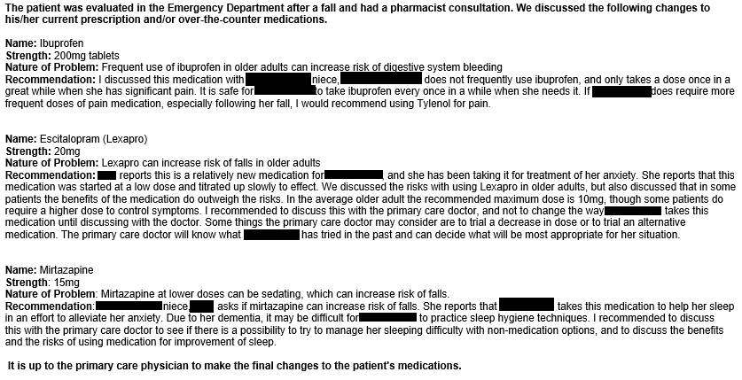
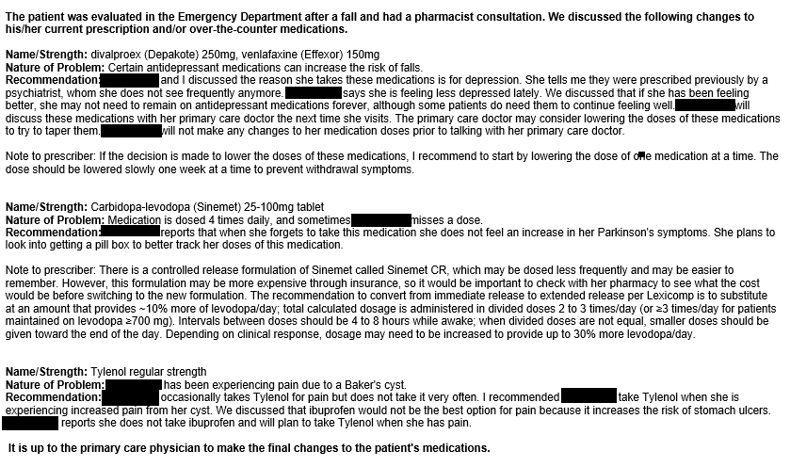
05
Pharmacy recommendation
Goldberg EM et al, Annals of Emerg Med, 2020

Slide 17
05
Physical therapy recommendation uptake
68% of PT recommendations with adopted eitherfully or partially
General education about falls (67%; 31) new or increased walker use (52%; 24) home PT (41%; 19) SNF stay (41%; 19) footwear education (37%; 17) initiate home exercises (22%; 10)
Goldberg EM et al, Annals of Emerg Med, 2020

Slide 18
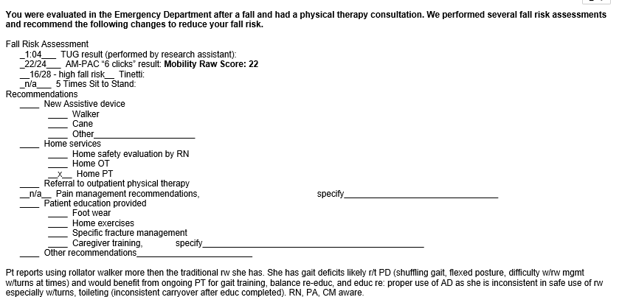
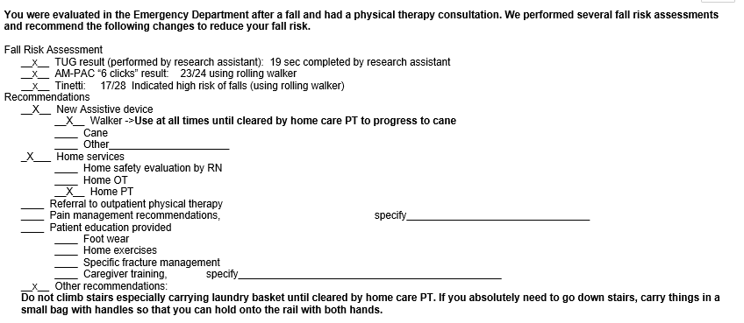
05
Physical therapy recommendation
Goldberg EM et al, Annals of Emerg Med, 2020

Slide 19
07
Qualitative Interview Themes
‘I felt as if I was under house arrest being in the house for like six weeks and not going out because, of course, the weather was awful. Very isolated. Isolated. There was a feeling of really being isolated.’Woman with humerus fracture
The fall was the trigger for psychological & physiological changes
GETTEL CJ ET AL, ACAD EMERG MED, 2020

Slide 20
07
Qualitative Interview Themes
‘Why don't you go and live in one of them?’ I says, ‘No! I don't like 'em.’ I don't. It's too clustered. It's alright for people in their 80s and 90s, but not for me! …I felt like I was an old lady…I came home, they checked me all out, I was okay. Then I came home, I had one more fall, they took me to the ED to check me out. And they said that I should put me in for rehabilitation. So, I says, ‘Okay. That was fine.’Patient in her 70s
SNF placement decision-making process
GETTEL CJ ET AL, ACAD EMERG MED, 2020

Slide 21
07
Qualitative Interview Themes
‘I sleep on the sofa now so that if he needs anything, I'm there and that's fine. That's no big deal. I'm trying, you know, to find something that can accommodate me that I’m comfortable with leaving him with whoever it is. My neighbor next door will stay with him if I want to go grocery shopping. The other night I needed to go to the drug store. My neighbor across the street came and sat with him, but I hate to ask too often.’Wife, caregiver
Direct effects of fall on caregivers
GETTEL CJ ET AL, ACAD EMERG MED, 2020

Slide 22
07
Qualitative Interview Themes
“Only hurdle now is to get her out of the house to see her primary care physician. He has put his foot down and said he’s not renewing anymore of her prescriptions until he sees her… She doesn't want to go out of the house because she's afraid to fall.”Cousin, caregiver
Barriers to receipt of recommended follow-up
GETTEL CJ ET AL, ACAD EMERG MED, 2020

Slide 23
1.
Consider your unique setting
09
Adjusted recruitment times to availability of pharmacists/PTs
Developed new communication strategies with the IT team to save time and reduce workload
Quarterly meetings with research staff & pharmacists & PTs to address challenges
Involved ED medical directors & geriatricians
@LIZGOLDBERGMD

Slide 24
2.
Deferred orthostatic vital signs and visual acuity screening
Intervention design:
What is doable, what is not
Limited ED nurse and physician need for additional work duties
Primary care physicians received automated messages, not 1:1 calls

Slide 25
12
ED-based interventions for fall prevention are feasible and do not increase ED length of stay
In Summary
A multidisciplinary approach is essential and can help alleviate care duties of ED physicians, nurses, and staff
Brief motivational interviewing can be effective to improve medication regimens even in patients with dementia
@LIZGOLDBERGMD

Slide 26
13
Physical therapists are essential to assess mobility, gait, and balance, and address safety of discharge
Attention to communication and integration with the electronic health record is a critical component of care transition
Caregiver engagement can help improve interest in participation and uptake of recommendations
@LIZGOLDBERGMD

Slide 27
Thank you
@LizGoldbergMD elizabeth_goldberg@brown.edu

