Slide 1





Delirium in Older Adults:
The Epidemic within the Pandemic
Sharon K. Inouye, M.D., M.P.H.
Professor of Medicine
Beth Israel Deaconess Medical Center
Harvard Medical School
Milton and Shirley F. Levy Family Chair
Director, Aging Brain Center
Hebrew SeniorLife

Slide 2
DSM5 CRITERIA FOR DELIRIUM
Disturbance in attention and awareness (reduced orientation to the environment)
Disturbance develops acutely and tends to fluctuate
An additional disturbance in cognition, (e.g., memory deficit, language, visuoperceptual)
Not better explained by a preexisting dementia
Not in face of severely reduced level of arousal or coma
Evidence of an underlying organic etiology or multiple etiologies
Used with permission. American Psychiatric Association, 2013

Slide 3
Why is delirium important?
  Common problem
  Serious complications
  Often unrecognized
  Complex multifactorial etiology
  Potentially preventable contributor to cognitive impairment

Slide 4


In U.S. hospitals today
5 older patients become delirious every minute
2.6 million older adults develop delirium each year
U.S. Dept HHS, AoA Report, Profile of Older Americans 2011
4
Notes:
4

Slide 5
Delirium is common
Delirium Rates
Hospital:
Prevalence (on admission) 14-24%
Incidence (in hospital) 6-56%
Postoperative: 15-53%
Intensive care unit: 70-87%
Nursing home/post-acute care: 20-60%
Palliative care: up to 80%
Mortality
Hospital mortality: 22-76%
One-year mortality: 35-40%
Ref: Inouye SK, NEJM 2006;354:1157-65; Lancet 2014; 383:911-922; JAMA 2017; 318:1161-1174
5
Notes:
5

Slide 6
Delirium has serious complications
6
Delirium associated with:
  Increased morbidity and mortality
  Functional and cognitive decline
  Increased rates of dementia
  Institutionalization
  Increased length of stay and healthcare costs
  Post-traumatic stress disorder
  Caregiver burden
Notes:
6

Slide 7
Patient Experience of Delirium
Patients describe fear, outrage, feeling unsafe, out of control, unprepared.
“I was afraid, not knowing where I was”
“I was not able to say what I wanted to say. It was very scary”
“I was outraged that I should be treated this way with chiming beds and people coming out of walls”
Schmitt EM…Inouye SK. Gerontologist. 2019; 59:327-337

Slide 8
Delirium is expensive
Hospital costs (> $8 billion/year)
Post-hospital costs (>$150 billion/year)
Rehospitalization
Institutionalization
Rehabilitation
Home care
Caregiver burden
Ref: Leslie DL, et al. Arch Intern Med 2008;168:27-32
8
Notes:
8

Slide 9
How do we identify delirium?
>30 tools. Confusion Assessment Method (CAM): most widely used method worldwide
Used in >5000 original studies to date, translated into over 20 languages
Short CAM (4-item)—diagnostic algorithm
  Acute onset and fluctuating course, -and-
  Inattention, -and either-
  Disorganized thinking -or- Altered level of consciousness
Long CAM (10-item):
  Provides information on severity/subtypes
  Diagnostic/Reference standard purposes
https://help.agscocare.org/table-of-contents/delirium-instruments/H00101

Slide 10
UB-CAM takes less than a minute combines UB-2 and 3D-CAM > 90% sens/spec
LINK to UB-CAM
https://deliriumnetwork.org/the-ultra-brief-confusion-assessment-method-ub-cam/
Marcantonio ER. Ann Intern Med. 2014; 161: 554-62; Fick DM. J Hosp Med. 2015; 10:645-650; Motyl CM. JAGS 2020 Epub.
https://deliriumnetwork.org/the-ultra-brief-confusion-assessment-method-ub-cam/

Slide 11
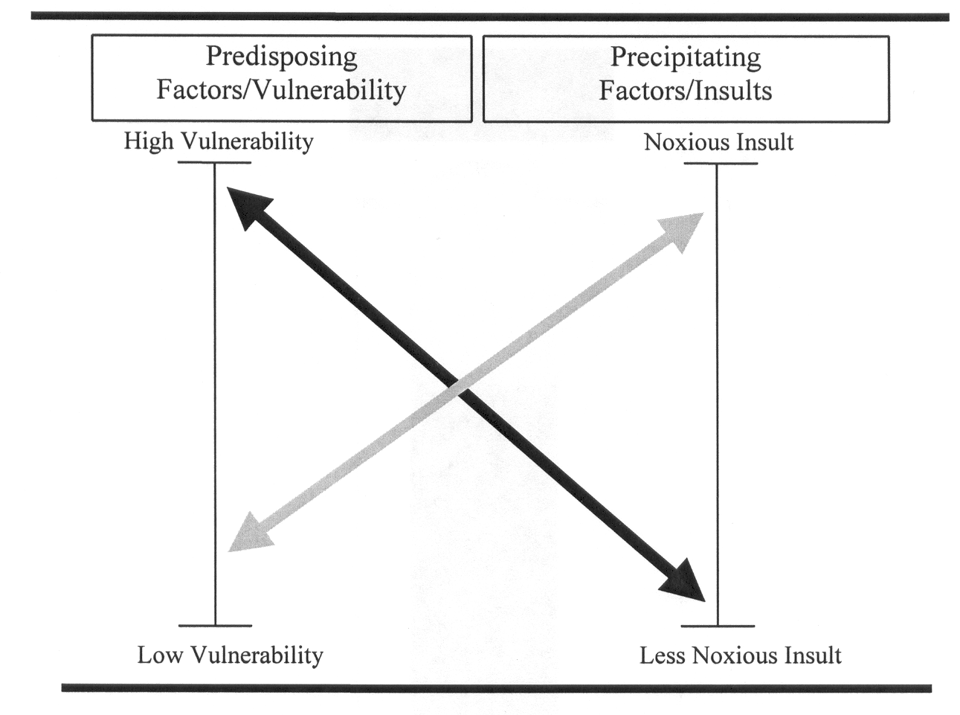
Delirium is typically multifactorial
Ref: Inouye SK et al. JAMA 1996; 275:852-857

Slide 12
Predisposing Factors from Predictive Models
Predisposing Factors | General Medicine | Surgery |  | ICU
 |  | Non-cardiac | Cardiac
 | Relative Risks
Dementia | 2.3-4.7 | 2.8
Cognitive impairment | 2.1-2.8 | 3.5-4.2 | 1.3
History of delirium |  | 3.0
Functional impairment | 4.0 | 2.5-3.5
Vision impairment | 2.1-3.5 | 1.1-3.0
Hearing impairment |  | 1.3
Comorbidity/severity of illness | 1.3-5.6 | 4.3 |  | 1.1
Depression | 3.2 |  | 1.2
History of transient ischemia/ stroke |  |  | 1.6
Alcohol abuse | 5.7 | 1.4-3.3
Older age | 4.0 | 3.3-6.6 |  | 1.1
Inouye SK et al. Lancet 2014; 383:911-922

Slide 13
Precipitating Factors from Predictive Models
Precipitating Factors | Medicine | Surgery |  | ICU
 |  | Non-cardiac | Cardiac
Medications
Multiple medications added | 2.9
Psychoactive medication use | 4.5
Sedative-hypnotics |  |  |  | 4.5
Use of physical restraints | 3.2-4.4
Use of bladder catheter | 2.4
Physiologic
Elevated BUN/creatinine ratio | 2.0-5.1 | 2.9
Abnormal sodium, glucose, potassium |  | 3.4
Metabolic acidosis |  |  |  | 1.4
Infection |  |  |  | 3.1
Any iatrogenic event | 1.9
Surgery |  | 3.5-8.3
Inouye SK et al. Lancet 2014; 383:911-922

Slide 14
Medications Associated with Delirium
[2019 AGS Beers Criteria: Potentially Inappropriate Medications for Elderly]
Anticholinergics (eg, diphenhydramine)
Antipsychotics
Benzodiazepines
Corticosteroids (oral and parenteral)
H₂-receptor agonists (eg, ranitidine)
Meperidine
Benzodiazepine receptor agonist hypnotics (eg, zolpidem)
American Geriatrics Society. JAGS 2019; 67:674–694

Slide 15
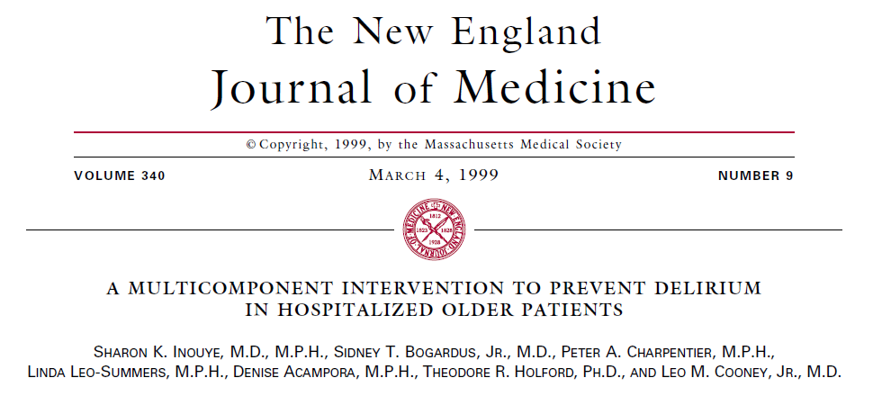

Slide 16
NONPHARMACOLOGIC DELIRIUM PREVENTION:
HOSPITAL ELDER LIFE PROGRAM (HELP)
Multicomponent intervention strategy targeted at 6 delirium risk factors
Risk Factor Intervention
Cognitive Impairment………………………………….Reality orientation
Therapeutic activities protocol
Sleep Deprivation…………………………………….. Nonpharmacological sleep protocol
Sleep enhancement protocol
Immobilization………………………………………… Early mobilization protocol
Minimizing immobilizing equipment
Vision Impairment…………………………………….. Vision aids
Adaptive equipment
Hearing Impairment………………………………….. Amplifying devices
Adaptive equipment and techniques
Dehydration…………………………………………… Early recognition and volume repletion
Inouye SK. N Engl J Med 1999;340:669-76.

Slide 17
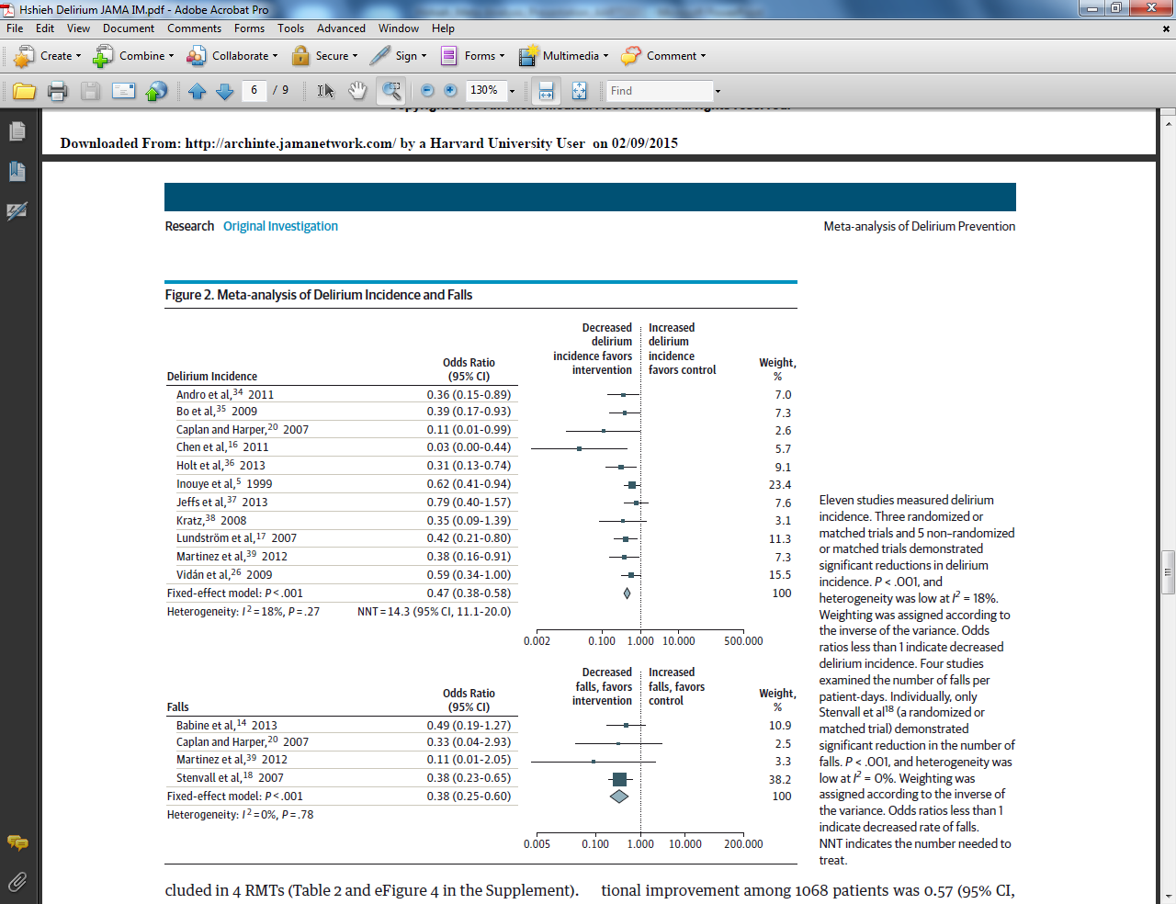
HELP: Delirium Incidence
(N=3,751)
Hshieh TT et al. JAMA IM. 2015; 175:512-520
Notes:
Eleven studies measured delirium (Table 2). Overall, meta-analysis involving 3751 patients showed that odds of delirium were 53% lower in the intervention group compared with controls (OR 0.47, 95% CI 0.38-0.58) (Figure 2). The NNT in the combined sample was 14.3 (95% CI 11.1-20.0) (Figure 2).
Stratified by study type, multi-component non-pharmacologic interventions lowered odds of delirium by 44% (RR 0.56, 95% CI 0.42-0.76) among 977 intervention patients included in four RMTs and by 63% (OR 0.37, 95% CI 0.27-0.53) among 752 intervention patients included in seven non-RMTs (Appendix Figure 1). The NNT was 20.0 patients (95% CI 12.5-33.3) among RMTs and 11.1 patients (95% CI 8.3-16.7) among non-RMTs (Appendix Figure 1).

Slide 18
HELP: Falls and Other Outcomes
(N=1,038)
Prevention of cognitive and functional decline
Decreased hospital length of stay
Reduced nursing home placement
Fewer readmissions within 90 days
Decreased sitter use
Cost savings of >$1000 per hospitalization; $10,000 in long-term nursing home costs
Notes:
Four studies examined the number of falls per patient-days (Table 2). Combined, meta-analysis involving 1038 patients showed that odds of falling were 62% lower among intervention subjects (OR 0.38, 95% CI 0.25-0.60) (Figure 2). This represents the equivalent of 4.26 falls prevented per 1000 patient-days or 2.79 falls per 1000 patient-days among intervention subjects compared to 7.05 falls per 1000 patient-days among controls.
Stratified by study type, multi-component non-pharmacologic interventions lowered odds of falling significantly among 245 intervention patients included in two RMT studies (OR 0.36, 95% CI 0.22-0.61) (Appendix Figure 2). This represents 8.53 falls prevented per 1000 patient-days or 4.34 falls per 1000 patient days among intervention subjects compared to 12.87 falls per 1000 patient days among controls. The odds of falling trended lower among 274 intervention patients included in two non-RMT studies (OR 0.46, 95% CI 0.19-1.10) (Appendix Figure 2). This represents the equivalent of 2.34 falls prevented per 1000 patient-days, or 1.35 falls per 1000 patient days among intervention subjects compared to 3.69 falls per 1000 patient days among controls.

Slide 19
Delirium and COVID-19
Severe COVID-19 infections occur most often in older adults
Studies have suggested high rates of delirium complicating COVID-19 infections
  Older hospitalized medical patients, 25-33% (1-4)
  ICU patients, 65% by CAM-ICU (5)
  Ref: (1) Garcez FB. JAGS Aug 24, 2020; (2) Zerah L. JGMS. Aug 26, 2020; (3) Knopp P. Eur Geriatr Med. Jul 30, 2020; (4) Kennedy M. In Press; (5) Helms J. NEJM April 17, 2020

Slide 20
CDC and WHO COVID-19 Criteria
CDC Case Report Form |  | WHO Case Record Form
Fever >100.4F Subjective fever Chills Rigors Muscle aches Runny nose Sore throat New olfactory and taste disorders Headache Fatigue | Cough (new onset or worsening) Wheezing Shortness of breath Difficulty breathing Chest pain Nausea or vomiting Abdominal pain Diarrhea Other__________ | History of fever Cough Sore throat Runny nose Wheezing Chest pain Muscle aches Joint pain Fatigue Loss of taste/smell Shortness of breath Lower chest wall indrawing Headache | Altered consciousness/ confusion Seizures Abdominal pain Vomiting/nausea Diarrhea Conjunctivitis Skin rash Skin ulcers Lymphadenopathy Inability to walk Bleeding

Slide 21
Delirium as an atypical presentation of COVID-19
In older adults, delirium is often the presenting symptom for acute medical illness (barometer or vital sign)(1). Very common presentation of COVID-19 (2)
Atypical presentation in 12-40% of older adults (3,4)
With COVID-19, delirium can be the primary symptom and the only presenting symptom in some (without fever or cough) (2,5)
Refs: (1) O’Hanlon S. Age Ageing. 2020. doi 10.1093/ageing/afaa094; (2) Kennedy M. In Press; (3) Gan JM. Irish J Med Sci. Sept 21, 2020; (4) Knopp P. Eur Geriatr Med. Jul 30, 2020; (5) Ward CF. Am J Geriatr Psychiatry; 2020.05.013

Slide 22
Etiology of Delirium in COVID-19
COVID-19 contributes to delirium via multiple pathways
  Direct CNS/meningeal involvement with virus
  Cytokine storm; triggering of neuro-inflammation
  Hypercoagulability and CNS vascular disease
  Other organ system failure (respiratory, renal, cardiac)
  Reversible factors: medications, prolonged mechanical ventilation, immobility, social isolation, circadian disruption/sleep deprivation, fear/emotional stress
Even in COVID-19, remember delirium is multifactorial: look for reversible factors
Refs: Azizi A. J NeuroVirol Sept 2, 2020; Koftis K. Crit Care 2020;24:176; Solomon IH. NEJM June 12, 2020.

Slide 23
Environment in Hospital and ICU: “Delirium Factory”
No visitors: social isolation, without human comfort or communication
Staff stressed, rushed, little time to communicate
Staff wearing PPE: faces disguised and voices muffled
To minimize exposure, nurses feel they can only provide bare essentials of care
Psychoactive drugs being widely used for any degree of fear, anxiety, agitation
  Concern about agitation increasing risk of exposure

Slide 24
Delirium Interventions during COVID-19
Risk Factor | Intervention during COVID-19
Disorientation/cognitive impairment | Communication boards Therapeutic activities (crosswords, games)
Immobilization | Minimize restraints, tethers Prioritize mobility, exercise
Circadian disruption/Sleep deprivation | Sunlight during day; dark/quiet room at night Melatonin for sleep PRN; relaxation approaches Ear plugs, eye masks, minimize interruptions
Dehydration/Malnutrition | Provide hydration and nutritional support
Sensory impairment | Vision/hearing adaptations
Emotional Stress/Social Isolation | Remote visits and communication with family; family caregiver involvement where possible
Psychoactive medication use | Minimize where possible
HELP COVID-19 Toolkit: https://help.agscocare.org/chapter-abstract/chapter/H00107/H00107_PART001_002

Slide 25
Clinical Pearls: COVID-19 and Delirium
Delirium is of heightened importance during COVID-19
All older patients should be screened, since it can be missed
  Atypical presentations of COVID-19 in elders are typical: Delirium can be the only symptom
Delirium is multifactorial: look for reversible factors
Nonpharmacologic approaches remain mainstay
  Creative ways to build a “new normal”
  Bring family caregivers back to the bedside
Long-term outcomes unclear: long-term disability and increased risk for dementia? Need for long-term rehab and support

Slide 26
Why is addressing delirium important?
Tremendous clinical impact—even moreso during COVID-19
Healthcare costs and policy implications
Indicator of quality of care for elders
Prevention of cognitive impairment and dementia

Slide 27



Interested in Learning More?
Delirium prevention-AGS CoCare HELP
  https://www.americangeriatrics.org/programs/ags-cocare-helptm
Delirium research-NIDUS (Network for Investigation of Delirium: Unifying Scientists)
  https://deliriumnetwork.org/
Contact me:
  AgingBrainCenter@hsl.harvard.edu
Follow: @sharon_inouye @NIDUS_Delirium @ElderLifeProg

