Slide 1
Age Friendly Health Systems - Practical Tips & Innovative Success Stories
Acute Care of Elders 2020 National Conference
November 6, 2020
Terry Fulmer, PhD, RN, FAAN
President
The John A. Hartford Foundation
Notes:
fjsdlkjfalksdj alk

Slide 2

A private philanthropy based in New York, established by family owners of the A&P grocery chain in 1929
$625,000,000 in
Aging & Health grants
authorized since 1982
Building the field of
aging experts;
Testing and replicating
innovation

Slide 3
Mission & Priorities
DEDICATED TO IMPROVING THE CARE OF OLDER ADULTS
Age-Friendly
Health
Systems
PRIORITY AREAS
Family
Caregiving
Serious Illness &
End of Life

Slide 4


Age-Friendly Health Systems
An initiative of
The John A. Hartford Foundation and the Institute for Healthcare Improvement,
in partnership with the
American Hospital Association and the​
Catholic Health Association of the
United States
Click icon to add picture
www.ihi.org/AgeFriendly

Slide 5


Why We Need Age-Friendly Care
Demography
Complexity
Disproportionate harm
The growing number of older adults in our health systems requires a different approach to care.

Slide 6
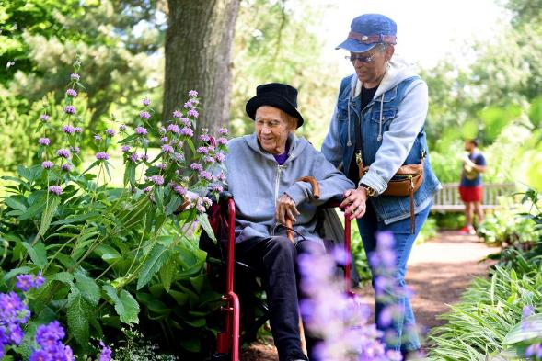
Age-Friendly Health Systems
Our aim: Build a social movement so all care with older adults is age-friendly care:
Guided by an essential set of evidence-based practices (4Ms)
Causes no harms
Is consistent with What Matters to the older adult and their family
Click icon to add picture
Fulmer, T., Mate, K. S., & Berman, A. (2018). The age‐friendly health system imperative. Journal of the American Geriatrics Society, 66(1), 22-24.

Slide 7
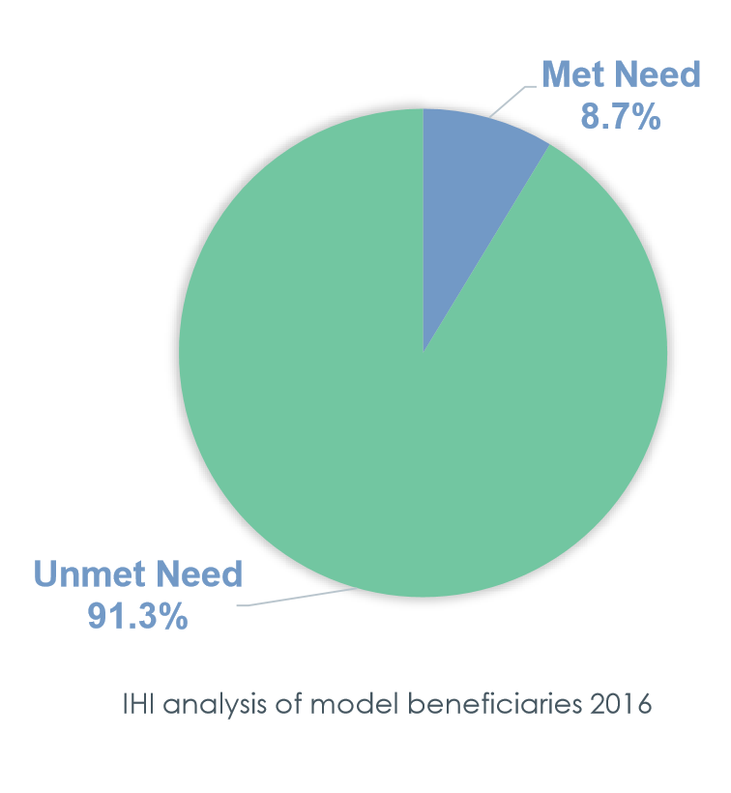
We Have a Know-Do Gap
We have many evidence-based geriatrics models of care
Yet, most reach only a portion of those who could benefit

Slide 8
Selection of the Vital Few Elements of Age-Friendly Care
90 discrete core features identified by model experts in pre-work
Redundant/similar concepts removed and 13 core features synthesized by IHI team
Expert Meeting – Selection of the “vital few” the 4Ms

Slide 9
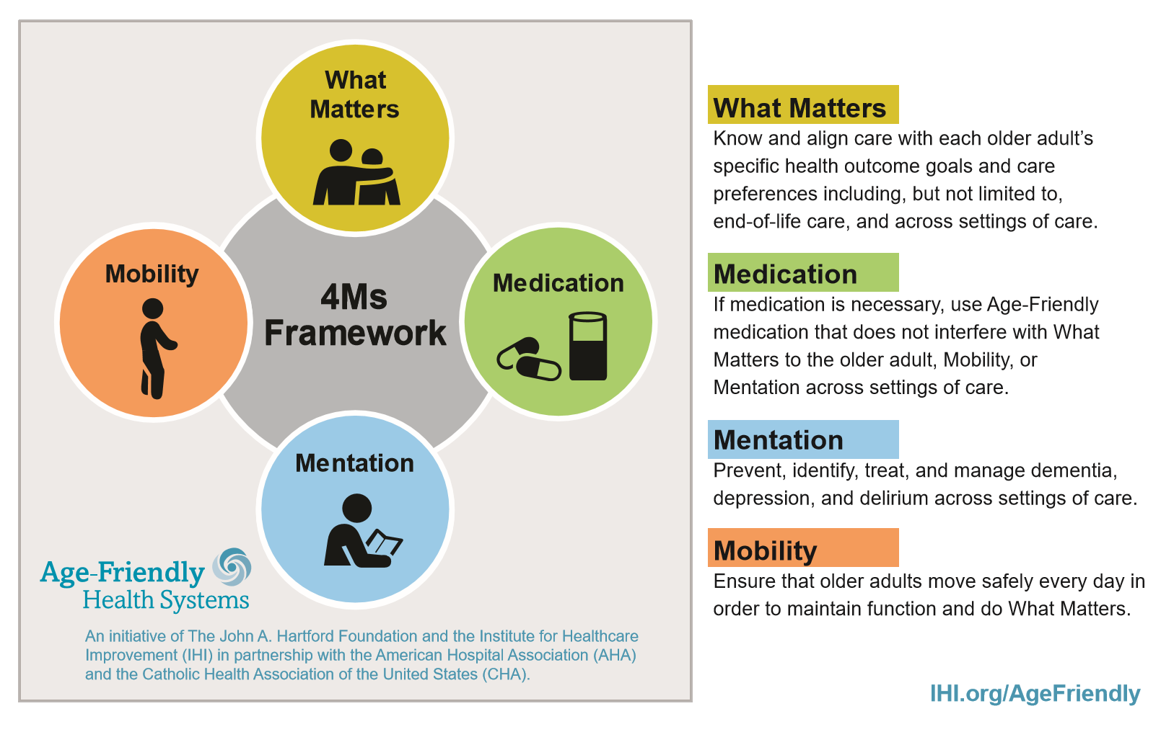
The 4Ms Framework

Slide 10
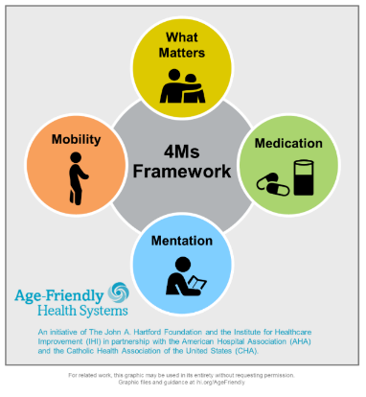
The 4Ms Framework – Measures
Outcome:
30-day readmissions
Emergency department visit rate
H/CG – CAHPS
Length of stay
Delirium incidence rate
Segmentation by race/ethnicity
Goal-concordant care (by collaboRATE survey)
Process:
What Matters:
  ACP documentation (NQF 326)
  What Matters documentation
Medications:
  Presence of any of 7 high-risk medications
Mentation: Screened & documented for
  Depression
  Dementia
  Delirium (hospital only)
Mobility: Screened for mobility

Slide 11
















A Growing Number of Partners
Department of Health

Slide 12


Age-Friendly Care in Retail Pharmacy Clinics
Partnered with CVS Health MinuteClinic and Case Western Reserve Frances Payne Bolton School of Nursing
Embedding Age-Friendly 4Ms Care in all 1,100 MinuteClinics
Training and education for NPs
Building 4Ms into EPIC EHR

Slide 13
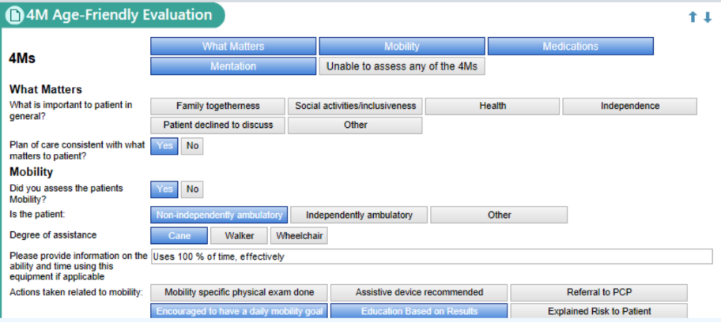

Age-Friendly Care in Retail Pharmacy Clinics
Building 4Ms into EPIC EHR

Slide 14
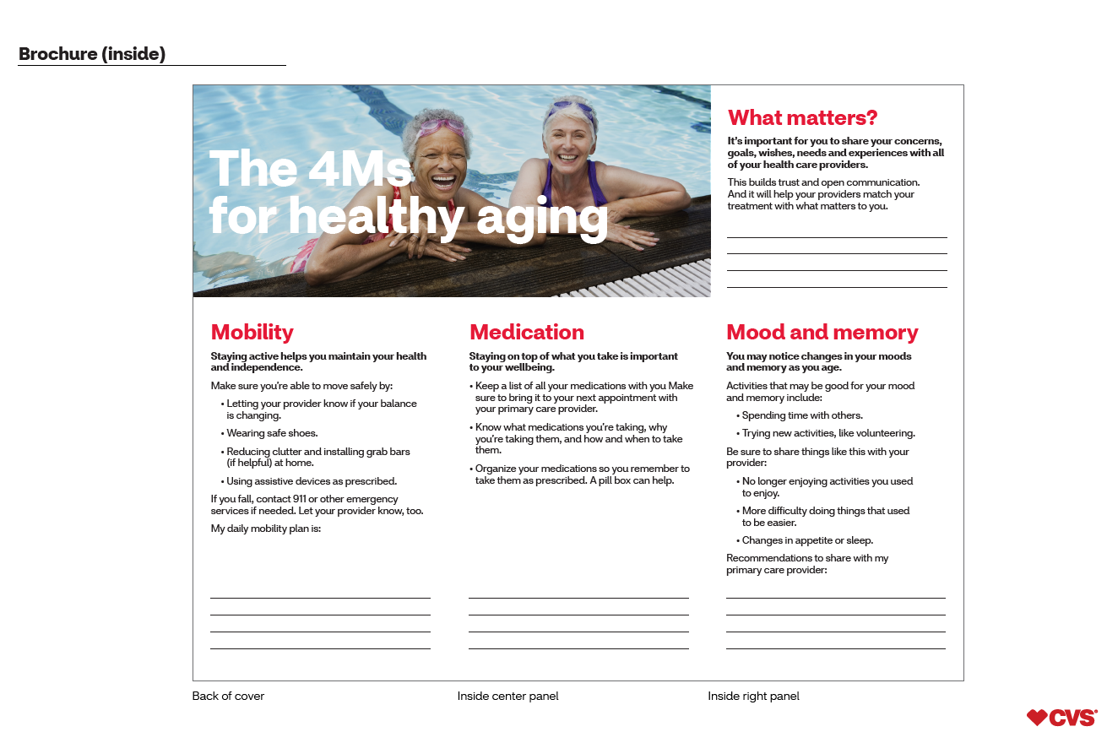
Age-Friendly Care in Retail Pharmacy Clinics
Building out consumer materials

Slide 15
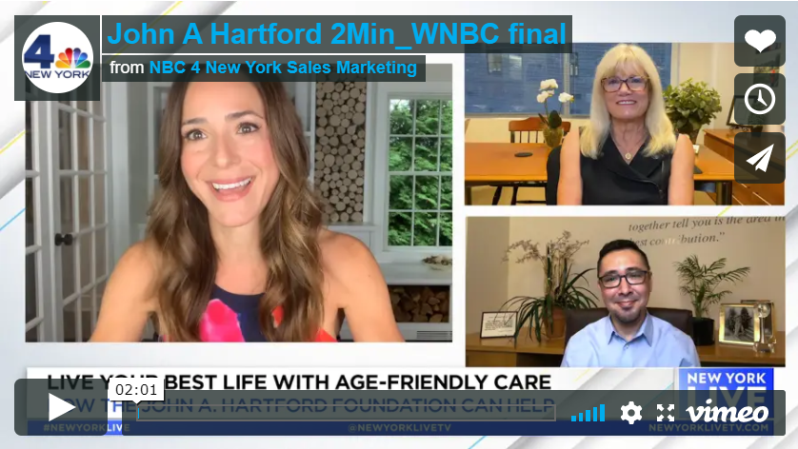
Age-Friendly Care – Helping Consumers Understand the 4Ms
NBC Universal/Telemundo video segment
For consumer information, visit:
johnahartford.org/agefriendly
WebMD.com/agefriendly

Slide 16
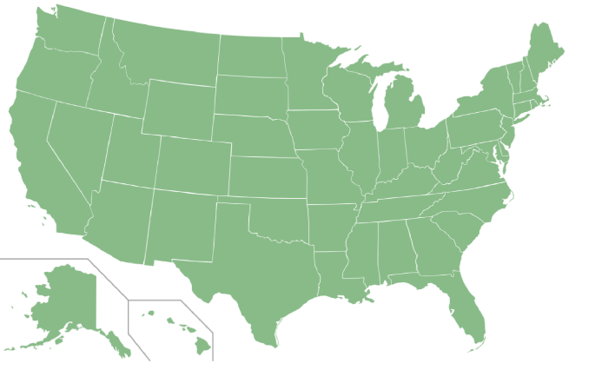

A Growing Movement!
As of August 2020,
876 hospitals, practices, retail pharmacy clinics and long-term care communities in all 50 states have received recognition.
876 Sites

Slide 17



Age-Friendly Recognition
Level 1 – Teams have successfully developed plans to implement the 4Ms​
Level 2 – Teams have three months of verified data to demonstrate early impact of using the 4Ms

Slide 18
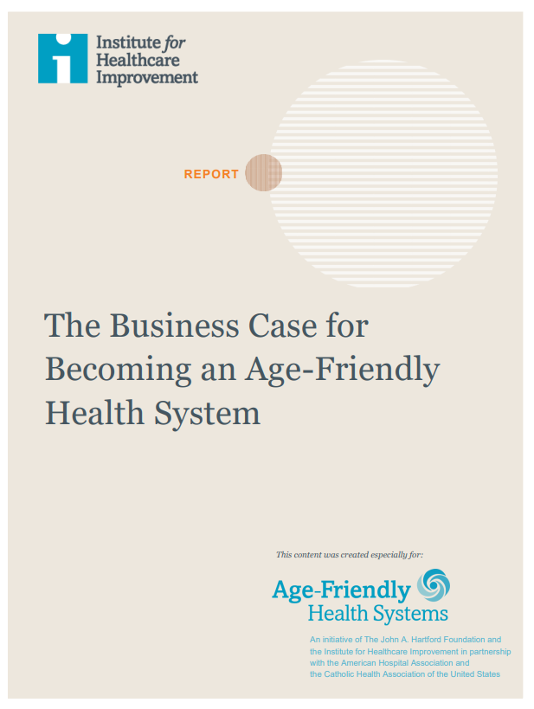
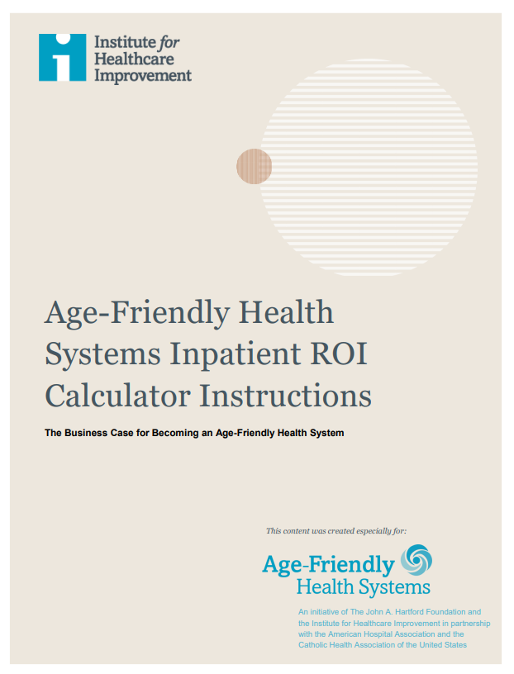
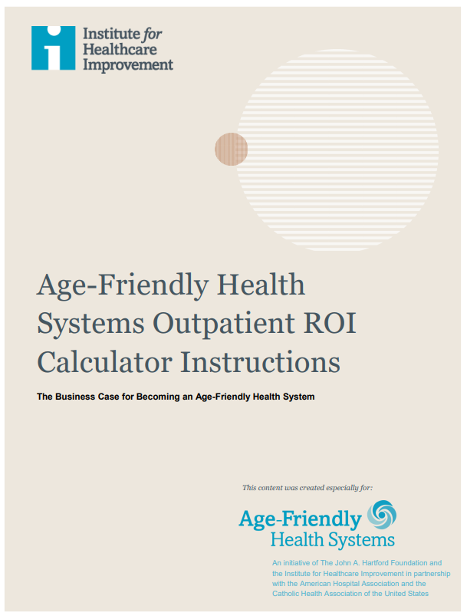
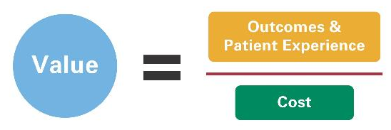
The Value of Age-Friendly Health Systems
Business Case for Becoming an Age-Friendly Health System​
Inpatient ROI Calculator
Outpatient ROI Calculator
Issue Brief: Creating Value with Age-Friendly Health Systems

Slide 19
Results of Age-Friendly Care
Baystate Health:
  40% increase in meaningful changes to treatment plans due to asking “what matters to you”
Stanford Health Care:
  Started Geriatric Trauma Service leading to reduced delirium incidence by 29%, mortality reduced by 48%
Anne Arundel Medical Center:
  Compared to prior year, 4Ms implementation led to 10.2 years less time older adults were in facility due to decreased readmissions, LOS, and ED time
Notes:
Make one bullet point

Slide 20

Results of Age-Friendly Care
ACTION: Hartford Hospital in Connecticut implemented ADAPT (Actions for Delirium Assessment Prevention and Treatment) that screens almost all patients for delirium and aligns with AFHS principles
RESULTS:
Delirium-attributable days decreased 40% and delirium-related readmission fell 14%
Decrease in length of stay for delirium patients from 16 days to 10.6 days
Estimated an average of $6.5 million in savings annually from 2012-2019.
https://www.aha.org/system/files/media/file/2020/08/value-initiative-issue-brief-10-creating-value-with-age-friendly-health-systems.pdf
Notes:
Make one bullet point

Slide 21

Age-Friendly Health Systems in the Time of COVID-19

Slide 22

COVID-19 and Nursing Homes - JAHF Actions
Urgently: funding the National Nursing Home Huddles led by Institute for Healthcare Improvement as a part of our Age-Friendly Health Systems movement
  Evolved into Nursing Home ECHO: COVID-19 Action Network Conversation Series funded by AHRQ
[ahrq.gov/nursing-home]
Emergently: funding the National Academies of Sciences, Engineering, and Medicine to launch a study on nursing home safety and quality post-COVID-19 [nationalacademies.org/our-work/the-quality-of-care-in-nursing-homes]
Emergently: funding the FrameWorks Institute to examine how to reframe the nursing home narrative [frameworksinstitute.org]
Notes:
Now, beyond the Commission, there have been many actions taken, including by JAHF.
Here you see three actions. We funded the Institute for Healthcare Improvement to begin daily National Nursing Home Huddles to assist nursing homes in dealing with the urgent crisis. That has evolved into a $255 million effort funded by AHRQ to use Project ECHO to continue virtual training sessions for all 15,000 nursing homes in the US.
Very importantly, we also funded the National Academies of Sciences, Engineering, and Medicine to begin a Nursing Home Quality & Safety Study, the first since 1986. This study will build off the Commission report and other work and provide a blueprint for longer-term systemic changes in nursing home care.
We are also funding the Frameworks Institute to help us change the public’s perceptions and understanding of nursing home care. In this country and many others, we choose not to see nursing homes and the people who live and work there until we need them, and then we are surprised and shocked when we see the cost and their quality issues. To make change, we have to change the narrative.

Slide 23

Example: 4Ms in an Age-Friendly Telemedicine Visit During COVID-19
What Matters
I am calling to check in with you. We know that this can be a stressful time with the Coronavirus limiting our abilities to go out and even just interact with others…How are you doing?... what matters most to you at this time?
Medication
Let’s do a review of your current medications…I will have you pick up each pill bottle…
Mentation
This can certainly be a stressful time and sometimes under stress we have difficulties with our memory, especially short-term memory…
Mobility
How you are getting around the home? If you are able, I want you to stand up and sit down in the chair, without using your arms to help push you up, five times in a row…

Slide 24
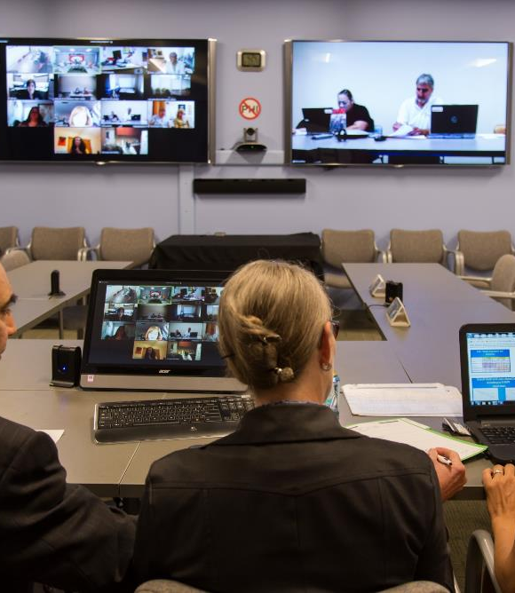
AFHS Training
Sessions Focus on Evidence-base NNHH and ECHO
PPE best practices
Infection control practices
COVID-19 testing
Clinical management of asymptomatic and mild cases
Minimizing the spread of COVID-19
Managing social isolation

Slide 25


Join Us in the Age-Friendly Health Systems Movement
Visit www.ihi.org/AgeFriendly to:
  Join an Action Community
  Access resources including the Guide to Using the 4Ms in the Care of Older Adults and the Business Case for Becoming an Age-Friendly Health System
  Sign up for Friends of Age-Friendly quarterly update calls

Slide 26
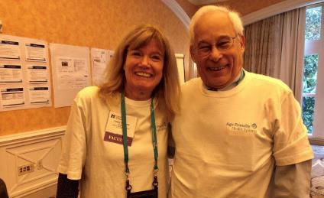
  Thank you!
  Terry.Fulmer@johnahartford.org
  www.johnahartford.org
DEDICATED TO IMPROVING THE CARE OF OLDER ADULTS

